Slide 1
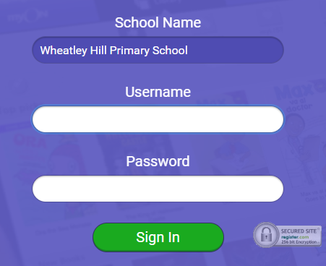
https://www.myon.co.uk/index.html
Remember to use myon for online reading
Example login -
Username
DavidW
Password
password1

Slide 2
Monday 11th – Friday 15th January
L.O To be able to spell words from the Year 3/4 list
There is a spelling activity at the start of each day’s lesson ☺
Subject: English

Slide 3
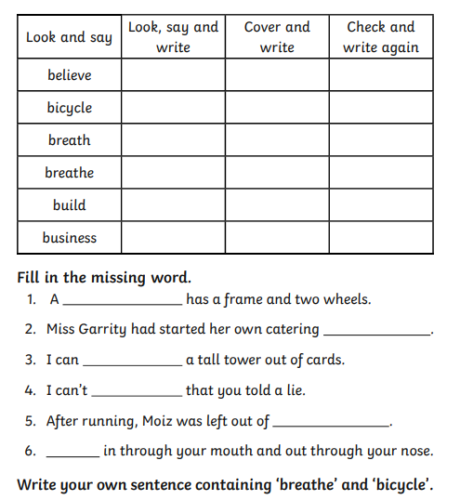
Try and practise your spellings every day ☺
https://cdn.oxfordowl.co.uk/2016/03/04/14/54/32/679/19038_content/index.html
Spelling game

Slide 4
Monday 11th January
L.O To be able to answer questions based on a text
Subject: English

Slide 5
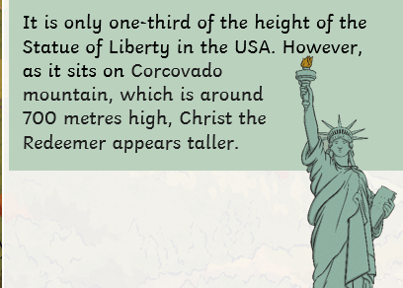
Christ the Redeemer
Read through the information on this page

Slide 6
Answer the questions in full sentences, e.g. Christ the Redeemer shows Jesus with his arms outstretched.
Where is Christ the Redeemer? Christ the Redeemer is ______________________________________________________________
How many tourists visit it each year? Around __________________________ visit Christ the Redeemer each year. _________________________________________________________________
How tall is Christ the Redeemer and why does it appear taller than it is?
Christ the Redeemer is _________________________ but appears taller because _________________________________________________________________________________________________________________________________
4. Why is Christ the Redeemer such a popular statue in Brazil? It is a popular statue because _______________________________________________________________________

Slide 7
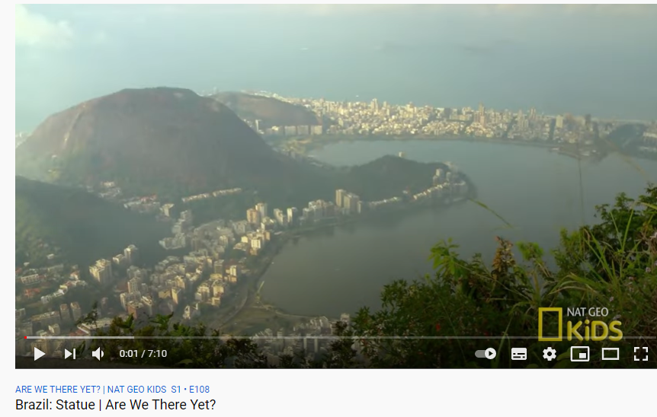
When was it built and where did the stones come from?
The building of Christ the Redeemer began in ________________ and the stones come from ____________________________ .
6. Would you like to visit Christ the Redeemer? Explain your answer
I would/ I would not like to visit Christ the Redeemer because ______________________________________________________________________________________________.
Watch this video for more information!
https://www.youtube.com/watch?v=WvZpgvoXB1M

Slide 8
Date: Tuesday 12th January
L.O To be able to write descriptive sentences
Subject: English

Slide 9
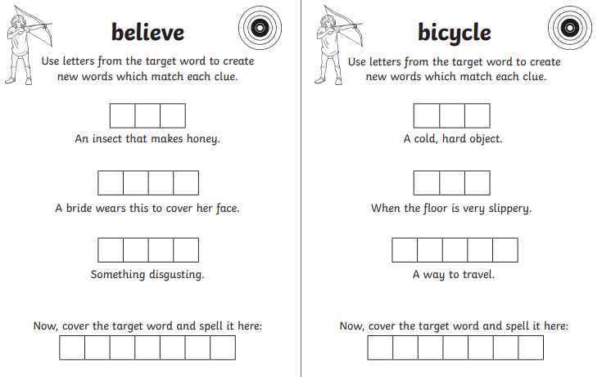

Slide 10
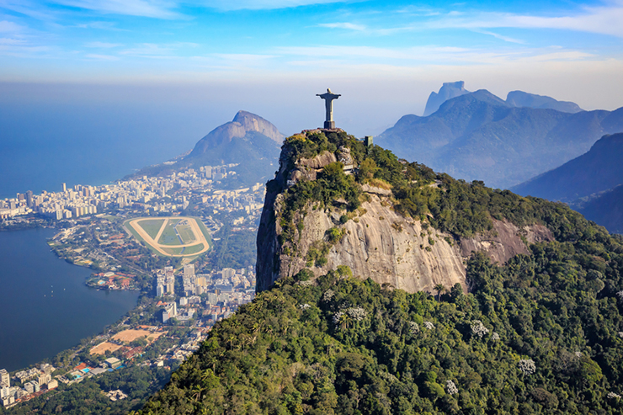
List everything you can see in the picture
Christ the Redeemer
City
Houses
_____________
_____________
_____________
_____________
_____________
_____________
_____________
_____________
_____________
_____________
_____________
_____________
Rio de Janeiro (Brazil)

Slide 11
Now think of adjectives to describe what you can see
______________ , _____________ statue
______________, ______________ city
_____________ , _______________ mountains
_____________ , _______________ ocean
_____________ , _______________ sky
_____________ , _______________ views
Rio de Janeiro (Brazil)
Adjectives are describing words

Slide 12
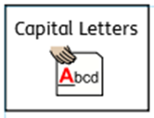
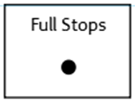
Use the adjectives you have came up with to write descriptive sentences
Don’t forget:
Rio de Janeiro (Brazil)
Christ the Redeemer is a _______________, _______________ statue, standing on the _______________, _____________ mountain.
The _______________ , _______________ sky looks beautiful above the _______________,
_______________ city.
The _____________ , _____________ weather makes it a ____________ , ______________ day in Rio de Janeiro

Slide 13
Use the adjectives you have came up with to write descriptive sentences
Don’t forget:
Now try 2 sentences of your own
Remember commas between your adjectives!
________________________________________________________________________________________________________________________________________________________________________________________________________________________________________________________________________________________________________________________________________________________________________________________________________________________________________________________________________

Slide 14
Date: Wednesday 13th January
L.O To be able to use prepositions
Subject: English

Slide 15
____________________________________________________________________________________________________________________________________________________________________________________

Slide 16
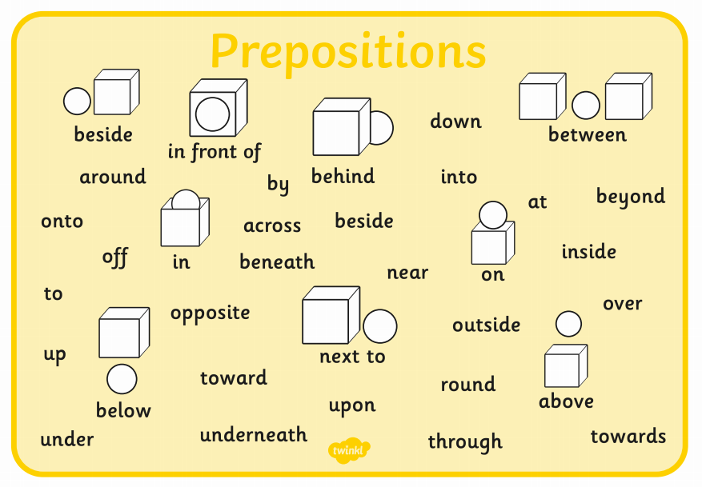
A preposition is a word that tells you where or when something is in relation to something else.

Slide 17
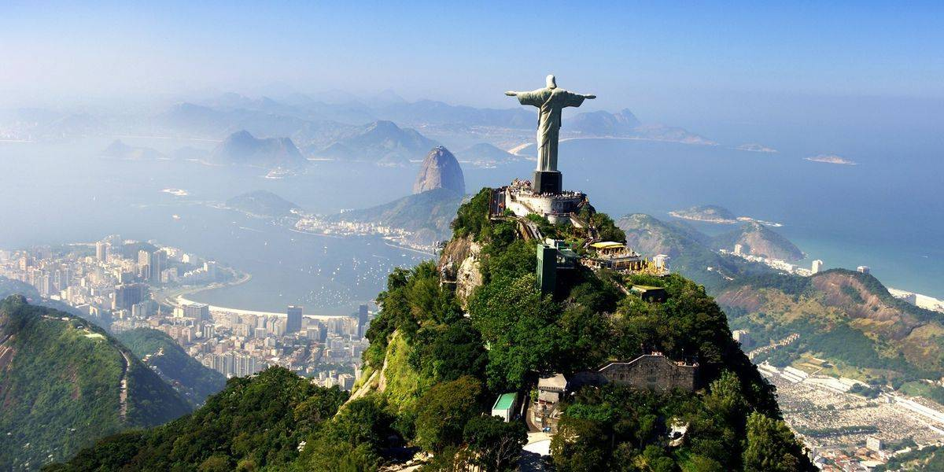
Imagine you are Christ the Redeemer and are looking out over the city.
Think about what you can see.
Remember- if you are the statue you will be writing in
First person – ‘I can see’
Make a list of prepositional phrases linked to the picture
above my head
down below
in front of me,
next to the ocean
_______________
_______________
_______________
_______________
_______________
_______________

Slide 18
Don’t forget:
_______________ birds are flying and ______________ clouds are floating above my head.
I can see the _________________ , ______________ buildings next to the ocean.
The sun is ____________ly shining down on the ____________ , ______________ city.
Everything looks so ________________ and __________________ in front of me.

Slide 19
Don’t forget:
Challenge
Now try 2 sentences of your own
_____________________________________________________________________________________________________________________________________________________________________________________________________________________________________________________________________________________________

Slide 20
Thursday 14th January
L.O To be able to use extend sentences with conjunctions
Subject: English

Slide 21
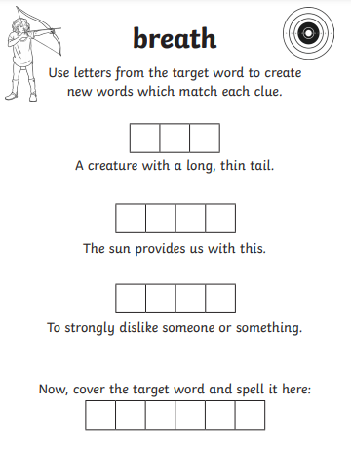
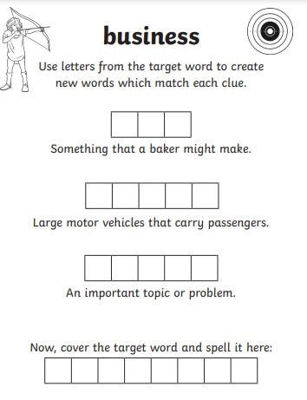

Slide 22
Follow the link for more information and some games
https://www.bbc.co.uk/bitesize/topics/zwwp8mn/articles/zqk37p3#:~:text=A%20conjunction%20is%20a%20word,information%20to%20the%20main%20clause.

Slide 23
Finish these sentences
Christ the Redeemer is an important statue because _______________________________________________________________________________________________________________________.
The weather in South America is usually hot but ______________________________________________________________________________________________________________________.
Brazil is the biggest country in the continent and ______________________________________________________________________________________________________________________.

Slide 24
4. The beaches in Brazil are very beautiful so _______________________________________________________________________________________________________________________.
5. There are lots of wealthy areas in Brazil but _______________________________________________________________________________________________________________________.
Challenge-
_______________________________________________________________________________________________________________________.
Write a sentence of your own containing a conjunction

Slide 25
Friday 15th January
L.O To be able to write a descriptive paragraph
Subject: English

Slide 26
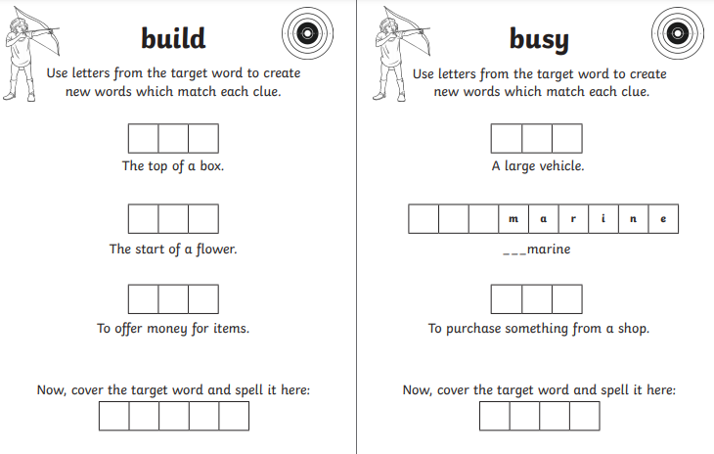

Slide 27
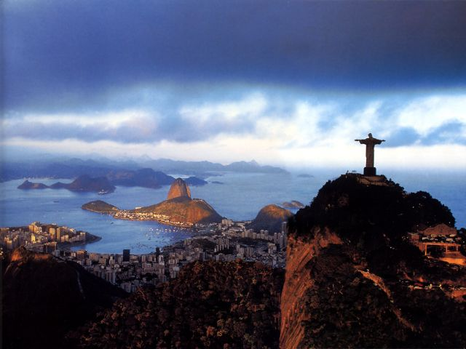
Think of everything we have learnt this week
List any adjectives/openers that could help you describe this picture
________________________________________________________________________________________________________________________________________________________________________________________________
________________________________________________________________________________________________________________________________________________________________________________________________

Slide 28
The famous statue is standing on the __________ , __________ mountains and the sun has set after a glorious, __________ day. Golden lights are illuminating the ______________ city so everything looks _________________ and ____________________. The _____________ , _______________ clouds are slowly drifting across the sky and night is starting to fall. People are happily walking down the _________________ streets and looking around at the ____________________ sights.
Challenge- finish the paragraph off by yourself by adding extra description
__________________________________________________________________________________________________________________________________________________________________________________________________________________________________________________________________________

Slide 29
Well done everyone!
Hope you are all ok ☺

