Slide 1
Tuesday 5th January 2021
L.O. To practice forming numbers
Subject: Maths

Slide 2
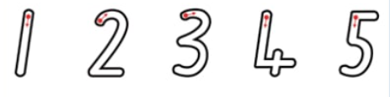
Forming Numbers
Write the numbers 1-5 on a piece of paper using a brightly coloured pen. Support your child to trace the numbers with their fingers. Once they have traced the numbers with their fingers, can your child trace the numbers with a pen?

Slide 3
Forming Numbers
Follow the link below to play the number formation game.
Number formation game

Slide 4
Wednesday 6th January 2021
L.O. To practice pouring water with control
Subject: Maths

Slide 5
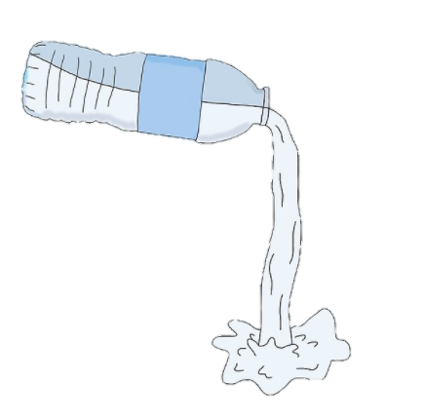
Pouring water
Fill a small dish with water. Using cups, jugs, beakers and whatever you can find in your home, practice pouring water from one container to another. Model this to your child and then encourage them to copy the action.

Slide 6
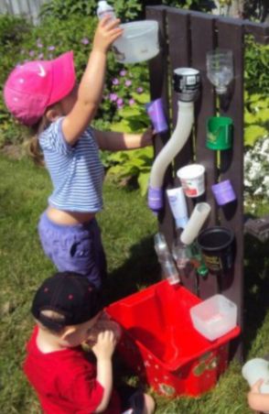
Pouring water
What other objects can you find that contain water, are there any objects where water pours out? Allow your child to explore using a range of different objects with water.

Slide 7
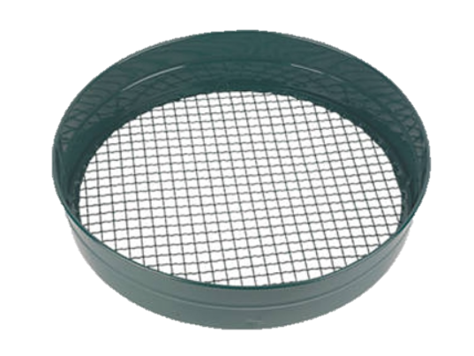
Pouring water
Add some spaghetti/rice/pasta to the water. Can your child scoop it out using a net/sieve or colander?

Slide 8
Thursday 7th January 2021
L.O. To count objects with support
Subject: Maths

Slide 9
Counting
Can you find the number 1?
3
2
4
1

Slide 10
Counting
4
Can you find the number 2?
3
1
2
5

Slide 11
Counting
4
Can you find the number 3?
3
1
5
2

Slide 12
Counting hunt
Go on a hunt in the garden or around the house and find objects such as sticks, leaves, pencils etc.. Once you have collected your objects see if you can count them together.

Slide 13
Friday 8th January 2021
L.O. To Practice counting by singing number songs
Subject: Maths

Slide 14
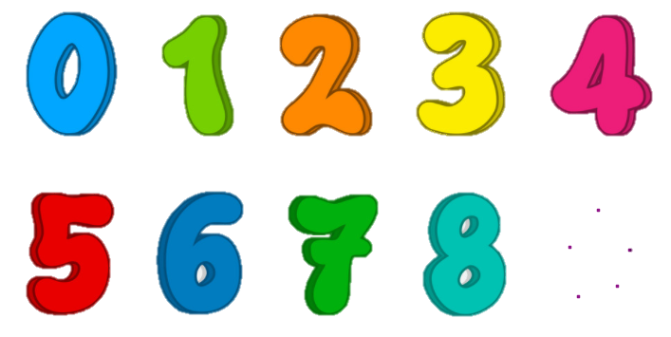
Counting nursery rhymes
Sing some nursery rhymes with your child. Use the suggestions below or follow the links to watch them on youtube.
5 little ducks
1,2,3,4,5 once I caught a fish alive
10 green bottles
Nursery rhymes

Slide 15
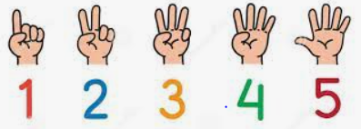
Counting nursery rhymes
Pick a number nursery rhyme, can you count along using your fingers?

