Slide 1
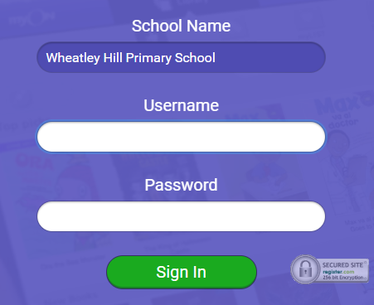
https://www.myon.co.uk/index.html
Remember to use myon for online reading
Example login -
Username
DavidW
Password
password1

Slide 2
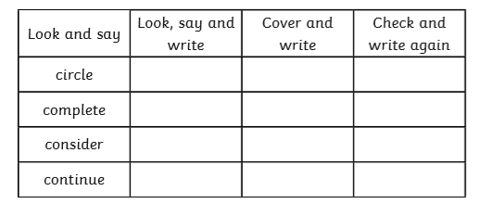
L.O To be able to spell words from the Y3/4 word list

Slide 3
Monday 25th January
L.O To be able to answer questions based on a text
Subject: English

Slide 4
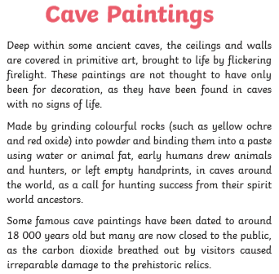
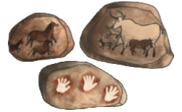
Read through the information on this page

Slide 5
Answer the questions in full sentences, e.g. The Stone Age covers a period of 3 million years.
1. How are the cave paintings brought to life?
___________________________________________________________________________________________________________________________________________________
2. What is used to make the paints?
___________________________________________________________________________________________________________________________________________________
3. What was often painted n the caves?
___________________________________________________________________________________________________________________________________________________
How old are some painting that have been found?
_______________________________________________________________________
5. Why are many of the caves now closed off to the public? ____________________________________________________________________________________________________________________________________________________

Slide 6
Here is the information again
Some words have been underlined that you might not know.
Use a dictionary or online dictionary to find the word meanings
Ancestors
________________________________________________________________________________________
Prehistoric
_________________________________________________________________________________________
Challenge-
Use the thesaurus to find other words that could be used instead of colourful
_______________________________________________________________________________________________________________________________________

Slide 7
Date: Tuesday 26th January
L.O To be able to class sentences as questions, statements and commands
Subject: English

Slide 8
L.O To be able to spell words from the Y3/4 word list

Slide 9
Read through the following pages to find out about different sentence types

Slide 12
Write next to each sentence if it is a command/statement/question
The Stone Age is split into 3 parts. ________________
Strike the flint stones to make fire. ________________
Can you cut the meat for dinner? ________________
Pick the berries and nuts for tea. ________________
Clothes were made out of animal skin. ________________
What tool would you use to catch an animal. ________________

Slide 13
Write a sentence for each type of sentence
Question ____________________________________________________________________________________________________________________________________
Command
__________________________________________________________________________________________________________________________________
Statement
____________________________________________________________________________________________________________________________________

Slide 14
Date: Wednesday 27th January
L.O To be able to extend sentences with conjunctions
Subject: English

Slide 15
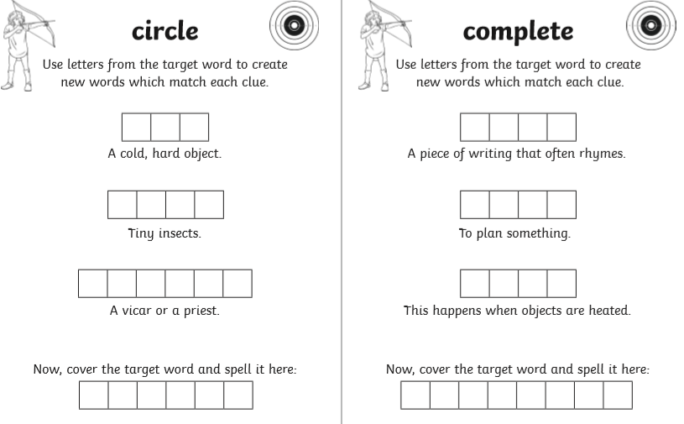
L.O To be able to spell words from the Y3/4 word list

Slide 16
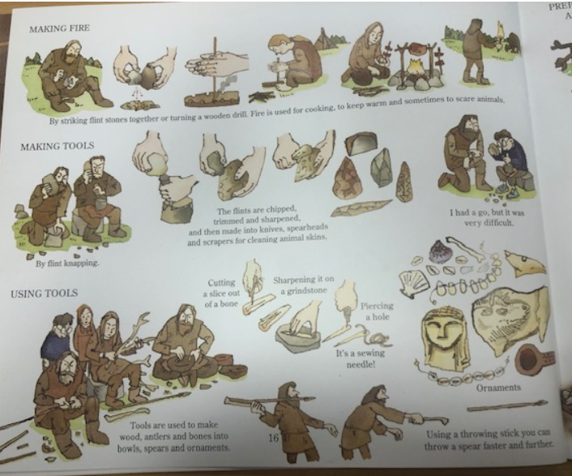
Look through this page to find out all the things they made in the Stone Age
This could help you with your own sentences today.

Slide 17
https://classroom.thenational.academy/lessons/to-explore-conjunctions-c4wkee?activity=video&step=1
Watch this video for more information ☺
1. The Stone Age Boy really enjoyed learning the Stone Age ways, although ________________________________________________________________________
2. During the Stone Age they made their own tools because ________________________________________________________________________
3. The camp helped the boy to start a fire, as well as ________________________________________________________________________.

Slide 18
Now try and write 3 sentences of your own
4. _______________________________________________________________________________________________________________________________________________
5. __________________________________________________________________________________________________________________________________________________
6. ________________________________________________________________________________________________________________________________________________.

Slide 19
Thursday 28th January
L.O To be able to use time openers
Subject: English

Slide 20
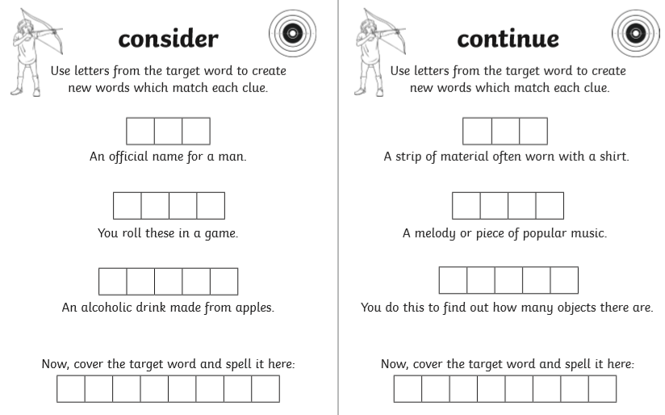
L.O To be able to spell words from the Y3/4 word list

Slide 21
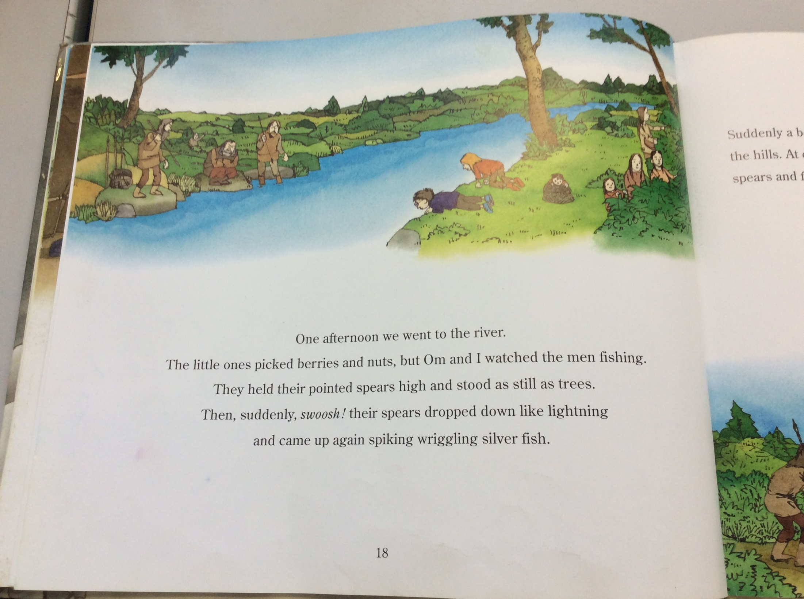
Have a think about what we’ve read in Stone Age Boy so far, then read the next few pages

Slide 22
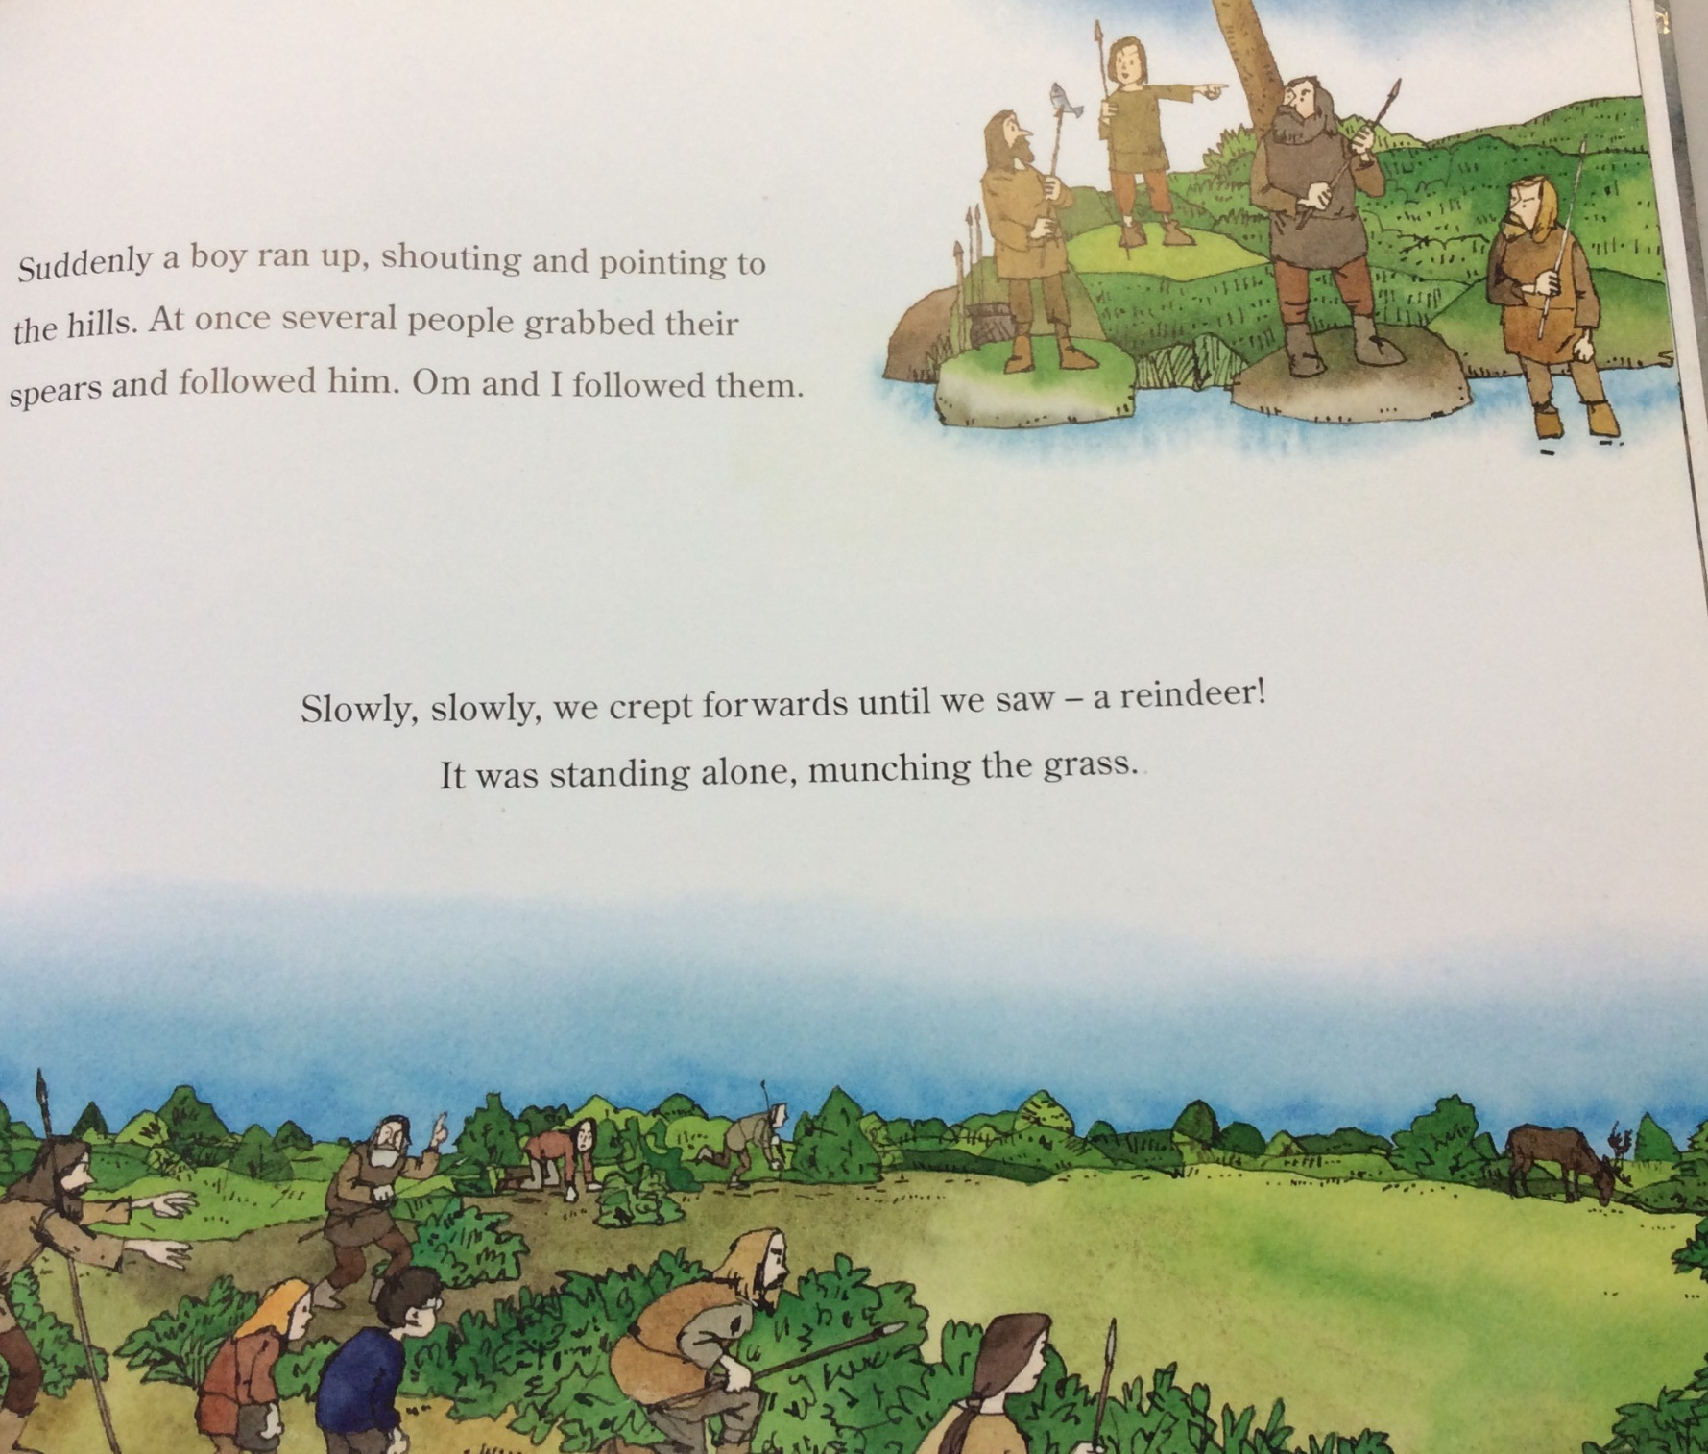

Slide 23
Time Openers tell us when something happens
E.g. That afternoon, we went to the river.
Remember the comma after the opener
Firstly,
Next
After that,
In the morning,
After a while,
________________
________________
________________
________________
________________
________________
________________
________________
________________
Have a think about what has
happened to the boy in the story so far.
Make a list of all the time openers you can think

Slide 24
Add a time opener for the first few sentences and then write 4 of your own.
_________________, the boy was happily walking in the woods.
2. __________________________, he found himself in a strange place where everything looked different.
____________________________________________________________________________________________________________________________________________
__________________________________________________________________________________________________________________________________________

Slide 25
5. ____________________________________________________________________________________________________________________________________________
6. __________________________________________________________________________________________________________________________________________
Extension
Extend one of your sentences using a conjunction
__________________________________________________________________________________________________________________________________________________

Slide 26
Friday 29th January
L.O To be able to write a diary entry
Subject: English

Slide 27
L.O To be able to spell words from the Y3/4 word list
Write your own sentences using these words
________________________________________________________________________________________________________________________________________________________________________________________________________________________________________________________________________________________________________________________

Slide 28
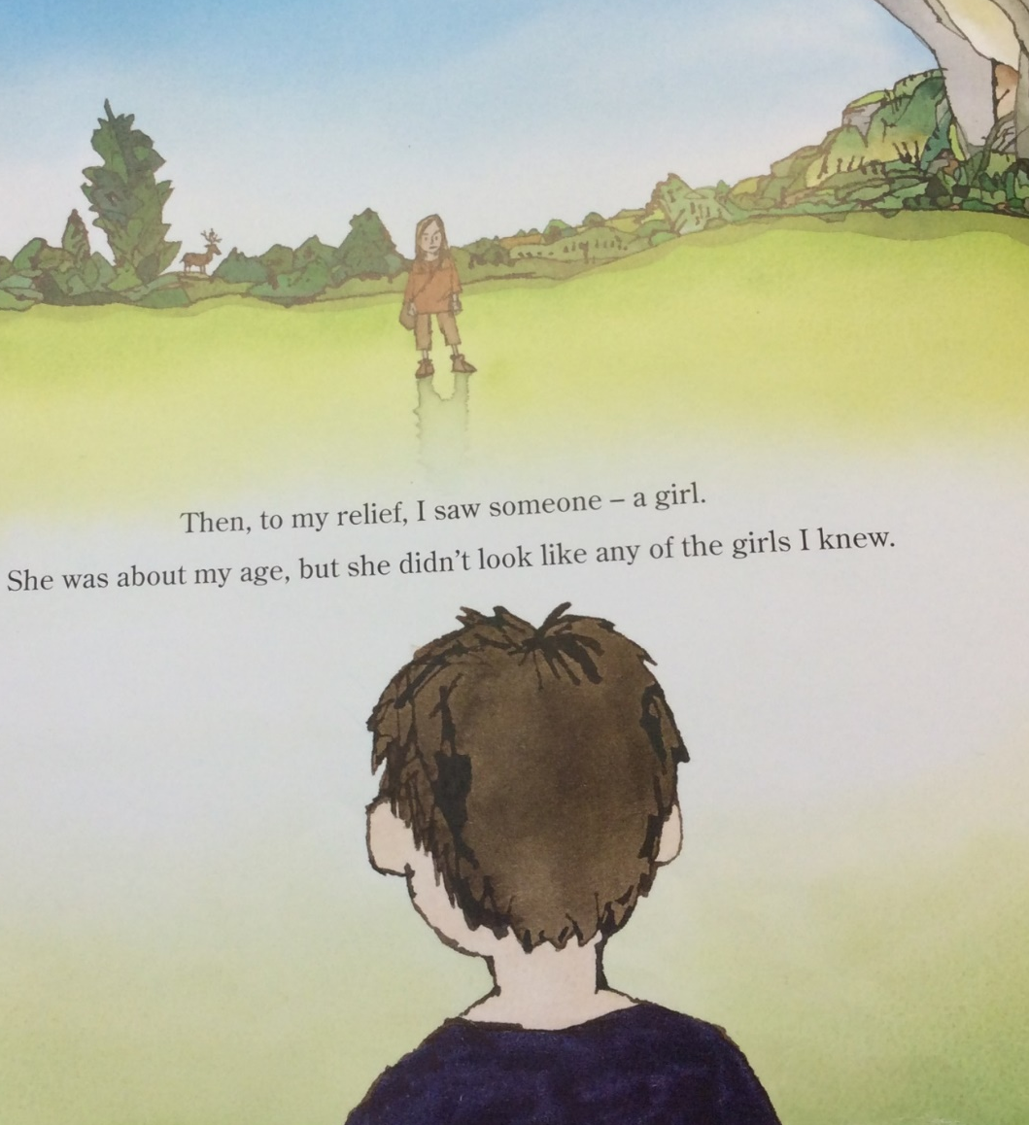
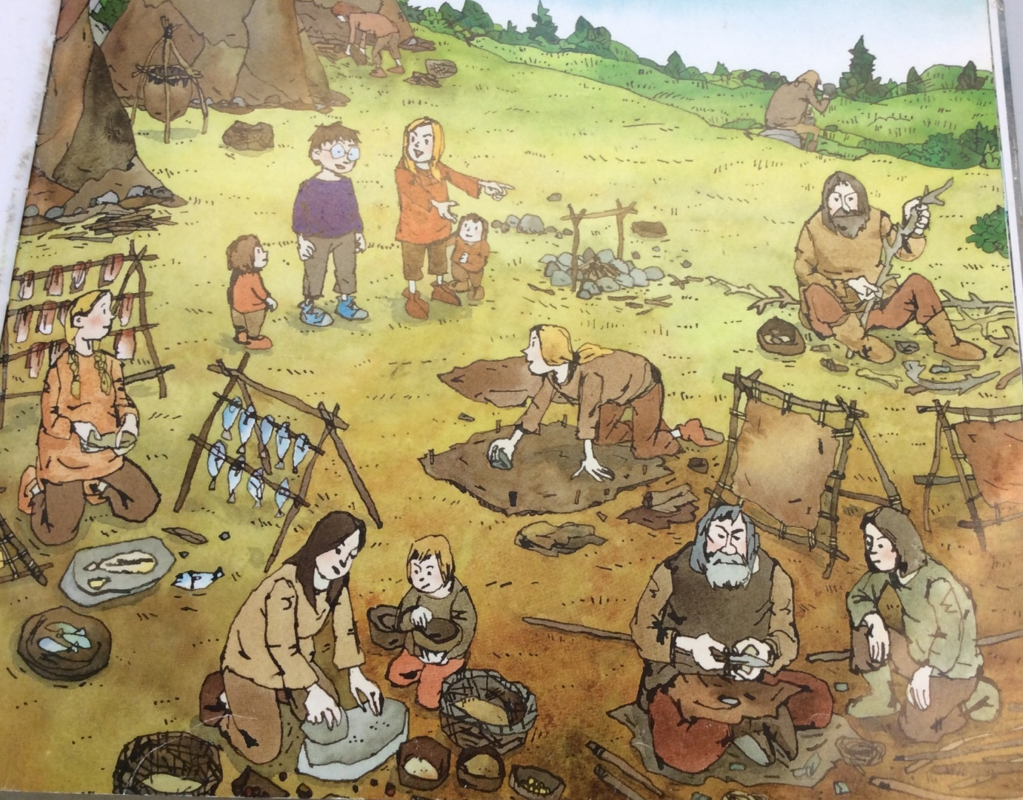
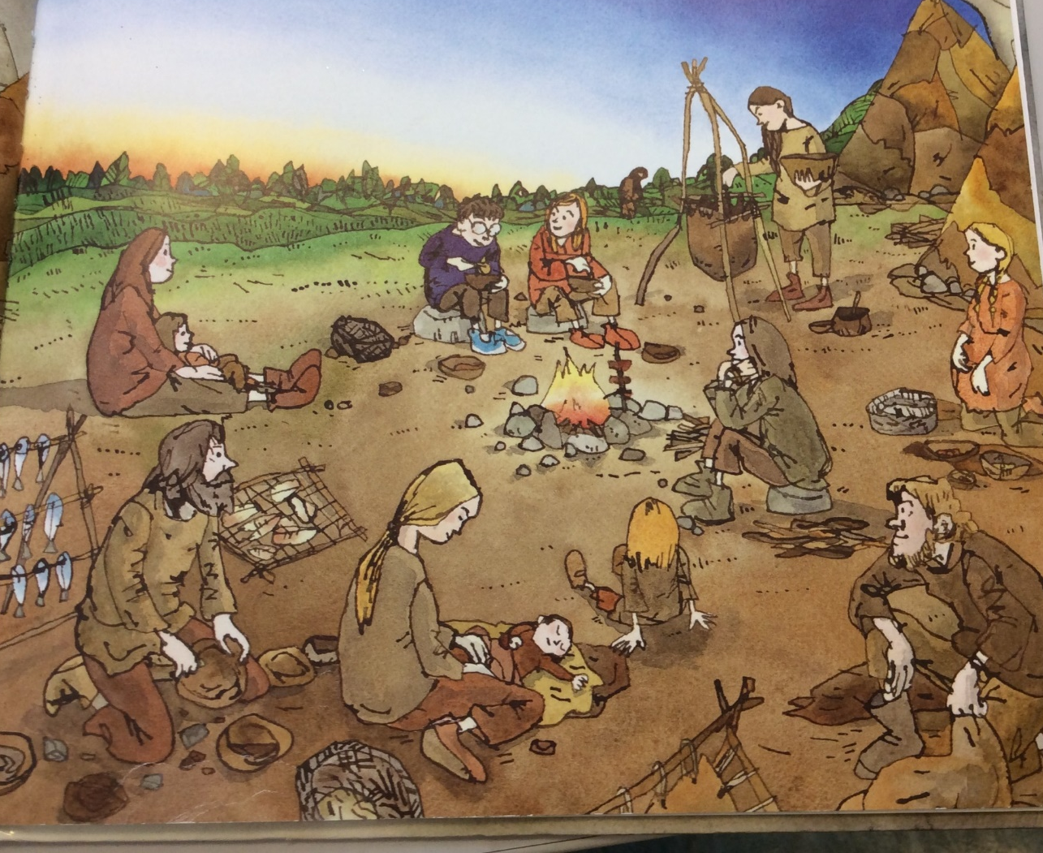
Put these in chronological order (time order) by numbering the pictures

Slide 29
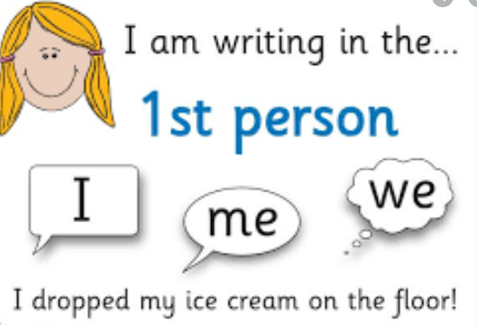
Today you are going to be the Stone Age Boy so you will write in first person.
Use the scaffold for the first paragraphs and then continue on your own.
Try and include how you would feel and what you learnt in the Stone Age
Dear Diary,
Today started like a normal day and I was wandering through the __________, ___________ woods. After a while, something strange happened and I found myself falling down down down.
_________________, I woke up in a ___________, ____________ place. I walked around and realised I was completely lost. I felt _____________________________________________ because everything looked different.

Slide 30
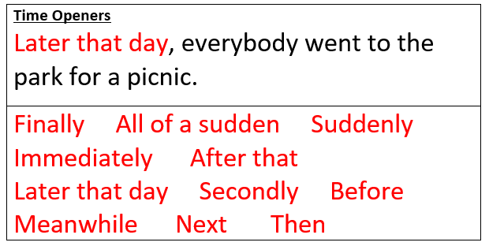
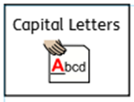
Now use the pictures that you ordered and what you know about the Stone Age.
_________________________ , I saw someone walking towards me- a girl. ___________________________________________________________________________________________________________________________________________________________________________________________________________________________________________________________________________________________________________
__________________________________________________________________________________________________________________________________________________________________________________________________________________________________________________________________________________________________________________________________________________________________________________________________________________________________________________________________

Slide 31
Well done everyone!
Hope everyone is ok ☺

