Slide 1
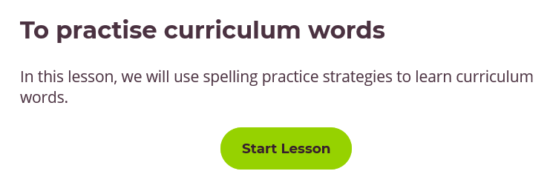
Spelling practise - Year 6 common exception words
Date: Monday 11th January 2021
You could complete this task by:
Writing the correct spellings on a piece of paper.
Writing the correct spellings in a Word document.
Click me
https://classroom.thenational.academy/lessons/to-practise-curriculum-words-6tj32d

Slide 2
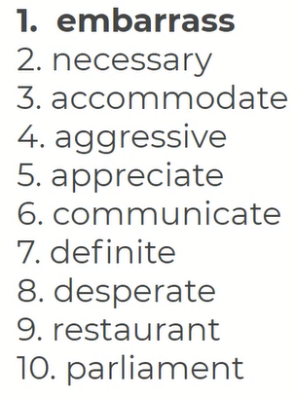
Read, copy, cover, spell today’s spellings.

Slide 3
Date: Monday 11th January 2021
LO: To be able to analyse the features of a non-chronological report.
Subject: English

Slide 4
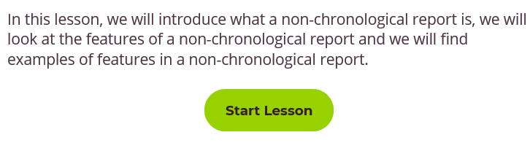
You will need: A pen or pencil (unless using a computer). Something to write on or type on. | You can complete this task by: Writing tasks on a piece of paper and email in a picture of your work. Writing tasks in a Word document and email a copy of your work. Writing tasks on a piece of paper and using the Friday drop box.
Email completed work to trailblazerspupils@gmail.com or use the drop box on Friday.
Click me
https://classroom.thenational.academy/lessons/to-analyse-the-features-of-a-non-chronological-report-6cv3ar

Slide 5
Reading time
Now that you have finished your main task, please enjoy some reading time.
You can read to yourself, an adult or sibling.
This can be done by logging on to your myON account, picking a book or magazine and enjoying at least 15 minutes reading time.
https://www.myon.co.uk/login/index.html
Remember that your login is your first name and first letter of your surname then password:
harryp
password1
Please email trailblazerspupils@gmail.com if you have any login issues.

Slide 6
End of lesson

Slide 7
Read, copy, cover, spell this week’s spellings.
Date: Tuesday 12th January 2021
pressure
exposure
pleasure
reassure
reinsure
moisture
puncture
structure
texture
lecture

Slide 8
Date: Tuesday 12th January 2021
LO: To be able to develop our knowledge of the function of a colon.
Subject: English

Slide 9
You will need: A pen or pencil (unless using a computer). Something to write on or type on. | You can complete this task by: Writing tasks on a piece of paper and email in a picture of your work. Writing tasks in a Word document and email a copy of your work. Writing tasks on a piece of paper and using the Friday drop box.
Email completed work to trailblazerspupils@gmail.com or use the drop box on Friday.
Click me
https://classroom.thenational.academy/lessons/to-develop-our-knowledge-of-the-function-of-a-colon-6hjk0t

Slide 10
Reading time
Now that you have finished your main task, please enjoy some reading time.
You can read to yourself, an adult or sibling.
This can be done by logging on to your myON account, picking a book or magazine and enjoying at least 15 minutes reading time.
https://www.myon.co.uk/login/index.html
Remember that your login is your first name and first letter of your surname then password:
harryp
password1
Please email trailblazerspupils@gmail.com if you have any login issues.

Slide 11
End of lesson

Slide 12
Read, copy, cover, spell this week’s spellings.
Date: Wednesday 13th January 2021
pressure
exposure
pleasure
reassure
reinsure
moisture
puncture
structure
texture
lecture

Slide 13
Date: Wednesday 13th January 2021
LO: To be able to gather information for a non-chronological report.
Subject: English

Slide 14
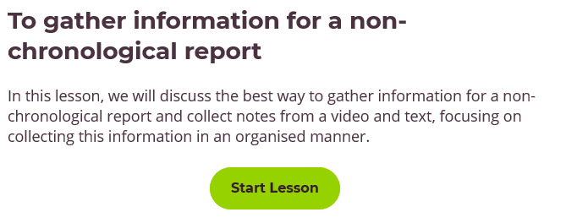
You will need: A pen or pencil (unless using a computer). Something to write on or type on. | You can complete this task by: Writing tasks on a piece of paper and email in a picture of your work. Writing tasks in a Word document and email a copy of your work. Writing tasks on a piece of paper and using the Friday drop box.
Email completed work to trailblazerspupils@gmail.com or use the drop box on Friday.
Click me
https://classroom.thenational.academy/lessons/to-gather-information-for-a-non-chronological-report-c8w34c

Slide 15
The notes that you have made today MUST be kept to help you with the rest of your non-chronological report lessons. See you tomorrow.

Slide 16
Reading time
Now that you have finished your main task, please enjoy some reading time.
You can read to yourself, an adult or sibling.
This can be done by logging on to your myON account, picking a book or magazine and enjoying at least 15 minutes reading time.
https://www.myon.co.uk/login/index.html
Remember that your login is your first name and first letter of your surname then password:
harryp
password1
Please email trailblazerspupils@gmail.com if you have any login issues.

Slide 17
End of lesson

Slide 18
Read, copy, cover, spell this week’s spellings.
Date: Thursday 14th January 2021
pressure
exposure
pleasure
reassure
reinsure
moisture
puncture
structure
texture
lecture

Slide 19
Date: Thursday 14th January 2021
LO: To be able to develop a rich understanding of words associated with eating.
Subject: English

Slide 20
You will need: A pen or pencil (unless using a computer). Something to write on or type on. | You can complete this task by: Writing tasks on a piece of paper and email in a picture of your work. Writing tasks in a Word document and email a copy of your work. Writing tasks on a piece of paper and using the Friday drop box.
Email completed work to trailblazerspupils@gmail.com or use the drop box on Friday.
Click me
https://classroom.thenational.academy/lessons/to-develop-a-rich-understanding-of-words-associated-with-eating-cmwk6d

Slide 21
Reading time
Now that you have finished your main task, please enjoy some reading time.
You can read to yourself, an adult or sibling.
This can be done by logging on to your myON account, picking a book or magazine and enjoying at least 15 minutes reading time.
https://www.myon.co.uk/login/index.html
Remember that your login is your first name and first letter of your surname then password:
harryp
password1
Please email trailblazerspupils@gmail.com if you have any login issues.

Slide 22
End of lesson

Slide 23
Read, copy, cover, spell this week’s spellings.
Date: Friday 15th January 2021
pressure
exposure
pleasure
reassure
reinsure
moisture
puncture
structure
texture
lecture

Slide 24
Date: Friday 15th January 2021
LO: To be able to plan the opening of a non-chronological report.
Subject: English

Slide 25
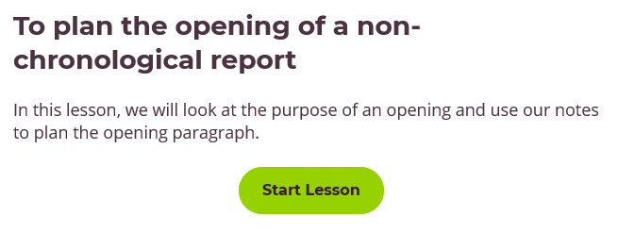
You will need: Your notes from Wednesday’s lesson. A pen or pencil (unless using a computer). Something to write on or type on. | You can complete this task by: Writing tasks on a piece of paper and email in a picture of your work. Writing tasks in a Word document and email a copy of your work. Writing tasks on a piece of paper and using the Friday drop box.
Email completed work to trailblazerspupils@gmail.com or use the drop box on Friday.
Click me
https://classroom.thenational.academy/lessons/to-plan-the-opening-of-a-non-chronological-report-6dk6ce

Slide 26
The notes that you have made today MUST be kept to help you with the rest of your non-chronological report lessons. See you on Monday.

Slide 27
Reading time
Now that you have finished your main task, please enjoy some reading time.
You can read to yourself, an adult or sibling.
This can be done by logging on to your myON account, picking a book or magazine and enjoying at least 15 minutes reading time.
https://www.myon.co.uk/login/index.html
Remember that your login is your first name and first letter of your surname then password:
harryp
password1
Please email trailblazerspupils@gmail.com if you have any login issues.

Slide 28
End of lesson

