Slide 1
Subject: English

Slide 2
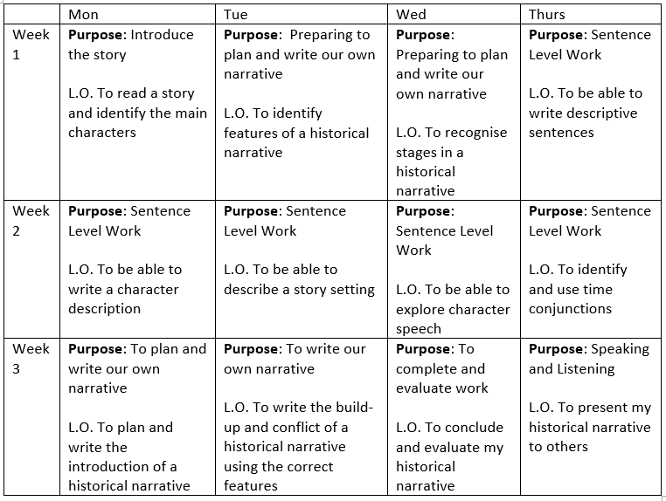
Date: W.B. Monday 1st February 2021
Hello Base 5! In English over the next few weeks, we will be looking at Historical Narratives. I have chosen the book ‘Escape from Pompeii’ to look at, as this links to our new topic – The Romans. On this PowerPoint, you will find this weeks’ English lessons, and some tasks to complete. Once complete, please email your work to climbpupils@gmail.com or ask an adult to drop it off at school. I am looking forward to seeing your amazing work!
Word of the week… disrupt
Disrupt: to interrupt by causing a disturbance or problem.
Subject: English

Slide 3
Date: Monday 1st February 2021
L.O. To plan and write the introduction of a historical narrative
Subject: English

Slide 4
Date: Monday 1st February 2021
What Work? | L.O. To plan and write the introduction of a historical narrative
How Much Work?
My work is Finished when...
Next?
or
or

Slide 5
This week, we are going to be writing our very own historical narrative! Let’s remind ourselves about the stages of a historical narrative…

Slide 6
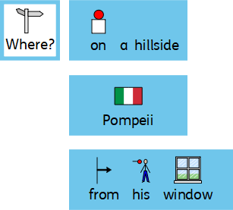
Let’s look at the introduction of ‘Escape from Pompeii’
The introduction should tell us where the story is set, who the main character is and what they are doing. It should be interesting, using descriptive language to make the reader want to read on! Can you highlight the adjectives in the introduction?
On a hillside overlooking the sparkling bay of Naples, the Roman city of Pompeii glimmered in the sunlight.
From his window, young Tranio listened to the noise humming from bars, taverns and shops around him, and to the busy tradesmen haggling in the streets below. Beyond the massive city walls he could see Pompeii’s greatest protector looming in the distance. They called it Vesuvius, the Gentle Mountain. Could anything feel safer than here, Tranio wondered? Was anything more beautiful?
Task: using your knowledge of description from last week, can you underline the adjectives in the introduction above?

Slide 7
Choose: Let’s get your historical narrative started!
or
I have given you 2 options to choose from. If you prefer, you can think of your own character / setting.
or
or

Slide 8
Your turn…
Drag and drop the cards on to the line to complete the sentence. This will be the introduction to your historical narrative.
Write your sentence out underneath – don’t forget to use the correct punctuation!

Slide 9
Your turn…
Now that you have built a sentence, can you add some adjectives to describe the setting?
Write your sentence out again underneath, but this time include your adjectives – don’t forget to use the correct punctuation!

Slide 10
Write 3 sentences – this will be the introduction to your historical narrative.
My turn…
In the beautiful city of Rome, Augustus was watching the amazing show at the phenomenal amphitheatre.
Your turn…

Slide 11
Your turn…
Write the introduction to your historical narrative.
You will need 5 sentences.
Can you include adjectives to make your introduction more descriptive?
1.
2.
3.
4.
5.

Slide 12
Date: Tuesday 2nd February 2021
LO: To write the build up and conflict of a historical narrative.
Subject: English

Slide 13
Date: Tuesday 2nd February 2021
What Work? | L.O. To write the build up and conflict of a historical narrative
How Much Work?
My work is Finished when...
Next?
or
or

Slide 14
Let’s look at the build-up of the story ‘Escape from Pompeii’…
Then something happened…
The stone steps creaked, the flaps began to rattle and the building quivered. Props fell to the stage and scenery split. Tranio’s father froze to the spot. Everyone fell silent.
But as they ran, the sky began to darken and a thick cloud drifted slowly overhead.
The build-up should contain some suspense. This makes the reader want to read on to find out what happens next…

Slide 15
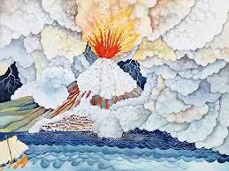
Now let’s look at the conflict…
And then, in one terrible endless moment, they heard mighty Mount Vesuvius roar. Its top exploded in a scream and flames ripped upwards to the sky. A massive cloud of silver ash rose to the heavens, twisting and bubbling in every direction until everything was in total darkness. Lightning flashed and thunder roared. Streams of molten liquid flowed in fast rivers down the mountain slopes and covered a nearby town. The walls, streets and gardens of their beloved Pompeii disappeared beneath a blanket of ash and stones. Before their very eyes, everything and everyone they had ever loved was destroyed.
If you close your eyes, can you picture what the explosion looked like?

Slide 16
Now it’s time to write about the build-up to the conflict in your historical narrative.
Conflict: choose 1
or
Build up: choose 2

Slide 17
My turn
Can you spot the description in my sentences? Underline any adjectives you can see.

Slide 18
Your turn
Drag and drop the options to build 2 sentences about the build-up and conflict of your historical narrative.
Suddenly,
and

Slide 19
Your turn…
Write 3 sentences about the build up of your historical narrative. Don’t forget to add description.
Adjective ideas…
Terrifying
Loud
Strong
Fierce
Enormous
Aggressive
Suddenly,
Then,
It was a

Slide 20
Your turn…
Adjective ideas…
Terrifying
Loud
Strong
Fierce
Enormous
Aggressive
Write 5 sentences about the build-up and conflict of your historical narrative. Remember to use description to make your story more interesting. Don’t forget to use the correct punctuation.
1.
2.
3.
4.
5.

Slide 21
Date: Wednesday 3rd February 2021
LO: To conclude and evaluate my historical narrative
Subject: English

Slide 22
Date: Wednesday 3rd February 2021
What Work? | L.O. To conclude and evaluate my historical narrative
How Much Work?
My work is Finished when...
Next?
or

Slide 23
Finally, let’s look at the resolution and ending of the story ‘Escape from Pompeii’.
Tranio and Livia held each other desperately as the steaming lava reached the sea itself. The water began to swell against the sides of the boat as it moved out to safety.
They had left just in time.
Many years passed … and the mountain grew cool and still.
Tranio and Livia walked back to their small house beside the orange grove. For the rest of their days, they would carry a deep sorrow within their hearts.
Does this story have a happy or sad ending?
Why do you think this?
I think the ending is both happy and sad because Tranio and Livia survived, but their families and homes were destroyed.

Slide 24
Your turn…
How will the conflict in your story be resolved? How will this affect the ending of your story? Drag and drop the options below to build 2 sentences, then write them out underneath.

Slide 25
Write 3 sentences:
Think about how your story is going to end. Will it be a happy or sad ending for your character? How will the conflict be resolved before you reach the end of your story?
Your turn…

Slide 26
Your turn…
Write 3 sentences about how the conflict in your historical narrative is resolved. Don’t forget to include the correct punctuation!
Does your story have a happy or sad ending?
1.
2.
3.

Slide 27
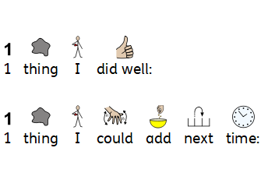
Well done! You have completed your very own historical narrative. Now it’s time to evaluate it.

Slide 28
Date: Thursday 4th February 2021
L.O. To present my historical narrative to others
Subject: English

Slide 29
Task 1: Read your historical narrative to a friend (parent/carer, sibling, pet or even a toy!) Make sure you speak slowly and clearly. You could even record yourself and send it into school for me to see! ☺
Task 2: Hot Seat!
Imagine you are the main character in your story. Have your friend ask you 5 questions about what happened to them / how they felt etc.
OR
Answer the following questions in the role of your main character…
What was the best thing about living in Rome?
Did you have any family or friends?
What did you like to do for entertainment?
How did you feel when the disaster happened?
Was it difficult to find safety?

Slide 30
Date: Friday 5th February 2021
LO: To spell words with the ‘s’ sound, spelt with ‘sc’
Subject: Spellings

Slide 31
Task 1: Here are your spellings this week.
Look, say, cover, write, check.
science
scene
discipline
crescent
fascinate

Slide 32
Task 2: Choose 3 of your spellings and write them in a sentence using your neatest handwriting. Make sure you use the correct punctuation.
Your turn:
1.
2.
3.

