Slide 1
Date: 1.03.21
L.O. To be able to double amounts of objects up to 10.
Subject: Maths

Slide 2
Doubling is when you take a number or number of objects and add it to itself, or, multiply it by 2.
Help to double the number of shapes on the butterfly’s wings.
How many shapes do we need to add to the other wing?
6
What is double 3?
Double 3 is 6.

Slide 3
Help to double the number of shapes on the butterfly’s wings.
10
What is double 5?
Double 5 is 10.

Slide 4
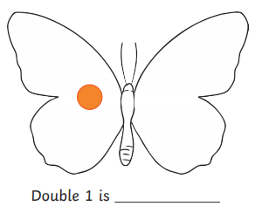
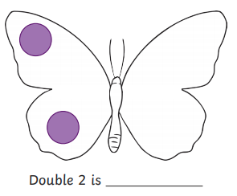
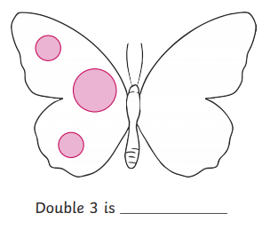

Slide 5
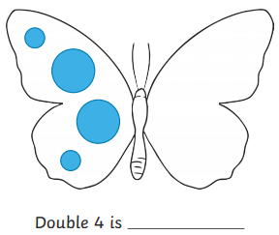
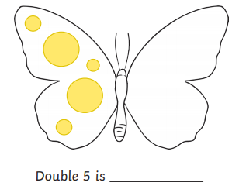

Slide 6
Date: 2.03.21
L.O. To be able to double amounts of objects up to 20.
Subject: Maths

Slide 7
Doubling is when you take a number or number of objects and add it to itself, or, multiply it by 2.
Double 5 is 10.

Slide 8
Doubling is when you take a number or number of objects and add it to itself, or, multiply it by 2.
Double 6 is 12.

Slide 9
Doubling is when you take a number or number of objects and add it to itself, or, multiply it by 2.
Double 7 is 14.

Slide 10
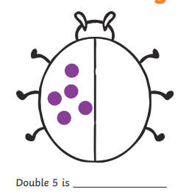
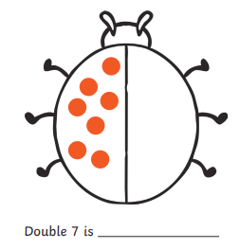
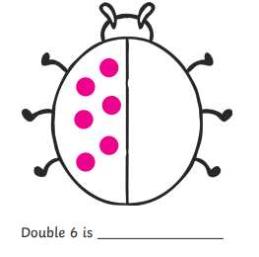

Slide 11
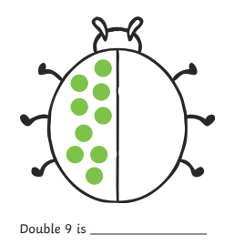
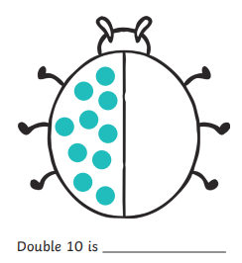
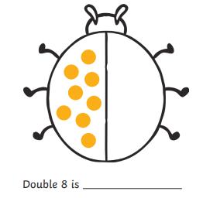

Slide 12
Date: 3.03.21
L.O. To be able to double number shapes.
Subject: Maths

Slide 13
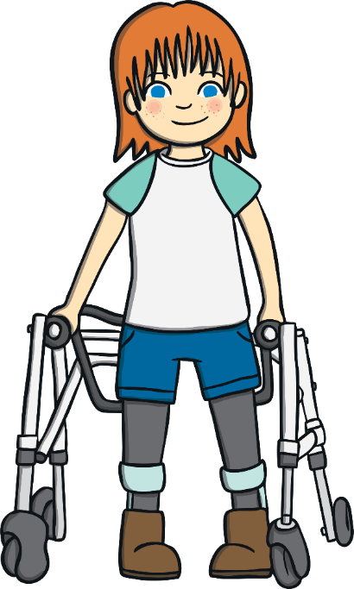
Doubling is when you take a number or number of objects and add it to itself, or, multiply it by 2.
What is double 2??
Double 2 is 4.

Slide 14
Doubling is when you take a number or number of objects and add it to itself, or, multiply it by 2.
What is double 3??
Double 3 is 6.

Slide 15
Doubling is when you take a number or number of objects and add it to itself, or, multiply it by 2.
What is double 5??
Double 5 is 10.

Slide 16
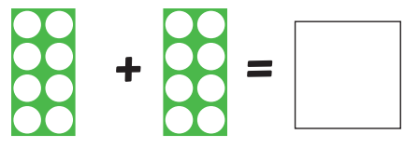
Double 3 is ________.
Double 8 is ________.
Double 5 is ________.

Slide 17
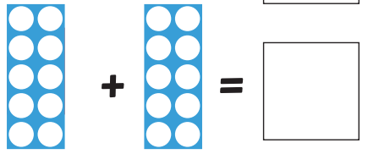
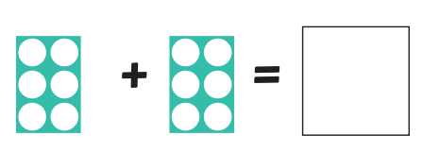
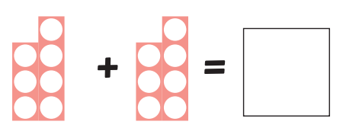
Double 10 is ________.
Double 6 is ________.
Double 7 is ________.

Slide 18
Date: 4.03.21
L.O. To be able to double a number.
Subject: Maths

Slide 19
Double 1 is 2.
Double 5 is 10.

Slide 20
Double 2 is _______.
Double 6 is _______.
Double 9 is _______.

Slide 21
Double 3 is _______.
Double 8 is _______.
Double 4 is _______.

Slide 22
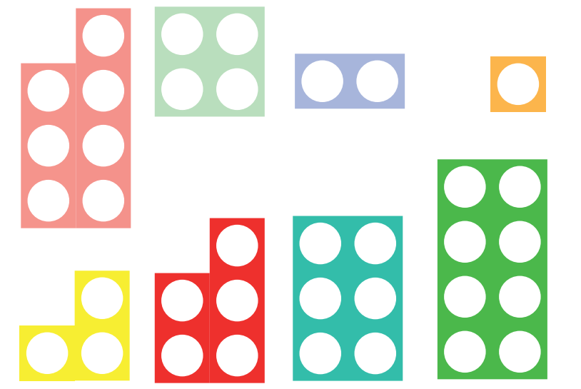
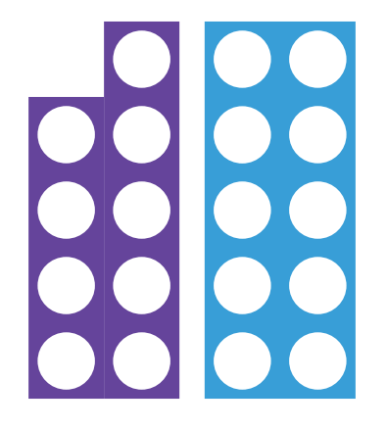

Slide 23
Date: 24.02.21
L.O. To double objects in practical everyday situations.
Subject: Maths

Slide 24
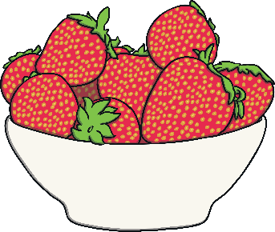
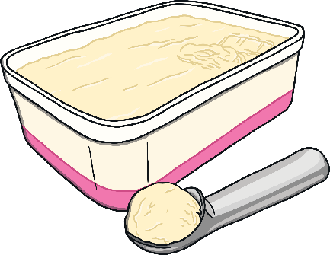
I have put some toppings on my pancake. Can you double the number of toppings? Click the toppings to move them on to the pancake.
add strawberries
add ice cream
double 5 is 10
Click the fork to check your answer.

Slide 25
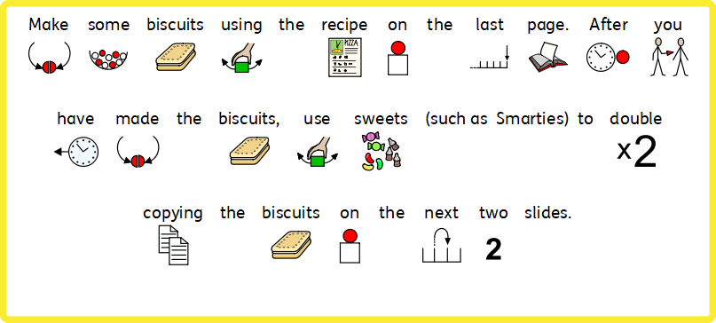
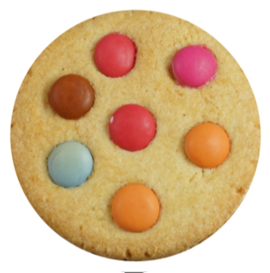
Double 7 is 14.

Slide 26
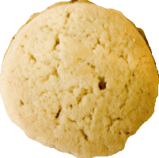
Double 3 is _______.
Double 6 is _______.
Double 4 is _______.

Slide 27
Double 7 is _______.
Double 8 is _______.
Double 2 is _______.

Slide 28
