Slide 2
Date: Monday 1st – Friday 5th March
L.O To be able to recognise sounds.
Please practise phonics every day for 20 minutes.
Subject: Phonics

Slide 3
Sound 1 - “ir”
Try my turn, your turn with a partner “ir” > “ir”
Say: ir
“whirl and twirl”
Now use your index finger and try forming the sound out in the air.
Once having practiced see if you can form todays sound on paper.
ir

Slide 4
Blending Independently
Fred Talk - Fred Frog can only say words in sounds but not the entire word all at once for example “g-ir-l”.
Read the Phonics green word car- Fred talk, read the word.
whirl
tirl
twirl
dirl
Review the words
Fred Talk, read the word
Fred in your head
Speedy reading
Can you separate the real words from the alien words?

Slide 5
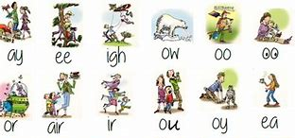
Review and Write
Can you spot todays sound?
Try thinking of some other words that have the sound ‘ir’.
Examples - birthday, girl, skirt, shirt, bird
Challenge! Can you put a word from your list into a sentence?
Example- On my birthday I plan on wearing my new skirt.

Slide 6
Sound 2 – “air”
Here you will learn another way we create an “air” sound.
Try my turn, your turn with a partner “air” > “air”
Say: “air”
“that’s not fair”
Now use your index finger and try forming the sound out in the air.
Once having practiced see if you can form todays sound on paper.
air

Slide 7
Blending Independently – Sound 2
Fred Talk - Fred Frog can only say words in sounds but not the entire word all at once for example .
Read the Phonics green word card- Fred talk, read the word.
fair
sair
chair
zair
Review the words
Fred Talk, read the word
Fred in your head
Speedy reading

Slide 8
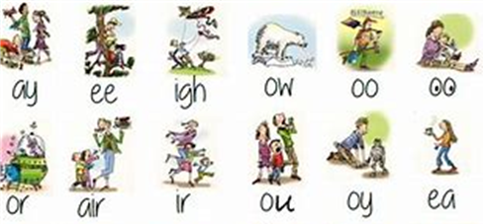
Review and Write 2
Try and think of other words that have the sound ‘air’.
Examples – fairground, airport, hair, stairs
Challenge! Can you put a word from your list into a sentence?
Example – There are lots of stairs in the airport.

Slide 9
Can separate the ‘air’ and ‘ir’ words?
You can colour the key to help categorise the two sounds!
ir
air
chair
whirl
stairs
fair
stir
twirl
girl
diary
repair
thirsty
shirt
dirty
pair
thirty

Slide 10
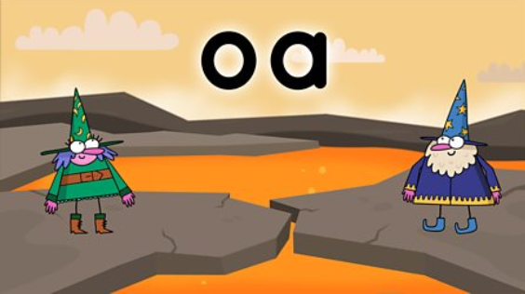
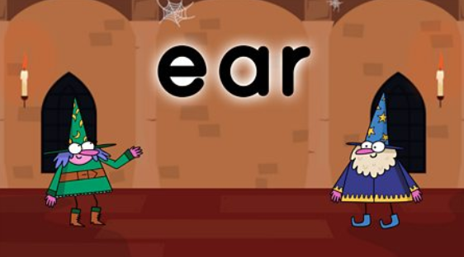
Phonics
BBC Bitesize has lots of 30 second videos focusing on each of the phonics sounds.
https://www.bbc.co.uk/bitesize/topics/zvq9bdm
Copy and paste the link.

Slide 11
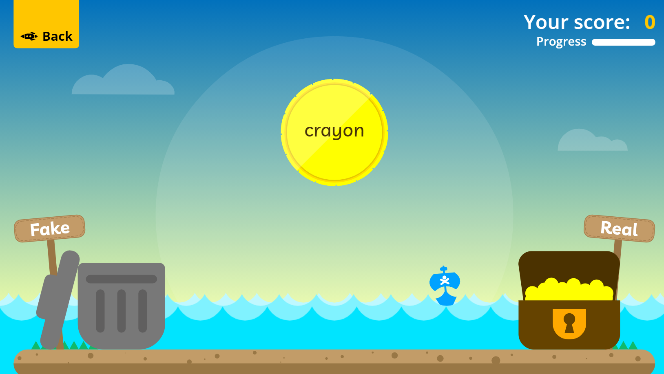
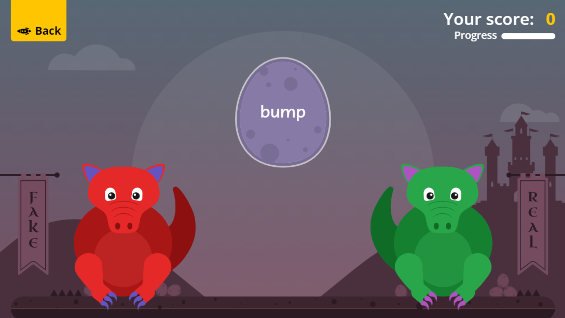
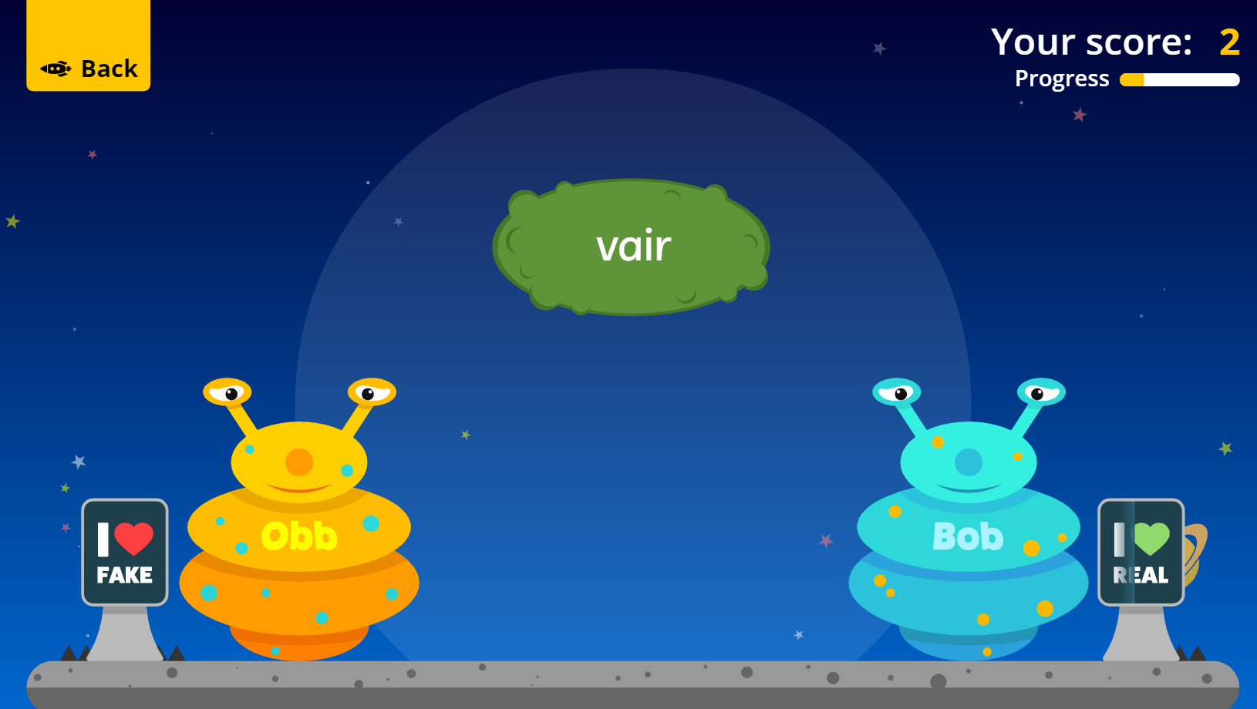
Fun Phonics Games!
Copy and paste the link to play these fun phonics games!
https://www.phonicsplay.co.uk/resources/phase/2/buried-treasure
All phases
https://www.phonicsplay.co.uk/resources/phase/2/dragons-den
All phases
https://www.phonicsplay.co.uk/resources/phase/2/picnic-on-pluto
All phases

