Slide 1
Date: Monday 22nd February
LO: To be able to identify hot countries near the equator.
Subject: Geography

Slide 2
Pre-recorded Teaching
Access the online teaching video below that will support you to complete the work in this lesson. This video will act as a support but all of the work can still be successfully understood & completed using paper-based versions of this pack. If you need further support to understand / complete work then please contact school via e-mail or telephone.
Play Video
https://classroom.thenational.academy/lessons/what-is-the-weather-like-in-brazil-6mr3gt?activity=video&step=2&view=1

Slide 3
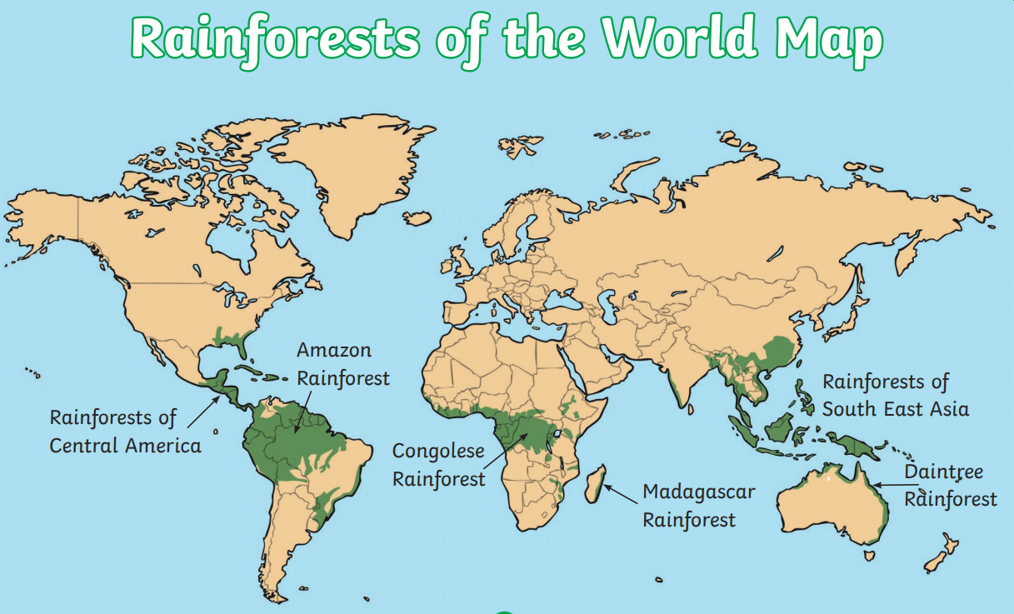
Recap: The Equator
The equator is an imaginary circle around the Earth. It is the hottest part of the Earth.
Today we are going to be looking at hot countries that run through the equator.
Did you know there are 13 countries that run through the equator?
Equator

Slide 4
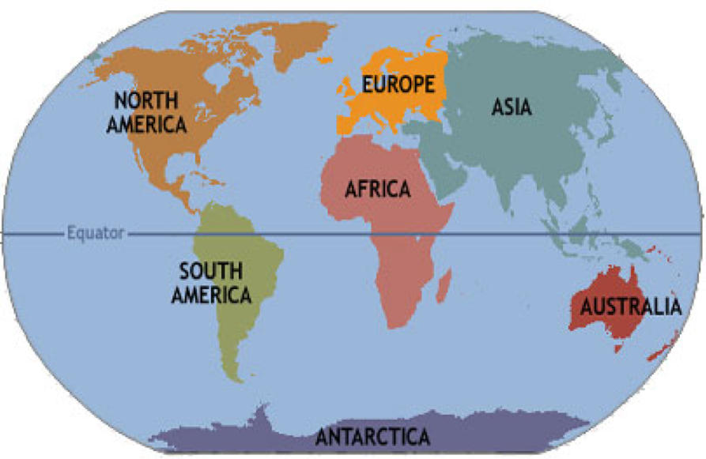
Continents of the world
There are 7 continents in the world.
Only 3 of these run through the equator.
Can you name the 3 continents that the equator runs though?

Slide 5
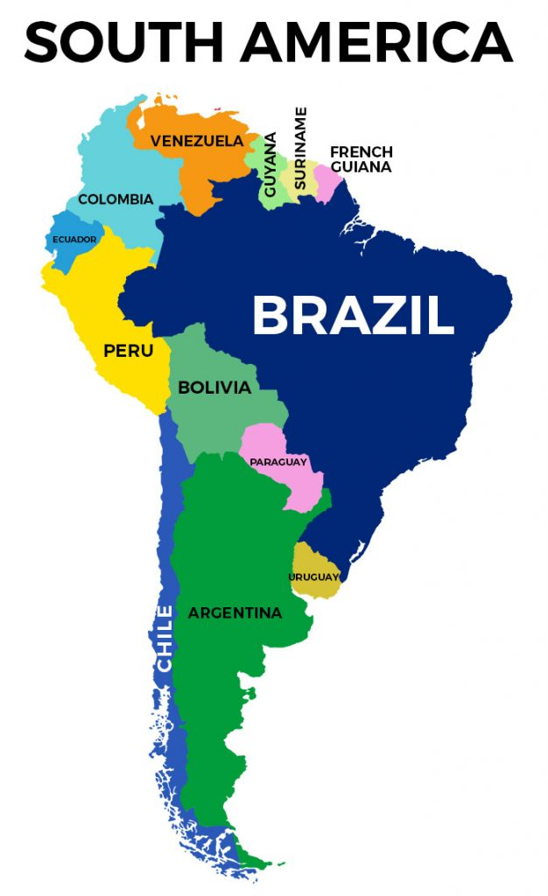
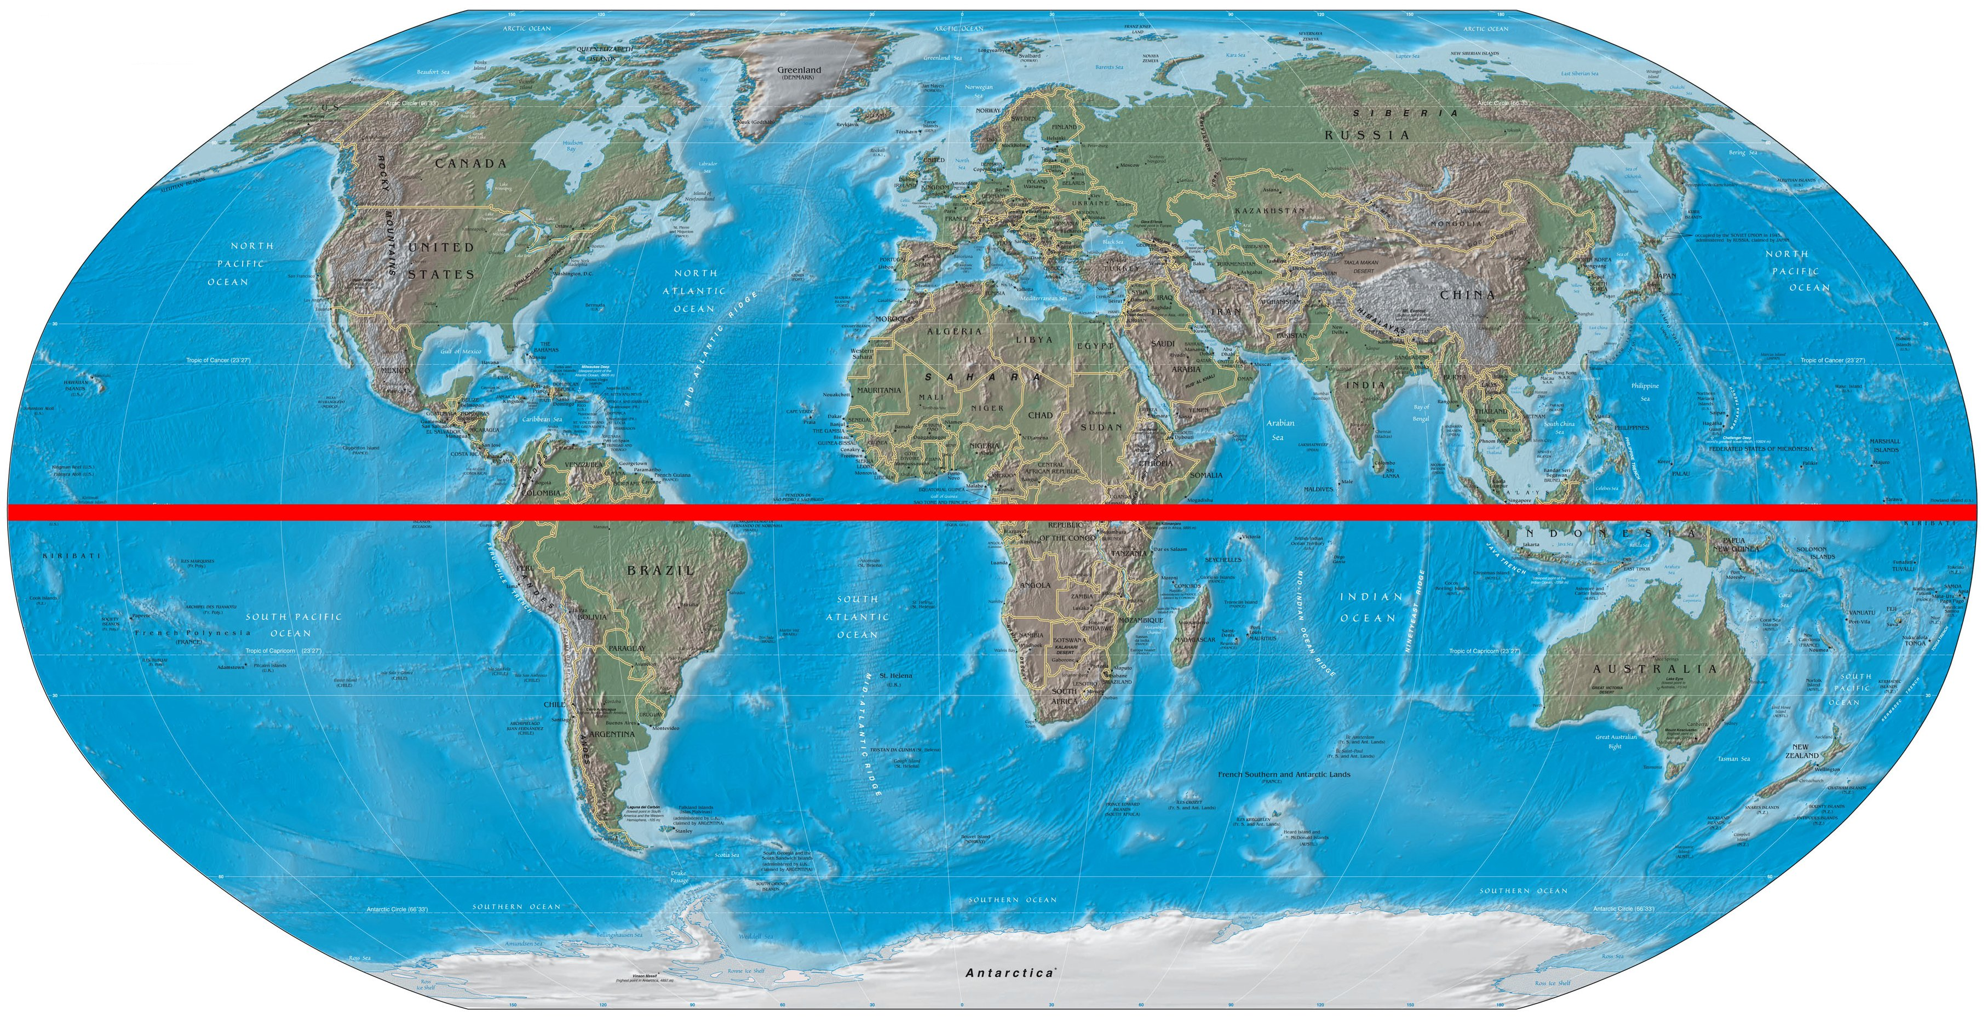
Hot countries near the equator
Brazil is in the continent of South America.
Fun Facts:
212 million people live in Brazil.
People who live in Brazil speak Portuguese.
The weather in Brazil is really hot as it is near the equator.
The Amazon rainforest is the world’s largest rainforest and can be found in Brazil.
Equator

Slide 6
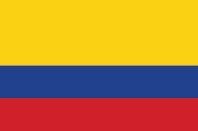
Hot countries near the equator
Colombia is in the continent of South America.
Fun Facts:
50 million people live in Colombia.
People from Colombia speak Spanish.
Colombia is a really hot country as it is near the equator.
10% of the Amazon rainforest is in Colombia
Equator

Slide 7
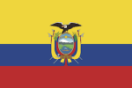
Hot countries near the equator
Ecuador is in the Continent of South America.
Fun Facts:
17 million people live in Ecuador.
People who live in Ecuador speak Spanish.
Ecuador is a really hot country that is near the equator.
The Amazon Rainforest runs through Ecuador.

Slide 8
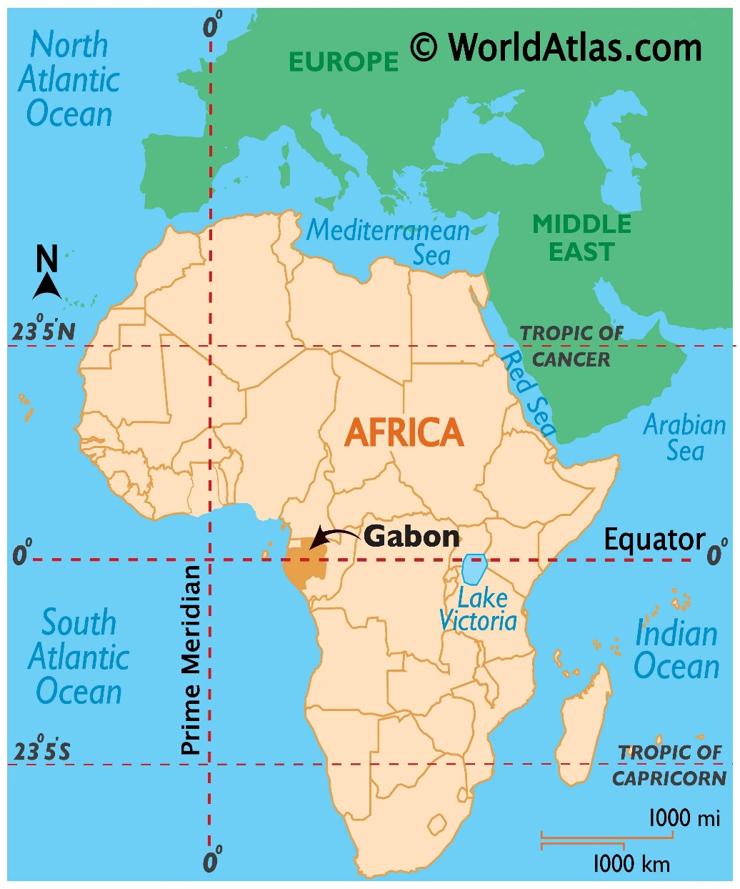
Hot countries near the equator
Gabon is located in continent of Africa.
Gabon is found on the equator, so it is a very hot country.
1.5 million people live in Gabon.
People from Gabon speak French.
The Congo Rainforest is in Gabon.

Slide 9
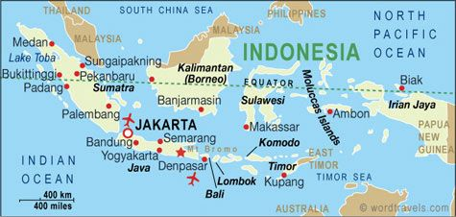
Hot countries near the equator
Indonesia is in the continent of Asia.
250 million people live in Indonesia.
There are lots of tropical rainforests in Indonesia.
It is a very hot country as it is on the equator.
Did you know Indonesia is made up of lots of small islands?

Slide 10
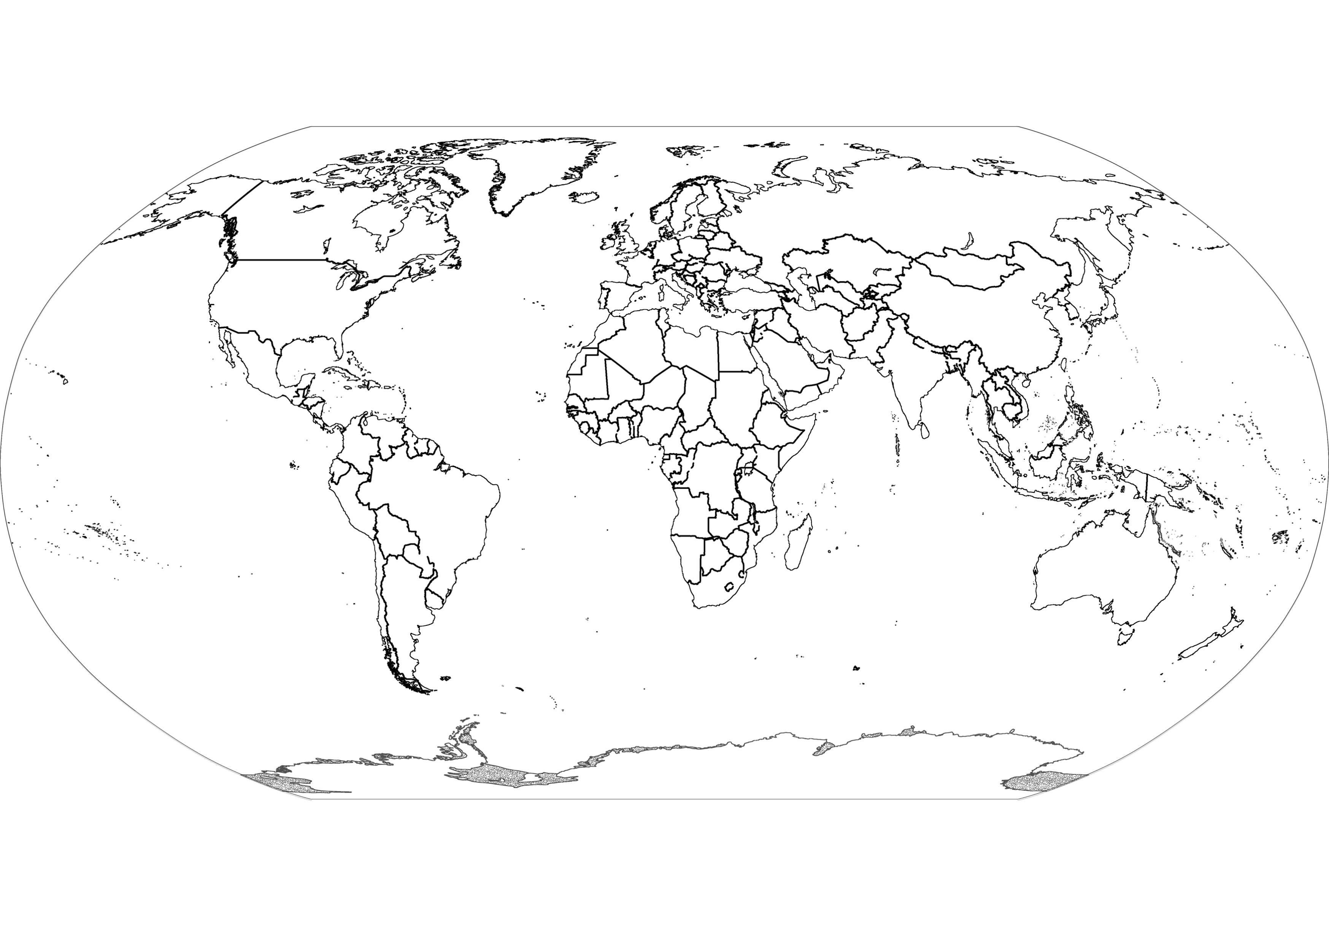
If you are unable to print the map to label it you can use the letters to create a key. For example A – Columbia
Task: Locate and label the 5 countries we have learnt about today on the map.
Indonesia, Brazil, Gabon, Ecuador and Columbia.
A.
E.
D.
B.
C.
Challenge:
Can you label the equator line?

Slide 11
Well done for all of your hard work this lesson!
Please send a photograph of you and your completed map to pioneerspupils@gmail.com
or deliver it to the drop box outside of school on a Friday.

Slide 12
Date: Tuesday 23rd February
LO: To be able to identify how mangrove trees are adapted to their habitat.
Subject: Science

Slide 13
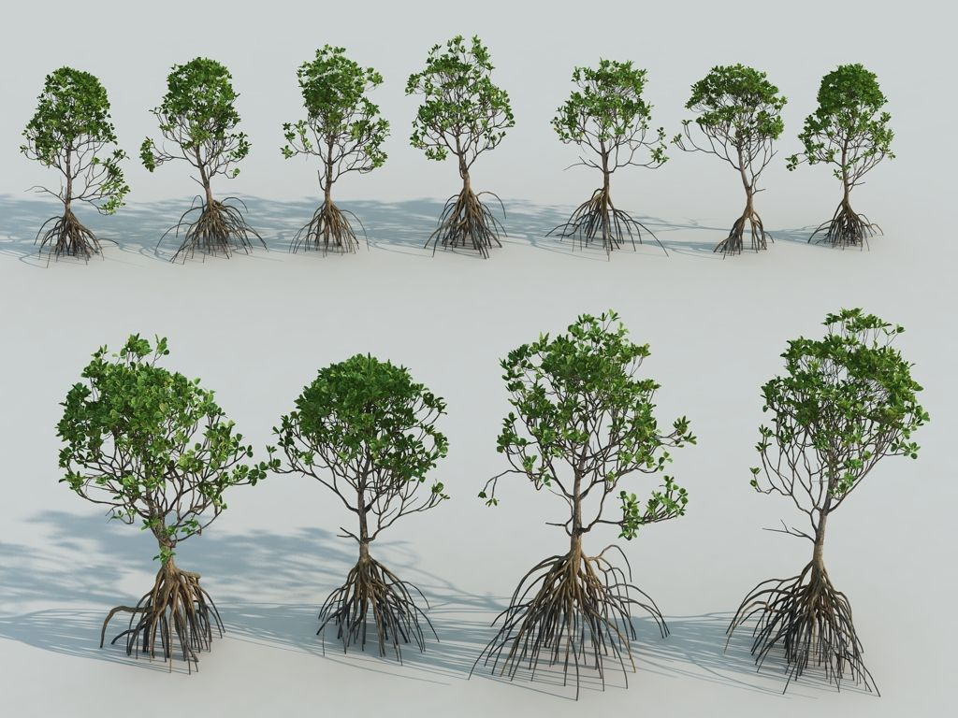
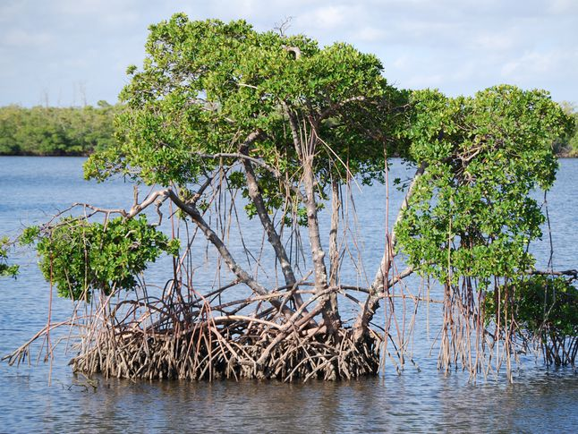
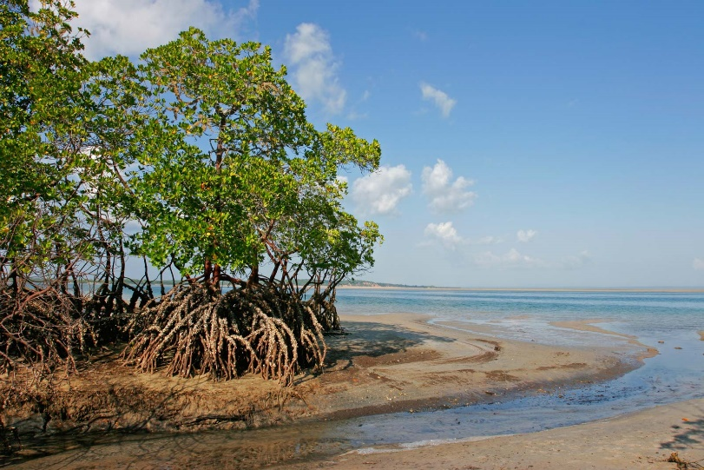
Mangrove Trees
Mangroves are trees or bushes that grow in thick clusters along seashores and riverbanks. They have a thick tangle of roots that sticks up through the mud. These roots help to keep waves from washing away the dirt and sand of the coastline.
Mangroves are forests of salt-tolerant trees that grow in the shallow tidal waters of coastal areas amongst many places in the world.

Slide 14
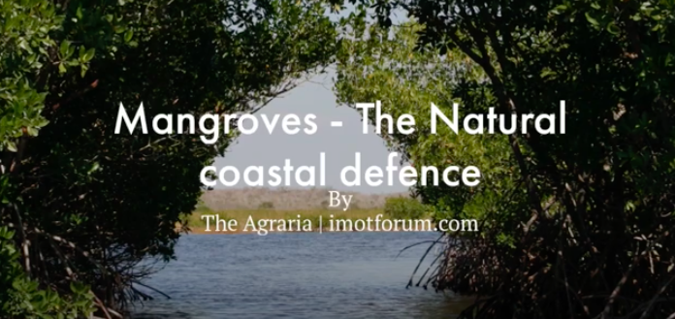
Mangrove – Coastlines
Mangrove trees protect coastlines by absorbing the force of large waves and storm surges, which can cause coastal damage, property damage and loss of life. Recently, more efforts have been made to plant new forests and to preserve existing mangroves as a natural and strong protector of the coast!
Watch this short video and see how many new facts you can learn about Mangroves!
https://www.youtube.com/watch?v=7kC9UOrn7B4
If you are unable to watch the video online you will find the facts from the video on the next two slides.

Slide 15
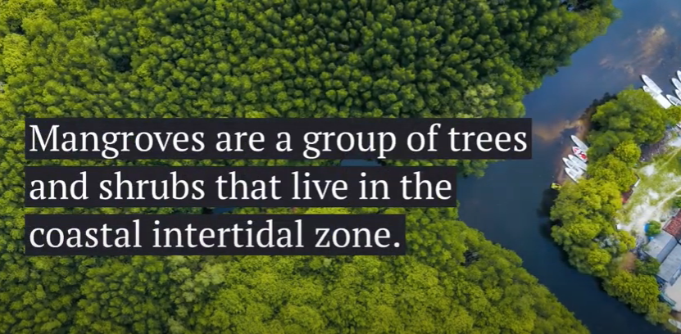
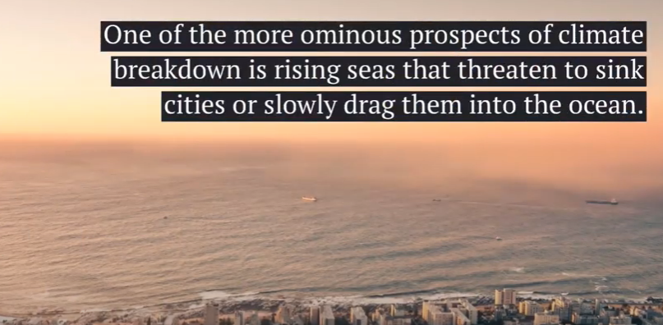
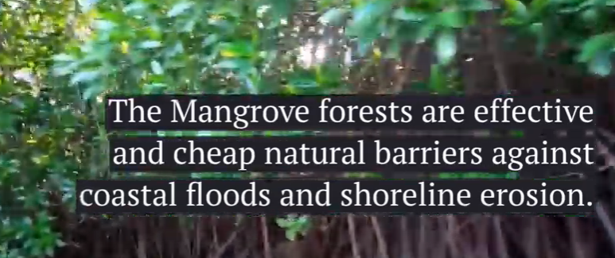
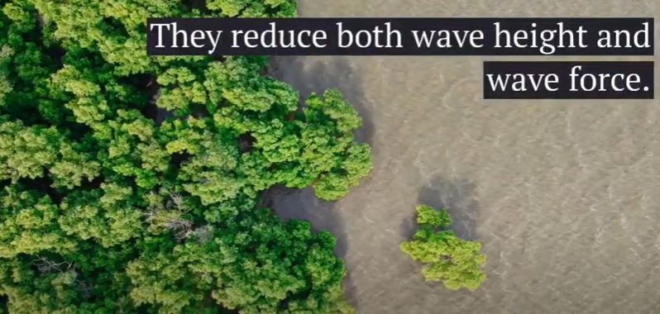
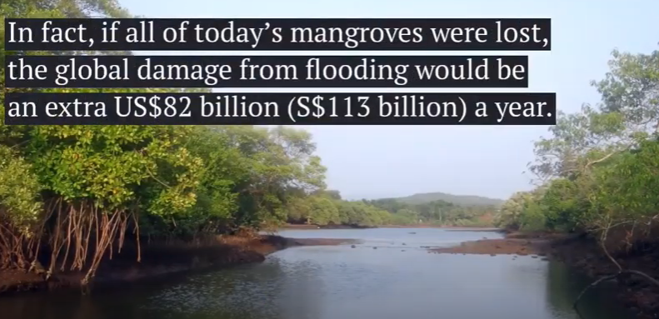
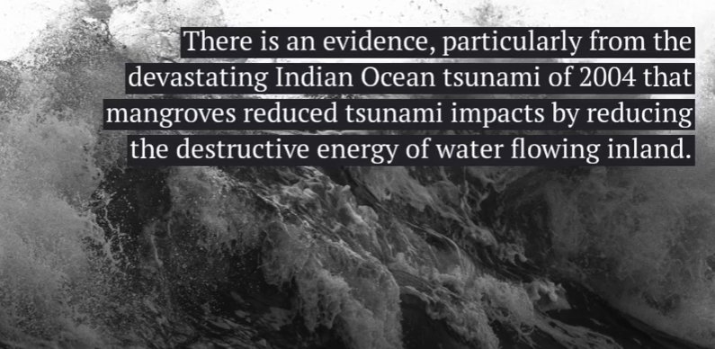
Facts about Mangroves

Slide 16
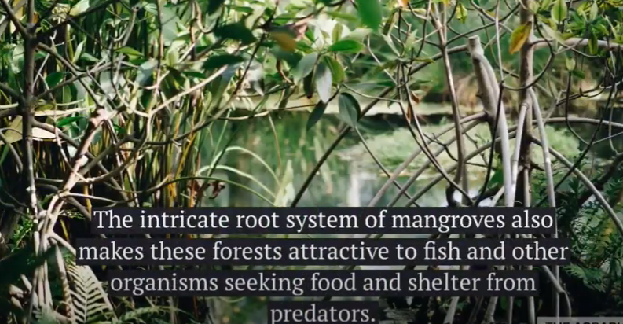
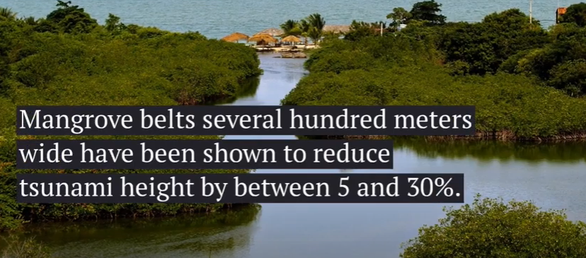
Facts about Mangroves

Slide 17
Where are they found?
Mangrove forests can be found on the saltwater coasts of 118 tropical and sub tropical countries.
The amount of mangrove forests in the world totals to 137,000 square kilometers – roughly the size of Greece!
The largest amount of mangrove coverage can be found in Indonesia, where mangrove trees cover 23,000 square kilometers – more than twice the size of Jamaica!
Indonesia, Brazil, Nigeria and Australia account for around 41% of all mangroves and 60% of the total mangrove area is found in just 10 countries!

Slide 18
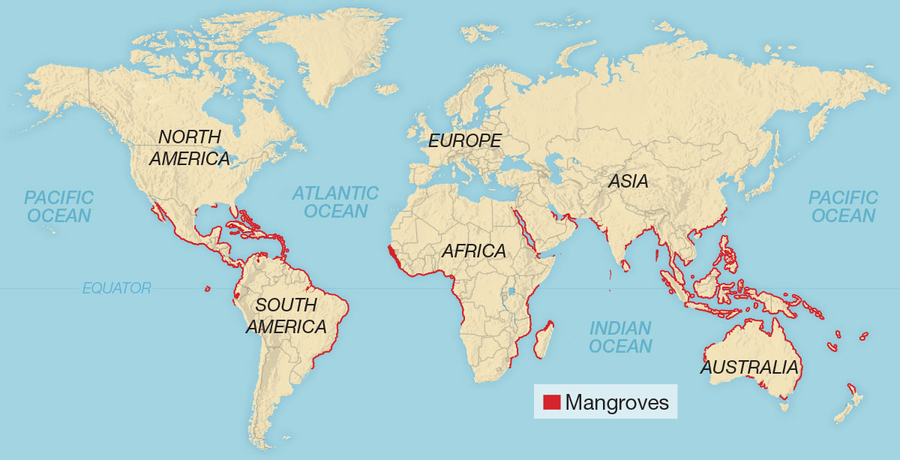
The areas lined in red on this map are where Mangroves can be found around the world.
They occur worldwide in the tropics and subtropics, mainly between latitudes 25° North and 25° South. Mangroves are restricted mainly to the tropical areas as they cannot tolerate the extreme cold events typical of the temperate zone.

Slide 19
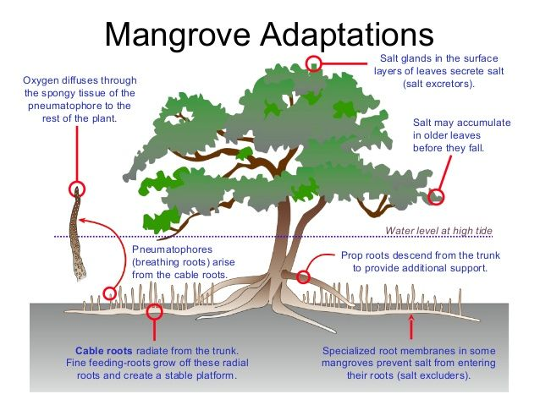
How are mangroves adapted to their habitat?
Mangroves must take fresh water from the seawater that surrounds them. Many mangrove species survive by filtering out as much as 90 percent of the salt found in seawater as it enters their roots. Some species pass salt through glands in their leaves.
Mangroves store fresh water in thick succulent leaves. A waxy coating on the leaves of some mangrove species seals in water and minimises evaporation.
Some mangroves grow pencil-like roots that stick up out of the dense, wet ground like snorkels. These breathing tubes, called pneumatophores, allow mangroves to cope with daily flooding by the tides.
Their unusual root systems give them support and stability in the loose soil.
‘pneumatophores’ means an aerial root which is made for gas filled exchanges!

Slide 20
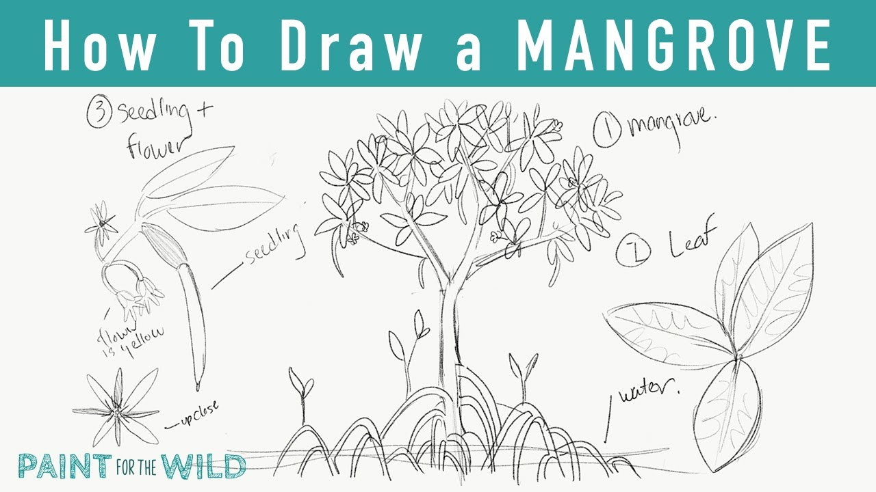
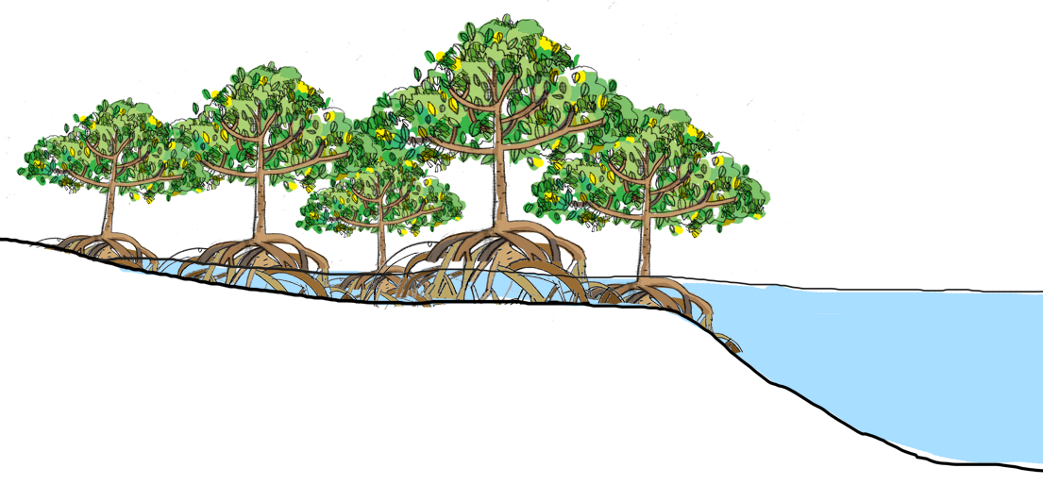
Your task- Create an informative poster about Mangrove Trees.
With all of the new information and fun facts you have just learned about Mangrove Trees, create an informative poster including pictures and facts!
Use this step by step picture to help you draw your own Mangrove!
Take a look at an example poster on the next slide!

Slide 21
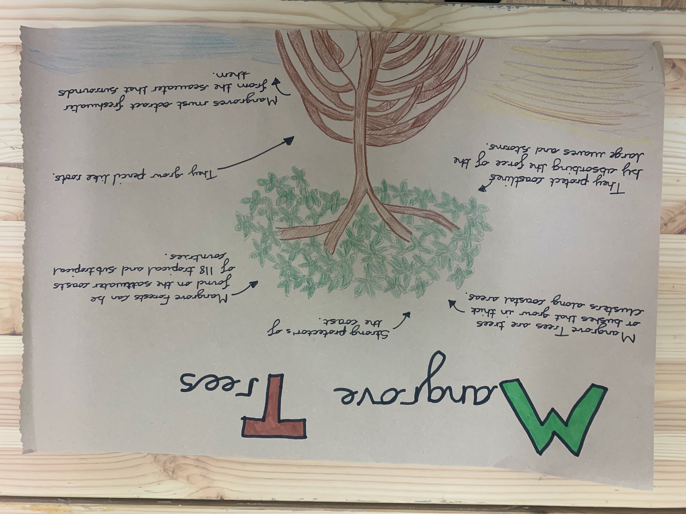
Here is an example poster!
Many different facts and information about Mangrove Trees!
A picture of a Mangrove Tree. Use the step by step ‘how to draw a mangrove’ on the previous slide to help you!

Slide 22
Well done for all of your hard work this lesson!
Please send a photograph of you and your completed poster to pioneerspupils@gmail.com
or deliver it to the drop box outside of school on a Friday.

Slide 23
Date: Wednesday 24th February
LO To be able to draw different types of lines.
Subject: Art & Design

Slide 24
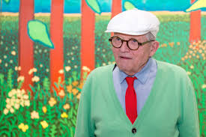
Who is David Hockney?
David Hockney is an English artist, he was born in Bradford, England in 1937. He is one of the most important painters in the world. He has painted pictures of different landscapes around the world. He likes to make his paintings bright and colourful to attract people’s attention. David Hockney likes painting outside in all weathers.

Slide 25
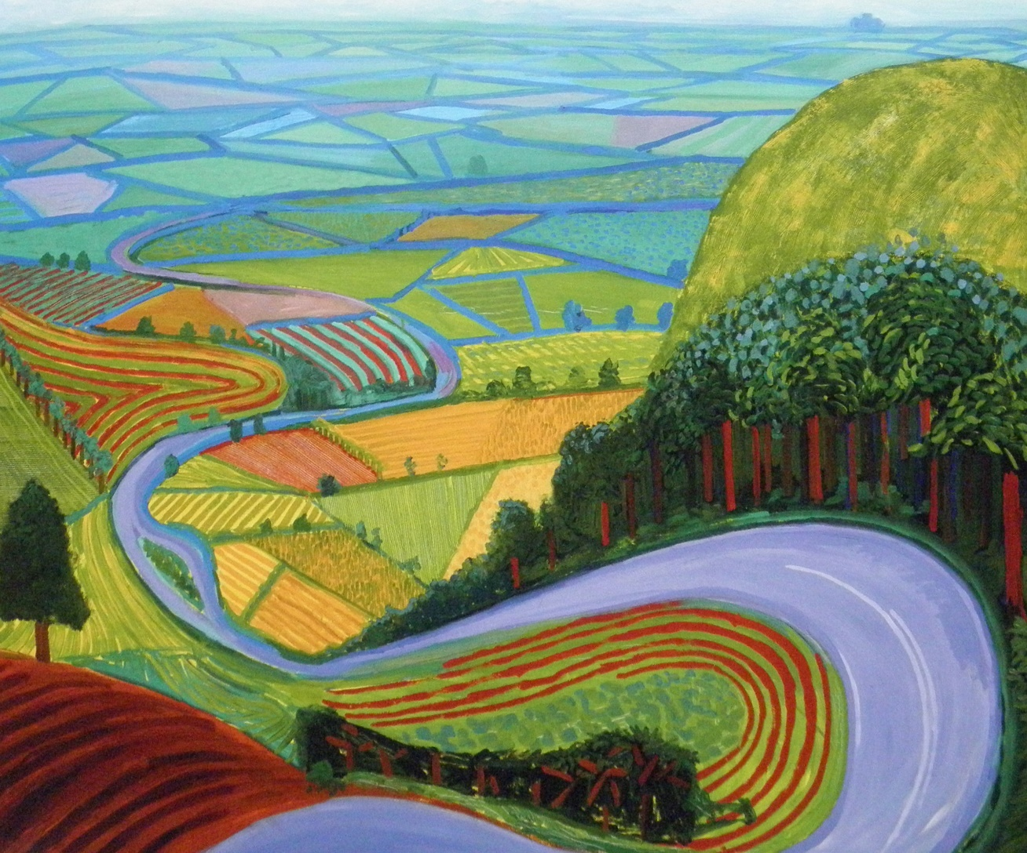
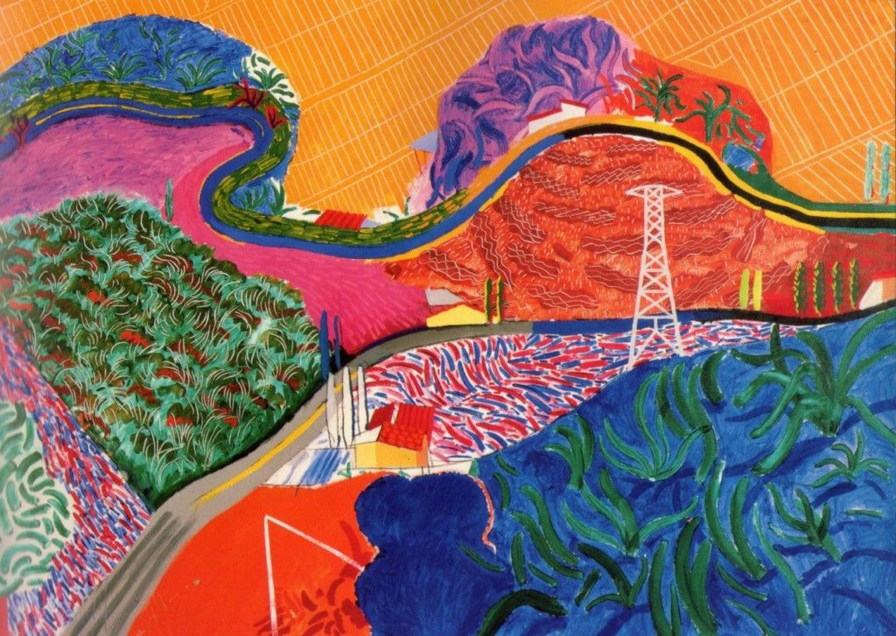
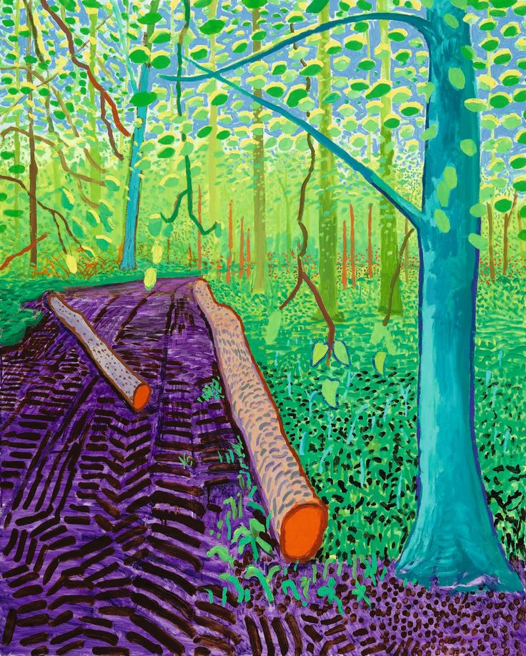
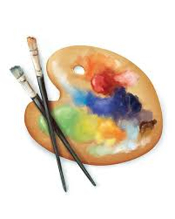
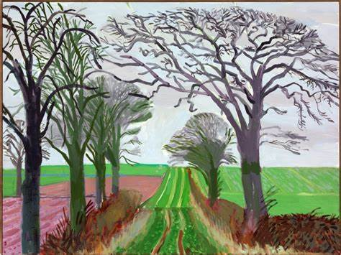
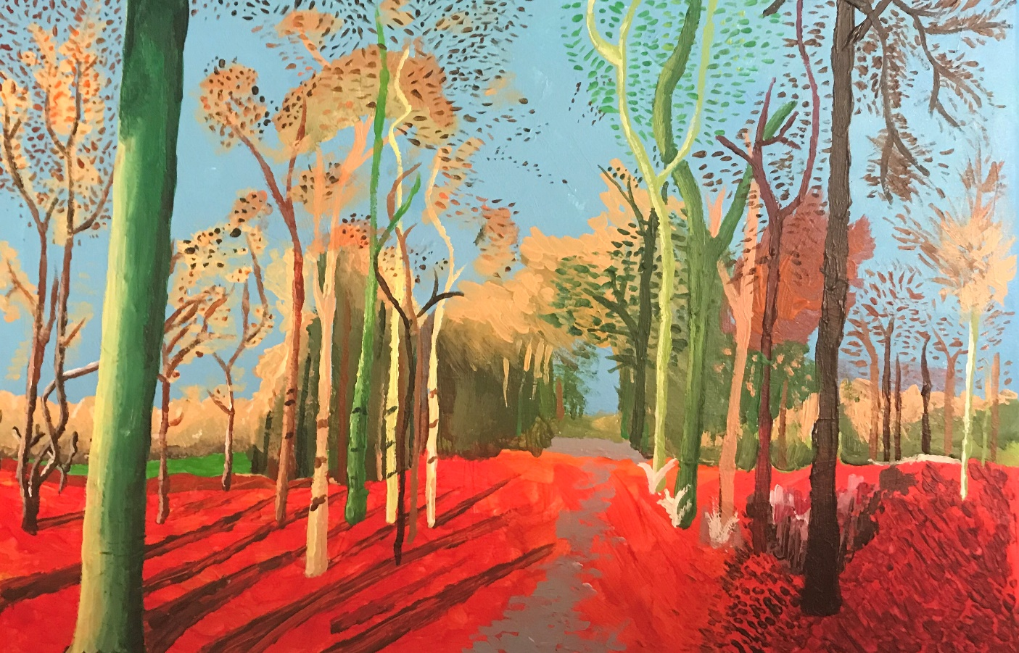
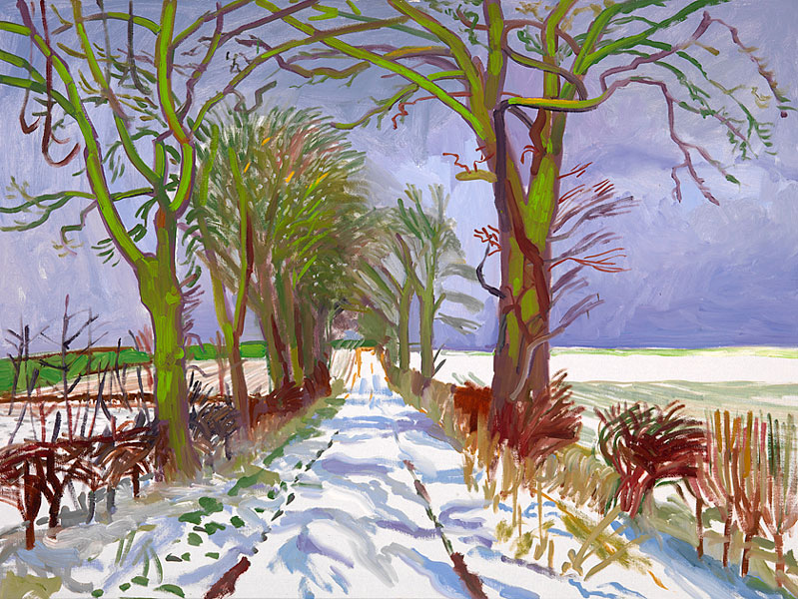
David Hockney’s artwork!

Slide 26
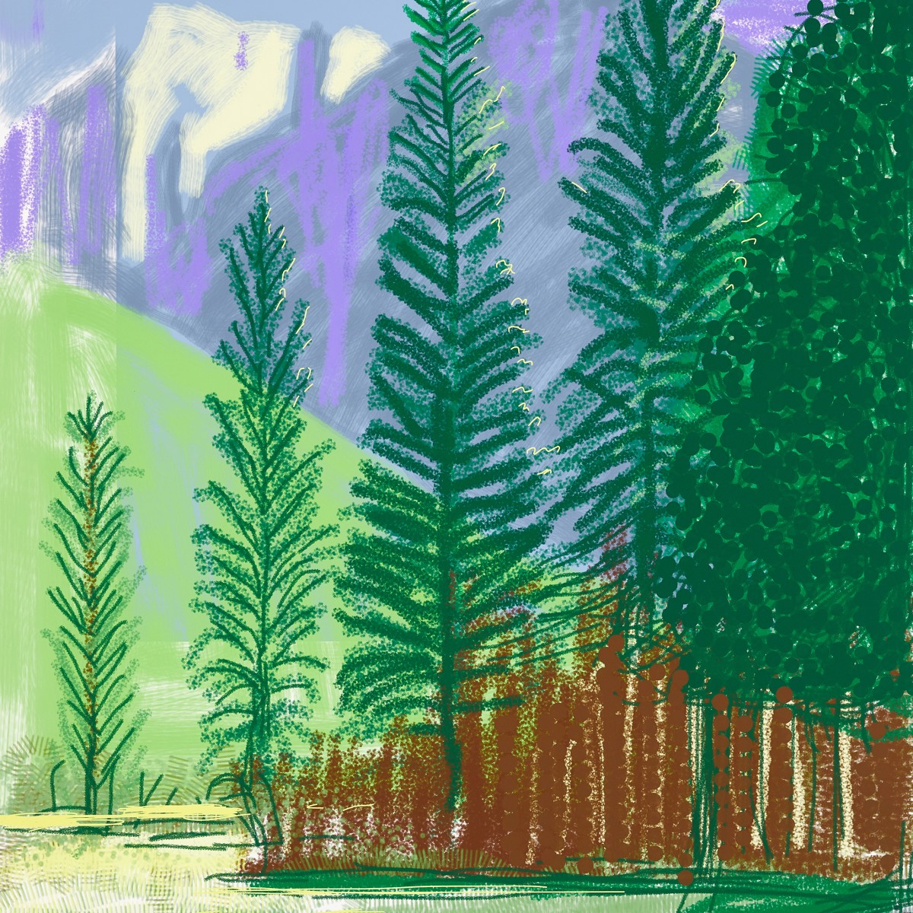
Landscape art with lines!
Curved lines
Dotted lines
Straight lines

Slide 27
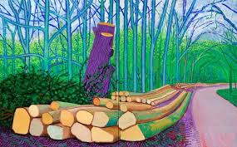
Landscape art with lines!
Straight lines
Curved lines

Slide 28
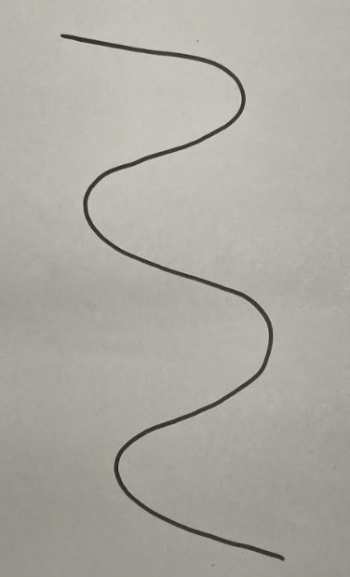
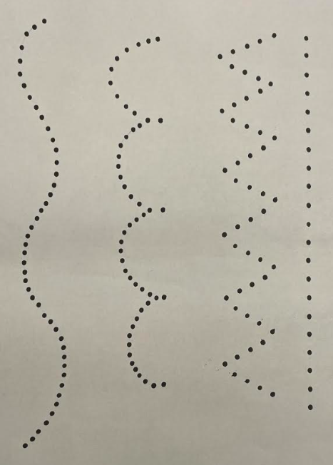
Line art
There are four main types of lines people use when drawing.
1. A straight line
2. A curved line
3. A zig zag line
4. A dotted line

Slide 29
Straight line
This is a straight line. I used my ruler to make sure my line was straight.
Your job is to draw as many straight lines as you can on your piece of paper!
You could make your lines all different lengths and colours!

Slide 30
Curved line
This is a curved line.
Your job is to draw as many curved lines as you can on your piece of paper!

Slide 31
Zig zag line
This is a zig zag line. I used my ruler to make sure my lines were straight.
Your job is to draw as many zig zag lines as you can on your piece of paper!

Slide 32
Dotted line
These are examples of dotted lines. I used dots to create a straight line, a curved line and a zig zag line.
Your job is to draw as many dotted lines as you can on your piece of paper!

Slide 33
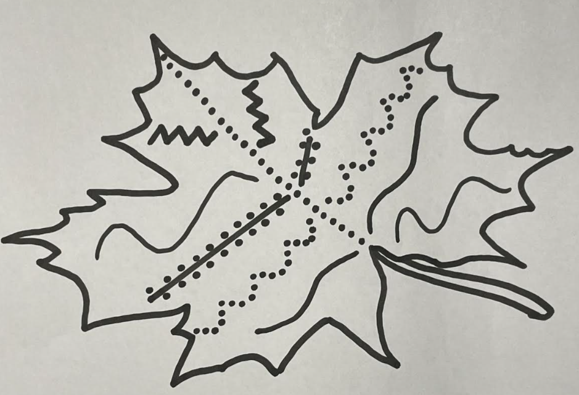
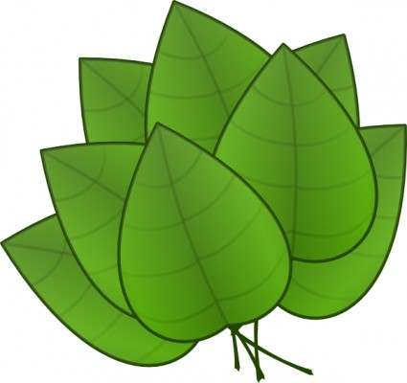
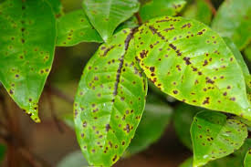
Task: To decorate a leaf using different lines
You need to decorate a leaf using the four types of lines we have been looking at this lesson.
This is my example of a leaf decorated using the different types of lines.
Remember:
Straight line
Curved line
Zig zag line
Dotted line
You can draw the outline of a leaf and decorate the inside or you can print the leaf template on the next slide and then decorate the inside.
Look at these examples of leaves decorated with different lines to give you some ideas.

Slide 34
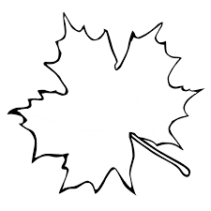
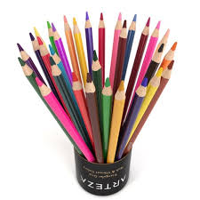
Task: To decorate a leaf using different lines
Here is a leaf outline. You can print this and decorate the inside using the four types of lines.
Why not add some colours to your leaf? Remember to use some of the different lines we have been learning about. Such as, straight, curved, dotted or zig zag.

Slide 35
Well done for all of your hard work this lesson!
Please send a photograph of you and your completed drawing to pioneerspupils@gmail.com
or deliver it to the drop box outside of school on a Friday.

Slide 36
Date: Thursday 25th February
LO To be able to use different drawing techniques.
Subject: Art & Design

Slide 37
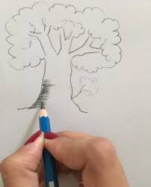
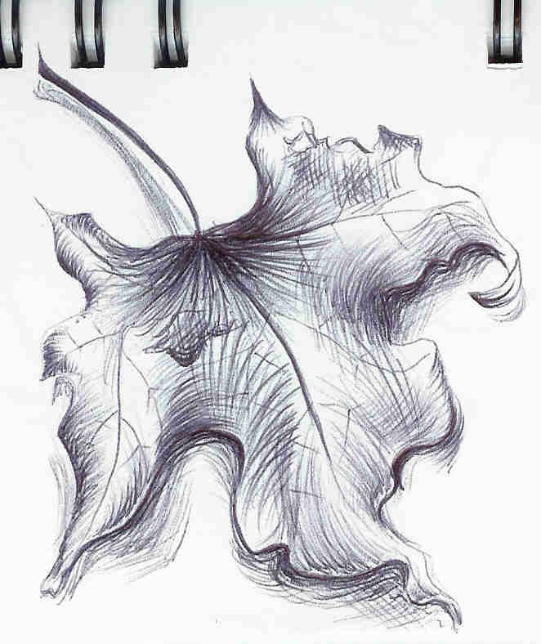
Hatching technique
What is the hatching technique? Hatching technique is when you draw lines in the same direction, evenly spread out and of the same size.
Here is another picture showing the hatching technique. Lots of lines going in the same direction.
Can you see the hatching technique? This person is drawing lines going in the same direction.

Slide 38
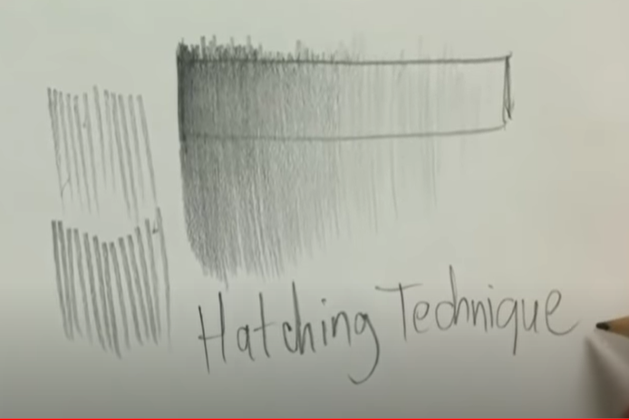
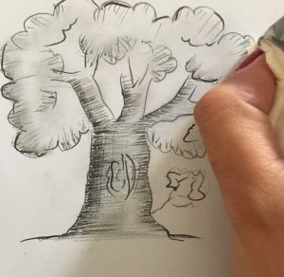
Hatching technique!
Hatching technique.
If you are unable to watch the video online you will find some step by step pictures on the next slide.
Click on the link below to watch the video on the hatching technique.
https://youtu.be/Nx6OR1wvGVQ

Slide 39
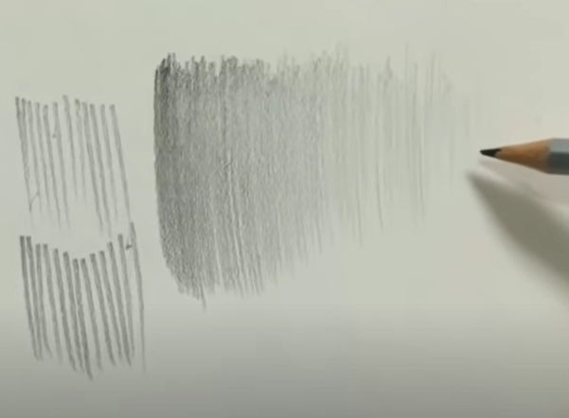
Hatching technique!
If you are unable to watch the video online, you can use these pictures as a step-by-step guide.
Step 1
Step 2
Step 1
Step 3
Step 4

Slide 40
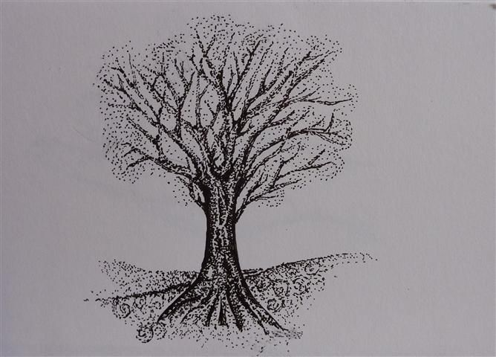
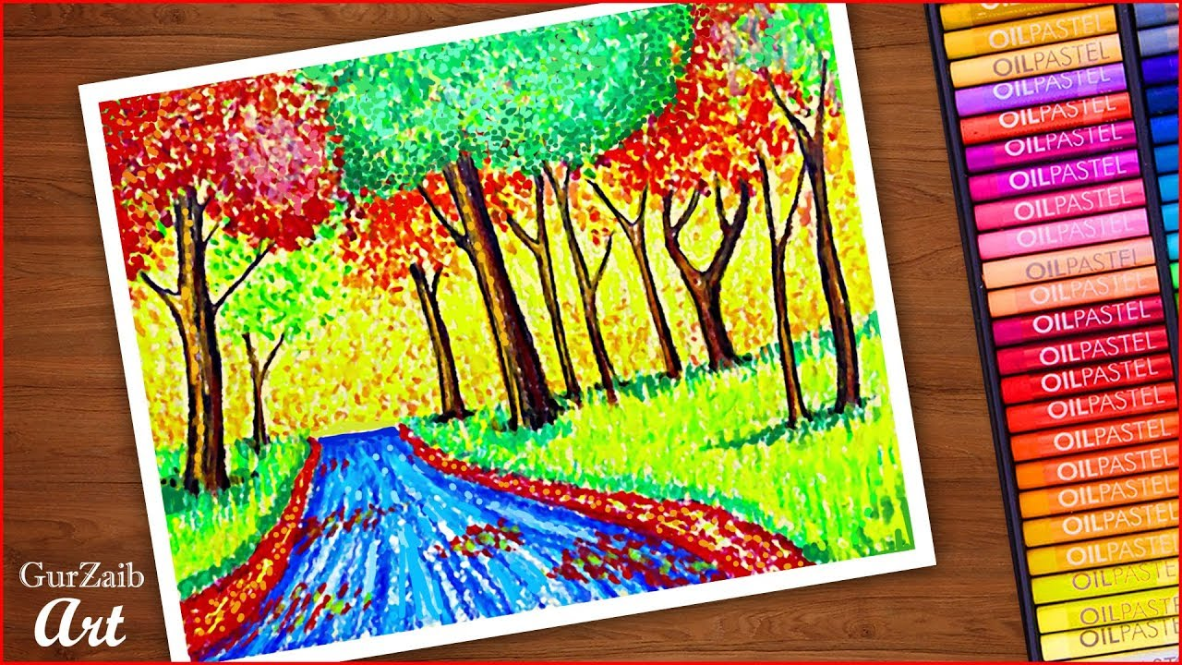
Stippling technique!
What is the stippling technique? Stippling technique is when you use lots of dots to darken or lighten an area of your artwork.
Can you see the stippling technique? In this picture they are lots of dots. This makes different parts of the picture look lighter or darker.
Can you see the stippling technique?
In this picture they have used lots of dots spread out, this makes the tree look lighter in different places.

Slide 41
Stippling technique!
Darker – more dots closer together!
Lighter – less dots spread out!

Slide 42
Stippling technique!
Click on the link below to watch the video on the stippling technique.
https://youtu.be/tMYI1wT0mB8
If you are unable to watch the video online you will find some step by step pictures on the next slide.

Slide 43
Stippling technique!
If you are unable to watch the video online, you can use these pictures as a step-by-step guide.
Step 2
Step 3
Step 1
Step 4
Step 5
Step 6

Slide 44
Task: To decorate a tree using the stippling and hatching techniques
You need to decorate a leaf using the two techniques we have been looking at this lesson.
This is my example of a tree decorated using the stippling and hatching techniques.
You can draw the outline of a tree and decorate the inside or you can print the tree template on the next slide and then decorate the inside.

Slide 45
Task: To decorate a tree using the stippling and hatching techniques
Here is an outline of a tree. You can print this and decorate the inside using the stippling and hatching techniques.
Why not add some colours to your tree?

Slide 46
Well done for all of your hard work this lesson!
Please send a photograph of you and your completed drawing to pioneerspupils@gmail.com
or deliver it to the drop box outside of school on a Friday.

Slide 47
Date: Friday 26th February
LO To be able to create a rainforest picture.
Subject: Art & Design

Slide 48
Recap- drawing different lines
On Wednesday we looked at drawing four different types of lines.
Can you remember the name of each line?
A straight line
A curved line
A zig zag line
A dotted line

Slide 49
Recap- different drawing techniques!
On Thursday we looked at two different drawing techniques.
Can you remember the name of each technique?
Stippling technique
Hatching technique

Slide 50
Creating a final piece
Now we are going to look at using the four types of lines and the stippling and hatching techniques to create a picture of the rainforest.
Lets look at some examples:
Stippling technique
Stippling technique
Straight line
Dotted line
Hatching technique
Curved line

Slide 51
Task: To create a rainforest picture.
Using the four lines and the two techniques we have learnt this week your job is to create a picture of the rainforest. Try and include all four lines and the stippling and hatching technique.
Have a look at my rainforest picture
Zig zag line
Stippling technique
Try and include:
A straight line
A zig zag line
A curved line
A dotted line
Hatching technique
Stippling technique
straight line
Dotted line
Curved line
Hatching technique

Slide 52
Well done for all of your hard work this lesson!
Please send a photograph of you and your completed drawing to pioneerspupils@gmail.com
or deliver it to the drop box outside of school on a Friday.

