Slide 1
Subject: Maths
Pack: A

Slide 2
Date: 22.02.21
LO To be able to measure in litres.
Subject: Maths

Slide 3
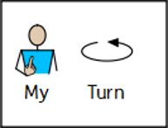
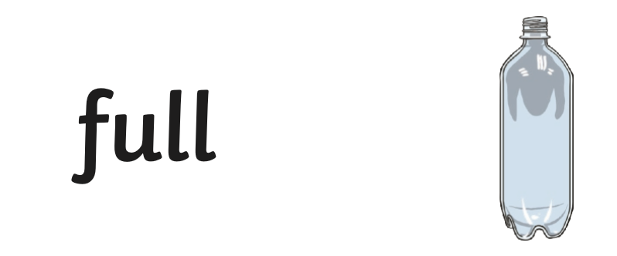
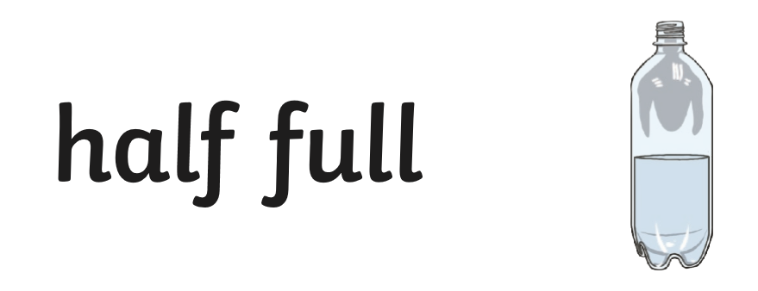
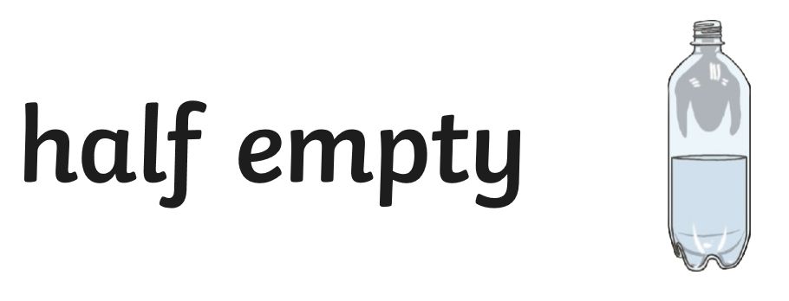
Capacity
Capacity is the amount of liquid that a container can hold.

Slide 4
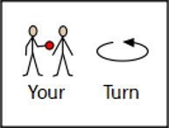
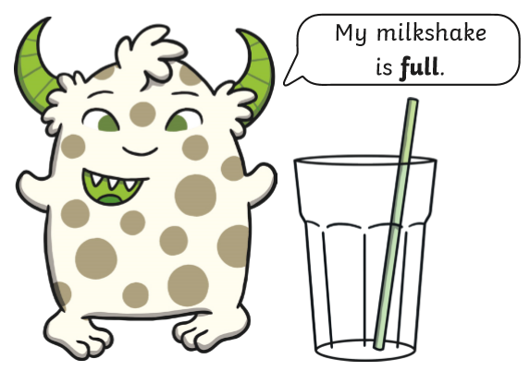
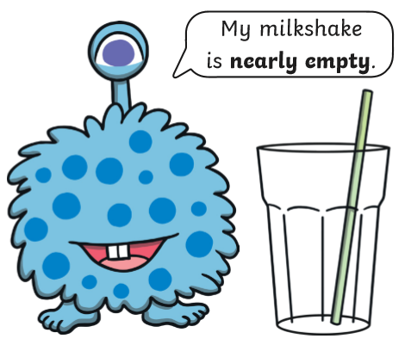
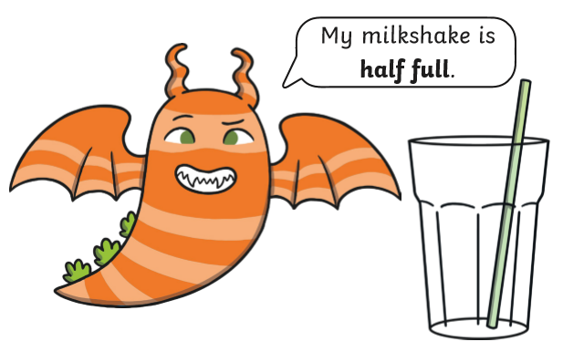
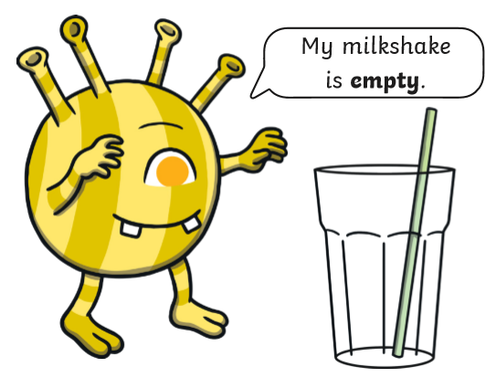
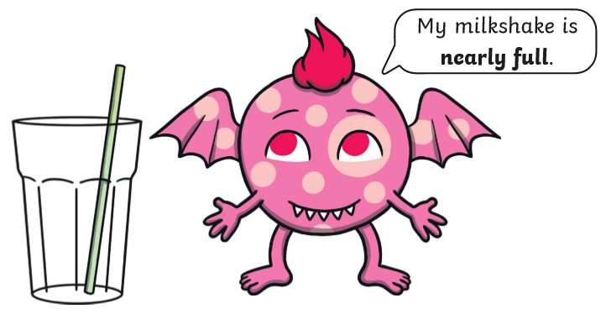
Capacity Warm Up
Capacity is the amount of liquid that a container can hold.
Colour in the monsters milkshakes to match what they are saying:

Slide 5
Pre-recorded Teaching
Access the online teaching video below that will support you to complete the work in this lesson. This video will act as a support but all of the work can still be successfully understood & completed using paper-based versions of this pack. If you need further support to understand / complete work then please contact school via e-mail or telephone.
Play Video

Slide 6
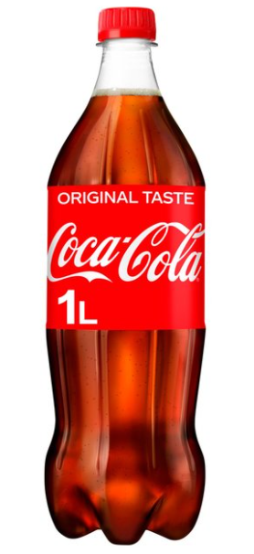
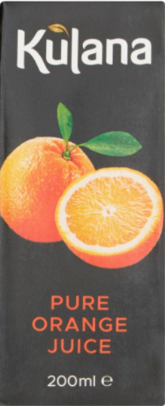
Capacity
Capacity is measured in litres and millilitres.
Litres is written as a ‘L’ for short. This is how we will often see it on packaging.
Millilitres is written as ‘ml’ for short. This is how we will often see it on packaging.

Slide 7
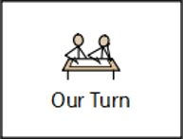
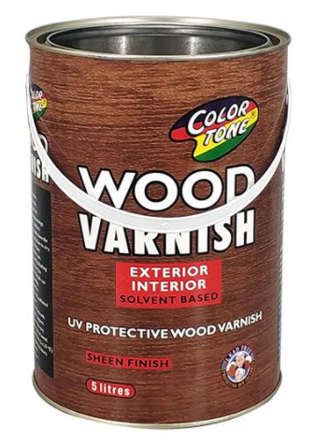
Litres
How many litres are there?
Paint is measured in litres.
How much paint is in the tin?

Slide 8
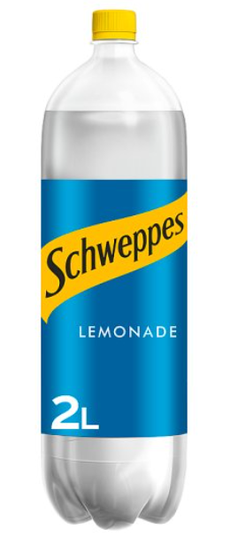
Litres
How many litres are there?
Lemonade can be measured in litres when it is in large bottles.
How much lemonade is in the bottle?

Slide 9
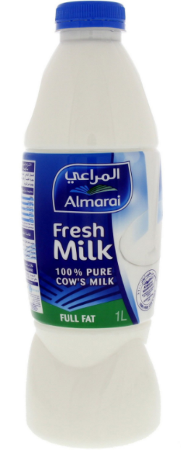
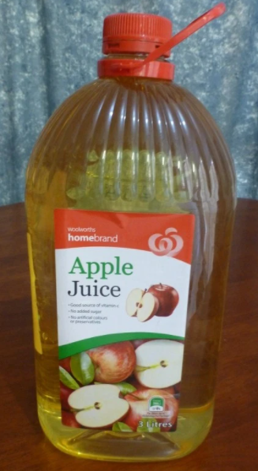
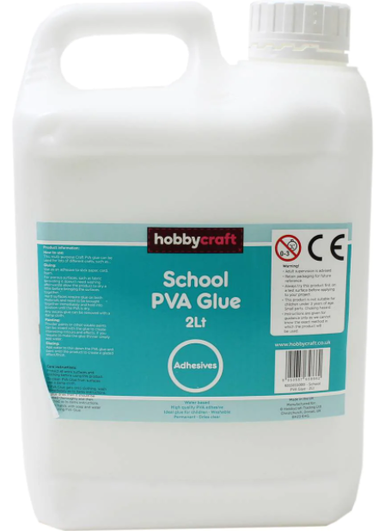
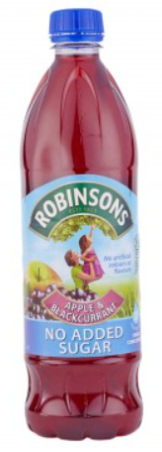
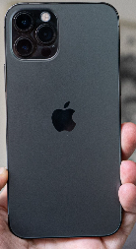
Practical Task
What packaging can you find in your house that is measured in litres?
Remember – Litres can be shown as ‘L’ on packaging.
Examples:
Find packaging in your house that contains things measured in litres.
Write the items you found below:
Email a photo of you hunting for items measured in ‘litres’ to
pioneerspupils@gmail.com so that you can be in our weekly Facebook post!

Slide 10
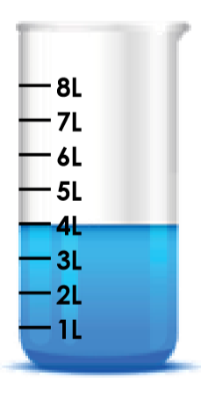
Reading Capacity in Litres
How many litres of rainforest water is being held in the container?
Look closely at the water level to read how much rainforest water there is…
We know that ‘L’ stands for litres.
4L
There is ________ of rainforest water in the container.

Slide 11
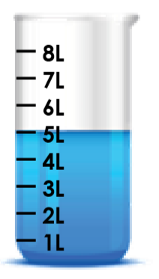
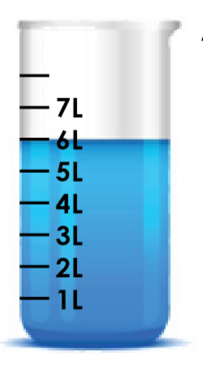
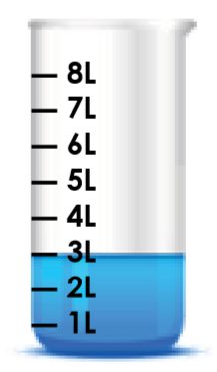
Reading Capacity in Litres
Don’t forget, you need to have ‘L’ in your answer.
How many litres of rainforest water is being held in the container?
There is ________ of rainforest water in the container.
There is ________ of rainforest water in the container.
There is ________ of rainforest water in the container.

Slide 12
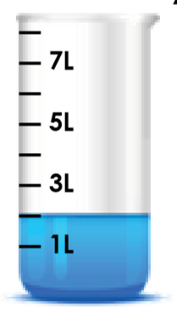
Reading Capacity in Litres
How many litres of rainforest water is being held in the container?
8L
Look closely at the water level to read how much rainforest water there is…
We need to find out the intervals the container is going up in.
6L
We know that the first two amounts on the container are 1L and 3L.
4L
4L
2L
1L
2L
3L
There is ________ of rainforest water in the container.
So we know that each marker is counting in 1’s because the number between 1 and 3 is 2.

Slide 13
Reading Capacity in Litres
How many litres of rainforest water is being held in the container?
Look closely at the water level to read how much rainforest water there is…
We know that ‘L’ stands for litres.
There is ________ of rainforest water in the container.

Slide 14
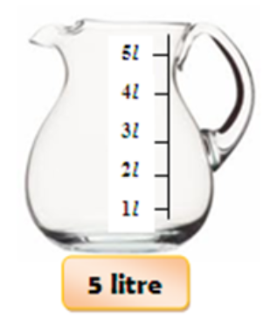
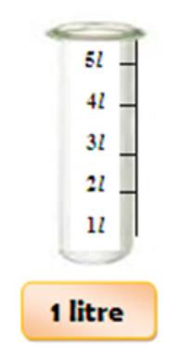
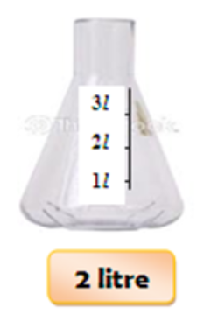
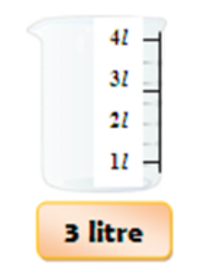
Litres
Draw and colour the correct amount of juice in each container.

Slide 15
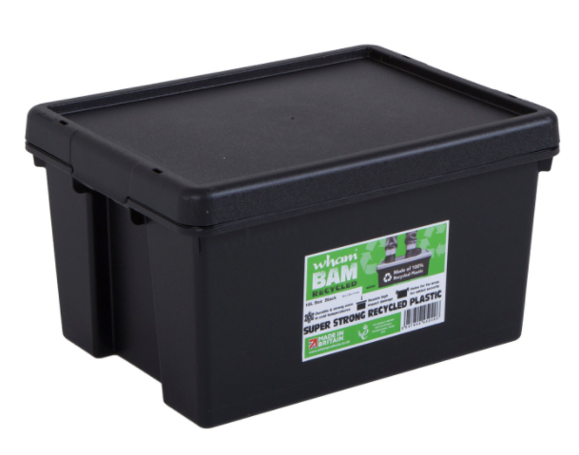
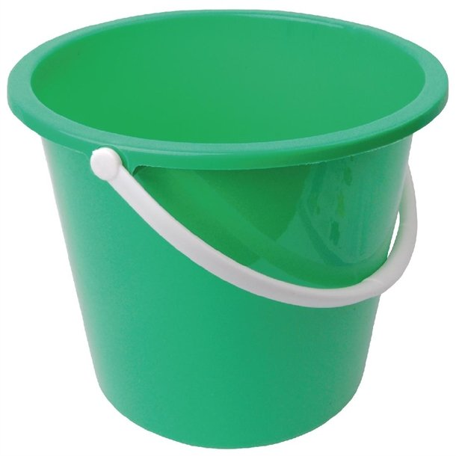
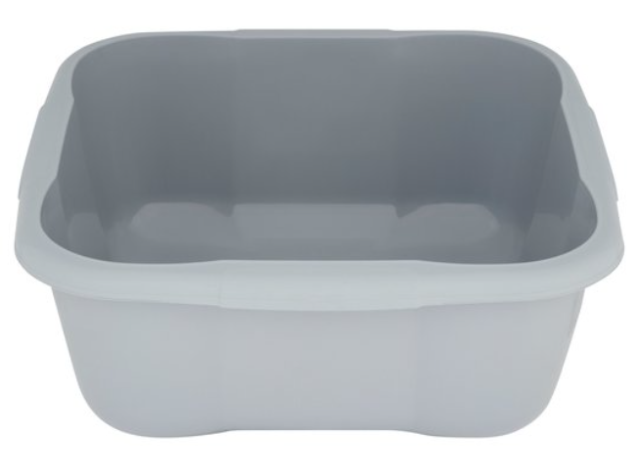
Practical Task
How many litres does the large container hold?
Find a large container/bucket in your house. Measure out a litre at a time using your measuring cylinder/measuring jug and pour it into your container. Continue to do this until the container is full.
Email a photo of you measuring in litres to:
pioneerspupils@gmail.com so that you can be in our weekly Facebook post!

Slide 16
Challenge!
Have a go at these problems…

Slide 17
Challenge
How do you know?
is the odd one out because…

Slide 18
Tricky Challenge

Slide 19
Well done for all of your hard work this lesson!
Please send any completed work/photographed evidence of completed work (practical activities) to pioneerspupils@gmail.com or deliver it to the dropbox outside of school on a Friday.

Slide 20
Date: 23.02.21
LO To be able to measure in millilitres.
Subject: Maths

Slide 21
Recap - Capacity
Capacity is measured in litres and millilitres.
Litres is written as a ‘L’ for short. This is how we will often see it on packaging.
Millilitres is written as ‘ml’ for short. This is how we will often see it on packaging.

Slide 22
Pre-recorded Teaching
Access the online teaching video below that will support you to complete the work in this lesson. This video will act as a support but all of the work can still be successfully understood & completed using paper-based versions of this pack. If you need further support to understand / complete work then please contact school via e-mail or telephone.
Play Video

Slide 23
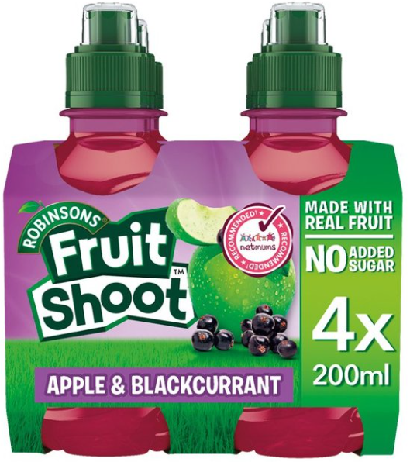
Millilitres
How many millilitres are there?
Juice is measured in millilitres.
How much juice is in a fruit shoot bottle?

Slide 24
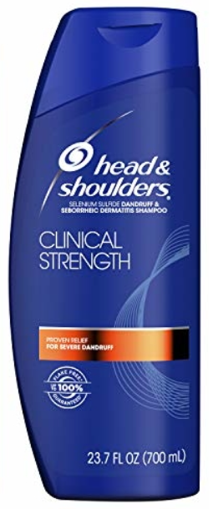
Millilitres
How many millilitres are there?
Shampoo is measured in millilitres.
How much shampoo is in the bottle?

Slide 25
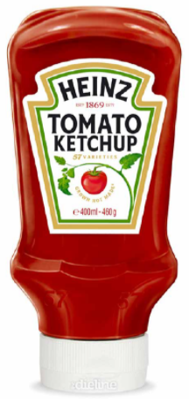
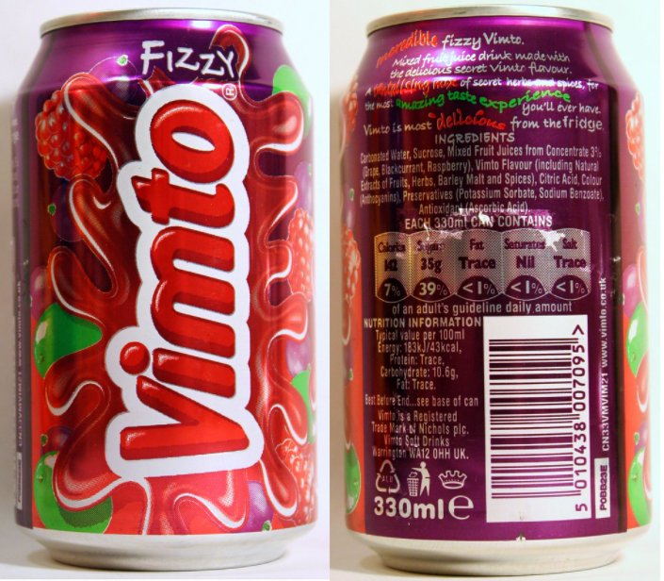
Practical Task
What packaging can you find in your house that is measured in millilitres?
Remember – Millilitres can be shown as ‘ml’ on packaging.
Examples:
Find packaging in your house that contains things measured in millilitres.
Write the items you found below:
Email a photo of you hunting for items measured in ‘millilitres’ to
pioneerspupils@gmail.com so that you can be in our weekly Facebook post!

Slide 26
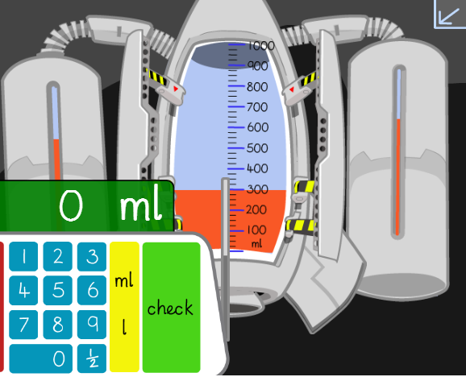
Reading Capacity in Millilitres
How much rocket fuel is stored in the tank?
Look closely at the fuel level to read how much rocket fuel there is…
We know that ‘ml’ stands for millilitres.
There is ________ of fuel in the rocket tank.
300ml

Slide 27
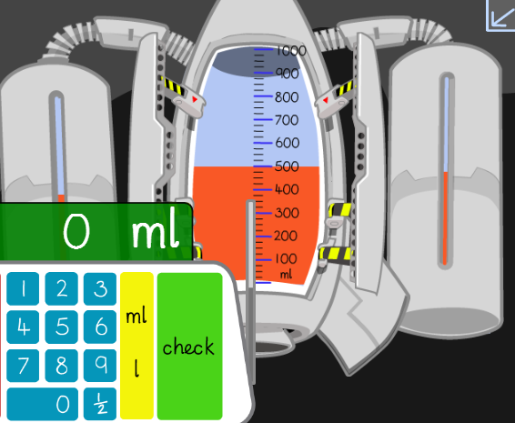
Reading Capacity in Millilitres
How much rocket fuel is stored in the tank?
Look closely at the fuel level to read how much rocket fuel there is…
We know that ‘ml’ stands for millilitres.
There is ________ of fuel in the rocket tank.

Slide 28
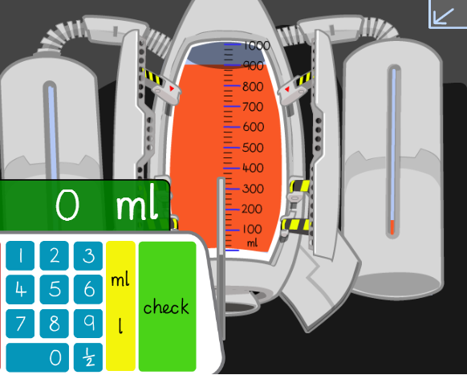
Reading Capacity in Millilitres
How much rocket fuel is stored in the tank?
Look closely at the fuel level to read how much rocket fuel there is…
We know that ‘ml’ stands for millilitres.
There is ________ of fuel in the rocket tank.

Slide 29
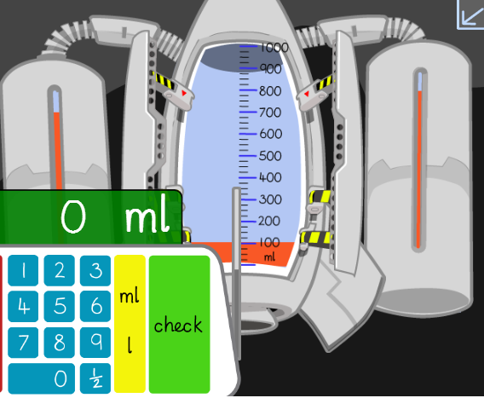
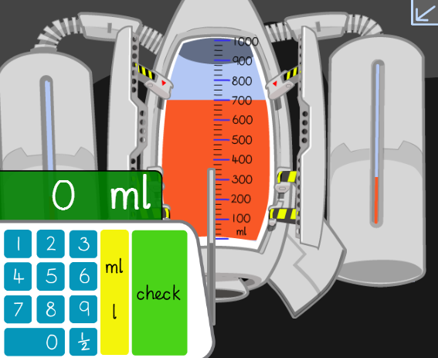
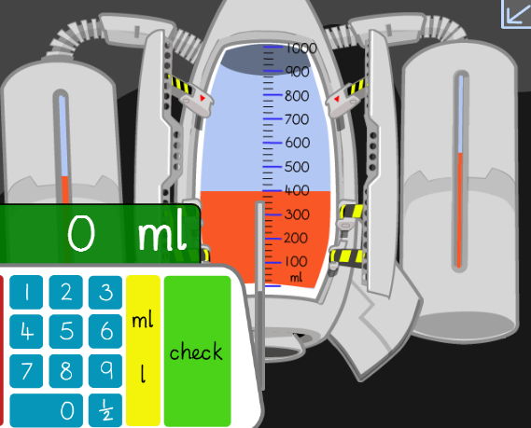
Reading Capacity in Millilitres
How much rocket fuel is stored in the tank?
Make sure you have written ‘ml’ after the number in your answer.

Slide 30
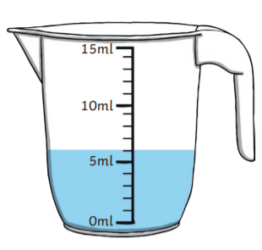
Reading Capacity in Millilitres
How much water has been collected from the waterfall?
Look closely at the water level to read how much waterfall water there is…
We know that ‘ml’ stands for millilitres.
6ml
We know that each of the little lines on the jug is 1ml because if we count in 1’s up to 5, it matches up with the 5ml mark.
4ml
3ml
2ml
1ml
6ml
There is ________ of waterfall water in the jug.

Slide 31
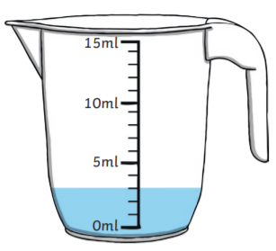
Reading Capacity in Millilitres
How much water has been collected from the waterfall?
Look closely at the water level to read how much waterfall water there is…
We know that ‘ml’ stands for millilitres.
We know that each of the little lines on the jug is 1ml because if we count in 1’s up to 5, it matches up with the 5ml mark.
There is ________ of waterfall water in the jug.

Slide 32
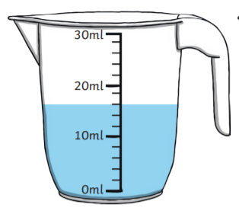
Reading Capacity in Millilitres
How much water has been collected from the waterfall?
Look closely at the water level to read how much waterfall water there is…
We know that ‘ml’ stands for millilitres.
16ml
14ml
12ml
We know that each of the little lines on the jug is 2ml because if we count in 2’s up to 10, it matches up with the 10ml mark.
8ml
6ml
4ml
2ml
16ml
There is ________ of waterfall water in the jug.

Slide 33
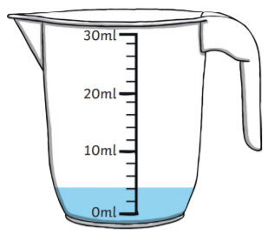
Reading Capacity in Millilitres
How much water has been collected from the waterfall?
Look closely at the water level to read how much waterfall water there is…
We know that ‘ml’ stands for millilitres.
We know that each of the little lines on the jug is 2ml because if we count in 2’s up to 10, it matches up with the 10ml mark.
There is ________ of waterfall water in the jug.

Slide 34
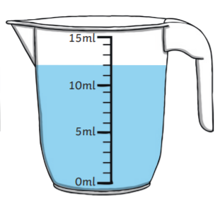
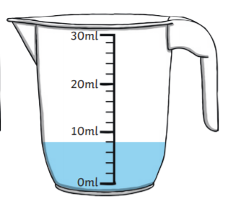
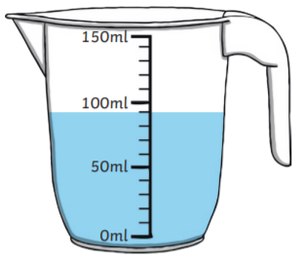
Reading Capacity in Millilitres
How much water has been collected from the waterfall?
Don’t forget to write ‘ml’ after the number in your answer.
There is _____________ of waterfall water in the jug.
There is _____________ of waterfall water in the jug.
Hint: 10’s may help!
There is _____________ of waterfall water in the jug.

Slide 35
Challenge!
Have a go at these problems…

Slide 36
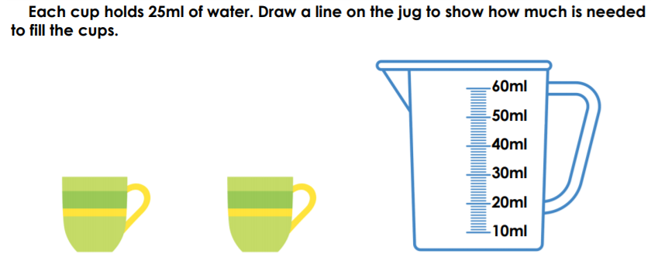
Challenge
Explain your answer on the lines.
Sam is . I know
this because

Slide 37
Tricky Challenge!
For example:
Write the combinations on the lines.

Slide 38
Well done for all of your hard work this lesson!
Please send any completed work/photographed evidence of completed work (practical activities) to pioneerspupils@gmail.com or deliver it to the dropbox outside of school on a Friday.

Slide 39
Date: 24.02.21
LO To be able to compare and order litres and millilitres.
Subject: Maths

Slide 40
Comparing millilitres and litres
One litre is made up of 1000 millilitres!
1000ml = 1L
The abbreviation for millilitres is ‘ml’ and the abbreviation for litres is ‘L’.
The maximum capacity for this cylinder is 1 litre.
Maximum capacity is the highest amount that something can contain.

Slide 41
What do we measure in millilitres and litres?
We use millilitres and litres to measure volume and capacity. Capacity is the amount of liquid a container can hold and volume is how much liquid is in the container. Depending on the amount of liquid we are measuring, will depend if we need to measure it in millilitres (ml) or litres (L).
Let's take a look at some examples!
What we would measure in millilitres (ml)
What we would measure in litres (L)
Can of pop
Cup of tea
Bottle of orange squash
Carton of milk

Slide 42
Measuring your own liquids!
Using a measuring jug or cylinder which measures in millilitres, have a go at measuring some liquids. Here are some measurements for you to measure out:
100ml
500ml
750ml
1 L
Here are some examples of what to measure your liquids in!
Don’t worry if you don’t have a measuring jug, school can provide one if you don’t have one to use at home.
Measuring Jug
Measuring
Cylinder
Email a photo of you measuring different liquids to:
pioneerspupils@gmail.com so that you can be in our weekly Facebook post!

Slide 43
Try these!
What do these liquids measure? Write your answers on the line.

Slide 44
Pre-recorded Teaching
Access the online teaching video below that will support you to complete the work in this lesson. This video will act as a support but all of the work can still be successfully understood & completed using paper-based versions of this pack. If you need further support to understand / complete work then please contact school via e-mail or telephone.
Play Video

Slide 45
Measuring Cylinders
We have learned that there are 1000 millilitres (ml) in 1 litre (L), therefore we know that anything under 1000 millilitres is smaller than 1 litre (L).
Take a close look at this measuring cylinder which measures up to 1000ml which equals to 1 L.
This measuring cylinder begins at 100ml and goes all the way up to 1000ml
100ml, 200ml, 300ml, 400ml, 500ml, 600ml, 700ml, 800ml, 900ml, 1000ml
The lines in between the numbers represent the numbers in between going up in tens:
100, 110, 120, 130, 140, 150, 160, 170, 180, 190, 200

Slide 46
Ordering millilitres and litres
Let’s take a look at how we order millilitres and litres:
This can of pop holds 330ml
This bottle of shampoo holds 450ml
This carton of apple juice holds 950ml
This bottle of water holds 2L.
These items are liquids that are measured in millilitres or litres. They have been ordered for you. The can of pop holds 330ml which is the smallest amount and the bottle of water holds 2L which is the largest amount.
2L is equal to 2000ml as we already know that 1L = 1000ml

Slide 47
Let’s order them together!
Remember – 1L is the same as 1000ml.
Can you order these amounts?
(drag the amounts into the boxes in order)
75ml
1L
Smallest
Largest
600ml
250ml

Slide 48
Your turn!
Remember – 1L is the same as 1000ml.
Can you order these amounts?
(drag the amounts into the boxes in order)
Smallest
Largest
5L
725ml
500ml
25ml

Slide 49
Your turn!
Remember – 1L is the same as 1000ml.
Can you order these amounts?
(drag the amounts into the boxes in order)
Smallest
Largest
1L
1200ml
900ml
4L

Slide 50
Your turn!
Remember – 1L is the same as 1000ml.
Can you order these amounts?
(drag the amounts into the boxes in order)
Smallest
Largest
2L
1100ml
800ml
2400ml

Slide 51
Practical Task
Find some different liquids in your house that are measured in ml’s or L’s.
Order your amounts from least capacity to most capacity.
Send us some photographs!
For example:
200ml
330ml
400ml
700ml
Email a photo of you hunting for items measured in ‘millilitres’ to
pioneerspupils@gmail.com so that you can be in our weekly Facebook post!

Slide 52
Have a go at these!
Using <, > and = symbols, work out the following tasks!
(Drag the symbols into the right box)
>
<
=
Remember: the open side of the symbol points at the larger amount!
More than
Less than
Equal to

Slide 53
Which orange juice measures the least and which measures the most?
A.
B.
C.
300ml
Explain your thoughts below
1L
650ml

Slide 54
Challenge!
Have a go at these problems…

Slide 55
Challenge

Slide 56
Tricky Challenge

Slide 57
Well done for all of your hard work this lesson!
Please send any completed work/photographed evidence of completed work (practical activities) to pioneerspupils@gmail.com or deliver it to the dropbox outside of school on a Friday.

Slide 58
Date: 25.02.21
LO: To be able to create a rainforest potion.
Subject: Maths

Slide 59
Rainforest Potion
Today we are going to measure out different amounts to make our own rainforest potions!
First, I am going to mix lots of things together from the rainforest to make a potion.
To create my potion, I’m going to be measuring in millilitres (ml’s).

Slide 60
Pre-recorded Teaching
Access the teaching video by Miss Malloy that will support you to complete the work in this lesson. This video will act as a support but all of the work can still be successfully understood & completed using paper-based versions of this pack. If you need further support to understand / complete work then please contact school via e-mail or telephone.
Play the video from the school website.

Slide 61
Rainforest Potion
Your Task: Measure the volume of each ingredient to create your own rainforest potion. You can be as creative as you like when naming your ingredients.
1. First, to make a rainforest potion, you need some different liquids that you can name after something you would find in the rainforest. This could water with different colouring in or it could be different coloured liquids (e.g. coke, orange juice, blackcurrant, washing up liquid etc.
2. Next, pour the ingredients into separate containers. Each ingredient needs to be a different volume that is accurately measured in millilitres (ml).
3. Finally, mix your ingredients together in a container or a bottle. Then, add a sprinkle of something from the rainforest! (E.g. glitter, crushed cereal, sugar etc.)

Slide 62
My Rainforest Potion
80ml of squashed tree frogs
200ml of crushed, ripe bananas
50ml of destroyed tree bark
65ml of liquefied bugs
1 sprinkle of blue morpho butterfly dust

Slide 63
Your Rainforest Potion
Write the ingredients for your rainforest potion.
Make sure to measure each of your ingredients accurately, making sure they are each different amounts.
Email us photos of you measuring your ingredients, making your potion and the final product to
pioneerspupils@gmail.com
so that you can be in our weekly Facebook post!

Slide 64
Comparing Ingredients
80ml of squashed tree frogs
200ml of crushed, ripe bananas
50ml of destroyed tree bark
65ml of liquefied bugs
1 sprinkle of blue morpho butterfly dust
I am going to use the words more and less to complete the statements about my potion:
more
There is ___________ liquefied bugs than destroyed tree bark in the potion.
less
There is ___________ liquefied bugs than squashed tree frogs in the potion.

Slide 65
Comparing Ingredients
80ml of squashed tree frogs
200ml of crushed, ripe bananas
50ml of destroyed tree bark
65ml of liquefied bugs
1 sprinkle of blue morpho butterfly dust
I am going to use the words more and less to complete the statements about my potion:
There is ___________ destroyed tree bark than crushed, ripe bananas in the potion.
There is ___________ squashed tree frogs than liquefied bugs in the potion.

Slide 66
Comparing Ingredients
80ml of squashed tree frogs
200ml of crushed, ripe bananas
50ml of destroyed tree bark
65ml of liquefied bugs
1 sprinkle of blue morpho butterfly dust
Use the symbols <, > or = to complete the statements:
Remember, the wider, open side of the symbol needs to face the larger capacity.
<
Destroyed tree bark
Liquefied bugs
Squashed tree frogs
>
Liquefied bugs

Slide 67
Comparing Ingredients
80ml of squashed tree frogs
200ml of crushed, ripe bananas
50ml of destroyed tree bark
65ml of liquefied bugs
1 sprinkle of blue morpho butterfly dust
Use the symbols <, > or = to complete the statements:
Remember, the wider, open side of the symbol needs to face the larger capacity.
Crushed, ripe bananas
Destroyed tree bark
Squashed tree frogs
Crushed, ripe bananas

Slide 68
Comparing Ingredients
Write 3 of your own statements, use the symbols
<, > or = that link to the ingredients in your
own potion:
For example:
Remember, the wider, open side of the symbol needs to face the larger capacity.
Crushed, ripe bananas > Destroyed tree bark

Slide 69
Challenge!
Have a go at these problems…

Slide 70
Challenge
What is the total volume of your potion?
Don’t forget – your total amount needs to be in ml’s or L’s.
Add together the amount of each of your ingredients to find the total…
Total =

Slide 71
Tricky Challenge
For example: C + C + C + C = B

Slide 72
Well done for all of your hard work this lesson!
Please send any completed work/photographed evidence of completed work (practical activities) to pioneerspupils@gmail.com or deliver it to the dropbox outside of school on a Friday.

Slide 73
Date: 26.02.21
LO To be able to read temperature in degrees Celsius.
Subject: Maths

Slide 74
Temperature
Temperature is how hot or cold something is.
Temperature is measured by a thermometer.
Thermometers can look like this:

Slide 75
Thermometers
Thermometers can be used to check the temperature of lots of different things.
This can include:
How hot or cold our bodies are
The temperature of the air outside
How hot food is that has been in the oven

Slide 76
Degrees Celsius
Temperature is measured in degrees Celsius.
‘Degrees Celsius’ are long words so we can write degrees Celsius as
When water is 0˚C, it freezes to form ice.
When water is 100˚C, it boils and starts to evaporate, creating steam.

Slide 77
Pre-recorded Teaching
Access the online teaching video below that will support you to complete the work in this lesson. This video will act as a support but all of the work can still be successfully understood & completed using paper-based versions of this pack. If you need further support to understand / complete work then please contact school via e-mail or telephone.
Play Video

Slide 78
Reading Temperature
The thermometer goes up in intervals of 2˚C.
The line where the colour changes shows the temperature on the thermometer.
If we look at the numbers 0˚C and 4 ˚C, there is a line half way between the numbers.
1
2
3
4
0˚C
The temperature is ________ .
2 is in the middle of the two numbers so we know the thermometer goes up in intervals of 2.

Slide 79
Reading Temperature
The thermometer goes up in intervals of 2˚C.
The line where the colour changes shows the temperature on the thermometer.
We look at the line where the colour changes to work out the temperature.
The temperature is ________ .
Write the temperature here – don’t forget to write ˚C.

Slide 80
Reading Temperature
The thermometer goes up in intervals of 2˚C.
The line where the colour changes shows the temperature on the thermometer.
The temperature is ________ .
Write the temperature here – don’t forget to write ˚C.

Slide 81
Reading Temperature
The thermometer goes up in intervals of 2˚C.
The line where the colour changes shows the temperature on the thermometer.
The temperature is ________ .
Write the temperature here – don’t forget to write ˚C.

Slide 82
Reading Temperature
The thermometer goes up in intervals of 2˚C.
The line where the colour changes shows the temperature on the thermometer.
The temperature is ________ .
Write the temperature here – don’t forget to write ˚C.

Slide 83
Reading Temperature
The thermometer goes up in intervals of 2˚C.
If the colour change line is below the 0, we know the temperature is going to be a minus number.
The line where the colour changes shows the temperature on the thermometer.
A minus number has a – sign in front of the number.
-4˚C
The temperature is ________ .

Slide 84
Reading Temperature
The thermometer goes up in intervals of 2˚C.
The line where the colour changes shows the temperature on the thermometer.
If the colour change line is below the 0, we know the temperature is going to be a minus number.
A minus number has a – sign in front of the number.
Write the temperature here – don’t forget to write ˚C.
The temperature is ________ .

Slide 85
Reading Temperature
The thermometer goes up in intervals of 2˚C.
The line where the colour changes shows the temperature on the thermometer.
If the colour change line is below the 0, we know the temperature is going to be a minus number.
A minus number has a – sign in front of the number.
Write the temperature here – don’t forget to write ˚C.
The temperature is ________ .

Slide 86
Reading Temperature
The thermometer goes up in intervals of 2˚C.
The line where the colour changes shows the temperature on the thermometer.
If the colour change line is below the 0, we know the temperature is going to be a minus number.
A minus number has a – sign in front of the number.
Write the temperature here – don’t forget to write ˚C.
The temperature is ________ .

Slide 87
Reading Temperature
The thermometer goes up in intervals of 2˚C.
We know we need to count up the intervals in 2’s to find the numbers on the thermometer that aren’t labelled.
6
2
The line where the colour changes shows the temperature on the thermometer.
6˚C
So the temperature is ________ .

Slide 88
Reading Temperature
The thermometer goes up in intervals of 2˚C.
14
10
We know we need to count up the intervals in 2’s to find the numbers on the thermometer that aren’t labelled.
6
2
The line where the colour changes shows the temperature on the thermometer.
So the temperature is ________ .
Write the temperature here – don’t forget to write ˚C.

Slide 89
Reading Temperature
Don’t forget to write ˚C after your temperature!
Write the temperatures under the thermometers:
Temperature = ________ .
Temperature = ________ .
Temperature = ________ .
Temperature = ________ .

Slide 90
Practical Task
Can you make a liquid (e.g. water, juice etc) change temperature with your adult at home.
Make a drink that you like at home – what temperature is it?
Can you boil it? – what temperature is it now?
3. Can you freeze it? – what temperature is it now?
Email photos of you changing the temperature of your liquid to
pioneerspupils@gmail.com so that you can be in our weekly Facebook post!

Slide 91
Challenge!
Have a go at these problems…

Slide 92
Challenge
Lowest
Highest

Slide 93
Tricky Challenge

Slide 94
Well done for all of your hard work this lesson!
Please send any completed work/photographed evidence of completed work (practical activities) to pioneerspupils@gmail.com or deliver it to the dropbox outside of school on a Friday.

