Slide 1
Hello reception, we hope that you enjoyed your home learning last week and had some great fun with the activities. Here you can find your home learning pack for this week.
We have put together some new exciting activities to learn about while you are at home this week. We have kept the phonics section in your pack this week with some ideas on how you can keep learning your sounds at home. As well as this, this week you can pick up your set of phonics cards from school to use at home. The group A pack contains set 1 letter cards and word cards and group B contains set 2 letter cards, word cards and new Ditty Book stories. Group B check out the new video clips on the phonics page.
Again, we are always here to help and support you with your learning.
We hope you have lots of fun and enjoy your home learning. From the reception staff.
*TOP TIP- DON'T USE SLIDE SHOW TO VIEW THIS POWERPOINT*

Slide 2
Parent Guidance
We hope we find you safe and well during these difficult times. We recognise that home learning provides its own challenges and is not always easy. We have put together some daily learning for your children. They have several activities for each day which will hopefully keep their learning moving forward. As the children are still so little the activities will need to be supported by an adult. All children learn differently and at different paces, as well as needing different levels of support. Some children may just need you to be with them while others may need you to write things out for them and support them step by step. All of this is fine. We want the activities to be fun for everybody, including yourselves. ☺
When completing this weeks work please make sure it is completed either on the PowerPoint, or if this isn’t possible written onto paper. This will be used as evidence that the home learning is being completed.
The reception staff at school are always here for you and are ready to help with any queries that you may have. If you have any problems please get in touch via the methods below and we will get back to you as soon as we can.
Email: explorerspupils@gmail.com
Telephone: 01429 820594
Hopefully we will see you all in person really soon, stay safe. The reception team.
Monday | Tuesday | Wednesday | Thursday | Friday
1 phonics activity English Maths Topic | 1 phonics activity English Maths Topic | 1 phonics activity English Maths Topic | 1 phonics activity English Maths Topic | 1 phonics activity English Maths Topic

Slide 3
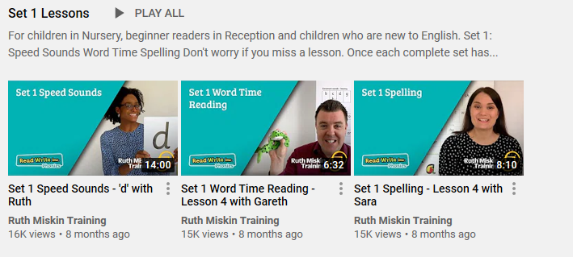
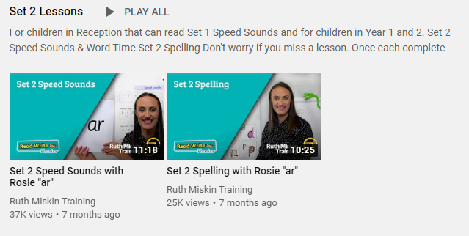
https://www.youtube.com/channel/UCo7fbLgY2oA_cFCIg9GdxtQ?mc_cid=71ef745098&mc_eid=c9705b8c67
Phonics information for remote learning.
Group A
Group B
At school, the children have daily phonics sessions to teach the letter sounds. In Term 1, reception children were taught all set 1 sounds, how to split simple words into sounds and how to blend sounds together to make words. All children will be at different stages with which sounds they can remember but it will still be beneficial to recap sounds already taught.
The image above is an example of the videos which are available through Read Write Inc on their YouTube channel for you to access daily from home (See link below). The videos will change daily for both Set 1 and Set 2 sounds.
S sSubject: Phonics

Slide 4
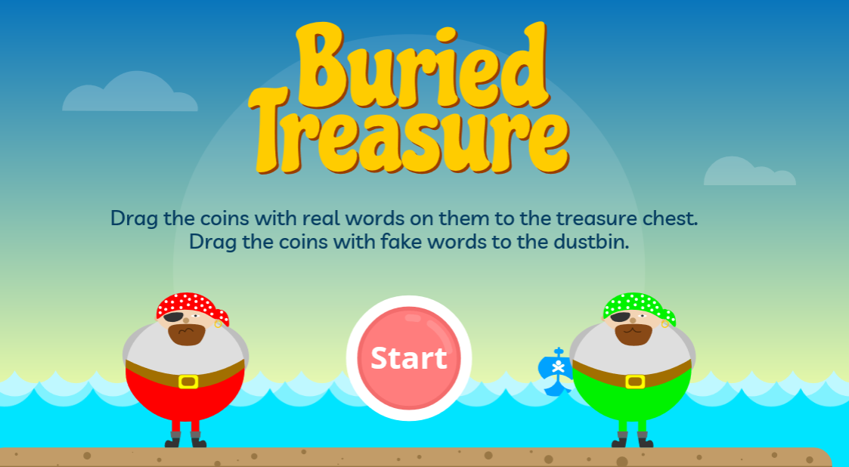
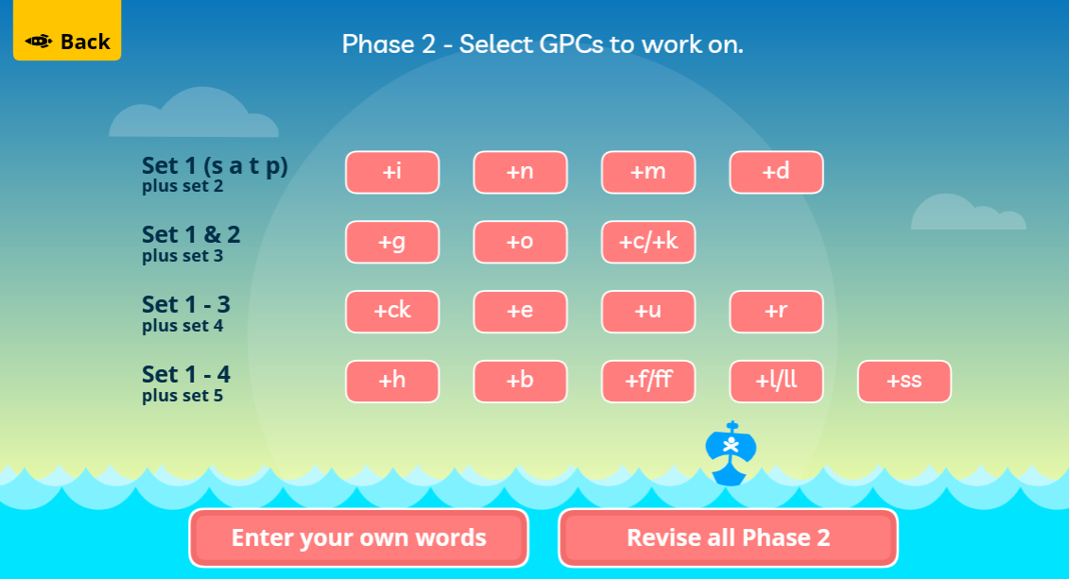
Phonics information for remote learning.
Here are some links to online phonics games you can play with your child at home.
Buried treasure
https://www.phonicsplay.co.uk/resources/phase/2/buried-treasure
After clicking start, choose phase 2 and revise all phase 2 sounds.

Slide 5
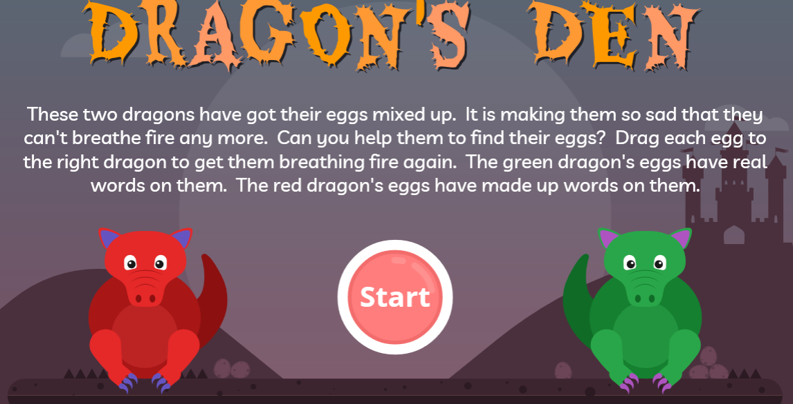
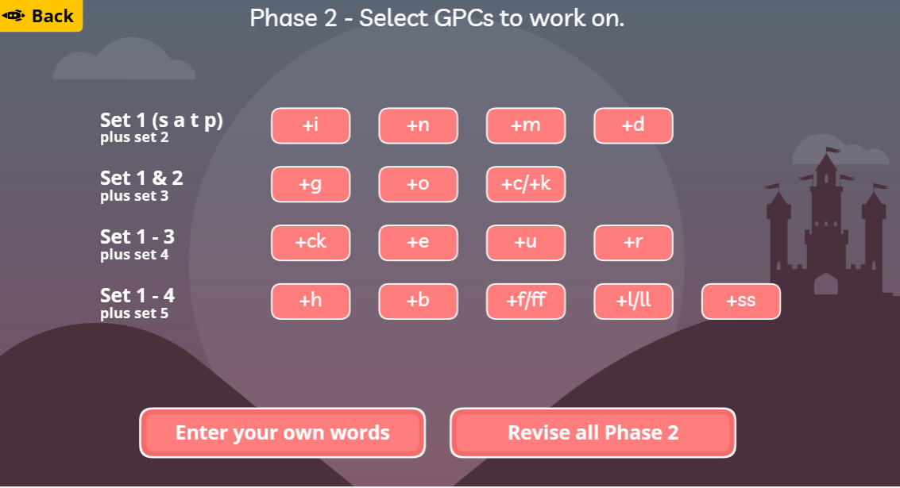
Phonics information for remote learning.
Here are some links to online phonics games you can play with your child at home.
Dragon's Den
https://www.phonicsplay.co.uk/resources/phase/2/dragons-den
After clicking start, choose phase 2 and revise all phase 2 sounds.

Slide 6
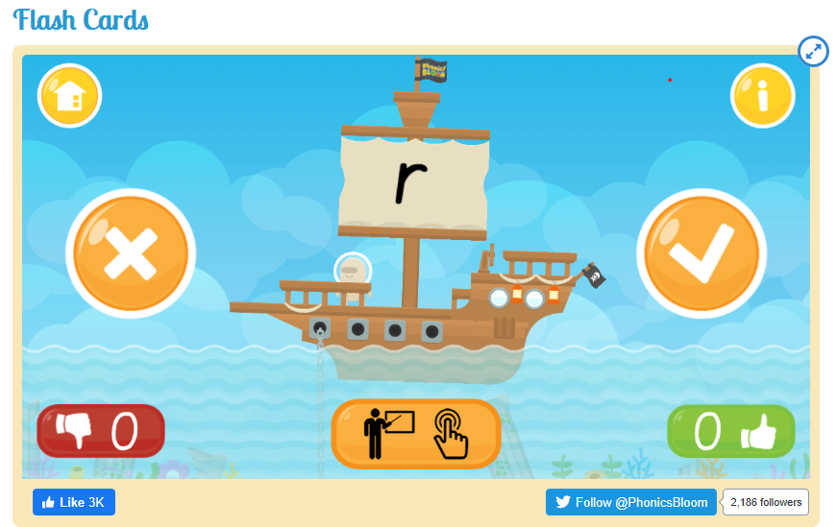
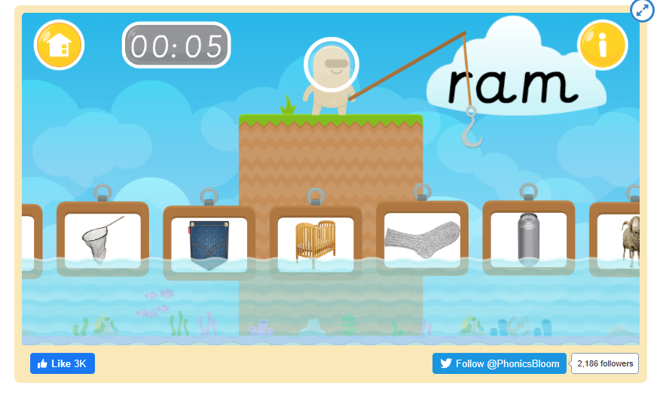
Phonics information for remote learning.
Here are some links to online phonics games you can play with your child at home.
Flash cards
https://www.phonicsbloom.com/uk/game/flash-cards?phase=2
Fishy Phonics
https://www.phonicsbloom.com/uk/game/fishy-phonics?phase=2

Slide 7
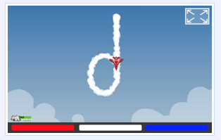
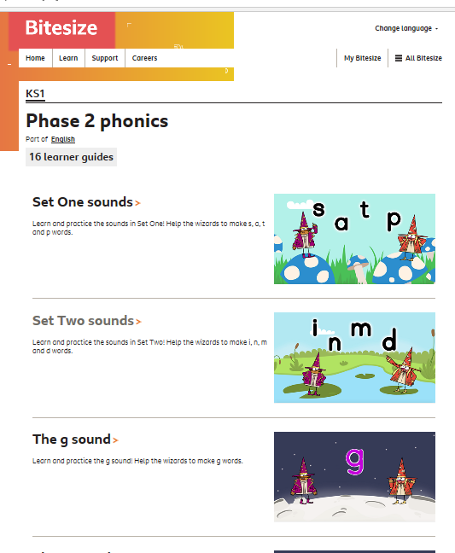
Phonics information for remote learning.
Here are some links to online phonics games you can play with your child at home.
Sky Writer
This is not a game but it demonstrates letter formation in a fun way.
http://www.ictgames.com/mobilePage/skyWriter/index.html
BBC Bitesize Phonics videos
This is a collection of fun videos to learn all about the set 1 and 2 sounds.
https://www.bbc.co.uk/bitesize/topics/zf2yf4j

Slide 8
Date: Monday 18th January 2021
LO. To be able to write labels to match the clues.
Subject: English

Slide 9
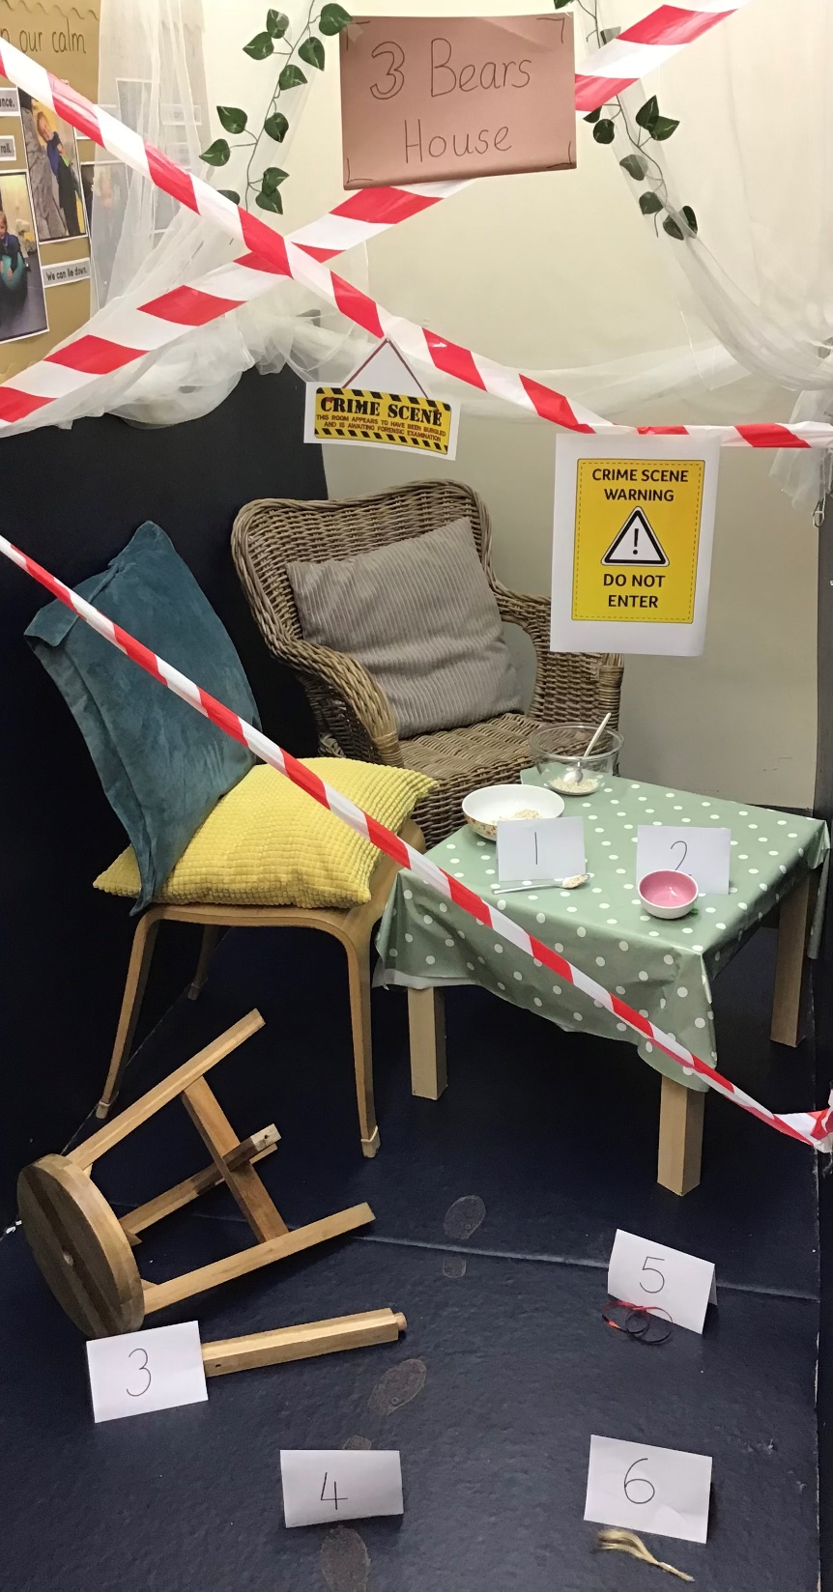
Oh no! Boys and girls we have had an incident in school where one of our story settings have had a break in! There is a bit of a mess. Can you be a detective to help work out who made this mess?
Have a look at the photo and talk to your adult about what you can see.
Scene photo

Slide 10
Put a circle around (or point to) the numbered clues in our crime scene. Did you see all
6?
Here are some sentence with missing words.
Ask your adult to read them to you and see if you can say the missing word.
I can see a broken______________.
I can see a dirty ________________.
I can see an empty ______________.
I can see a muddy __________ print.
I can see a red ______________.
I can see golden ______________.

Slide 11
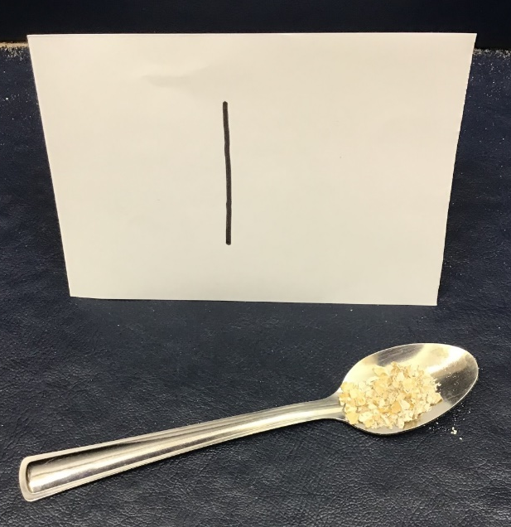
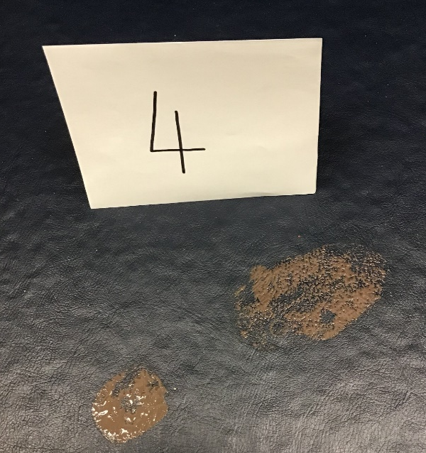
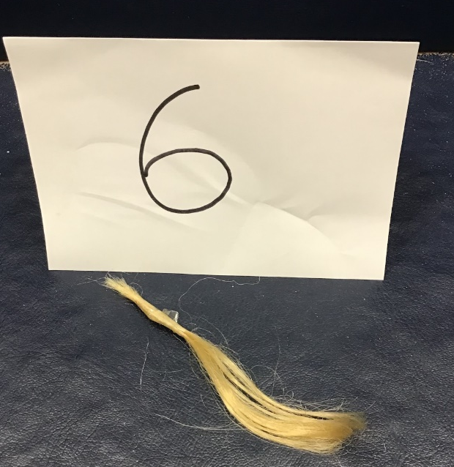
What did you see?
Here are the pictures of the clues. Add a label to each picture. Choose from these words.
chair print hair ribbon bowl spoon
If you are writing on paper or a note book you could draw the items first before adding labels.
What?

Slide 12
Date: 18.1.2021
LO. To recognise the different representations of 6.
Subject: Maths

Slide 13
All about the Number…
6

Slide 14
All about the Number 6
The number 6 can be shown in lots of different ways.
six
Next

Slide 15
Number Fingers
How many fingers are being shown?
Can you hold up 6 fingers?
back

Slide 16
Number Words
Do you know what this word says?
six
back
This is the number 6, written as a word.

Slide 17
Number Shapes
This is a number shape for the number 6. The number shape has 6 holes or circles.
back

Slide 18
Dotty Dice Numbers
Dice sometimes have numbers on them written as a pattern of dots. This is the number 6.
back

Slide 19
Number Lines
Can you spot the number 6 on the number line? Which numbers are next to number 6?
Click the hand to reveal the answer!
0
1
2
3
4
5
6
7
8
9
10

Slide 20
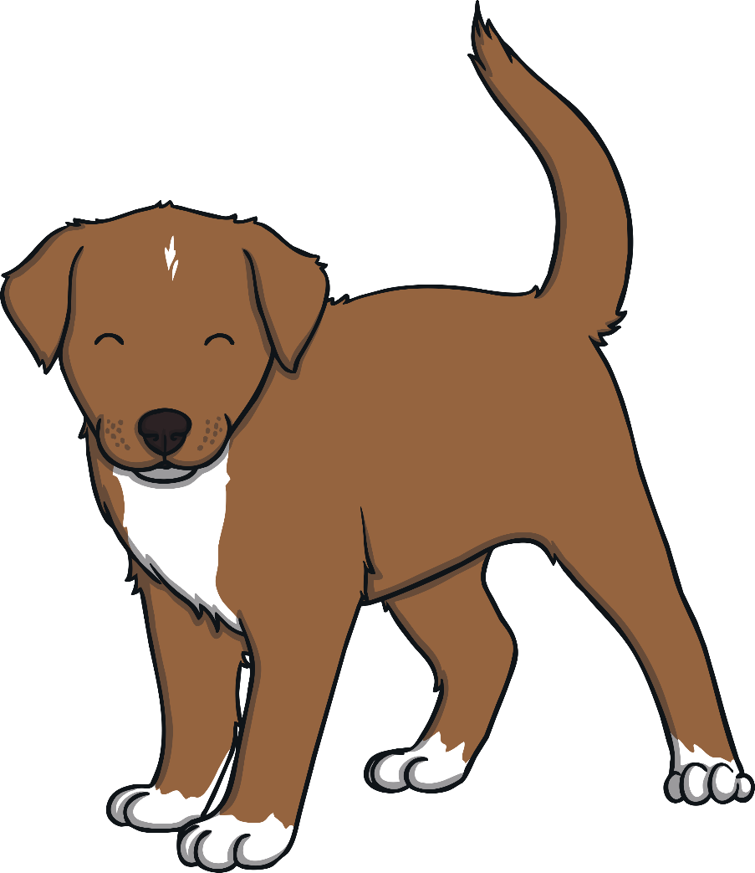
Let’s Try Together!
The dog wants 6 bones. Can you help him? Click on 6 bones to add them to the dog bowl.

Slide 21
Ted needs to find the jar of sweets with 6 sweets. Can you help him?

Slide 22
Numbers as Labels
6
Have you noticed how numbers can be used for labels too? For example, the number on a bus or the number on a door.
Have you ever seen a house with a number 6 on the door?

Slide 23
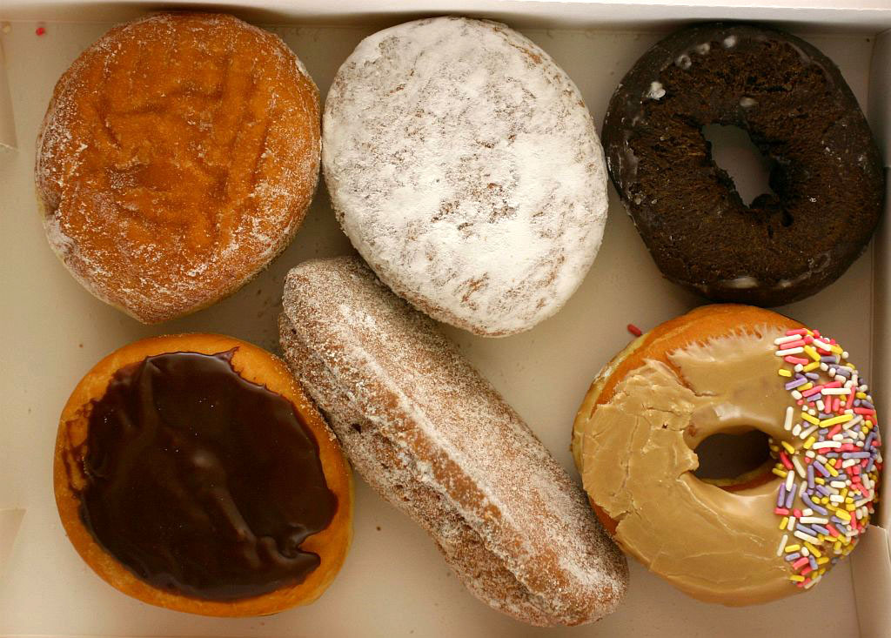
Numbers Everywhere!
Have you ever looked for numbers in your classroom or on your walk to school? Numbers are everywhere! Can you spot the number 6 in your house?
“6” by Steve Snodgrass is licensed under CC BY 2.0
“Six Donuts” by Rene Schwietzke is licensed under CC BY 2.0

Slide 24
Challenge
6
Quickly, find something in your house that shows the number 6. Take a picture of it.
six
back

Slide 25
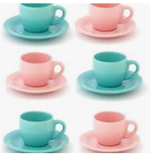
Challenge
Quickly, find 6 cups and get your adult to take a photo.
6
back

Slide 26
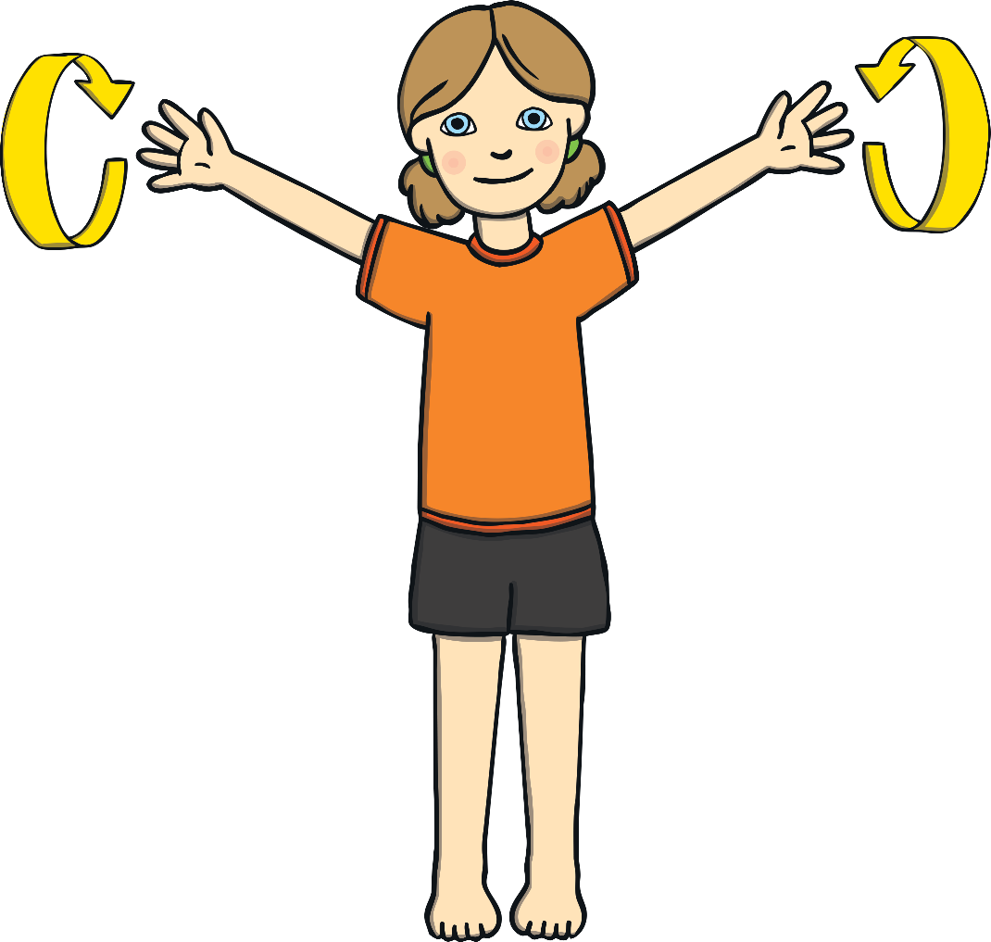
Challenge
Can you find a space and make 6 big circles with each arm?
back

Slide 27
Challenge
Can you show me 6 fingers?
back

Slide 28
Congratulations!
You are now an expert on the number 6.
Can you give yourself 6 pats on the back?
Can you give yourself 6 claps?
Don’t forget to send us your pictures of all the different 6's your found.

Slide 29
Date: Monday 18th January 2021
LO
LO. To be able to construct a model of a chair.
Subject: DT

Slide 30
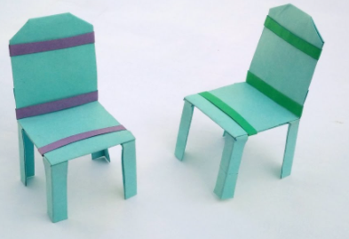
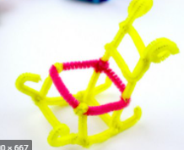
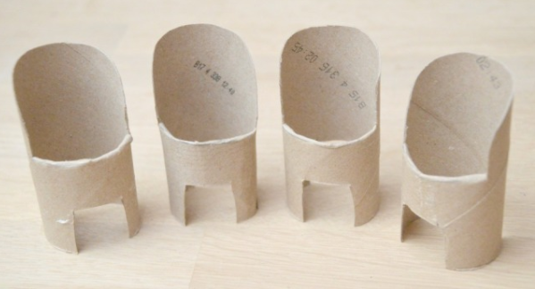
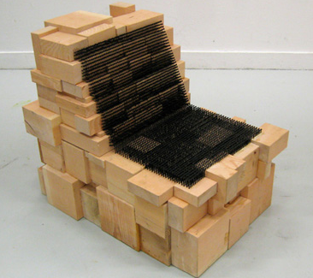
Making a chair
Today we are going to help fix the mess that was made in our story setting by solving the problem of the broken chair. You are going to make a model of a new chair. You can make your model chair out of anything you can find around your home.
This could include:
Empty boxes
Cardboard tubes
Lego
Building blocks
Folded paper
I wonder how creative you can be…
Can you explain to your adult why you
chose to use your materials. Is it because it
is strong, flat, bendy?
I wonder if your chair can hold a toy sitting on it? Test it out and take a picture. Don’t forget to send it to us.

Slide 31
Date: Tuesday 19th January 2021
LO. To be able to complete a sentence.
Subject: English

Slide 32
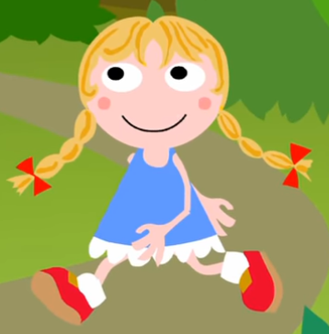
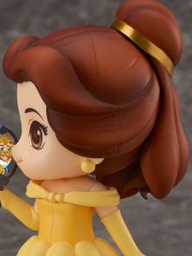
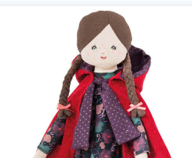
Who could it be?
Today we are thinking about the clues you saw in the photo yesterday to find out who could have messed our story setting. Talk to your grown up about who you think could have made this mess. Look carefully at each picture and decide which one is our naughty character and explain why.
Who?
1
3
5
6
2
4
Hint: check out the hair colour and ribbon colour.
Don’t forget to talk about the reasons why it would not be a specific character.

Slide 33
Did you work out it was picture 6? Well done if you did.
She is the only character who has red ribbons and golden hair, just like the clues.
Looking at the picture, could you create another clue to help
people guess that she committed the crime? Tell your adult.
Do you know who this character is? It is Goldilocks.
Let’s listen to the story being told in this video.
https://www.youtube.com/watch?v=0oUP2PFeOi8

Slide 34
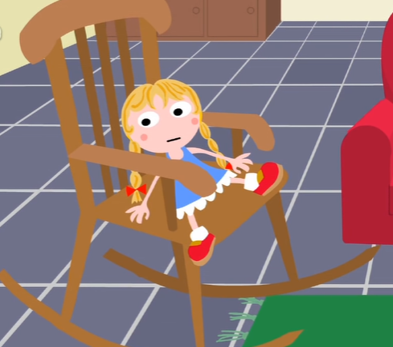
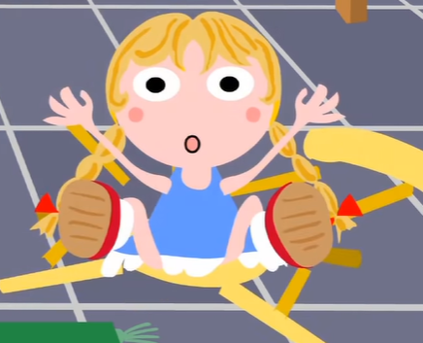
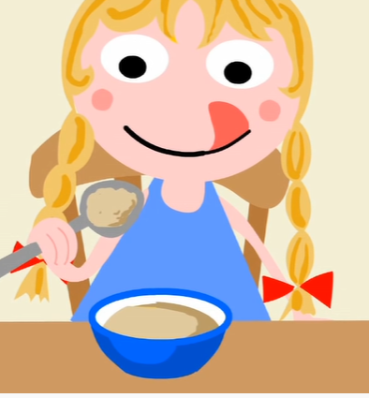
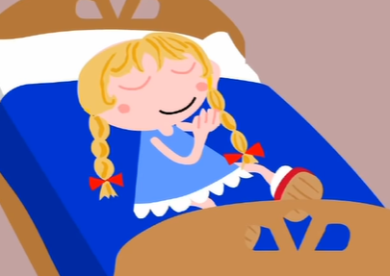
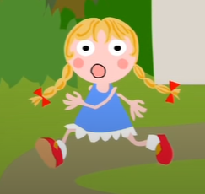
What did Goldilocks do?
Goldilocks made a lot of mess. Let's think about what she did. Get your adult to help you read these sentences.
She sat on the chairs.
She broke the little chair.
What did Goldilocks do?
Complete the next sentences by filling in the missing words or writing
them out on your paper.
She ate the _______________.
She had a _________.
She __________ away.
Use these words to help: ran porridge nap

Slide 35
Date: 19.1.2021
LO. To develop an understanding of the different compositions of 6.
Subject: Maths

Slide 36
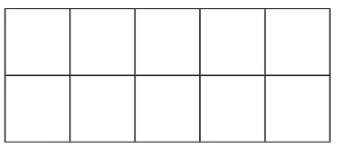
We are learning that all numbers are made up of smaller numbers. Today we will explore this further and notice the different compositions of 6.
Look at the way 6 can be made in these 10 frames.
In this one there are 5 spots on the top and 1 on the bottom
In this one there are 3 spots on the top and 3 on the bottom.
Have a try at counting the total in each 10 frame.
Can you spot what they both have in common?

Slide 37
Now look at these different compositions of 6.
For example, 6 can be made from 5 and 1.
Here are some ways that we did it.
Mrs Levington created these compositions of 6 but forgot to put the numbers on. Can you help her find the missing numbers?
+
= 6
+
= 6
5 + 1 = 6
+ = 6
+
+
= 6
2 + 2 + 2 = 6
+
+
= 6
+
= 6
+ + = 6
3 + 3 = 6

Slide 38
Miss Bentley has moved some of Mrs Levington's spots. Mrs Levington did not want the spots moving. Can you put them back for her? Remember, put the correct amount in to complete the sum.
+
+
= 6
Drag the dots to complete the sum or draw the spots on your paper.
+
= 6
2 + 2 + 2 = 6
+
= 6
2 + 4 = 6
1 + 5 = 6
+
+
= 6
+
= 6
3 + 2 + 1 = 6
3 + 3 = 6

Slide 39
Date: Tuesday 12th January 2021
LO
LO. To follow a set of instructions to make porridge.
Subject: DT

Slide 40
This afternoon we are going to make some delicious porridge just like Mammy Bear. Follow these instructions to make your porridge and see if you can make it 'just right' and eat it all up.
How to make Three Bears porridge with your adult.
You will need... Method
Ingredients
Porridge oats 1. Put the porridge in the bowl. 5. Add your topping.
Milk
Any toppings for your porridge
2. Add the milk. 6. Eat it and enjoy.
Equipment
A bowl 3. Stir the porridge and milk together.
A microwave or hob
A spoon.
4. Put it in the microwave and heat it up.
Don’t forget to send in your photos of you making and eating your yummy porridge.

Slide 41
Date: Wednesday 20th January 2021
to
L.O. To be able to write a set of instructions for making porridge.
Subject: English

Slide 42
Oh dear! Mrs Levington wants you to help write some instructions for making porridge, but she has mixed up the instructions! We need you to sort them back into the right order. Talk to your adult about when you made your porridge yesterday. What did you do first? Look at the sentences below. Can you spot the first one?
Get your adult to drag the sentences to the right order. If you are using a paper copy, get your adult to cut them out then you can sort them.
1.
4.
2.
5.
3.
6.

Slide 43
Great work everyone! That sorting was fantastic. Look, our instructions are now in the right order. Now it is your turn to have a go at writing some. We have chosen some of the simpler sentences for you to try for yourself.
Use the previous slide to copy the words and your adult will help you sound them out.
1.
4.
2.
5.
3.
6.

Slide 44
Date: 20.1.2021
LO. To be able to place the digits 0-6 in the correct order.
Subject: Maths

Slide 45
Click on the link below to watch this.
https://whiterosemaths.com/homelearning/early-years/alive-in-5-week-2/
When you have finished, move on to the next page.
Hello. Before we start arranging our digits 0-6, let's have a look at this problem solving task in this short video

Slide 46
Oh no. Mrs Simpson has mixed up all the digit cards! We need you to rearrange them back into the correct order. Drag each digit box to the right place on the line or, if you are writing on paper, write each digit in the right order. I'll start it for you.
5
0
1
4
2
6
3
0
Now practice writing your numbers 0 – 6 on some paper if you haven’t already.

Slide 47
Matching pairs to 6
Great work! I bet your number formation is coming on great.
Now we are going to find matching pairs to 6.
Remember a pair means two, so you are finding two images which represent the same number.
Have a look at the example first.
Point to the images which match then your adult can drag the images around the screen to put the pairs together.
If you are working with a printout, your adult will cut out the images for you to pair up.
Example

Slide 48
Date: Wednesday 20th January 2021
LO
LO. To be able to express preferences and opinions
Subject: Speaking and listening

Slide 49
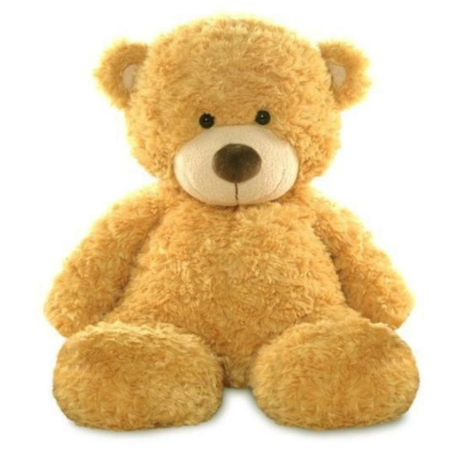
Our teddy bears
Did you know a teddy bear is one of our
favourite toys?
Do you have a teddy bear? Go and find it.
If not, chose your favourite toy.
Talk to your adult about your teddy/toy and
discuss why it is special.
Is it a gift from a special person? Is it one of your oldest toys? Or is it because it is so cuddly?
Now have a think about what you could play with your teddy/toy. You could read stories together, have a tea party or even take teddy for a walk.

Slide 50
My teddy
What a lot of good ideas! Now draw a picture of your teddy/toy. Don’t forget to look carefully at what your teddy/toy looks like. You could draw you and your teddy playing together or going for a walk.

Slide 51
Date: Thursday 21st January 2021
LO. To be able to describe goldilocks using labels.
Subject: English

Slide 52
Today we are going to write a character description of
Goldilocks. Have a look at her picture and talk to your adult
about what she looks like.
Think about what she is wearing, her hair etc. Don’t forget
to use describing words (adjectives). Here are some
examples below.
adjectives nouns
red
long
golden
shiny
dress
socks
bows
hair
shoes
face
frilly
white
smiley
blue
Can you finish the sentence below using one of your ideas? Ask your adult to help you.
Goldilocks has _____________ __ _________________ .

Slide 53
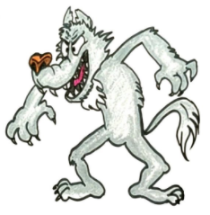
b
Now imagine you were the police looking for Goldilocks. You would need to find out if anyone had seen her run away. Sometimes the police make wanted posters of their suspects. We want you to make your own wanted poster and add some labels to describe Goldilocks.
Here is Mr Pennal’s example of his wanted poster for another fairy tale character.
big ears
Your adult will read these labels for you.
Sharp teeth
big eyes
Grey hair
Spiky claws

Slide 54
b
Now make your own wanted poster. You can use this template to draw your picture of Goldilocks or you can make your own on your paper.
Don’t forget to get your adult to help you add some descriptive labels of Goldilocks.
Great work today!

Slide 55
Date: 21.1.2021
LO. To be able to use mathematical language to describe length and height.
Subject: Maths

Slide 56
Looking at sizes
Did you notice our story about the three bears talks about the different sizes of things?
There was a big bear.
We could also say that Daddy bear was a tall bear.
There was a medium sized bear.
And that Baby bear was a short bear.
There was a little bear.

Slide 57
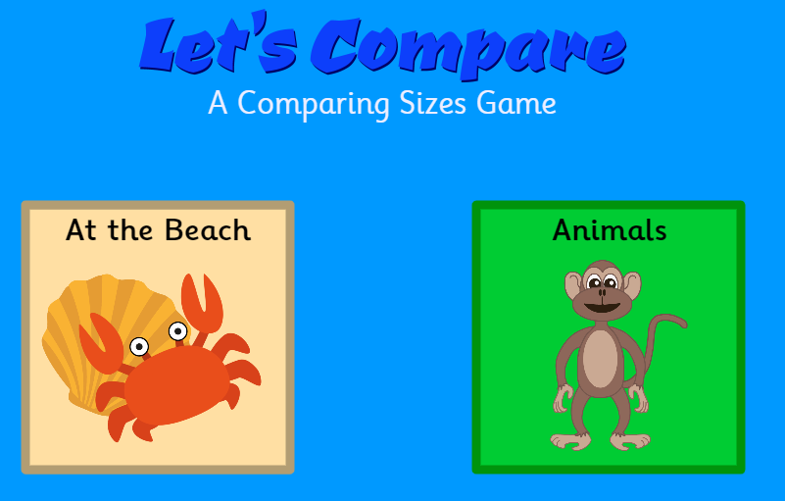
Looking at sizes
Have a go at playing this online game with your adult about tallest and shortest.
Click on the link https://www.topmarks.co.uk/early-years/lets-compare

Slide 58
Looking at sizes
How tall are you? If your adult has a tape measure you can get them to measure you. Write your size in the box or on your paper.
Now go and get some of your toys together. Line them up on the floor in order of size. Shortest to tallest. Which was tallest? Which was smallest? Don’t forget to send in your photos.
I am _____________________ cm tall.
My _____________________ was tallest.
Great measuring today!
My _____________________ was smallest.

Slide 59
Date: Thursday 21st January 2021
LO
LO. To describe the changes observed during our gummy bear experiment.
Subject: Science

Slide 60
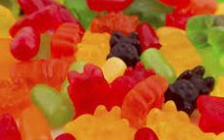
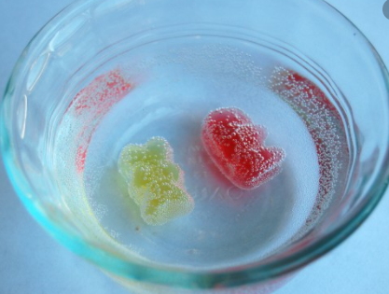
Gummy Bear experiment.
Today we will be carrying out an experiment to notice when change occurs.
You will need: Water, 2 glasses and gummy bears (or another gummy
sweet).
Method
Choose two gummy bears.
Half fill one glass with water.
Put one gummy bear in each glass. (one with water and one not)
Leave until the next day (or longer).
After leaving it, compare the gummy bear that had no water on it.
What happened?
Discuss what happened with your adult. Now complete activity on the next slide.
Don’t forget to take photos of your experiment.

Slide 61
Wow!
Did your gummy bear in the water change? How did it change? Draw a picture to show what the gummy bear looked like before and after leaving it in the water.
Now finish the sentence to explain what you noticed.
LO
LO
Before
After
The gummy bear in the water_______________________________________.

Slide 62
Date: Friday 22nd January 2021
LO. To be able to write a simple word.
Subject: English

Slide 63
As we do every Friday today we are going to have a word time lesson. Boys and girls you will have to show your parents how to use Fred fingers.
Let’s do an example together.
Let’s write the word ‘wet’. Show your adult three Fred fingers, split up the sounds from the word ‘wet’ onto each finger. Remember to pinch each finger as you say the sound. Then just like we do at school sound out the word three times before trying to write it down. Ask your adult to check that you have written the word correctly.
can
fit
hot
jog
lock
1.
2.
3.
4.
5.
Ask your adult to read the word then hide it from you while you write it down.

Slide 64
Date: 22.1.2021
LO. To understand the terms long and short.
Subject: Maths

Slide 65
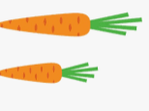
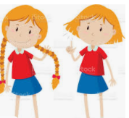
v
Now you know that tall and short are other ways to describe size, let's look at another way. We can use the words long and short to describe the size of some things.
The Three Bears walk in the woods could have been a long walk or a short walk.
Have a look at the pictures below and tell your adult which is the longest. Tick the box of the longest.
On some paper have a go at drawing some long and short things you might find at home.

Slide 66
Date: Friday 22nd January 2021
LO
LO. To be able to show an understanding of healthy foods.
Subject: Science

Slide 67
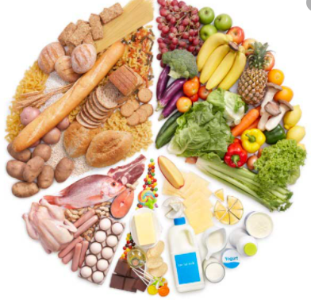
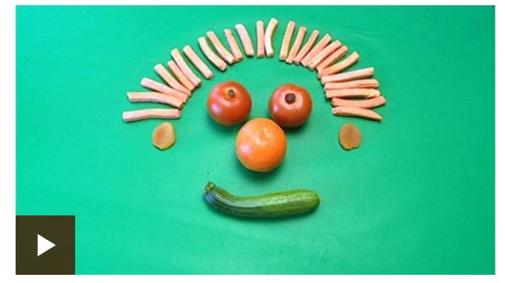
So what are healthy foods?
Did you know porridge is a healthy food and good for you to eat? The three bears like to eat healthy food because it keeps them fit and well.
Healthy foods are foods such as fruit, vegetables, cereals, lean meats, fish, dairy and eggs.
Click on the link to listen to a fun song about healthy
eating.
https://www.bbc.co.uk/bitesize/clips/z2pxpv4

Slide 68
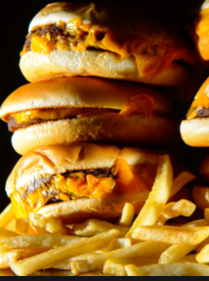
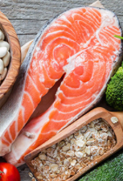
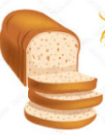
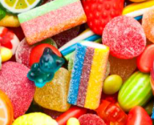
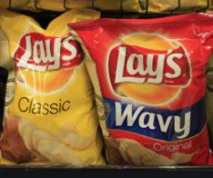
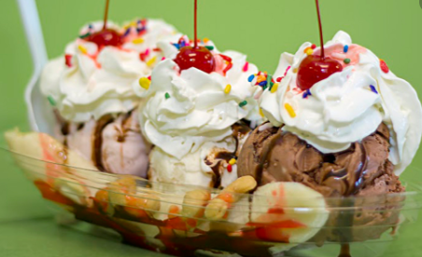
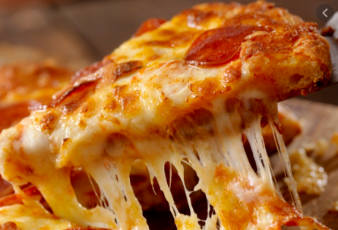
Sorting food
Have a look at these foods. Talk to your adult about which ones are healthy and which ones are not healthy and why.
Sort the foods into the two groups by dragging them across. If you are using a paper copy you can cut them out or alternatively you can draw them on paper in healthy and unhealthy groups.
Healthy
Unhealthy

Slide 69
A Healthy picnic for the Three Bears
Imagine you are Goldilocks and you are very sorry for breaking in to the Three Bears house. You want to do something nice to show them how sorry you are. Why don’t you make them a picnic? Remember, they only like healthy food. On the picnic blanket below (or on your own paper), draw the food you would pack for the picnic.
Why don’t you make your own indoors Bear’s picnic? Ask your adult if you can help make a healthy snack for you to have at your picnic and send us a lovely photo of you enjoying your healthy snack.

Slide 70
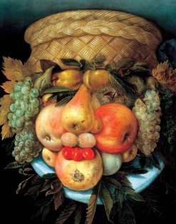
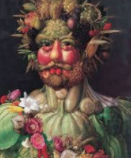
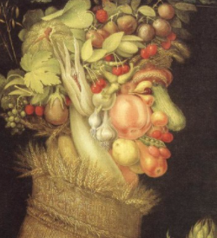
Healthy art
Do you know what an artist is? An artists is someone who use creativity and skill to make things like pictures, photos, models, movement and song.
Mrs Simpson has a favourite artist who likes to make images out of fruit and vegetables! Wow! How interesting. His name is Giuseppe Arcimboldo. Have a look at some of his art and talk about it with your adult.
Have a go at making your own Giuseppe fruit and vegetable art and send us some photos.

