Slide 1
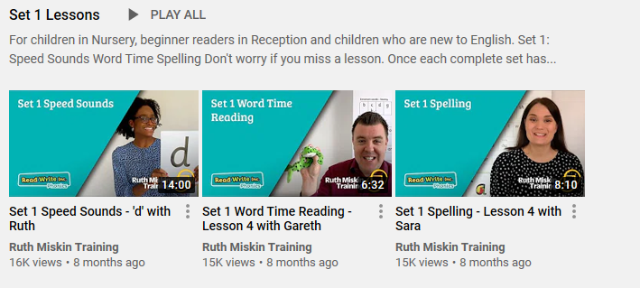
https://www.youtube.com/channel/UCo7fbLgY2oA_cFCIg9GdxtQ?mc_cid=71ef745098&mc_eid=c9705b8c67
Phonics information for remote learning.
At school, the children have daily phonics sessions to teach the letter sounds. In Term 1, reception children were taught all set 1 sounds, how to split simple words into sounds and how to blend sounds together to make words. All children will be at different stages with which sounds they can remember but it will still be beneficial to recap sounds already taught.
The image above is an example of the videos which are available through Read Write Inc on their YouTube channel for you to access daily from home (See link below). The Speed sound lesson video (Circled above) will change daily and the other two videos are there as an example of how to read and spell simple words using the sounds.
S sSubject: Phonics

Slide 2
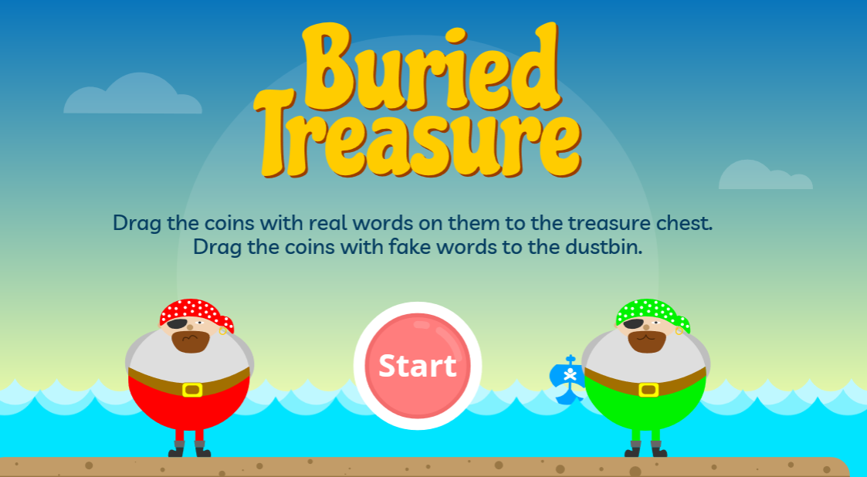
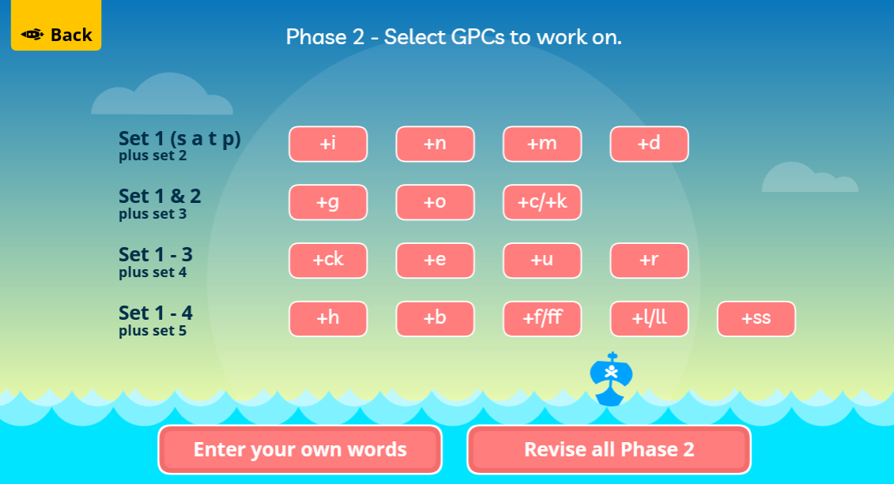
Phonics information for remote learning.
Here are some links to online phonics games you can play with your child at home.
Buried treasure
https://www.phonicsplay.co.uk/resources/phase/2/buried-treasure
After clicking start, choose phase 2 and revise all phase 2 sounds.

Slide 3
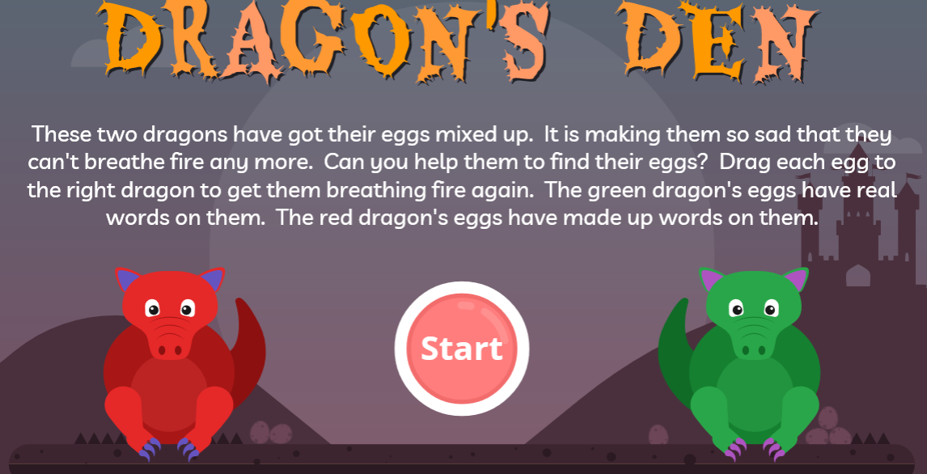
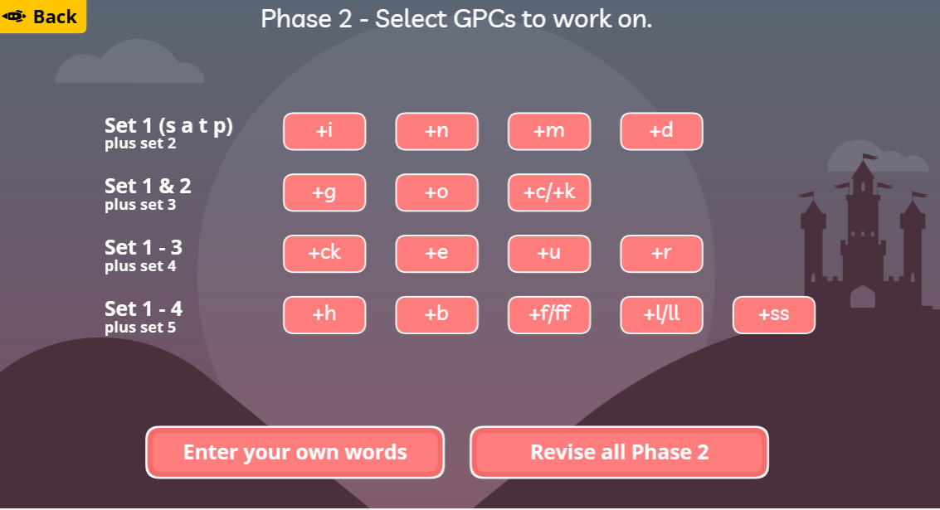
Phonics information for remote learning.
Here are some links to online phonics games you can play with your child at home.
Dragon's Den
https://www.phonicsplay.co.uk/resources/phase/2/dragons-den
After clicking start, choose phase 2 and revise all phase 2 sounds.

Slide 4
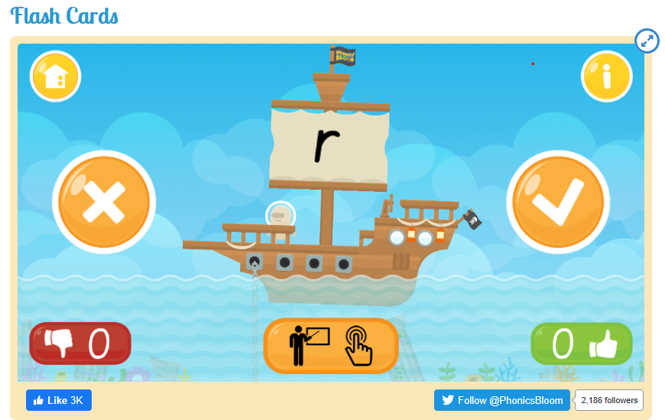
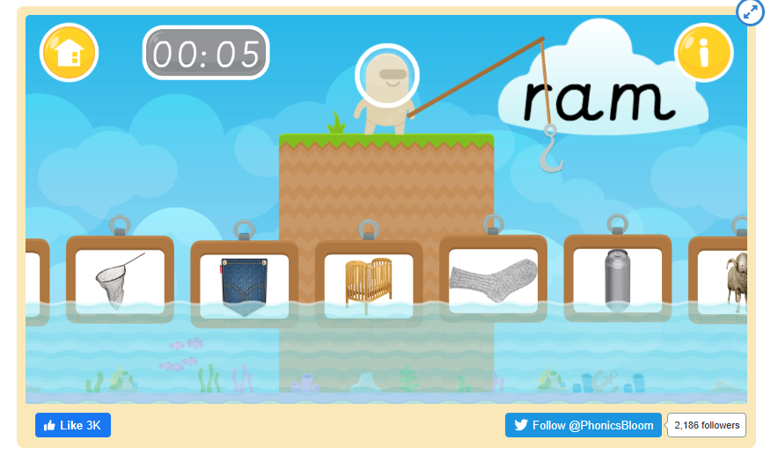
Phonics information for remote learning.
Here are some links to online phonics games you can play with your child at home.
Flash cards
https://www.phonicsbloom.com/uk/game/flash-cards?phase=2
Fishy Phonics
https://www.phonicsbloom.com/uk/game/fishy-phonics?phase=2

Slide 5
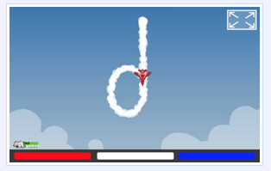
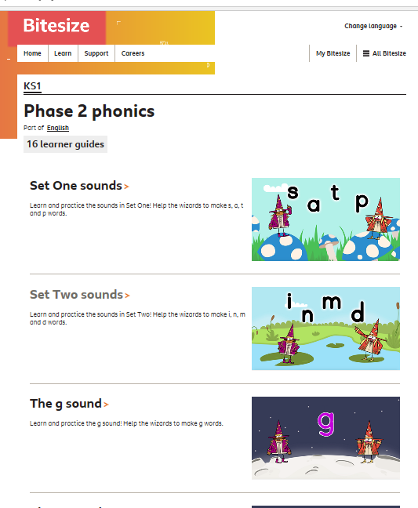
Phonics information for remote learning.
Here are some links to online phonics games you can play with your child at home.
Sky Writer
This is not a game but it demonstrates letter formation in a fun way.
http://www.ictgames.com/mobilePage/skyWriter/index.html
BBC Bitesize Phonics videos
This is a collection of fun videos to learn all about the set 1 and 2 sounds.
https://www.bbc.co.uk/bitesize/topics/zf2yf4j

