Slide 1
Subject: Maths
Base camp 3

Slide 2
Hello base camp 3, we hope that you enjoyed your home learning last week and had some great fun with the activities. Here you can find your home learning pack for this week.
We have put together some new exciting activities to learn about while you are at home this week. We have added a phonics section in your pack this week with some ideas on how you can learn your sounds at home. As well as this, this week you can pick up your set of phonics cards from school to use at home. We have added set 1 to begin with as these are the sounds we have been learning in school. You can also check out the new video clips on the phonics page.
Again, we are always here to help and support you with your learning.
We hope you have lots of fun and enjoy your home learning. From the base camp 3 staff.
*TOP TIP- DON'T USE SLIDE SHOW TO VIEW THIS POWERPOINT*

Slide 3
Parent Guidance
We hope we find you safe and well during these difficult times. We recognise that home learning provides its own challenges and is not always easy. We have put together some daily learning for your children. They have several activities for each day which will hopefully keep their learning moving forward. As the children are still so little the activities will need to be supported by an adult. All children learn differently and at different paces, as well as needing different levels of support. Some children may just need you to be with them while others may need you to write things out for them and support them step by step. All of this is fine. We want the activities to be fun for everybody, including yourselves. ☺
When completing this weeks work please make sure it is completed either on the PowerPoint, or if this isn’t possible written onto paper. This will be used as evidence that the home learning is being completed.
The base camp 3 staff at school are always here for you and are ready to help with any queries that you may have. If you have any problems please get in touch via the methods below and we will get back to you as soon as we can.
Email: Telephone: Climbpupils@gmail.com
01429 820594
Hopefully we will see you all in person really soon, stay safe. The base camp 3 team.
Monday | Tuesday | Wednesday | Thursday | Friday
1 phonics activity English Maths Topic | 1 phonics activity English Maths Topic | 1 phonics activity English Maths Topic | 1 phonics activity English Maths Topic | 1 phonics activity English Maths Topic

Slide 4
Maths Lessons
w/c 01/02/21

Slide 5
Date: Monday 1st February 2021
LO. To be able to name 2d shapes.
Subject: Maths

Slide 6
Today we are going to have a look at 2D shapes. A 2D shape is a flat shape that has sides and corners. Lets take a look at some of the names for these shapes:

Slide 7
Soon we are going to have a look for some shapes around our house. But first lets have a look at some examples of our shapes.
disks
clock

Slide 8
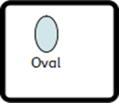
mirror
jewel

Slide 9
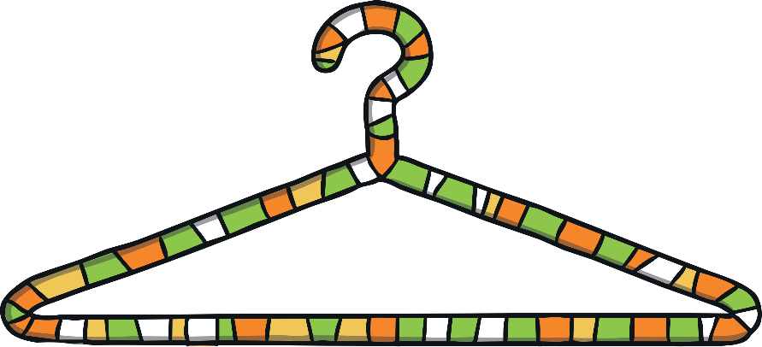
coat hanger
triangle

Slide 10
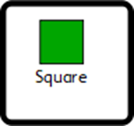
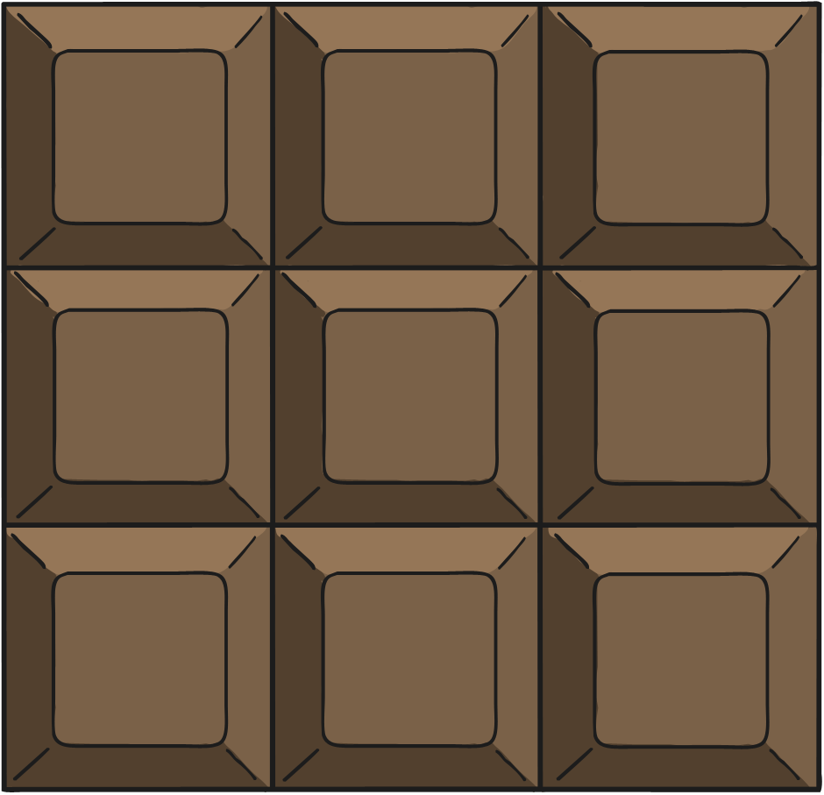
chocolate
windows

Slide 11
rulers
envelopes

Slide 12
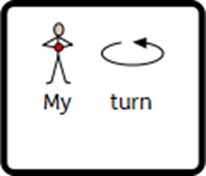
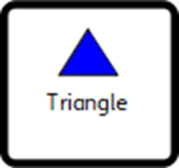
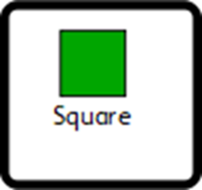
It would be great to see some photos of you with your shapes.
It’s time to see how many of our shapes we can find in our house.
Find as many circles, triangles, squares and rectangles as you can. Write what you find in the correct column below.

Slide 13
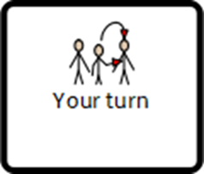
It would be great to see some photos of you with your shapes.
It’s time to see how many of our shapes we can find in our house.
Find as many circles, triangles, squares and rectangles as you can. Write what you find in the correct column below.

Slide 14
Date: Tuesday 2nd February 2021
LO. To be able to describe the properties of 2D shapes.
Subject: Maths

Slide 15
Yesterday we had a look at these 2D shapes and what their names were. Today we are going to find out how many sides and corners each shape has. Before we get started, you can read the names of the shapes with your adult to refresh your memory

Slide 16
Miss Anderson has made this chart of how many sides and corners each shape has.
Can you name the shapes that have one side?
There is one shape that has three corners and three sides, which shape is it?
Look at all of the shapes, which one has the most sides?
Which one has 5 corners?
Name | Sides | Corners
Circle | 1 | 0
Oval | 1 | 0
Triangle | 3 | 3
Square | 4 | 4
Rectangle | 4 | 4
Pentagon | 5 | 5
Hexagon | 6 | 6
Heptagon | 7 | 7

Slide 17
Mrs Hann has accidently deleted the numbers for the sides and corners. Can you help him by counting how many sides and corners each shape has got and write your answers into the table.
Name | Sides | Corners
Circle
Triangle
Square
Pentagon
Heptagon

Slide 18
You did a super job at writing the number of sides and corners each shape has.
But Miss Anderson has jumbled up the numbers you wrote. Can you draw a line to match the shape to the correct number of sides and corners?
4
5
5
4
3
0
1
7
7
3

Slide 19
Date: Wednesday 3rd February 2021
LO. To draw some simple shapes.
Subject: Maths

Slide 20
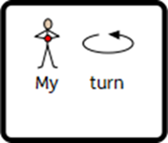
Can you trace the shapes then have a try drawing your own?

Slide 21
Can you trace the shapes then have a try drawing your own?

Slide 22
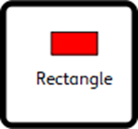
Can you trace the shapes then have a try drawing your own?

Slide 23
Date: Thursday 4th February 2021
LO. To match numbers to 5.
Subject: Maths

Slide 24
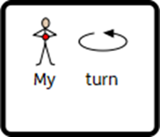
1
5
4
3
2

Slide 25
1
5
4
3
2

Slide 26
If you would like to do more numbers to 5 click the picture below to play the teddy number games.
https://www.topmarks.co.uk/learning-to-count/teddy-numbers

Slide 27
Date: Friday 5th February 2021
LO. To point to the large/smallest objects.
Subject: Maths

Slide 28
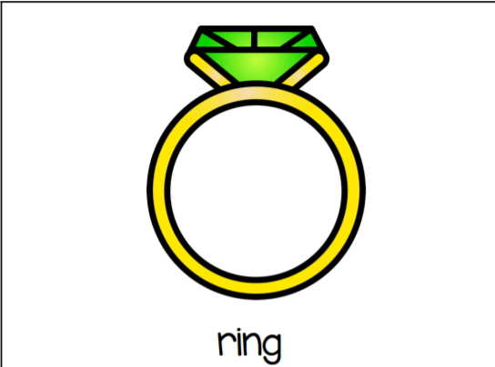
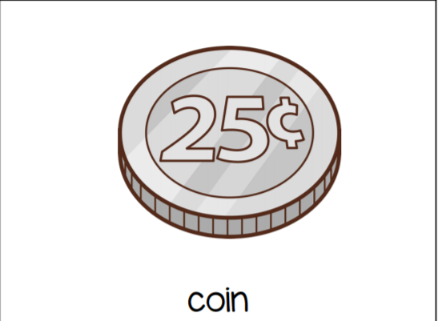

Slide 29
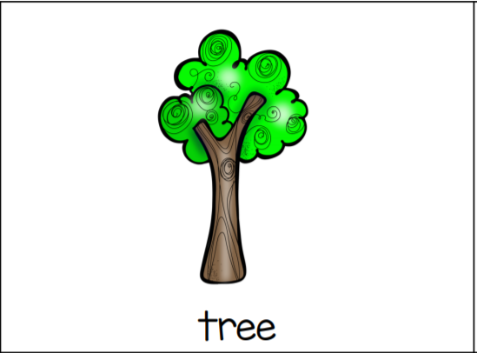
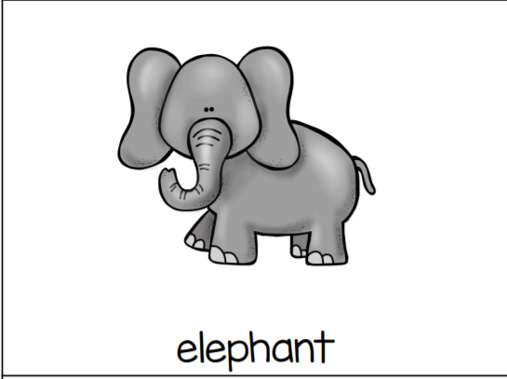

Slide 31
