Slide 1
Date: Monday 25th January
LO: To be able to identify the ‘t’ sound
Subject: English

Slide 2
The ‘t’ sound
Tt
This is the letter ‘t’.

Slide 3
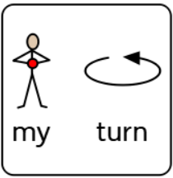
t
Click on the pencil to see how we draw a ‘t’.
Can you follow along with your finger?
Can you draw a t on some paper? (ask your adult for help)

Slide 4
t
d

Slide 7
Date: Tuesday 26th January
LO: To be able to follow instructions from an instructional text.
Subject: English

Slide 8
For parents: Read through the text on the next few slides with your child. See if they can follow the words using their finger.

Slide 10
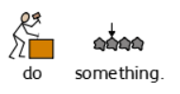

Slide 11
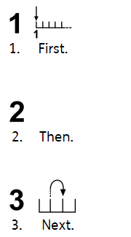

Slide 12
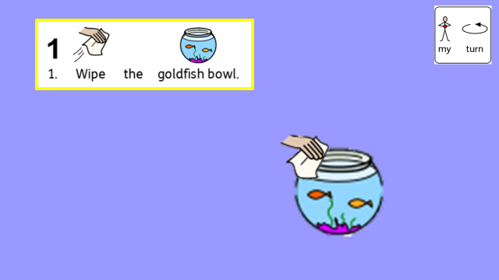
Explanation of activity
For Parents:
Using items you can find in your home, support your child to follow the instructions. Read the instruction aloud and demonstrate it to your child, then encourage them to do the same. (Be creative: use a goldfish teddy or biscuit for the fish and a normal bowl for the fishbowl)

Slide 14
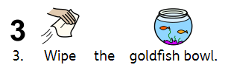

Slide 16
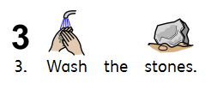

Slide 22
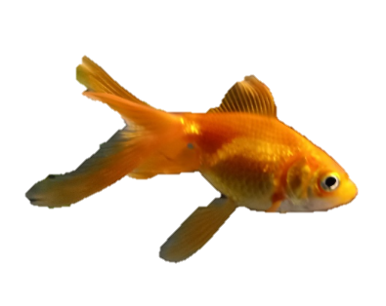

Slide 24
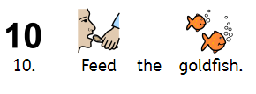
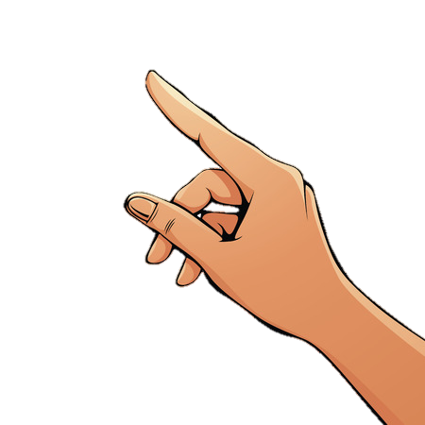

Slide 25
Date: Wednesday 27th January
LO: To be able to give instructions using imperative verbs.
Subject: English

Slide 26
Examples:

Slide 27
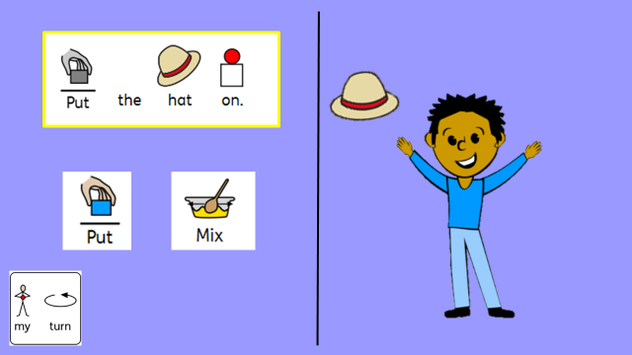
Explanation of activity
For Parents:
Using the imperative verb symbols, allow your child to drag the matching symbol to complete the instruction. Once they have dragged the correct symbol, click the slide to carry out the instruction.

Slide 28
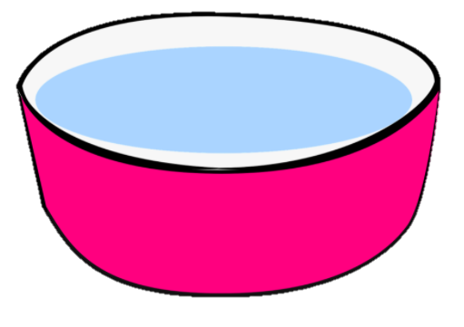

Slide 29
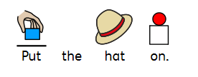

Slide 31
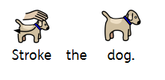

Slide 34
Date: Thursday 28th January
LO: To be able to sequence instructions.
Subject: English

Slide 36
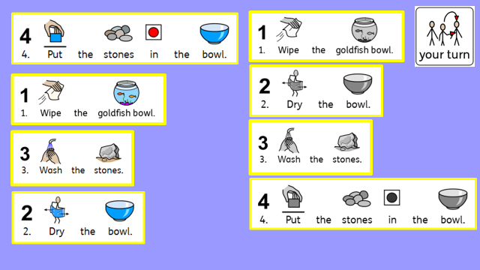
Explanation of activity
For Parents:
Using the grey backing sheet to help, support your child to drag the instructions into the correct order.

Slide 40
Date: Friday 29th January
LO: To match phonics letters and sounds.
Subject: English

Slide 41
Lets look at our phonics sounds!
Tt
This is the letter ‘t’.

Slide 42
The ‘d’ sound
This is the letter ‘d’.

Slide 43
The ‘s’ sound
Ss
This is the letter ‘s’.

Slide 44
The ‘a’ sound
Aa
This is the letter ‘a’.

Slide 45
The ‘m’ sound
Mm
This is the letter ‘m’.

Slide 46
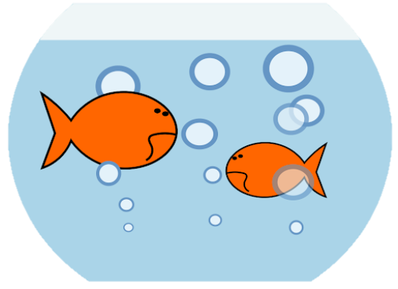
Explanation of activity
For Parents: Create a ‘goldfish pond’ using the instructions in yesterday’s lesson. One you have your pond put in 2 of each letter for the sounds on the previous pages (m, a, s, d, t). Can your child find the matching letters in the pond?

Slide 48
Mm
Tt
Dd
Ss
Aa

