Slide 1
Date: Monday 1st March 2021
L.O. To be able understand peoples importance in history.
Subject: History

Slide 2
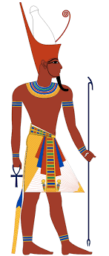
The Pharaohs
Who were they?
The pharaohs were the kings and queens of all of Egypt. Most were men but there were some famous female pharaohs, like: Nefertiti and Cleopatra. The pharaoh was the most important person in the kingdom and was in charge of the government and every temple. The Egyptians believed that the pharaoh was half-man, half-god. The god half of them was thought to be taken from Horus, the god of the sky. It was thought that after a pharaoh died, they would be joined with the Sun and a new Horus would be sent to rule on Earth.

Slide 3
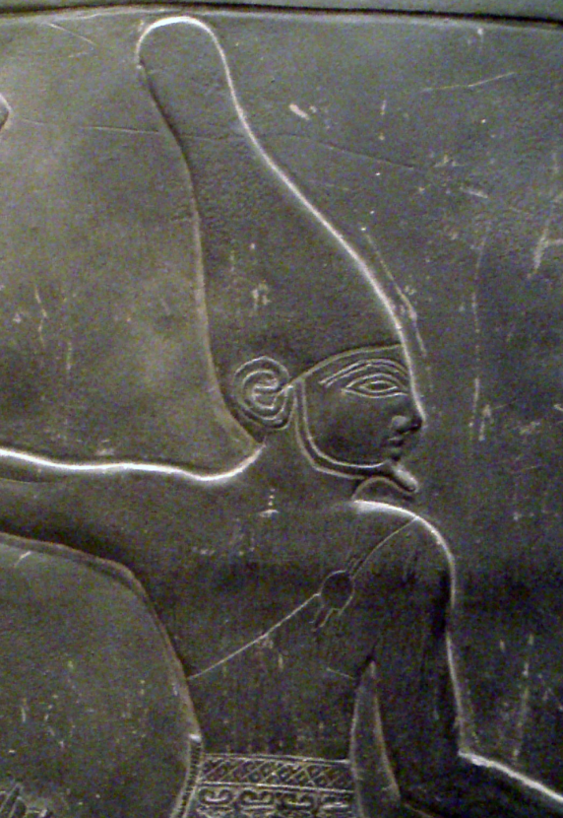
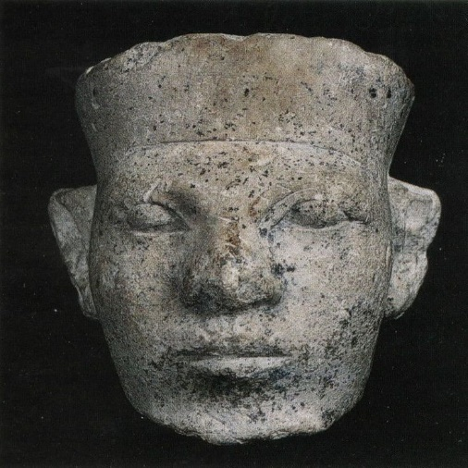
Let’s take at the very first Pharaohs
.
The first pharaoh of Egypt was Narmer, who united Lower Egypt and Upper Egypt. Egypt was once divided into two kingdoms. The kingdom in Lower Egypt was called the red crown and the one in Upper Egypt was known as the white crown.
Around 3100 B.C. Narmer, the pharaoh of the north, conquered the south and Egypt became united. He founded the first capital of Egypt where the two lands met. It was called Memphis. The story of Ancient Egypt begins from when the north and the south were united as one country.
Name: Narmer (also known as Menes)
Gender: Male
Date of Birth: 3180 BC
Date of Death: 3120 BC
Date of Reign: 31st century BC
Married to: Neithhotep
Location of Burial: Umm el-Qaab, Abydos
GOOD FACT: Narmer reigned for 62 years and it is believed that he was killed by a hippopotamus!

Slide 4
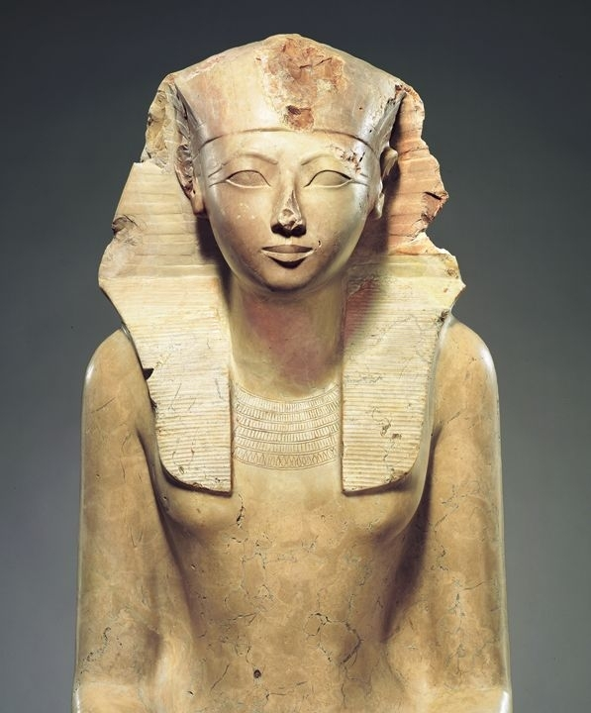
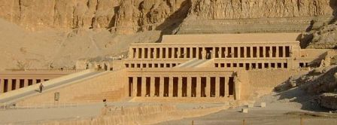
Let’s take a look at some more famous Pharaohs
Hatshepsut was the first lady to rule Egypt, actually the queen of a pharaoh, King Thutmose II. After he died she took the title of ‘regent’ to her nephew (Thutmose III), who was a baby and next in line. A regent is a guardian for a pharaoh, when they are too young to make decisions. It falls on the regent to make all of the decisions in the place of the young pharaoh.
Hatshepsut
Hatshepsut played the role of ‘regent’ until suddenly, she decided that she was a pharaoh. No one is sure why, but she began to dress in the same male pharaoh clothes and even wore the pharaoh “beard’ that was part of their sign of power. It is believed she dressed that way, because they didn’t have any way for a female pharaoh to dress.
One of her finest buildings was the temple Djeser-djeseru (which means holiest of holy places). This was dedicated to the god Amon. She continued to build and add monuments throughout Egypt. One of the two red granite obelisks still stands at the temple of Amon in Karnak.

Slide 5
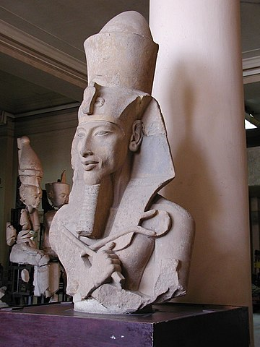
Akhenaten
During Akhenaten’s reign, Egypt was at its peak it was wealthy, powerful and respected the world over for its contributions to science and architecture. Akhenaten’s reign is most famous for the changes it made to the Ancient Egyptian religion; namely, his effort to switch the people from polytheistic worship of many gods to the worship of a single god, Aten. He closed all the temples to the old gods.
He moved the capital from Thebes to the city he named Akhetaton, in Middle Egypt.

Slide 6
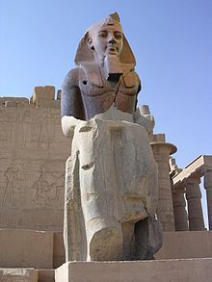
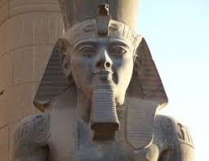
Ramess II
During his reign as Pharaoh, Ramses II led the Egyptian army against several enemies including the Hittites, Syrians, Libyans and Nubians. He expanded the Egyptian Empire and secured its borders.
Ramses II is also known as a great builder. He rebuilt many of the existing temples in Egypt and built many new structures of his own including: Ramesseum temple, Abu Simbel temple and a new capital city of Egypt called Pi-Ramesses
GOOD FACT: He lived to be over 90 years old. At the temple of Abu Simbel, he built 4 statues of himself which were 69 feet high!

Slide 7
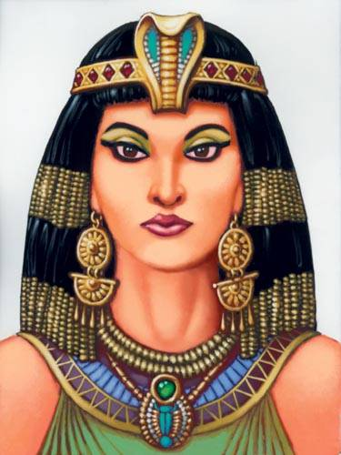
Cleopatra
Cleopatra VII was very intelligent and politically astute and one of the few Queens, who learned the Egyptian language.
In 47 BC, she had a son (Caesarion) she claimed that Caesar (Roman dictator and military general) was the father.
When she was in Rome Caesar was assassinated and when she returned back to Egypt a similar fate happened to her brother who she replaced with Caesarion.
She married Mark Antony and had twins (34 BC), later in 32 BC Mark Antony’s Roman wife brother (Octavian) led a campaign against him and Cleopatra in the Naval battle of Actium.
Cleopatras troops withdrew and fled unexpectedly and Octavian pursue them into Egypt but Anthony committed suicide and Cleopatra followed shortly after.
Octavian also killed Cleopatra’s son Caesarion and made himself Pharaoh.

Slide 8
Your tune: Can you now fill in the missing words to complete the sentences, use the words below to support your learning.
The Pharaoh was the most_________________________ person in the land.
The Pharaohs were the _________________________________of all of Egypt.
The Egyptian believed that the pharaoh was half-man, half ____________________________.
The first pharaoh of Egypt was ________________________.
______________________ was the first lady to rule Egypt.
Hatstepsut dressed as a ____________________.
Akhenaten's reign is most famous for the changing _______________________>
Ramess ii lived to be over ____________ years old.
Cleopatra was married to ________________________________________.
King and Queen religion Hatshepsut powerfulness God Pharaoh Mark Antony’s Narmer 90

Slide 9
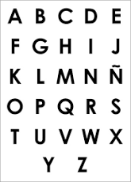
My turn: Now you have found out some information about some of the most famous Pharaohs, lets see if we can put the in alphabetical order.
list
alphabet
Cleopatra
Rameses II
Hatshepsut
Narmer
Akhenaten
So lets look at the alphabet, we know it starts with the letter A. To find my first answer, I need to look down the list and see if any of the Pharaohs names begin with an A. The first in my list would be Akhenaten

Slide 10
My turn: lets try together to see if we can put the in alphabetical order.
list
alphabet
The first Pharaoh
Akhenaten
Cleopatra is next as there is no Phararoh beginning with B
Hatshepsut
Narmer
Rameses II
Cleopatra
Rameses II
Hatshepsut
Narmer
Akhenaten

Slide 11
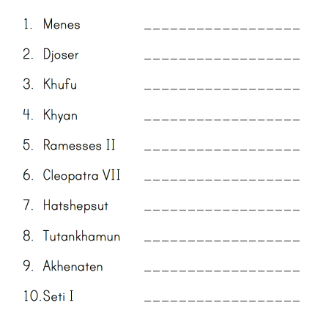
Your tune: Can you now put the list of Pharaohs in alphabetical order? Use the alphabet to support your task.

Slide 12
Here is a short clip about the very first Pharaoh.
Here are some Pharaohs and when their reigned.
Djoser (reign 2667 BC – 2648 BC) Khufu (reign 2589 ‒ 2566 BC) Hatshepsut (reign 1473–1458 BC) Thutmose III (reign 1479–1425 BC) Amenhotep III (reign 1390–1352 BC) Akhenaten (reign 1352–1336 BC) Tutankhamun (reign 1336–1327 BC) Ramses II (reign 1279–1213 BC) Cleopatra VII (51-30 BC)
Challenge time: if you could be one of the Pharaohs which one would you be and why?
https://www.youtube.com/watch?v=e_ByLv949-8
Now write me 3 sentences to support your choose?

Slide 13
Date: Tuesday 2nd March 2021
L.O. To be able answer questions about a historical artefact.
Subject: History

Slide 14
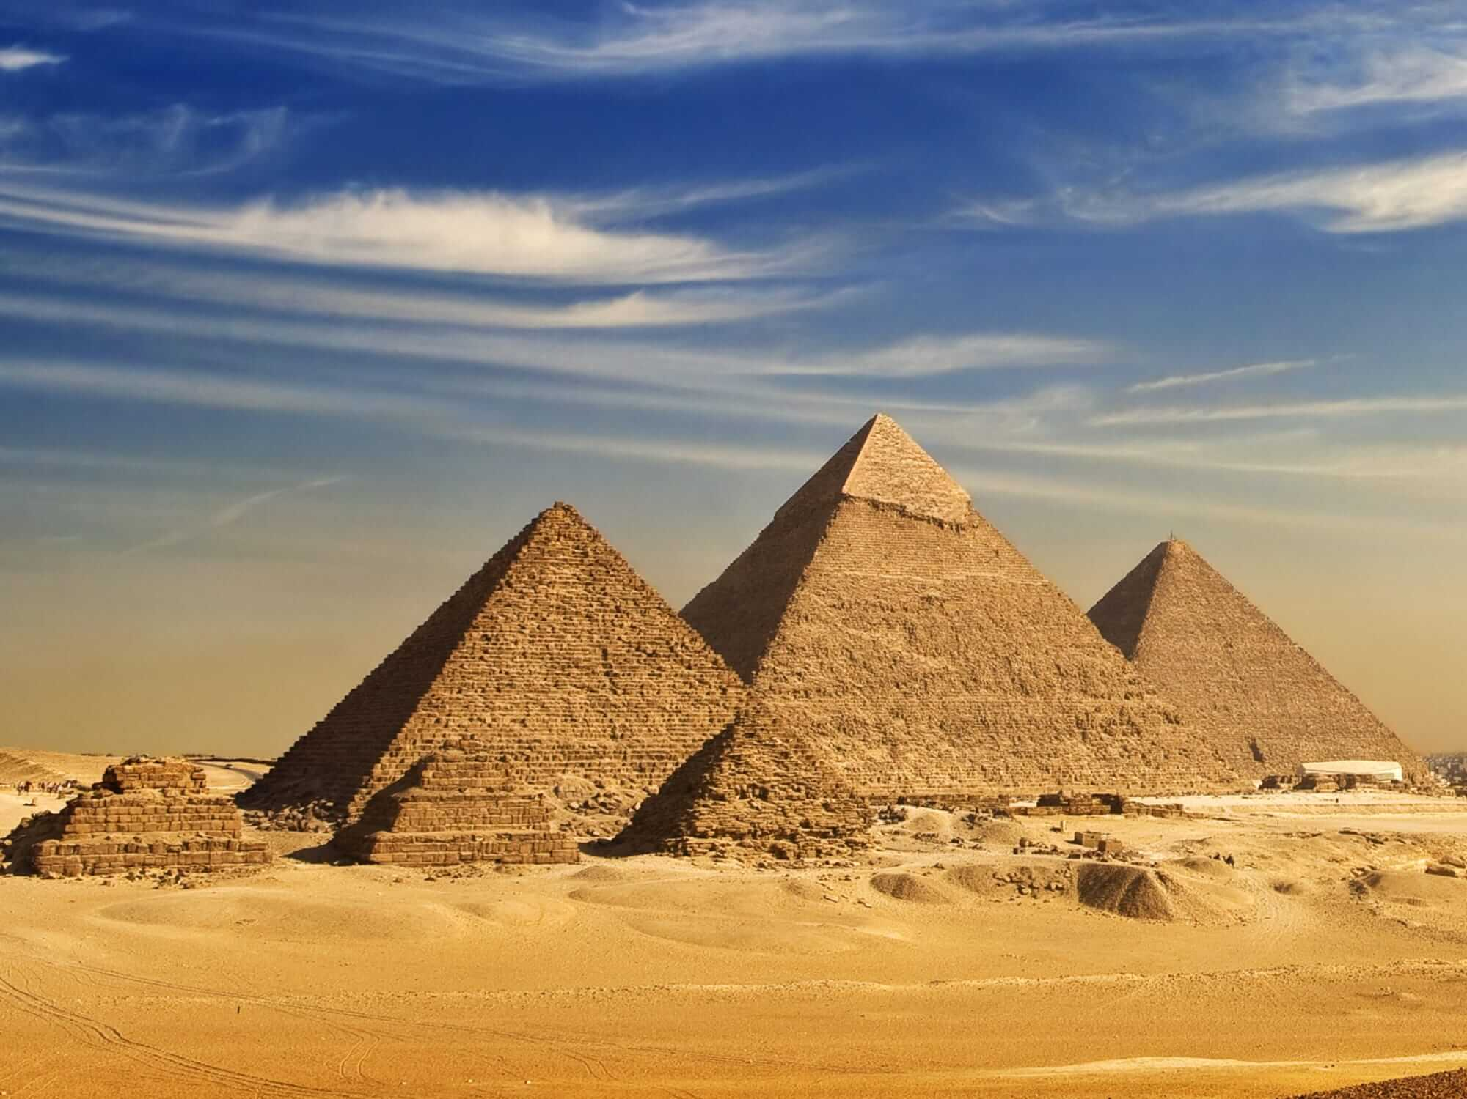
Egyptian Pyramids
.
In Ancient Egypt, the pyramids were impressive structures used as tombs for the burial of pharaohs, alongside their greatest treasures. The Egyptians believed it was important that the pharaoh’s memories were kept alive, even after death. This they called “afterlife”. The three pyamids were build more the 4500 years ago for threes kings. Khufu,Khafre and Menkaura.
Some of the pyramids have survived for thousands of years and provide important clues about life in Ancient Egypt.

Slide 15
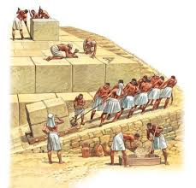
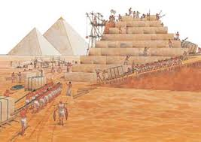
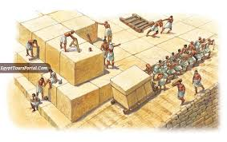
How were the Pyramids built?
It is believed that thousands of slaves used to cut up the large blocks of limestone and then slowly moved them up the pyramid on ramps. The pyramid would get slowly built, one block at a time. Scientists estimate it took at least 20,000 workers over 23 years to build the Great Pyramid of Giza.

Slide 16
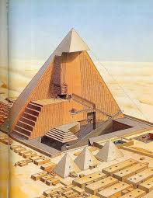
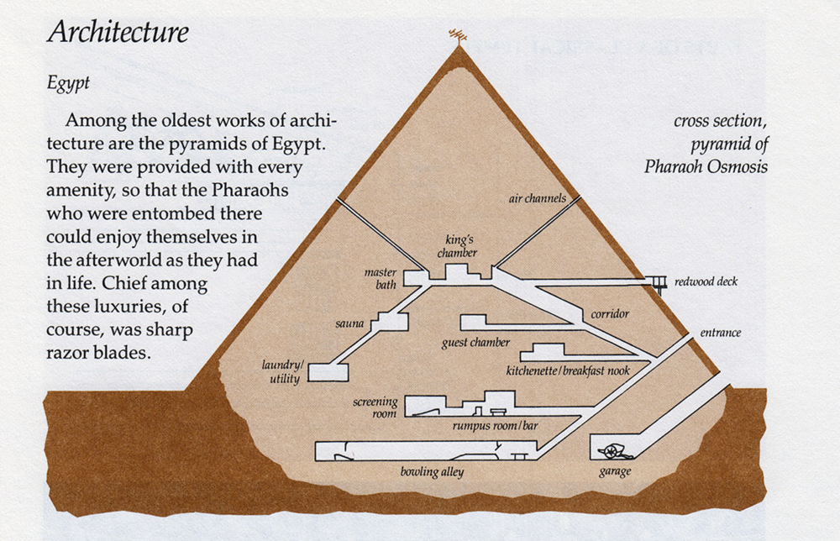
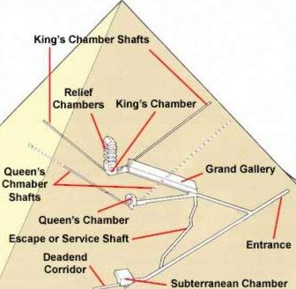
What inside the Pyramids
I
Deep inside the pyramids, lies the Pharaoh's burial chamber - which would be filled with treasure and items for the Pharaoh to use in the afterlife. The walls were often covered with carvings and paintings telling a story of their life.. Near the Pharaoh's chamber would be other rooms where family members and servants were buried.

Slide 17
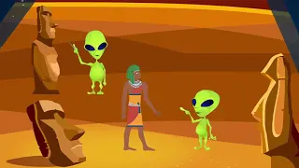
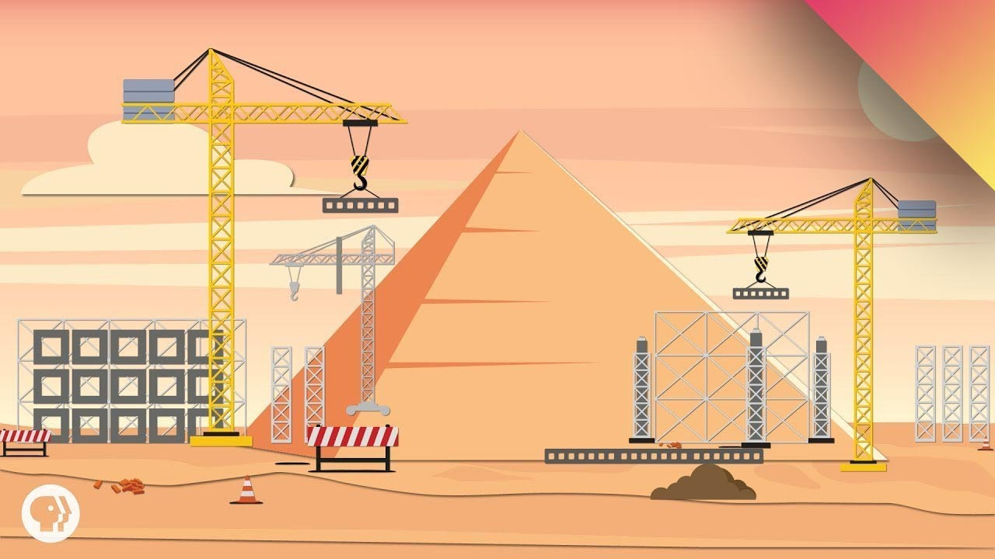
How and Why and How the Pyramids were built?
https://www.youtube.com/watch?v=7GjLBj2RyMs
https://www.youtube.com/watch?v=52V9jmrgSbI

Slide 18
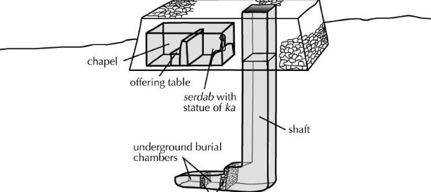
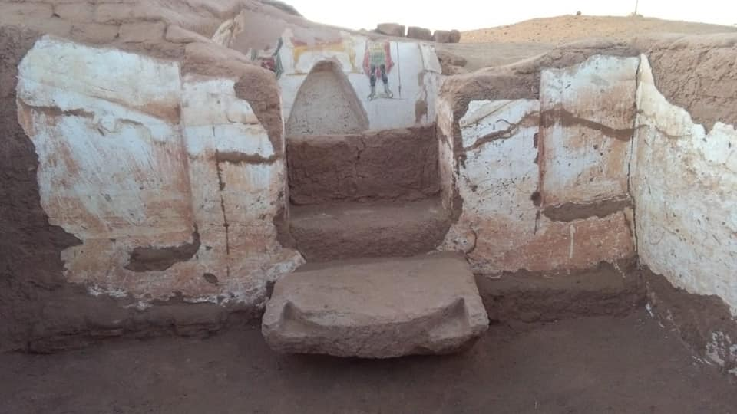
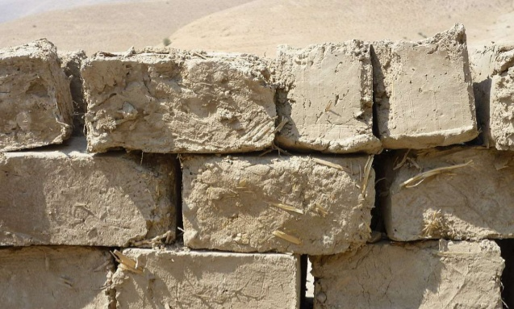
Before pyramids were built the pharaohs and nobles were buried in chamber below flat topped buildings call mastabas. These were made of mud bricks but this was not very practical.
.
The burial chambers were lined with wood and often decorated with paintings. As time went on, the chambers became more complex and would include a small ‘chapel’. At ground level, there were rooms where offerings were left for the deceased.

Slide 19
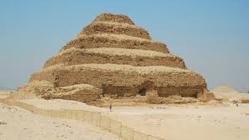
Lets take a closer look at the Pyramids over time.
.
Today in Egypt, there are about 5O pyramids still standing. We are going to look at what happens over the ages and how the pyramids chance.
The stepped pyramid
The Step Pyramid was built in 2630 B.C in Saqqara and is the earliest pyramid build, the pyramid is still there today. It was the burial place of King Djoser. The pyramid was actually a mastaba, which Djoser added rose in six giant steps.
These steps were meant as a huge stairway for King Djoser to climb up to join Ra, the sun-god.

Slide 20
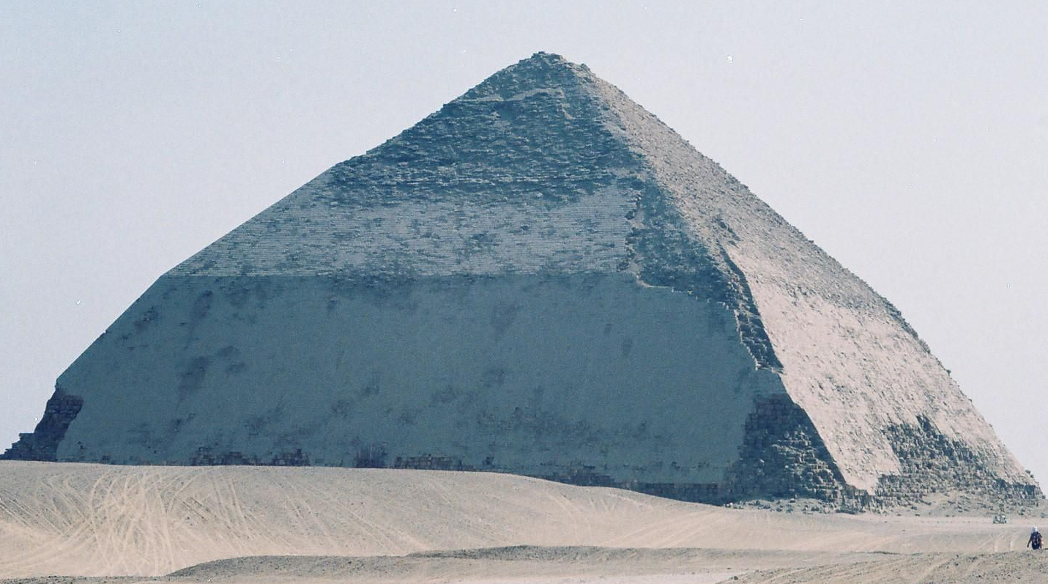
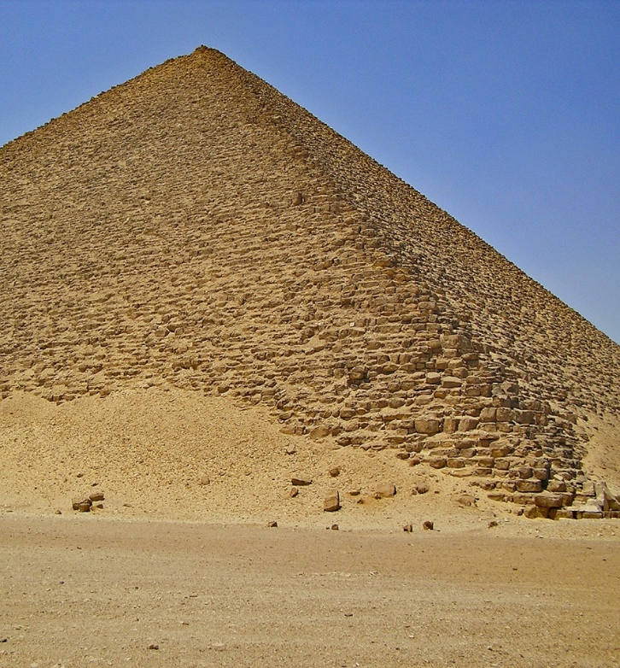
The Bent Pyramid at Dahshur was created by accident and was King Sneferu’s attempt to build the first smooth-sided (true) pyramid. The pyramid was built in Dahshur around 2,600 BC
However, when the building began, the 55° angle of the slope was too steep and while building, engineers realised it was unstable. So, half way up, the angle was changed to 43° to make it more shallow.
The red pyramid and a good fact it took 17 years to build.
The Bent Pyramid
Sneferu learnt lessons in this error and would have the first true pyramid – The Red Pyramid – created in his name with this knowledge.

Slide 21
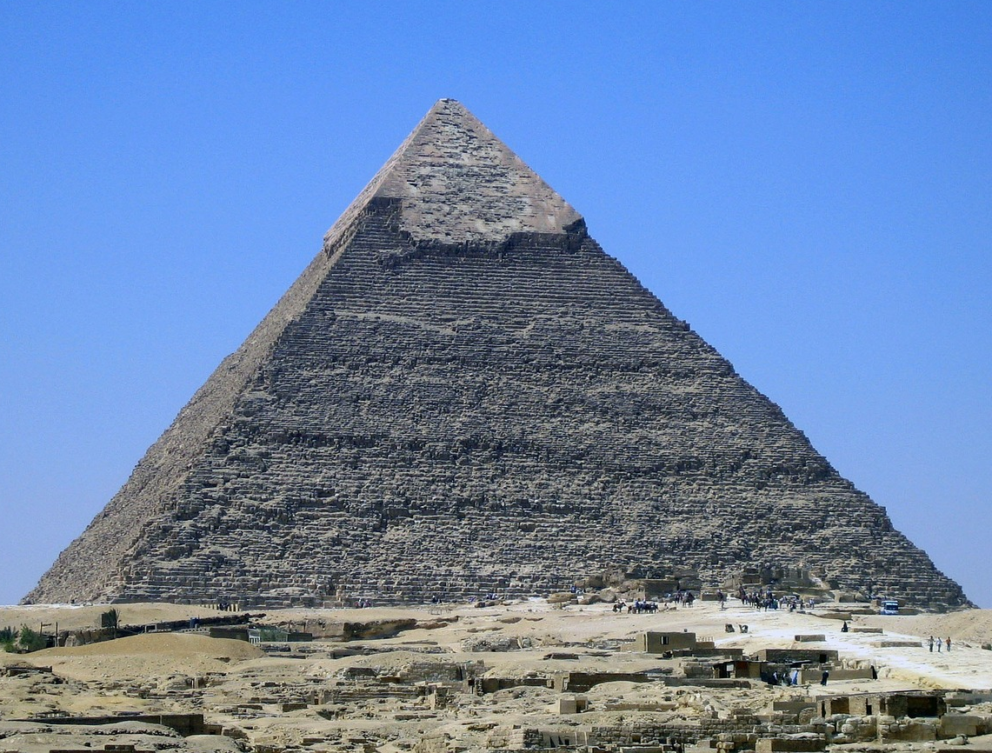
The Greatest Pyramid
The Pyramid of Khufu, sometimes called the 'Great Pyramid' of Giza, is the largest of all the Egyptian pyramids. Built over 4500 years ago, this pyramid was the tallest man made structure in the world until the 1300's. King Khufu ordered another three smaller Pyramids to be build for his three wives.
It is one of the 'Seven Wonders of the Ancient World' and is the only one still standing.

Slide 22
Facts and figure of the Greatest Pyramid
It took over 20 years to build the Great Pyramid of Giza Weight of each block:
Average 2.5 tons and about
2,300,000 limestone blocks were used.
146m high
(original height before removal of stones and natural erosion)
230m
230m
230m
230m
.

Slide 23
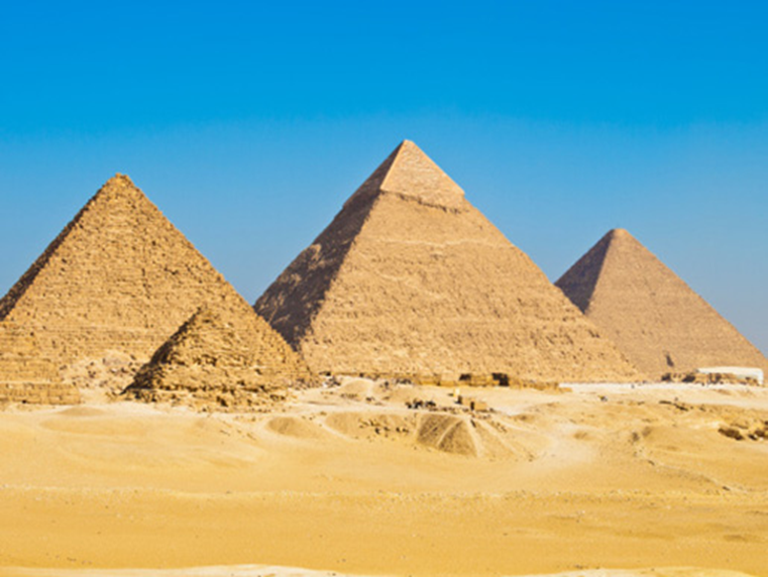
Your turn: Now you have learnt lots of information about the Pyramids fill in the fact sheet.
Ancient Egyptian Pyramids Fasts
Who built the pyramids?
How were the pyramid built?
When was the first pyramid built?
Why where the pyramids built?

Slide 24
Date: Wednesday 3rd March 2021
L.O. To be able to give examples of evidence used to back up historical claims.
Subject: History

Slide 25
Historical Claims.
How do we know its all true?
Over the last week we have been looking at Ancients Egypt
Where Egypt is
The physical and human feathers
How the empery and civilization was ran
The Pharaohs
The Pyramids
What tell us it true?
What proof do we have to say its true?
What thing can have been see or found to support our findings.

Slide 26
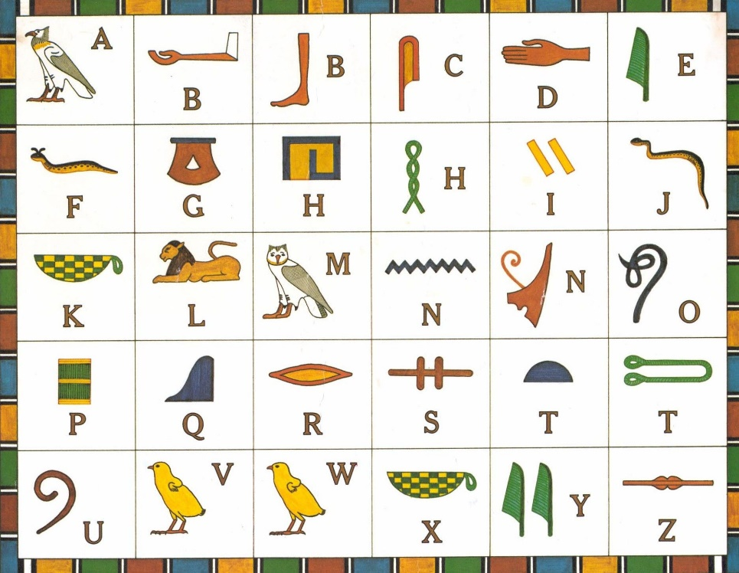
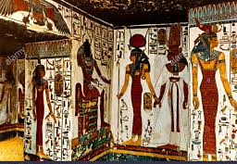
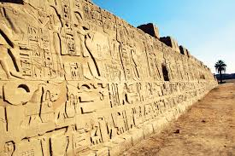
Let’s take a look at another historical facts to support our finding?
First let’s take a look at the pyramids, theses are a fascial features we can see, but deep with the tombs when discovered the wall were full of paintings call hieroglyphics. The hieroglyph painting of the pharaoh life.
Hieroglyphics is a writing system that uses pictures and symbols instead of letters and words. The word hieroglyph means “holy carving.” The Egyptians used hieroglyphics on their temple walls and public monuments.

Slide 27
My turn: to be able discoid hieroglyphics
First picture in the problem.
Now look at the letter next to it. Letter I
I l o v e
t o r u n
So solve the problem look at the hieroglyphic grid and find the picture that match.
I love to run

Slide 28
Your turn: Can you try and solve the problem?

Slide 29
My turn: To give examples of evidence used to back history claims.
Evidence to back up history
There still pyramids in Egypt today.
Pictures and illustrations of the pharaohs were found in the tomb.
Hieroglyphics are still cover the walls of the tombs today.
The pyramids are built next to the river Nile.
I have read back over last weeks work and made some notes.
Here are some of my finding to evidence history claims

Slide 30
Your turn: Now give examples of evidence to back history claims.
Parents please support you child in looking back over all the slide form last week.
Children make notes to of what you find is good evidence. The evidence you find can be transfused onto the grid.
Evidence to back up history
See if you can find a claim I have not told you about yet?

Slide 31
Date: Thursday 4th February 2021
L.O. To be able understand historical events.
Subject:

Slide 32
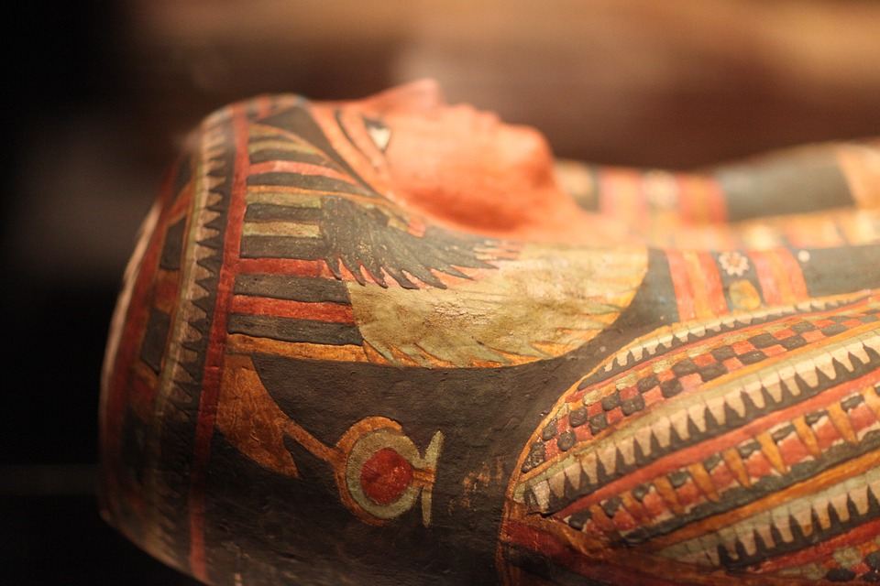
Secrete Ritual of Mummification
A mummy is a body that has been preserved after death, it could be a human or an animal.

Slide 33
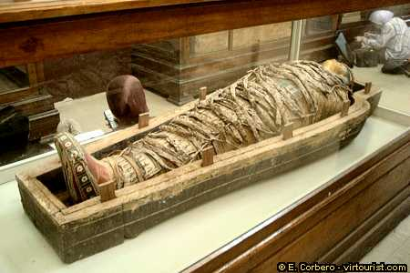
Why did the Egyptians preserve bodies?
The Egyptians believed that when they died their soul left their bodies. After they were buried their soul would return and together with the body would live forever in the afterlife when the world had ended. Unless their body was preserved, it would be no good in the afterlife. Not everyone could afford to, it was a very expensive process that took around 70 days to complete.

Slide 34
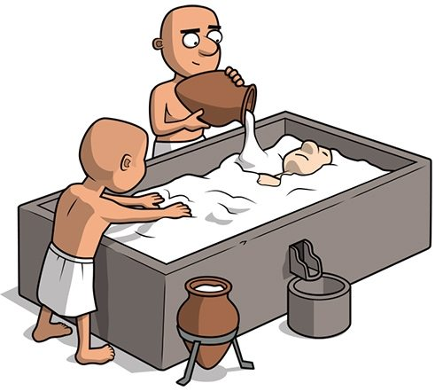
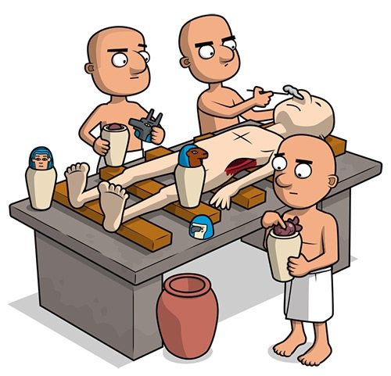
What is the posses of Mummification?
The body was taken to a place called the Beautiful House. It wasn’t as beautiful as the name suggests!
1. The body was cleansed with palm wine and rinsed with water from the River Nile.
2. A cut was made on the left side of the body and the organs removed to stop the body decomposing.
3. The liver, lungs, intestines and stomach were washed, dried in natron and either wrapped in cloth to place in the body later or stored in canopic jars.

Slide 35
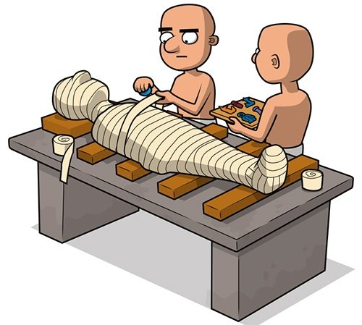
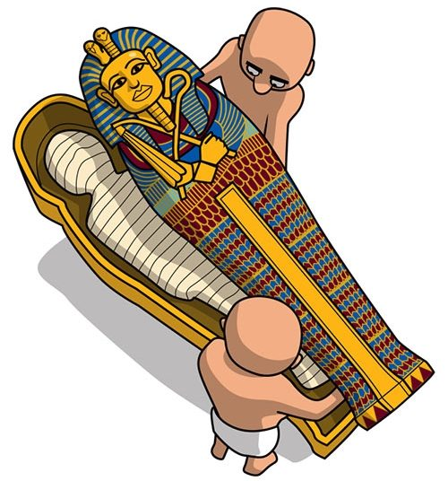
Mummification
5. The heart was put back in the body and salt called natron fill up the cavities and coved up the body. This was to get rid of moisture and was left for 40 days.
6. After the 40 day the natron was scooped out and the body stuffed with spices, rags and plants this so the body doesn’t lose its shape.
7. Wrap up the body in fine linen bandages. Don’t forget to tuck in some lucky amulets, and then utter spells to activate their magical protective powers. When the wrapping is all done, put the mummy in a coffin. Then put that coffin in a coffin, and that coffin in another one and so on. Then place the whole lot in a tomb.

Slide 36
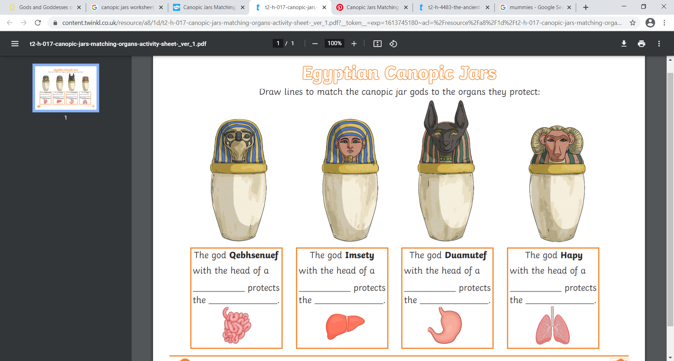
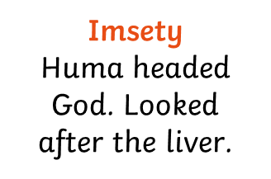
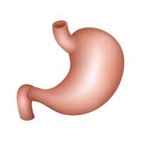
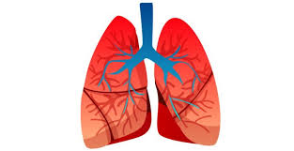
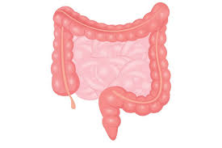
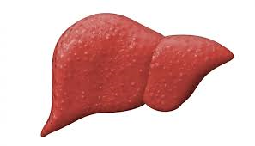
Canopic Jars
The canopic jars had four different heads representing the four sons of Horus.
Hapi
Baboon headed God. Looked after the lungs.

Slide 37
Please watch the two clip to help support your learning.
https://classroom.thenational.academy/lessons/where-did-the-ancient-egyptians-believe-they-would-go-after-death-6hgpce?step=2&activity=video
https://www.natgeokids.com/uk/discover/history/egypt/how-to-make-a-mummy/

Slide 38
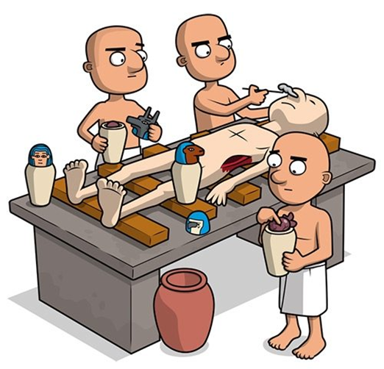
My turn: To fill in the grid with the six stages of mummification. I used the slides above to support my answers.
Stagers of mummification | The stagers of mummification
1 | The body was cleansed with palm wine and rinsed with water from the River Nile.
2
3
4
5
6
7

Slide 39
Your turn: fill in the grid with the six stages of mummification. Use the slides above to support your answers.
Stagers of mummification | The stagers of mummification
1 | The body was cleansed with palm wine and rinsed with water from the River Nile.
2
3
4
5
6
7

Slide 40
Can you fill in the missing words to complete the facts.
The canopic jars had four different heads representing the four sons of Horus.
Qebehsenuef
_________
headed God. Looked after the
_____________
Imsety
Huma headed ______________
Looked after the ______________
Duamutee
Jackal headed God. Looked after the ___________
Hapi
_________ headed God. Looked after the ________

Slide 41
Match the correct organ to the Canopic jar. You point or drag and drop then in place.
Qebehsenuef
Imsety
Duamutee
Hapi

