Slide 1
Tuesday 22nd June 2021
LO. To be able to label a plant and know how it grows.
Subject: Science

Slide 2
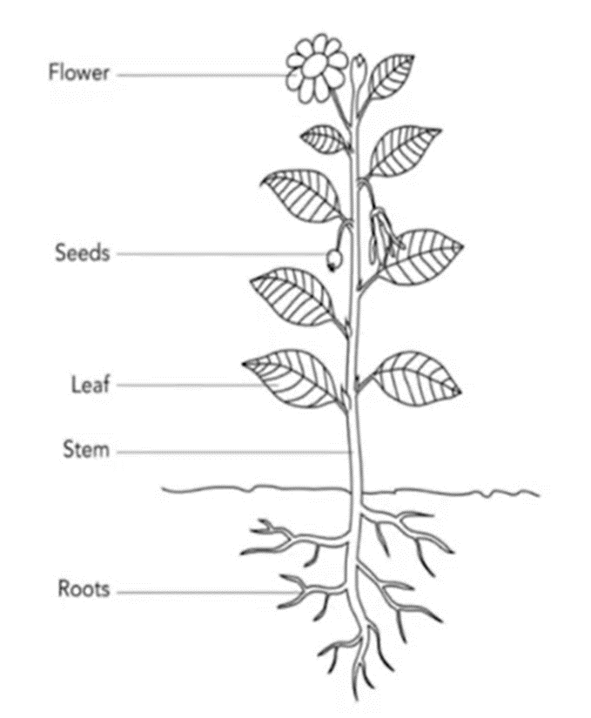
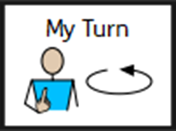
Today we are going to be looking at different parts of a plant and the function it has.

Slide 3
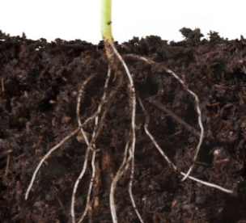
The roots
Most plants have the same basic parts. Each part of the plant has a function to help it grow and survive.
The roots of the plant are usually found under the ground. They help to hold the plant in place and absorb water and nutrients from the soil.

Slide 4
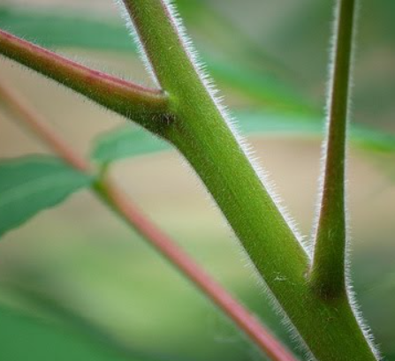
The stem
Supports the plant and helps it to stay upright.
The function of the stem is to move water and nutrients from the roots up to the other parts of the flower.

Slide 5
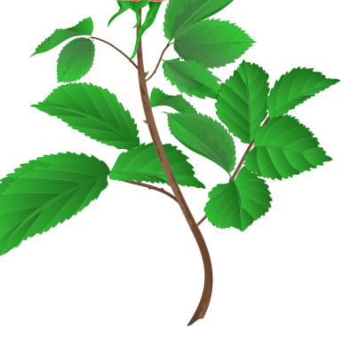
The leaves
Leaves are connected to the stem.
This is where the plants are able to make their own food.
Leaves can come in lots of different shapes and sizes.

Slide 6
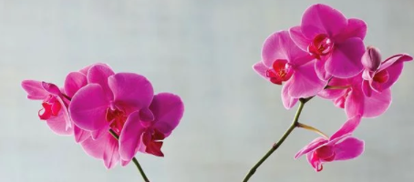
The flower
Some plants may even have flowers during some parts of the year. Flowers produce seeds which form new plants.

Slide 7
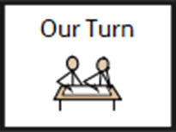
What do plants need to grow?
Watch the clip below and write down the 5 things plants need to grow.
https://www.bbc.co.uk/bitesize/clips/z9f87hv

Slide 8
Did you get all of them?
Water
Sunlight
Suitable temperature
Air
Time
Place the pot somewhere it will get sunlight and keep watering the plant until you can see the stem starting to grow.
If you take care of your plant it will slowly grow to have strong roots, stem and have a flower at the top.
If a plant does not get the right care the roots will grow weak and the flower will die.

Slide 9
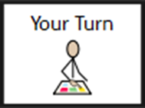
The task
Draw a flower and see if you can label each part:
Roots
Stem
Leaves
Flower
Write next to each label what the function of the part is.
Challenge- Write it down
Can you remember the 5 things a plant needs to grow?

Slide 10
Roots
Stem
Leaves
Flower

Slide 11
Wednesday 23rd June 2021
L.O To be able to recognise classroom objects.
Subject: French

Slide 12
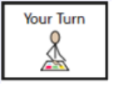
Watch the video below to help you pronounce a range of classroom objects in French.
https://www.youtube.com/watch?v=dzEPv-Zc3eg

Slide 13
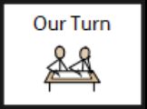
If you are struggling to access the video. These are the classroom objects we have been through!

Slide 14
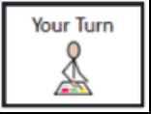
Classroom Objects
Task 1 - Draw a line to match the English and French.
English
French
A pen
A pencil
A textbook
A rubber
A ruler
A pencil case
Un stylo
Un livre
Un crayon
Une regle
Une gomme
Une trousse

Slide 15
Task 2 - Complete the sentences by adding the correct classroom object in French from the list.
Once writing my date and learning objective I use a _____________to underline my work.
I store all of my equipment inside of my _______________.
The ____________ are stacked in our classroom cupboards until needed.
I am relieved I used a __________ therefore I can use a __________ to remove my mistakes.
Word List
Une regle
Un crayon
Un stylos
Un livre
Une trousse

Slide 16
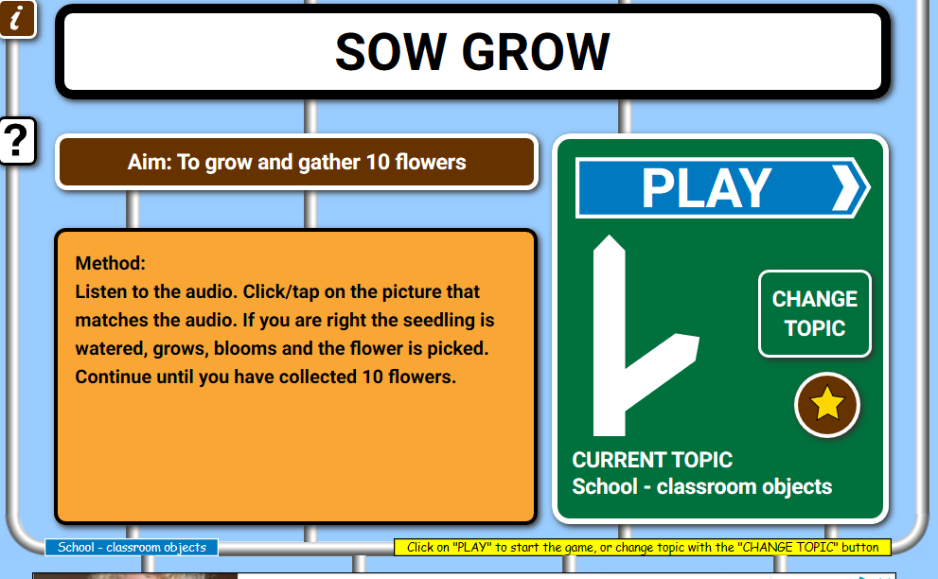
Test yourself using a classroom objects game!
https://www.french-games.net/frenchgames/sow-grow?topic=School%20-%20classroom%20objects&level=primary

Slide 17
Thursday 23rd June 2021
LO To be able to describe how to be safe on the roads
Subject: PSHE

Slide 18
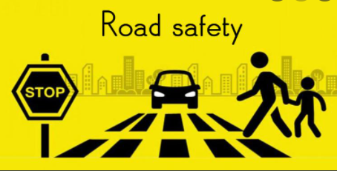
It is important to keep yourself safe when you are near roads.
You might play out with your friends, go on bike rides or go for walks.
You also need to be safe when you are a passenger inside a vehicle.

Slide 19
What can Reggie do to cross the road safely?

Slide 20
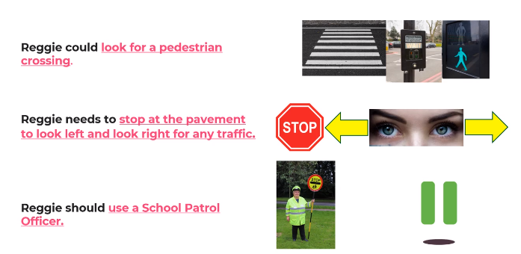
Did you think of any these ideas?

Slide 21
You will see lots of road signs when you are out and about.
Do you know what these ones mean?

Slide 22
Here is a handy tip. Signs in a triangle are a warning. Signs in a circle are an order.

Slide 23
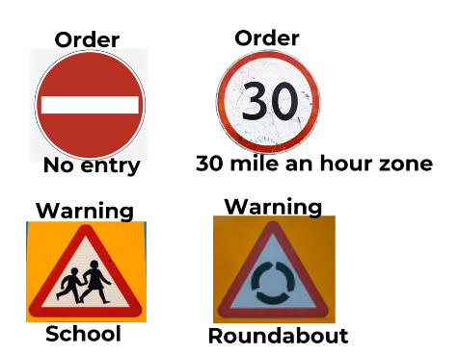
Check your answers to see how many you identified correctly.

Slide 24
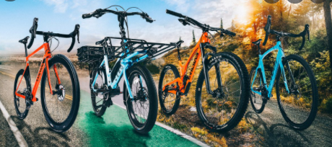
Question. What could you do when you are out on your bike to help you keep safe?

Slide 25
Write some ideas in the bubbles.

Slide 26
Top tips to cycle safety.

Slide 27
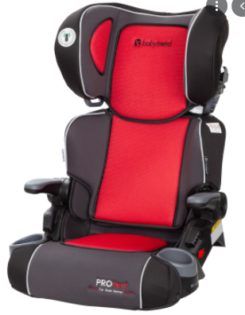
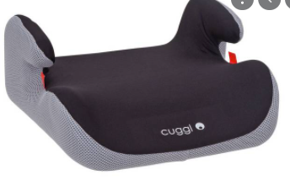
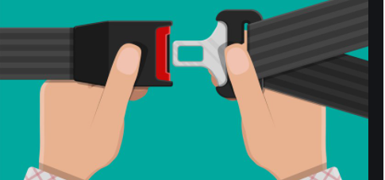
Stay safe when traveling in a vehicle.
Use a seat that supports you best.
You have to be taller than 135cm or 12 years old to travel in a vehicle with out needing a booster seat or car seat.
Always fasten your seatbelt and wear it across your shoulder.

Slide 28
Road Safety top tips.
Use these top tips when completing your task.

Slide 29
Your Task - Create a road safety information poster.

Slide 30
Road Safety

Slide 31
Friday 25th June 2021
LO. To be able to understand the life cycle of a plant.
Subject: Science

Slide 32
What is the life cycle of a plant?
https://www.bbc.co.uk/bitesize/topics/zpxnyrd/articles/z2vdjxs

Slide 33
From a Seed to a Plant
The first step in the life cycle of a plant is the seed needs to
be planted in the soil.
The seed can be planted in a pot inside or in the ground outside
Once the seed is planted in the soil and watered, it will take about one to two weeks before it starts to grow. This is called the germination stage.
Once the seed germinates, it will start to sprout and roots appear. The roots help the plant get food and water from the soil.

Slide 34
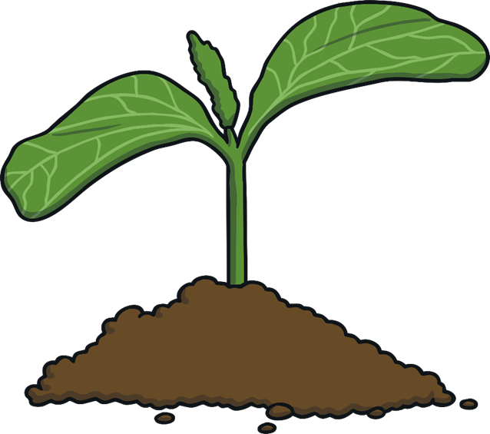
From a Seed to a Plant
In the next few weeks, the seed will begin to push through the soil.
It is now a seedling.
It is still very tiny during this stage and the roots will anchor it in the soil and keep it from blowing away.

Slide 35
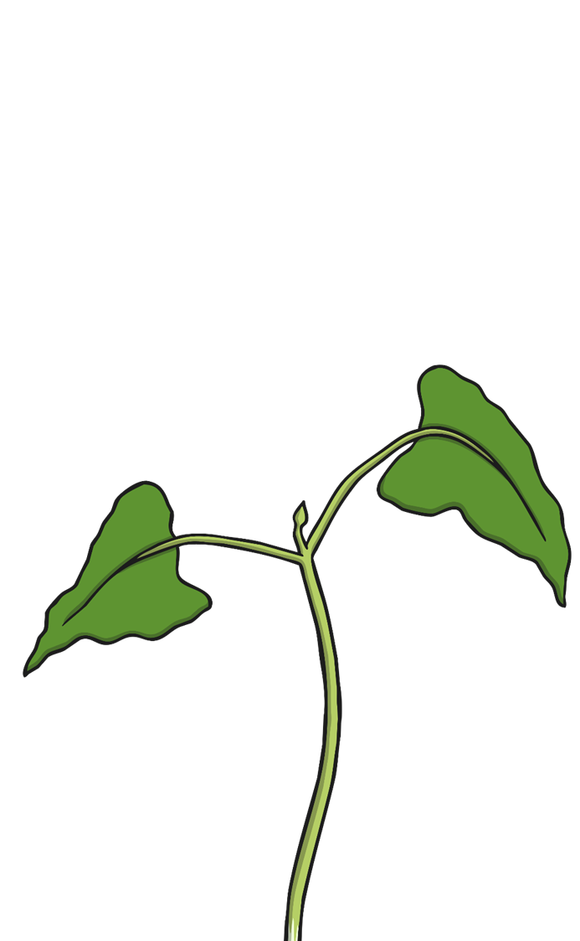
Growing seedling
As the seedling continues to grow, it will begin to get leaves and the stem will grow longer and longer. The stem helps the plant stand upright.
The stem also delivers water from the roots through tiny tubes. The leaves soak up the light and air to make food for the plant. This process is called photosynthesis.

Slide 36
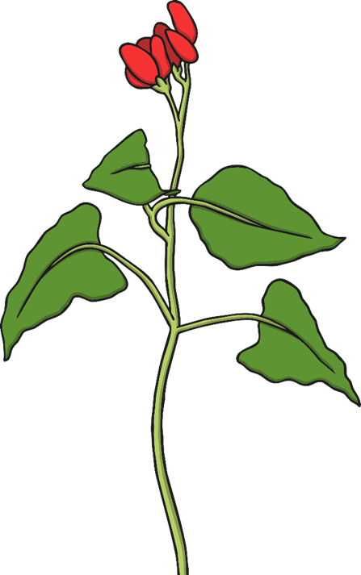
Turning into a young plant
A bud will begin to appear on the plant and it will turn into a flower. Depending on the type of seed planted, the flower may turn into either a fruit or vegetable or stay a flower.

Slide 37
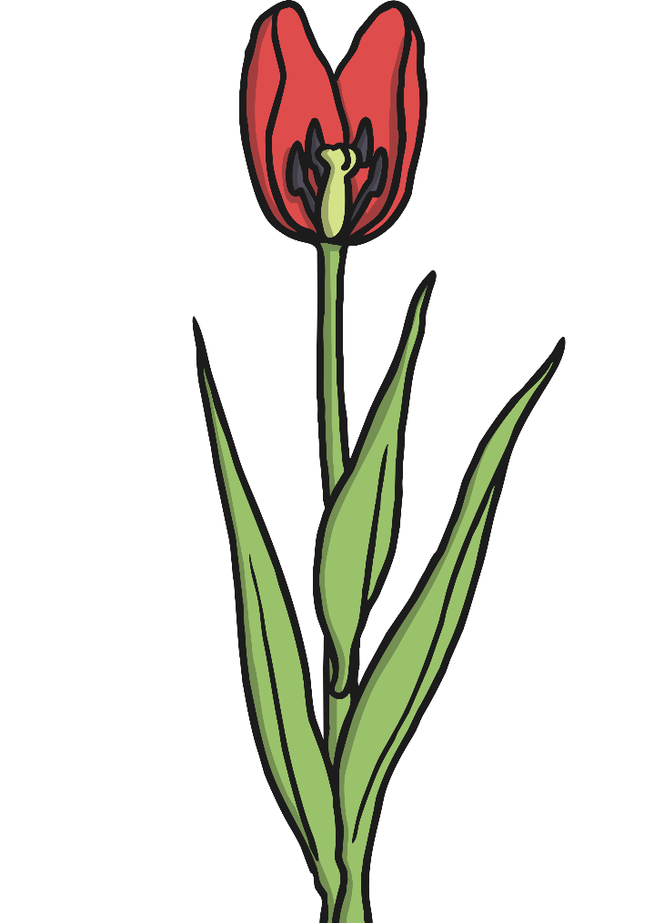
Mature plant
Seeds are located in the centre of the flower. Once the plant stops growing, it will drop seeds onto the ground.
Some seeds are spread by the wind or by animals. These seeds will begin to grow in the soil and the life cycle of the plant will repeat.

Slide 38
Seed dispersal
Plants disperse their seeds in lots of different ways. Some seeds are transported by the wind and are shaped to float, glide or spin through the air.
Plants growing near a river may use the flowing water to transport their seeds.
Some seed pods are designed to explode and throw the seeds a good distance from the parent plant.
Many plants also use animals to carry their seeds. This type of seed may have handy hooks which attach to an animal’s fur. Alternatively, the plants might make tasty fruit to enclose the seeds, which attract animals to eat them.

Slide 39
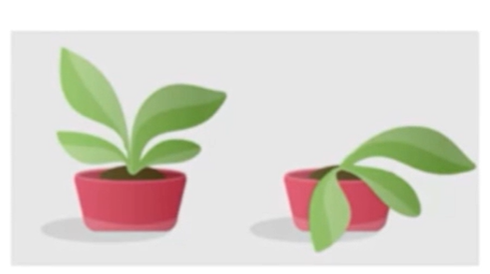
Lack of water
If there is not enough water in the soil, there will be less water in the stem and leaves.
This will cause the plant to wilt.
We know plants need water to survive.

Slide 40
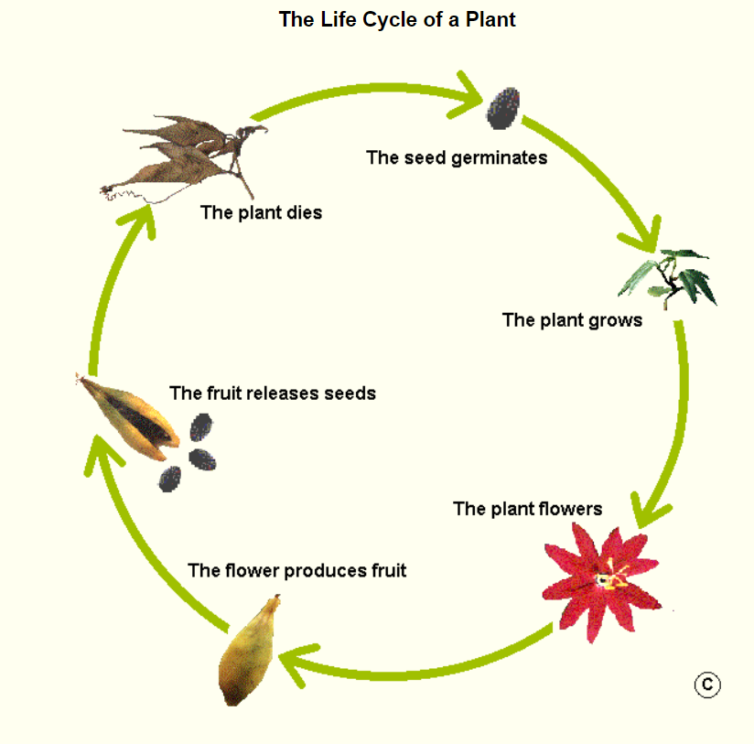
The task
To draw a diagram showing the life cycle of a plant. Similar to the picture using the knowledge you have learnt today.
Planting the seed.
Becoming a seedling
What happens next? Keep going.

Slide 42
Monday 28th June 2021
L.O To be able to use classroom instructions.
Subject: French

Slide 43
Use the link below to help you pronounce a range of classroom instructions in French.
Locate the Instructions in the classroom heading and click the orange sound symbols to listen.
https://www.bbc.co.uk/bitesize/topics/zjcbrj6/articles/z4q8g7h

Slide 44
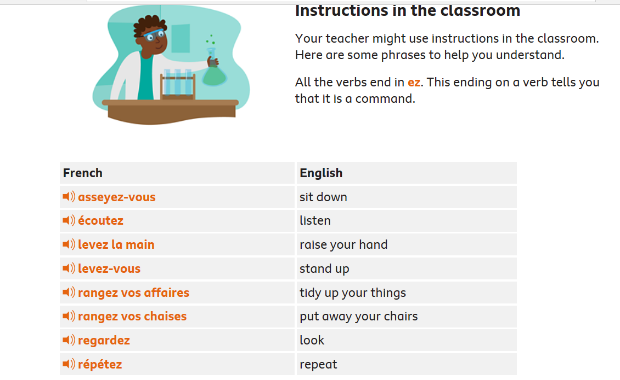
With a partner take turns pronouncing some of the instructions.

Slide 45
Task 1 - Number the images correctly in each box so the demonstration and instruction match.
1. ecoutez
2. levez-vous
3. regardez
4. levez la main
5. asseyez-vous

Slide 46
Task 2- Complete the sentences by adding in the correct classroom instruction.
When I want to share my ideas I must ______________.
I must _________________ carefully so I understand the task given.
Sometimes when we _________ at the board, it is easier if we ___________ in our carpet spots.
At the end of the day we __________ and push our chairs under the table.
Word list
asseyez-vous
ecoutez
levez- la main
levez-vous
regardez

Slide 47
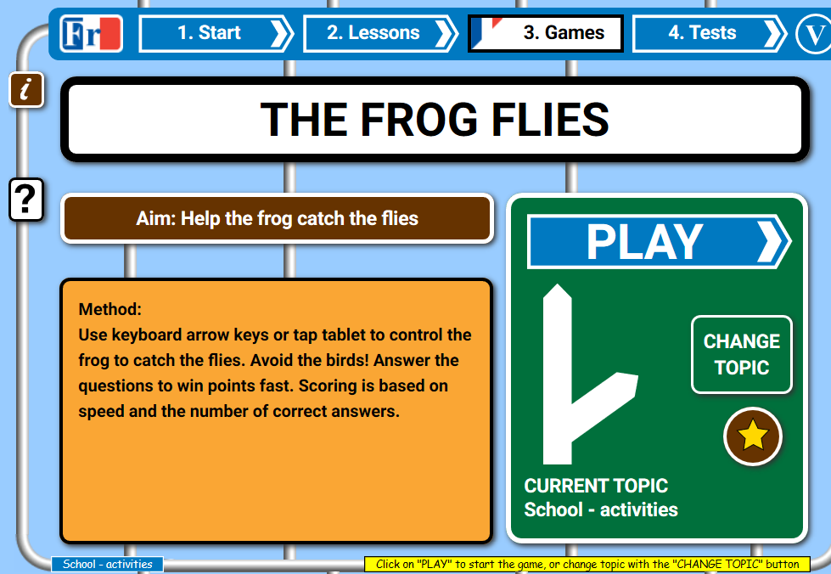
Test yourself using a school activities game!
https://www.french-games.net/frenchgames/the-frog-flies?topic=School%20-%20activities&level=primary

