Slide 1
Subject: Maths
Pack: A

Slide 2
Date: 08.02.21
LO To be able to read scales in kilograms.
Subject: Maths

Slide 3
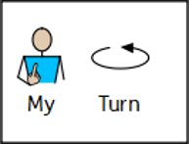
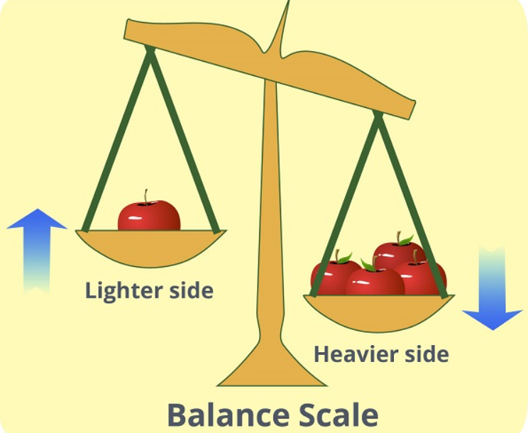
Mass
Mass is the amount of matter (stuff) that an object contains.
The more matter something has, the more it will weigh here on Earth.
The lighter the objects, the less mass (matter) there is.
The heavier the objects, the more mass (matter) there is.

Slide 4
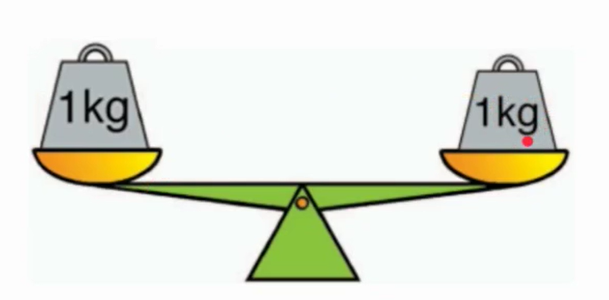
Kilograms
Mass is the amount of matter (stuff) that an object contains.
It is a unit of measure often used to weigh objects.
When we are weighing in kilograms, we need to write the letters kg after the weight.

Slide 5
Pre-recorded Teaching
Access the online teaching video below that will support you to complete the work in this lesson. This video will act as a support but all of the work can still be successfully understood & completed using paper-based versions of this pack. If you need further support to understand / complete work then please contact school via e-mail or telephone.
Play Video

Slide 6
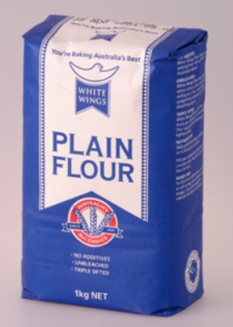
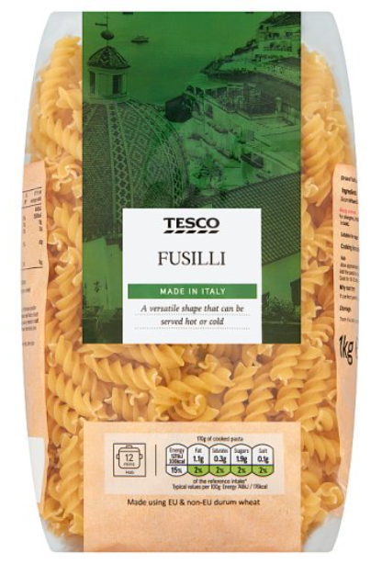
Kilograms
Mass is the amount of matter (stuff) that an object contains.
It is a unit of measure often used to weigh objects.
Some objects weighed in kg’s are…
1kg is written on the packet to show us how much mass is in the packet

Slide 7
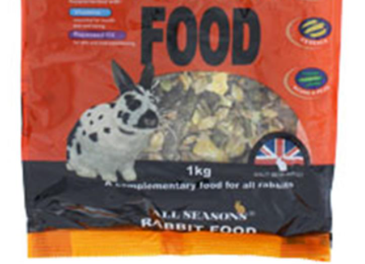
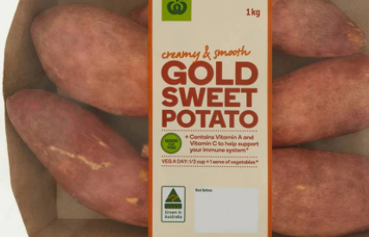
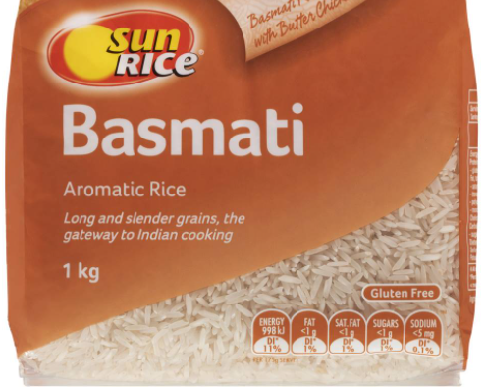
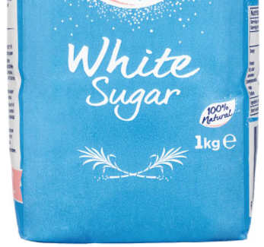
Finding objects that are weighed in kg’s
Here is the kg notation showing us the weight of the object.
Pasta and flour can be bought in 1kg bags.
Circle the ‘kg’ notation on these items:

Slide 8
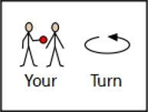
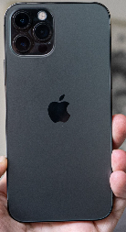
Kg Hunt
Here is the kg notation showing us the mass of the object.
Pasta and flour can be bought in 1kg bags.
Look around your house for items showing the objects mass in kg’s. Write them down on the lines below.
Hint - it might be easiest to find things in the kitchen!
Email a photo of you hunting for kg packets to:
pioneerspupils@gmail.com so that you can be in our weekly Facebook post!

Slide 9
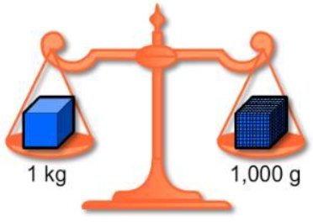
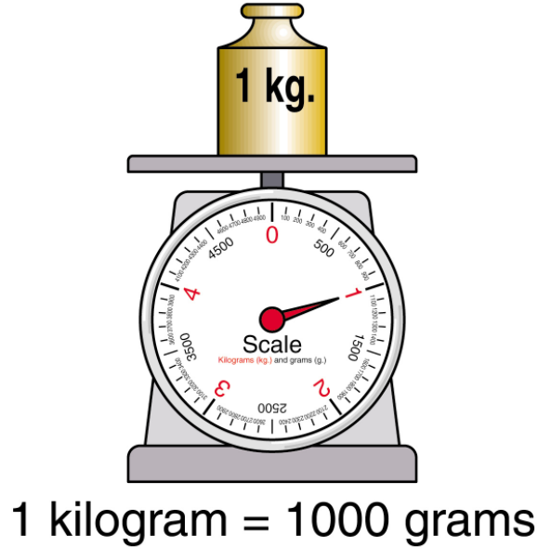
Grams
They are a unit of measure often used to weigh objects.
Grams can be shortened to g when we are finding the mass of different objects.
1 gram (1g) is a lot less than 1 kilogram (1kg).
There are 1000g (1 thousand grams) in a kg.

Slide 10
Grams or Kilograms
Would be measure these objects in grams (g) or kilograms (kg)?
Circle the correct measurement below…
I know roughly how much 1kg feels like because I’ve held a bag of flour.
I know that a letter weighs a lot less than a bag of flour so the letter would be measured in grams rather than kilograms.
Grams (g)
Kilograms (kg)

Slide 11
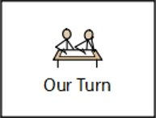
Grams or Kilograms
Would be measure these objects in grams (g) or kilograms (kg)?
Circle the correct measurement below…
I know roughly how much 1kg feels like because I’ve held a bag of flour.
I know that a suitcase weighs more than a bag of flour so the suitcase would be measured in kilograms.
Grams (g)
Kilograms (kg)
Use this information to circle either grams or kilograms.

Slide 12
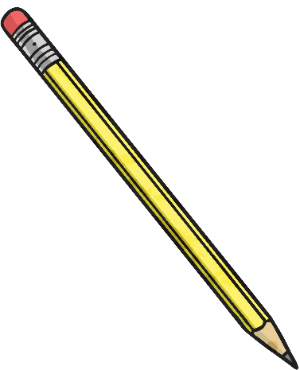
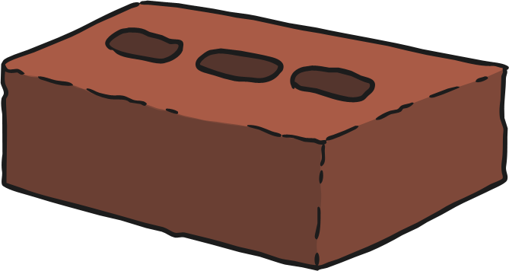
Grams or Kilograms
Would be measure these objects in grams (g) or kilograms (kg)?
Circle the correct measurement below…
Grams (g)
Kilograms (kg)
Grams (g)
Kilograms (kg)

Slide 13
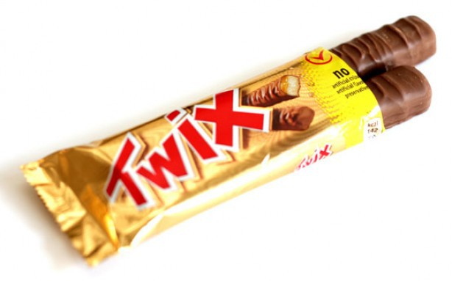
Grams or Kilograms
Would be measure these objects in grams (g) or kilograms (kg)?
Circle the correct measurement below…
Grams (g)
Kilograms (kg)
Grams (g)
Kilograms (kg)

Slide 14
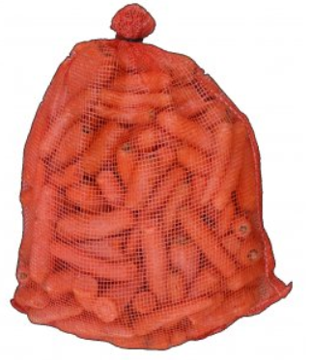
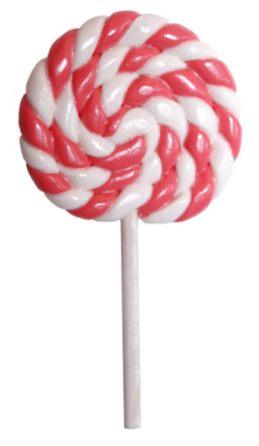
Grams or Kilograms
Would be measure these objects in grams (g) or kilograms (kg)?
Circle the correct measurement below…
Grams (g)
Kilograms (kg)
Grams (g)
Kilograms (kg)

Slide 15
Grams or Kilograms
Would be measure these objects in grams (g) or kilograms (kg)?
Find some different objects around your house that you would measure in grams (g) or kilograms (kg). Record the different items you find in the table below:
Measure weight in grams (g) | Measure weight in kilograms (kg)
Tub of jelly | Box full of books
Email a photo of you finding objects measured in grams/kilograms to:
pioneerspupils@gmail.com so that you can be in our weekly Facebook post!

Slide 16
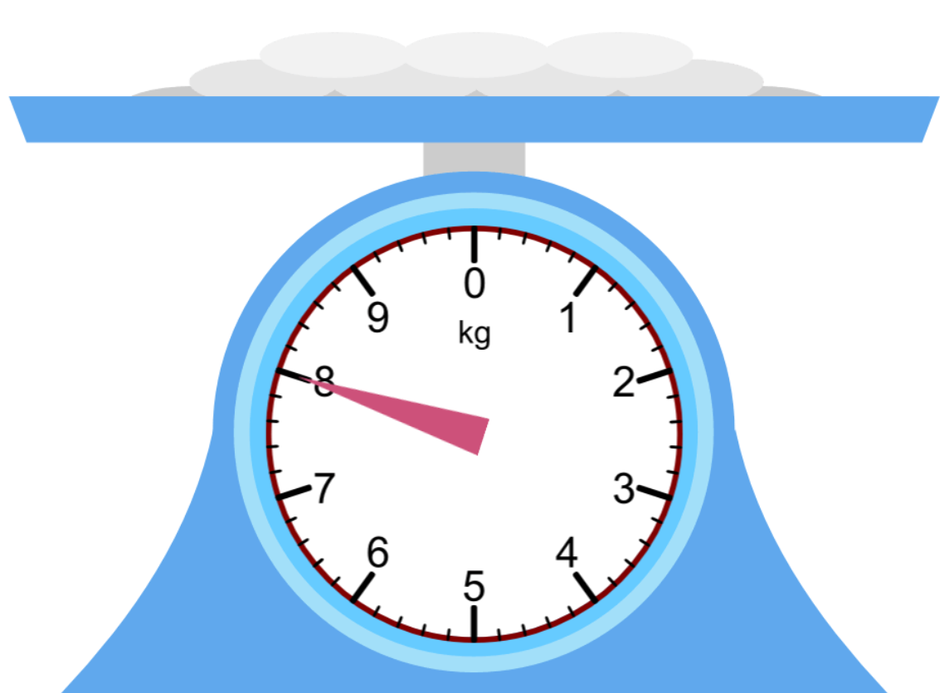
Reading Scales in Kilograms
We know we are reading the scales in kilograms because it says kg on the scales.
How much does the flour weigh?
8kg
We know it’s 8kg because we are measuring in kg’s and the hand (pointer) is pointing right onto the 8.

Slide 17
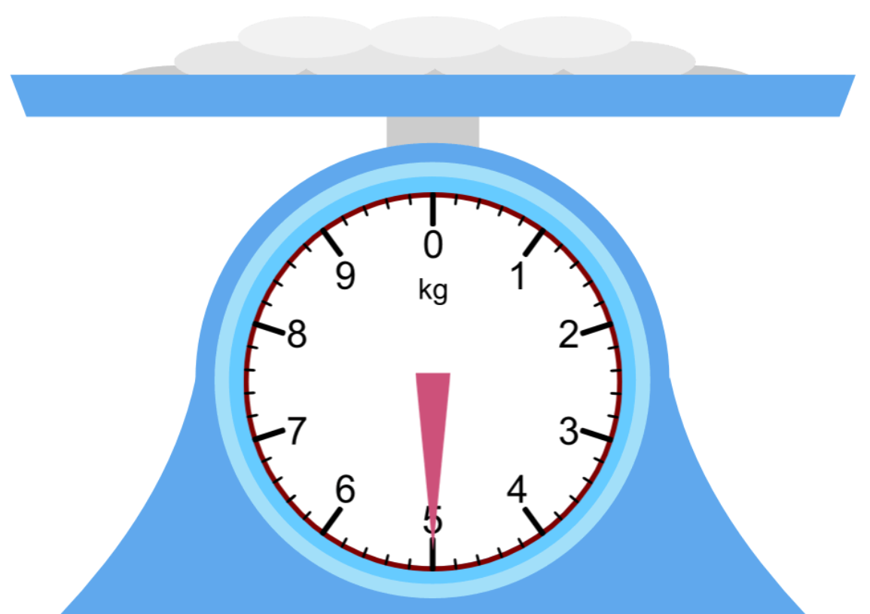
Reading Scales in Kilograms
We know we are reading the scales in kilograms because it says kg on the scales.
Write your answer on the line.
How much does the flour weigh?
Look carefully at the number the hand is pointing to on the scales.
Don’t forget, your answer needs to have kg at the end.

Slide 18
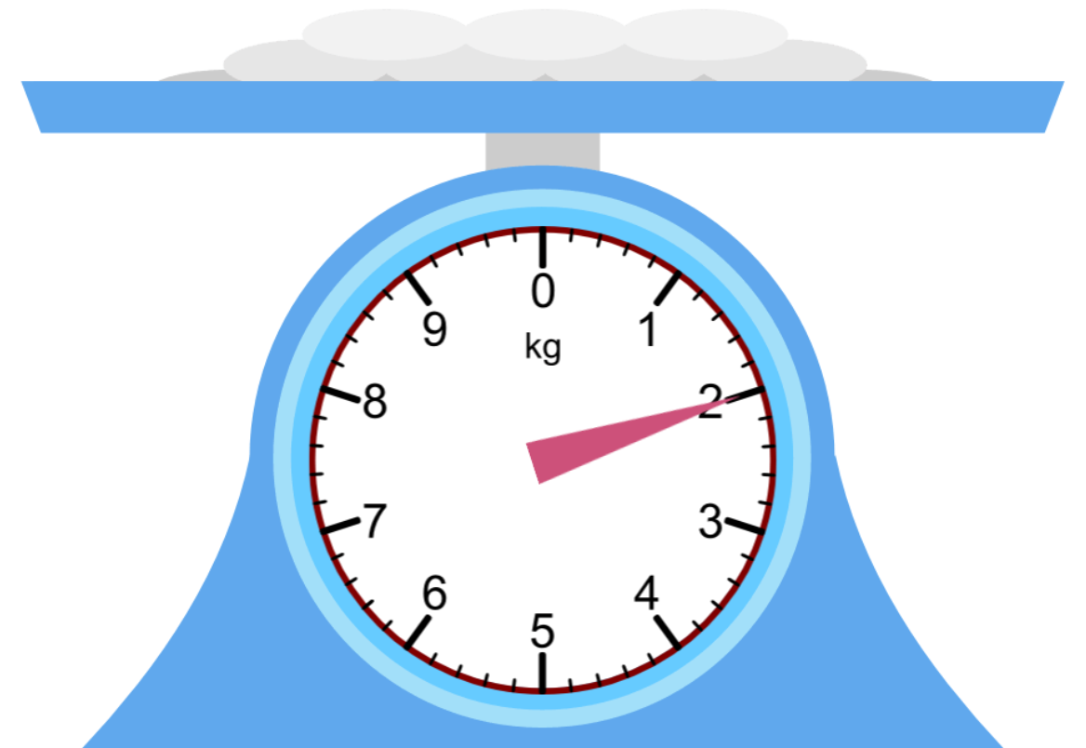
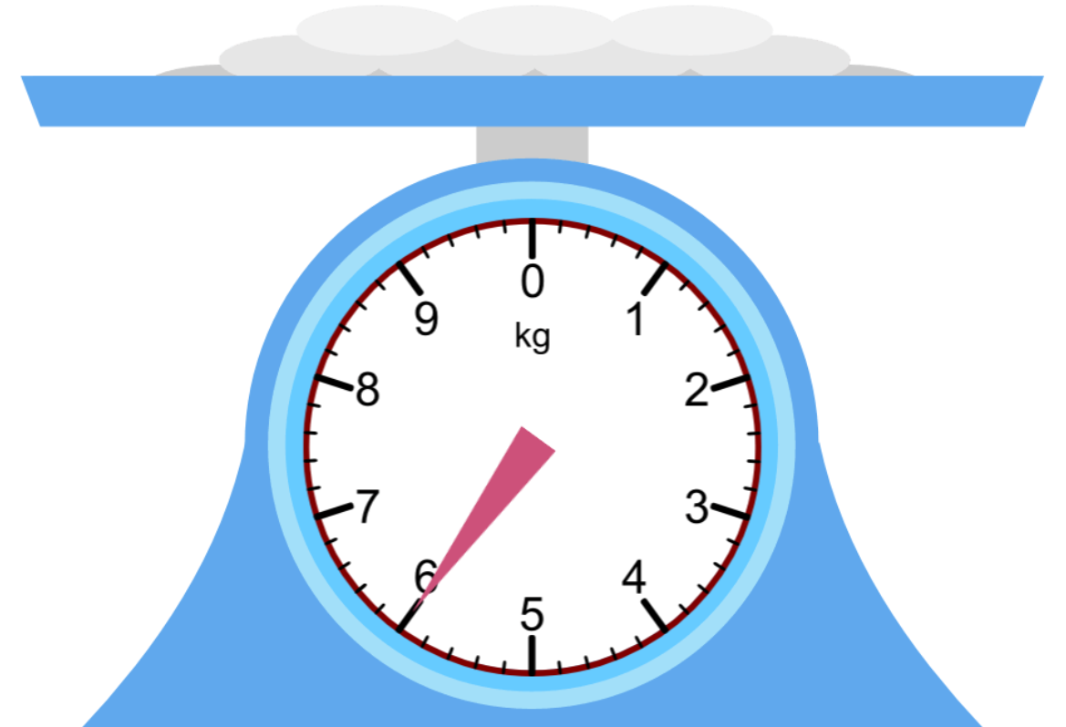
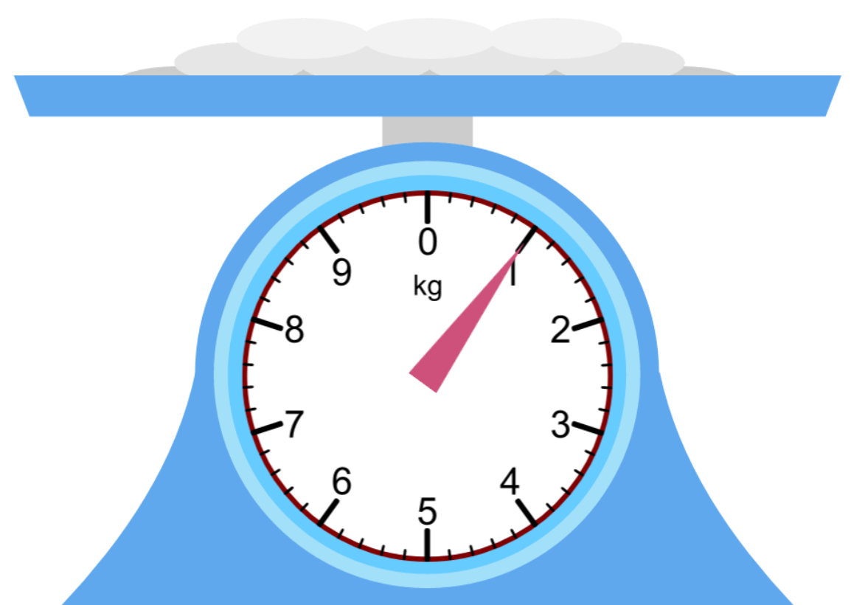
Reading Scales in Kilograms
We know we are reading the scales in kilograms because it says kg on the scales.
Don’t forget, your answer needs to have kg at the end.
How much does the flour weigh?
A)
B)
C)
Which scales shows the heaviest amount of flour?
Answer A, B or C.
Which scales shows the lightest amount of flour?
How much flour was weighed altogether?

Slide 19
Challenge!
Have a go at these problems…

Slide 20
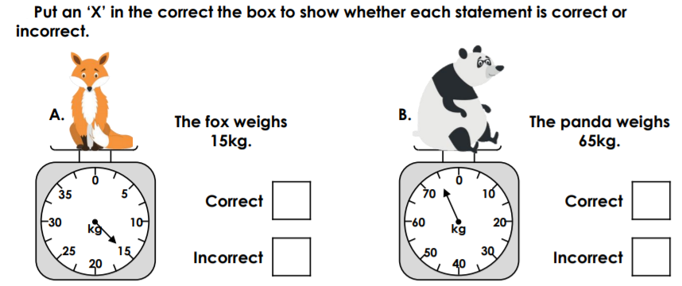
Challenge
Complete the sentence about the panda…
correct/incorrect
The weight of the panda is _____________________ because ____________________
________________________________________________________________________

Slide 21
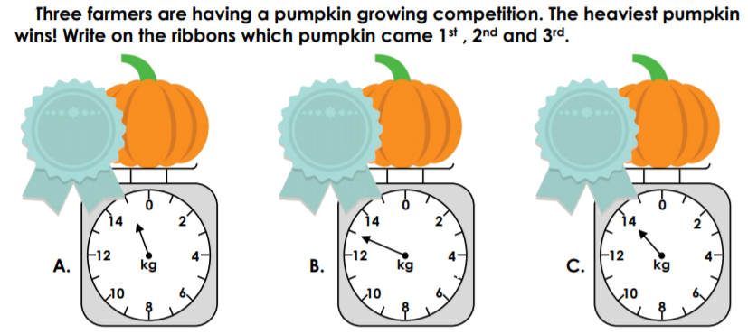
Tricky Challenge
A / B / C
lightest / heaviest
Complete the sentence about the winning pumpkin…
Pumpkin ______ is the winning pumpkin because it is the ____________________ .
I know this because ___________________________________________________________ .

Slide 22
Well done for all of your hard work this lesson!
Please send any completed work/photographed evidence of completed work (practical activities) to pioneerspupils@gmail.com or deliver it to the dropbox outside of school on a Friday.

Slide 23
Date: 09.02.21
LO To be able to read scales in grams.
Subject: Maths

Slide 24
Recap - Mass
Mass is the amount of matter (stuff) that an object contains.
The more matter something has, the more it will weigh.
The lighter the objects, the less mass (matter) there is.
The heavier the objects, the more mass (matter) there is.

Slide 25
Recap - Grams
They are a unit of measure often used to weigh objects.
Grams can be shortened to g when we are weighing objects.
1 gram (1g) is a lot less than 1 kilogram (1kg).
There are 1000g (1 thousand grams) in a kg.

Slide 26
Pre-recorded Teaching
Access the online teaching video below that will support you to complete the work in this lesson. This video will act as a support but all of the work can still be successfully understood & completed using paper-based versions of this pack. If you need further support to understand / complete work then please contact school via e-mail or telephone.
Play Video

Slide 27
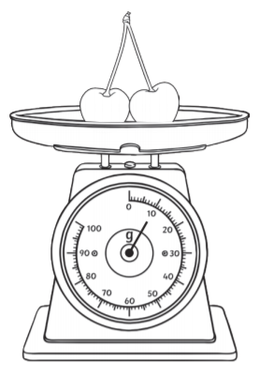
Reading Scales in Grams
We know we are reading the scales in grams because it says g on the scales.
How much do the cherries weigh?
10g
We know it’s 10g because we are measuring in g’s and the hand (pointer) is pointing right at the 10.

Slide 28
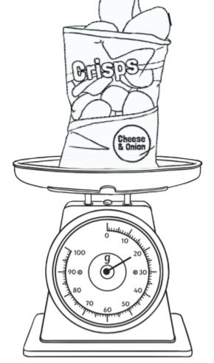
Reading Scales in Grams
We know we are reading the scales in grams because it says g on the scales.
How much do the crisps weigh?
We know it’s _____ because we are measuring in g’s and the hand (pointer) is pointing right at the ____ .

Slide 29
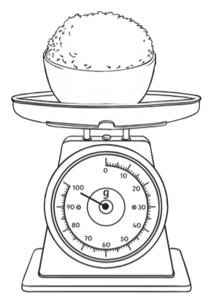
Reading Scales in Grams
We know we are reading the scales in grams because it says g on the scales.
How much does the rice weigh?
We know it’s ________ because we are measuring in g’s and the hand (pointer) is pointing right at the _______ .

Slide 30
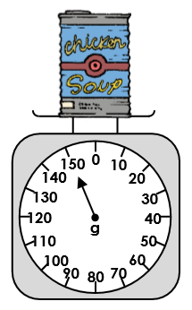
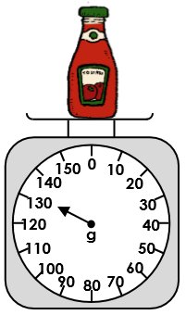
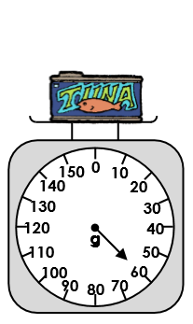
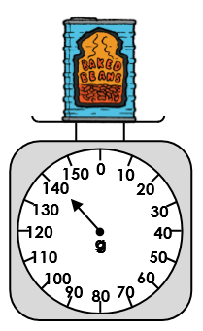
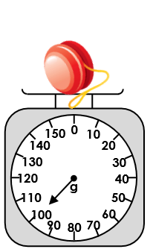
Reading Scales in Grams
Don’t forget, you need to write g after the number so we know they’ve been measured in grams.
Scales can have different numbers on them depending on the intervals they go up in. Look closely at the different scales to work out the weighs of the different objects.

Slide 31
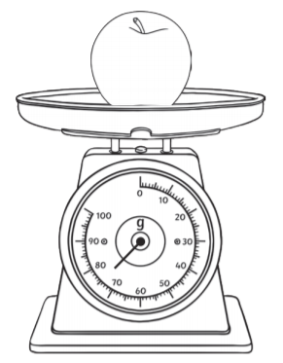
Reading Scales in Grams
How much does the apple weigh?
We know we are reading the scales in grams because it says g on the scales.
75g
We know it’s 75g because if I look between 70 and 80 on a number line …
70
71
72
73
74
75
76
77
78
79
80
75 is in the middle of the two numbers.
The pointer is pointing right in the middle of 70 and 80 so we know this is 75g.

Slide 32
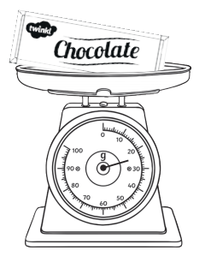
Reading Scales in Grams
We know we are reading the scales in grams because it says g on the scales.
How much does the chocolate weigh?
The two numbers the pointer is in between is 20 and 30 so I have put them at either end of the number line. Fill out the other numbers missing from the number line.
20
__
__
__
__
__
__
__
__
__
30
Because the pointer is right in the middle of 20 and 30, we know the weight of the chocolate is _________ .

Slide 33
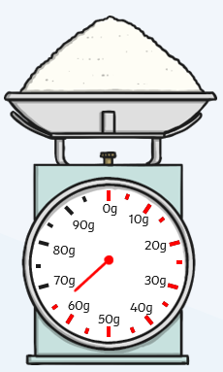
Reading Scales in Grams
How much does the talc weigh?
We know we are reading the scales in grams because it says g after each number on the scales.
Use the number line below to help you.
__
__
__
__
__
__
__
__
__
__
__
We can then find the number in the middle of the number line.

Slide 34
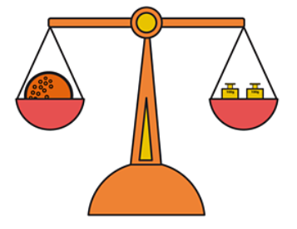
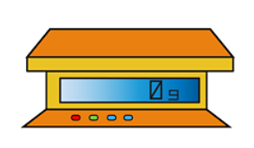
Weighing Challenge
You may have some scales in your house. Scales can look very different, here are some of the different types.
You will need to set up your scales for the challenge on the next page.
If you don’t have any scales at home, please contact school to borrow some.

Slide 35
Weighing Challenge
You may have some scales in your house. Scales can look very different, here are some of the different types.
Weigh some different objects around your house and record their weight in the table below:
Object | Weight
TV Remote | 25g
If you don’t have any scales at home, please contact school to borrow some.
Email a photo of you weighing objects using scales to
pioneerspupils@gmail.com so that you can be in our weekly Facebook post!

Slide 36
Weighing Challenge
You may have some scales in your house. Scales can look very different, here are some of the different types.
Write the object here.
Find an object in your house that matches these statements:
1. Find an object that weighs more than 50g _________________________
2. Find an object that weighs less than 30g _________________________
3. Find an object that weighs less than 100g but more than 70g _________________________
4. Find an object that weighs more than 200g _________________________
5. Find an object that weighs between 300g and 500g _________________________
If you don’t have any scales at home, please contact school to borrow some.
Email a photo of you weighing objects using scales to
pioneerspupils@gmail.com so that you can be in our weekly Facebook post!

Slide 37
Challenge!
Have a go at these problems…

Slide 38
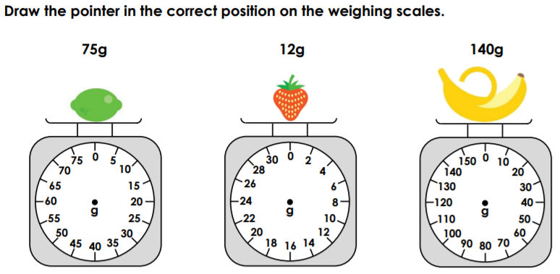
Challenge
Make sure the pointer is nice and straight.

Slide 39
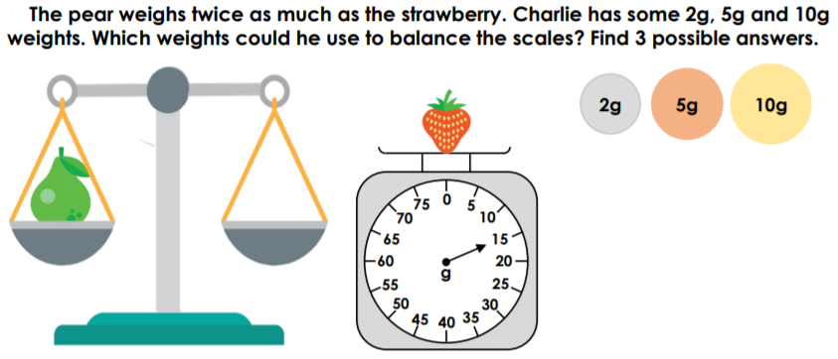
Tricky Challenge!
1st possibility
2nd possibility
3rd possibility

Slide 40
Well done for all of your hard work this lesson!
Please send any completed work/photographed evidence of completed work (practical activities) to pioneerspupils@gmail.com or deliver it to the dropbox outside of school on a Friday.

Slide 41
Date: 11.02.21
LO To be able to match scales to their amounts.
Subject: Maths

Slide 42
Recap - Reading Scales in Grams
We know we are reading the scales in grams because it says g on the scales.
How much do the cherries weigh?
10g
We know it’s 10g because we are measuring in g’s and the hand (pointer) is pointing right at the 10.

Slide 43
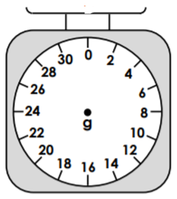
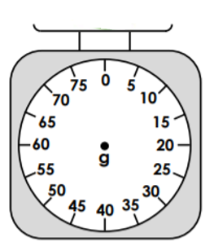
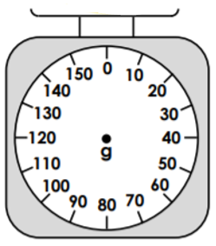
Finding Amounts on the Scales
Here are 3 different sets of scales. The numbers on the scales go up in different intervals…
Going up in 2’s
Going up in 5’s
Going up in 10’s
Practice counting up in 2’s, 5’s and 10’s, using the scales to help you.

Slide 44
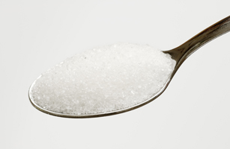
Finding Amounts on the Scales
The sugar on the scale weighs 10g.
The scale is counting up in intervals of ________ .
Draw the pointer on the scale so that it shows there is 10g of sugar.
2
A tally chart records data.

Slide 45
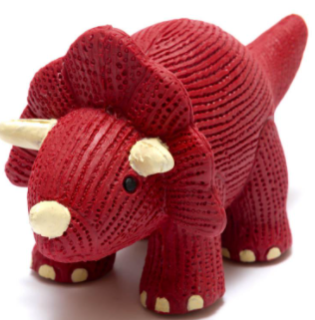
Finding Amounts on the Scales
The dinosaur rubber on the scale weighs
22g.
The scale is counting up in intervals of ________ .
Draw the pointer on the scale so that it shows there is a 22g dinosaur rubber.
Look at the numbers carefully on the scales – what do they go up in?
A tally chart records data.
The pointer needs to go from the dot in the middle of the scale to the number of grams the object weighs.
The pointer should be straight.

Slide 46
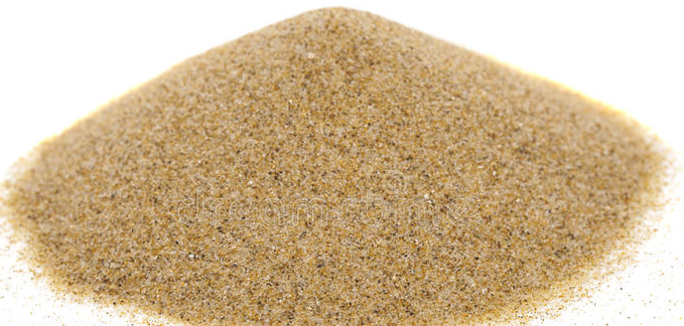
Finding Amounts on the Scales
The sand on the scale weighs 90g.
The scale is counting up in intervals of ________ .
Draw the pointer on the scale so that it shows there is 90g of sand.
Look at the numbers carefully on the scales – what do they go up in?
The pointer needs to go from the dot in the middle of the scale to the number of grams the object weighs.
The pointer should be straight.

Slide 47
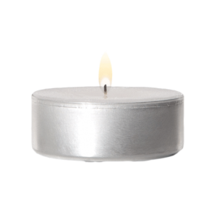
Finding Amounts on the Scales
The candle on the scale weighs 35g.
The scale is counting up in intervals of ________ .
Draw the pointer on the scale so that it shows there is a 35g candle.
Look at the numbers carefully on the scales – what do they go up in?
The pointer needs to go from the dot in the middle of the scale to the number of grams the object weighs.
The pointer should be straight.

Slide 48
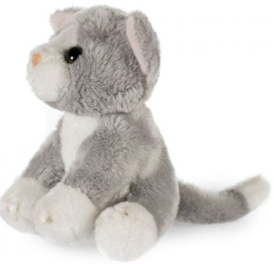
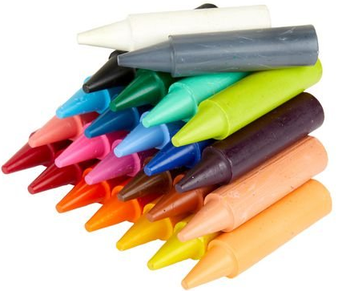
Finding Amounts on the Scales
The pointer should always be straight.
Draw the pointers carefully on the scales.
Soft Toy
65g
Tin of Beans
150g
Lego Figures
10g
Crayons
45g
Marble
16g

Slide 49
Finding Amounts on the Scales
We know we are reading the scales in grams because it says g on the scales.
Draw the pointer on your scales to show that the chocolate is 85g.
I know that 85 is between 80 and 90 on the scales so I write the 80 and 90 at either end of the number line.
80
81
82
83
84
85
86
87
88
89
90
I can then fill out the other numbers I know on the number line. From this, I can see that 85 is right in the middle of 80 and 90 so I know this is where I need to draw my pointer.

Slide 50
Finding Amounts on the Scales
We know we are reading the scales in grams because it says g on the scales.
Draw the pointer on your scales to show that the pasta is 35g.
I know that 35 is between 30 and 40 on the scales so I write the 30 and 40 at either end of the number line.
__
__
__
__
__
__
__
__
__
__
__
Draw the pointer either using a pencil by hand or using the arrow tool.
I then fill out the other numbers I know on the number line. From this, I can see that 35 is right in the middle of 30 and 40 so I know this is where I need to draw my pointer.

Slide 51
Finding Amounts on the Scales
We know we are reading the scales in grams because it says g on the scales.
Draw the pointer on your scales to show that the teabags are 15g.
I know that 15 is between ___ and ___ on the scales so I write the ___ and ___ at either end of the number line.
__
__
__
__
__
__
__
__
__
__
__
Draw the pointer either using a pencil by hand or using the arrow tool.
I then fill out the other numbers I know on the number line. From this, I can see that 15 is right in the middle of ___ and ___ so I know this is where I need to draw my pointer.

Slide 52
Challenge!
Have a go at these problems…

Slide 53
Challenge
Use your scales to practice measuring different amounts of food an/or other small items.
For example:
Weigh out 100g of flour,
300g of pasta etc.
Weigh these amounts of different things you find in your kitchen using your scales!
100g
200g
150g
50g
300g
Email a photo of you weighing objects using your scales to
pioneerspupils@gmail.com so that you can be in our weekly Facebook post!

Slide 54
Tricky Challenge
Find out the mass of both pencil cases first!

Slide 55
Well done for all of your hard work this lesson!
Please send any completed work/photographed evidence of completed work (practical activities) to pioneerspupils@gmail.com or deliver it to the dropbox outside of school on a Friday.

Slide 56
Date: 10.02.21
LO: To be able to add and subtract masses.
Subject: Maths

Slide 57
Pre-recorded Teaching
Access the online teaching video below that will support you to complete the work in this lesson. This video will act as a support but all of the work can still be successfully understood & completed using paper-based versions of this pack. If you need further support to understand / complete work then please contact school via e-mail or telephone.
Play Video

Slide 58
What is mass?
Mass is the amount of matter that an object contains. The more matter something has, the more it will weigh.
Is there a difference between the mass and weight of something?
YES…
The mass of something always stays the same, however the weight of something can change when there is changes in gravity.

Slide 59
Measuring mass
Mass can be measured in both grams and kilograms, depending on the object.
We can use different kinds of scales to measure the mass of something, here are some examples:
Balance Scale
Digital Scale
Kitchen Scale

Slide 60
How do we measure the mass of something?
We will be measuring in grams and the abbreviation we use for this is ’g’.
By looking at these scales, we can work out that the mass of this object is 70 grams (70g). We can work this out because the scales are going up in tens.
50 60 70 80 90 100

Slide 61
The mass of different objects
There will be lots of different objects around your house that will have different masses to one another.
Go and find some different objects that you believe have different masses to each other. Don’t worry if you do not have scales to measure the mass in grams, just have a think about which object you believe measures the biggest and smallest mass. On the next slide, type what you found or write it down onto a piece of paper.
Here are some examples:

Slide 62
Have a go!
Type what different objects you found below or send us a photograph of what you wrote down on paper!
____________________________________
____________________________________
____________________________________
____________________________________
____________________________________
Email a photo of you ordering your objects to
pioneerspupils@gmail.com so that you can be in our weekly Facebook post!

Slide 63
Adding masses
When we are adding masses together, we add each objects mass together, lets take a look:
This can of beans has a mass of 25 grams (g).
This teddy bear has a mass of 50 grams (g).
We can see that the can of beans has a mass of 25g and that the teddy bear has a mass of 50g so we need to add both of these together to get our overall total of mass.
25g + 50g = 75g
(Look at the next slide to remind yourself how we can add these two numbers together).

Slide 64
Recap
How we add our Tens and Ones …
Count up the counters, start with your tens
and then move to your ones…
T O T O T O
25 + 50 =
____
Write the answer on the line.
10
1
10
1
10
10
1
10
1
1
10
Count… 10, 20, 30, 40, 50, 60, 70, 71, 72, 73, 74, 75
10

Slide 65
Subtracting masses
When we are subtracting masses from each other, we subtract the smallest mass from the largest mass, lets take a look:
This mug has a mass of 40 grams (g).
These beanbags have a mass of 30 grams (g).
We can see that the mug has a mass of 40g and that the beanbags have a mass of 30g so we need to subtract the lowest mass from the highest mass to get our overall total of mass.
40g - 30g = 10g
(Look at the next slide to remind yourself how we can subtract using these two numbers).

Slide 66
Recap
1. Make your biggest number (40 = 4 tens).
How we subtract our Tens and Ones …
T O T O T O
2. Then cross out the number of tens you are taking away (30 = 3 tens).
40 - 30 =
____
Write the answer on the line.
10
10
10
3. Count up how many you have got left…
10
10

Slide 67
Your turn!
_____________ g
60g
37g
_____________ g
Draw your tens and ones to help you!
45g
11g

Slide 68
Our Turn
The mass of the crisps is 20g
The mass of the apple is 75g
The total mass of the crisps and the apple is _________ g (Total = add)
20g + 75g =
What is the difference between the mass of the apple and (Difference between = subtract)
the crisps? _________ g
75g - 20g =

Slide 69
Have a go at these!
Here are some questions for you to have a go at. Type your answers below or write them down onto a piece of paper.
If a notebook has a mass of 23g and a feather has a mass of 15g, what is the total mass when they are added together?
= ___________________ g
If a brick has a mass of 45g and a rock also has a mass of 45g, what is the total mass when the brick’s mass is subtracted from the rock’s mass?
= ___________________ g
If a can of pop has a mass of 30g and a computer has a mass of 53g, what is the difference in mass between them?
= ___________________ g

Slide 70
Challenge!
Have a go at these problems…

Slide 71
Challenge

Slide 72
Tricky Challenge

Slide 73
Well done for all of your hard work this lesson!
Please send any completed work/photographed evidence of completed work (practical activities) to pioneerspupils@gmail.com or deliver it to the dropbox outside of school on a Friday.

Slide 74
Date: 12.02.21
LO To be able to weigh using scales to make biscuits.
Subject: Maths

Slide 75
Recap - Grams
They are a unit of measure often used to weigh objects.
Grams can be shortened to g when we are weighing objects.
1 gram (1g) is a lot less than 1 kilogram (1kg).
There are 1000g (1 thousand grams) in a kg.

Slide 76
Recap - Reading Scales in Grams
We know we are reading the scales in grams because it says g on the scales.
How much do the cherries weigh?
10g
We know it’s 10g because we are measuring in g’s and the hand (pointer) is pointing right at the 10.

Slide 77
Pre-recorded Teaching
Recap – Measuring with Scales
Access the online teaching video by Miss Malloy on the school website that will support you to complete the work in this lesson.
This video will act as a support but all of the work can still be successfully understood & completed using paper-based versions of this pack.
If you need further support to understand / complete work then please contact school via e-mail or telephone.

Slide 78
Baking Activity
Today we are going to use everything we have learnt about measuring mass to bake some valentines biscuits!
On the next slides you will find the recipe to follow.
Make sure you measure the ingredients accurately so that your biscuits taste delicious!
Email photos of you baking your biscuits to
pioneerspupils@gmail.com so that you can be in our weekly Facebook post!

Slide 79
Biscuit Recipe
Use your scales to weigh your ingredients accurately. Follow the recipe closely to make your valentines biscuits.
Ingredients:
100g butter, softened
50g caster sugar
170g plain flour
Icing and edible decorations (optional)

Slide 80
Biscuit Recipe
Use your scales to weigh your ingredients accurately. Follow the recipe closely to make your valentines biscuits.
Equipment:
Scales
Non-stick baking paper
Mixing bowl
Wooden spoon
Rolling pin
Cutters or knife
Baking trays

Slide 81
Biscuit Recipe
Use your scales to weigh your ingredients accurately. Follow the recipe closely to make your valentines biscuits.
1. Preheat the oven to 180°C/160°C Fan/Gas Mark 4 and line two baking trays with non-stick baking paper.
2. Beat the butter and sugar until they are pale and creamy. Then work in the flour to make a stiff dough. You may find it easier to do this with your hands.
3. Turn the dough out onto a lightly floured surface and knead gently until smooth. Roll out to the thickness of a pound coin.
4. Cut out the dough with heart shaped cutter. If you do not have one, use your cup to cut out a circular shape or use a knife to cut out the shape of a heart (with adult supervision).
Continued…

Slide 82
Biscuit Recipe
Use your scales to weigh your ingredients accurately. Follow the recipe closely to make your valentines biscuits.
5. Carefully, transfer to the baking sheet and bake for 12 to 15 minutes.
6. Leave them to cool on the baking sheet for a few minutes to firm up, before transferring to a wire cooling rack.
7. Once they are completely cool, decorate with icing. You could also sprinkle with some edible decorations (if you have some).

Slide 83
Challenge!
Have a go at these problems…

Slide 84
Challenge
What is the weight of 1 of your finished biscuits?
________________
Are all of your biscuits the same weight?
_________________
Email a photo of you and your biscuits to
pioneerspupils@gmail.com so that you can be in our weekly Facebook post!

Slide 85
Well done for all of your hard work this lesson!
Please send any completed work/photographed evidence of completed work (practical activities) to pioneerspupils@gmail.com or deliver it to the dropbox outside of school on a Friday.

