Slide 1
Date: 18.01.21
L.O. To be able to identify 2D shapes
Subject: Maths

Slide 2
Pre-recorded Teaching
Access the online teaching video below that will support you to complete the work in this lesson. This video will act as a support but all of the work can still be successfully understood & completed using paper-based versions of this pack. If you need further support to understand / complete work then please contact school via e-mail or telephone.
Play Video

Slide 3
2D Shapes
A 2D shape is a flat shape with 2 dimensions, length and width!
width
Let’s have a look at some 2D shapes. Do you already know their names?
length
Square
Rectangle
Circle
Triangle

Slide 4
Circle
Circles have 1 circular side and 0 corners.
Circles can be different sizes.

Slide 5
Square
Squares can be different sizes. They can also be different orientations.
Squares have 4 corners and 4 sides.

Slide 6
Rectangle
Rectangles can also be different sizes and different orientations.
Rectangles have 4 corners and 4 sides.

Slide 7
Triangle
Triangles can also be different sizes and different orientations.
Triangles have 3 corners and 3 sides.

Slide 8
Match the 2D shape with the name
Task 1: Can you draw a line or drag the shapes to the correct name?
Triangle
Circle
Square
Rectangle

Slide 9
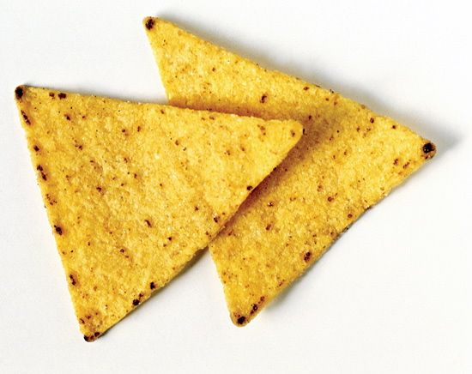
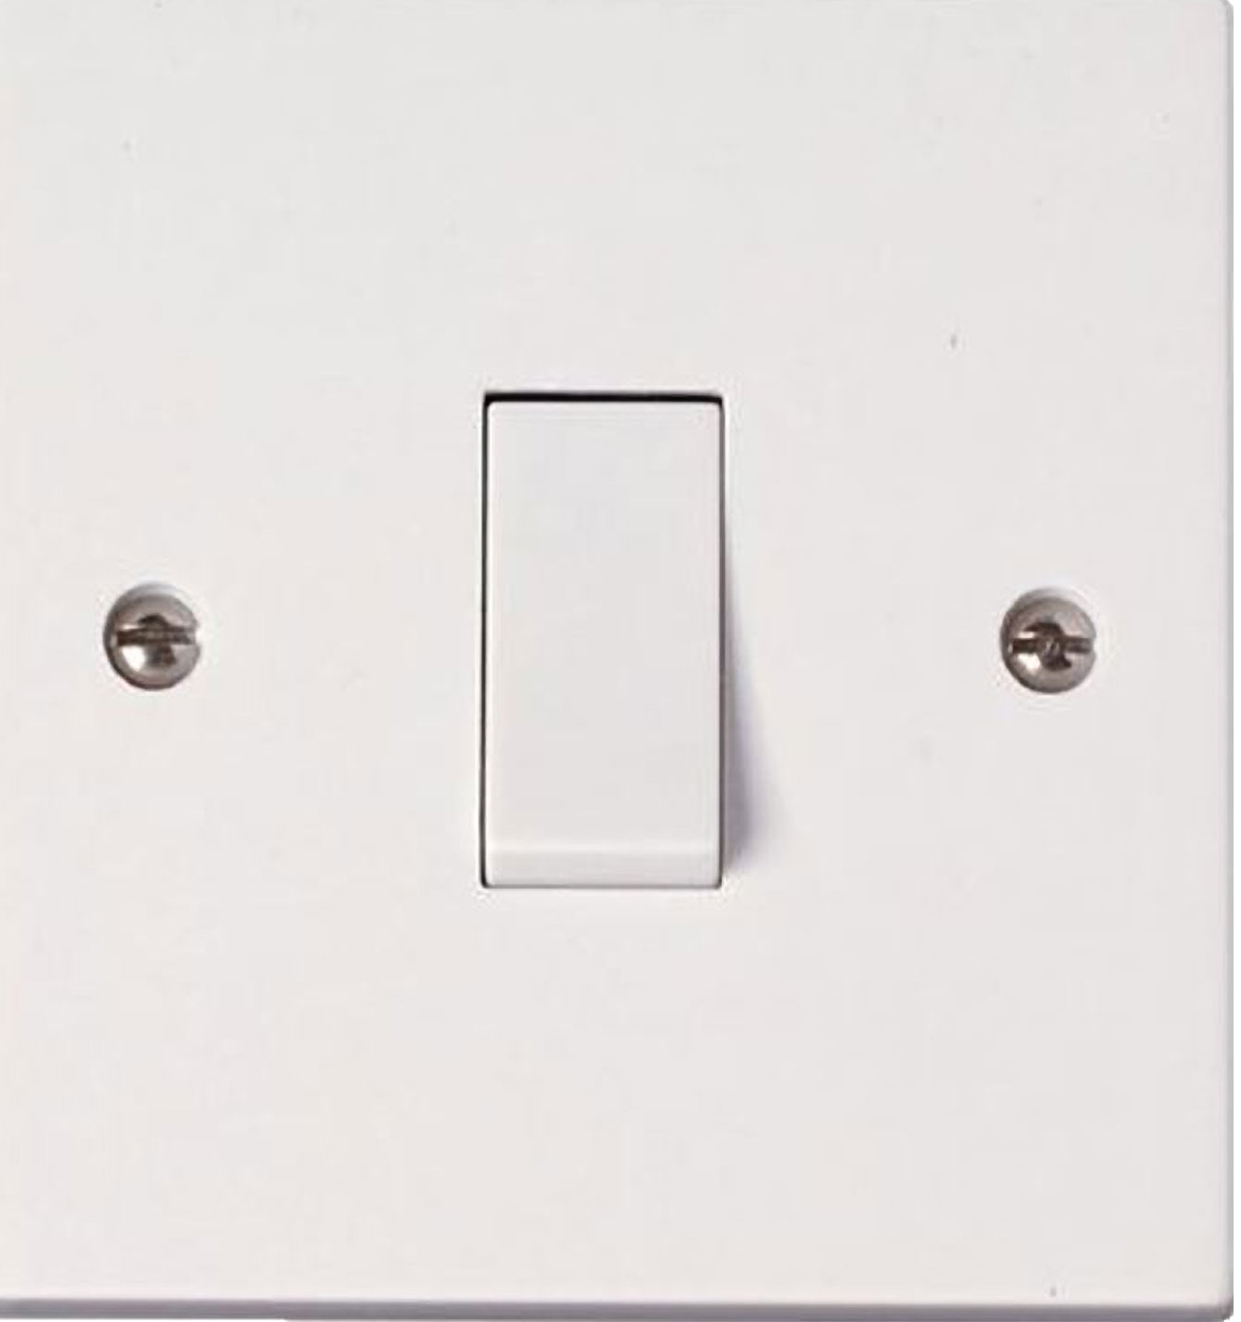
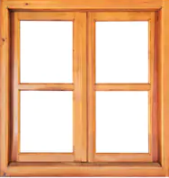
2D Shape Hunt!
Remember
2D shapes are flat!
Choose objects which are flat.
Task 2: Can you find any of the 2D shapes we have learned about around your house?
Here are a couple of ideas:
Challenge
If the objects are small enough, can you trace around the objects onto some paper and write what shapes they are?
Square
Rectangle
Circle
Triangle

Slide 10
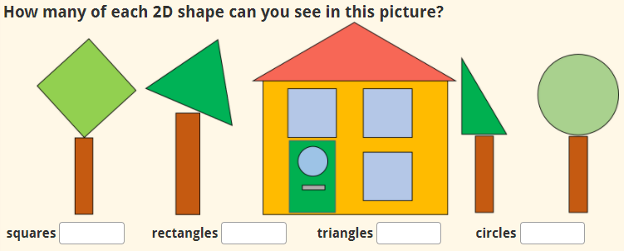
2D Shape Pictures
Task 3: Can you draw a picture only using the shapes we have learned about?
Square
Triangle
Circle
Here is mine!
Rectangle
Challenge
Can you label the 2D shapes you have used in your picture? I have started labelling mine!
Square
Rectangle
Circle
Triangle

Slide 11
2D Shapes
Task 4
Challenge
Can you do the same for the picture you have drawn? How many squares, rectangles, triangles and circles can you see?
Insert a text box if you are using a computer.

Slide 12
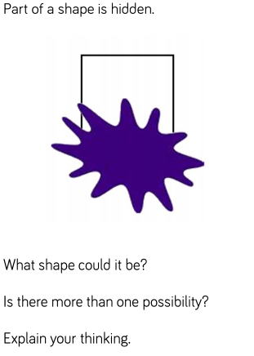
Challenge!
If you are working on a computer, insert a text box to type your answer.

Slide 13
Date: 19.01.21
L.O. To be able to describe and classify 2D shapes.
Subject: Maths

Slide 14
Pre-recorded Teaching
Access the online teaching video below that will support you to complete the work in this lesson. This video will act as a support but all of the work can still be successfully understood & completed using paper-based versions of this pack. If you need further support to understand / complete work then please contact school via e-mail or telephone.
Play Video

Slide 15
Recap: Match the 2D shape with the name
Task 1: Can you draw a line or drag the shapes to the correct name?
Triangle
Circle
Square
Rectangle

Slide 16
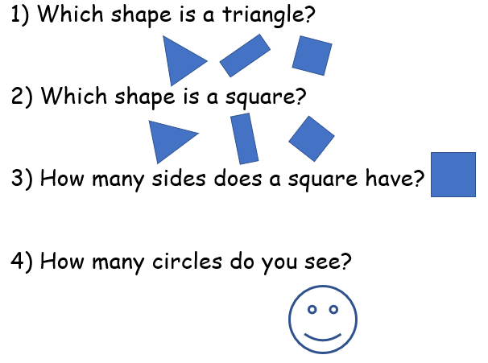
Recap
Task 2
If you are working on a computer, you can insert a circle around the correct shape and insert a text box to write your answers.

Slide 17
Sorting shapes
Shapes can be sorted into smaller groups in many ways, such as by type, size and colour.
Task 3: Can you sort the below shapes by colour?
Red
Blue
If you are working on a computer, you can drag the shapes into the correct group. If not, you can draw the shapes in the correct group.

Slide 18
Sorting shapes
Shapes can be sorted into smaller groups in many ways, such as by type, size and colour.
Task 4: Can you sort the below shapes by shape?
Triangles
Squares
How many shapes can not be sorted into these groups?
If you are working on a computer, you can drag the shapes into the correct group. If not, you can draw the shapes in the correct group.

Slide 19
Sorting shapes
Shapes can be sorted into smaller groups in many ways, such as by type, size and colour.
Task 5: Can you sort the below shapes by shape?
Rectangles
Circles
How many shapes can not be sorted into these groups?
If you are working on a computer, you can drag the shapes into the correct group. If not, you can draw the shapes in the correct group.

Slide 20
Sorting shapes
Shapes can be sorted into smaller groups in many ways, such as by type, size and colour.
Task 6: Can you sort the below shapes by size?
Big
Small
If you are working on a computer, you can drag the shapes into the correct group. If not, you can draw the shapes in the correct group.

Slide 21
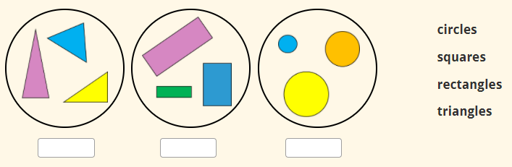
Sorting shapes
Shapes can be sorted into smaller groups in many ways, such as by type, size and colour.
Task 7: Can you label the groups of 2D shapes?
Use the names to help you.
If you are working on a computer, insert a textbox to write your answers.

Slide 22
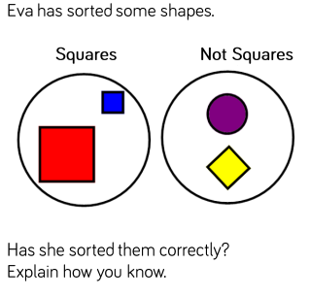
Challenge!
If you are working on a computer, insert a text box to type your answer.
Challenge 1:
Can you find 2D shapes around your house and sort them into groups?
Remember, you can group shapes by type, size and colour!
Challenge 2:

Slide 23
Date: 20.01.21
L.O. To be able to identify 3D shapes.
Subject: Maths

Slide 24
Pre-recorded Teaching
Access the online teaching video below that will support you to complete the work in this lesson. This video will act as a support but all of the work can still be successfully understood & completed using paper-based versions of this pack. If you need further support to understand / complete work then please contact school via e-mail or telephone.
Play Video

Slide 25
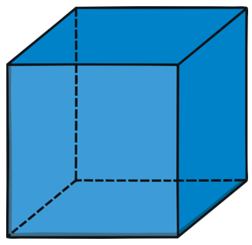
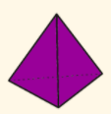
3D Shapes
A 3D shape is a solid shape with 3 dimensions: length, width and height!
Let’s have a look at some 3D shapes.
All real-life objects are 3D!
height
width
length
Cube
Cuboid
Pyramid
Sphere
Cylinder
Cone

Slide 26
Match the 3D shape with the name
Task 1: Can you draw a line or drag the shapes to the correct name?
Cube
Sphere
Cylinder
Cuboid
Pyramid
Cone

Slide 27
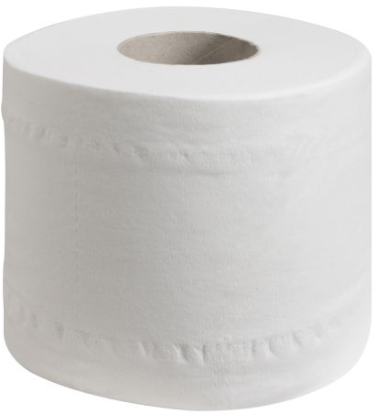
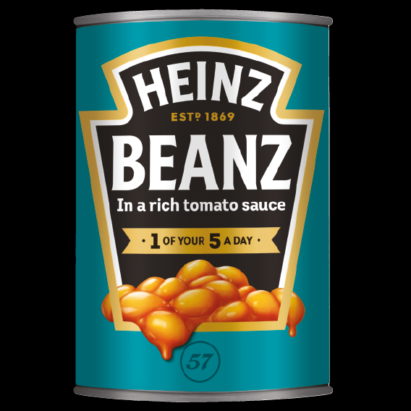
3D Shape Hunt!
Task 2: Can you find any of the 3D shapes we have learned about around your house?
Here are some ideas:
You could take a picture of all of the 3D shapes you find in your house and send it to us!
Cube
Cuboid
Cylinder
Pyramid
Cone
Sphere

Slide 28
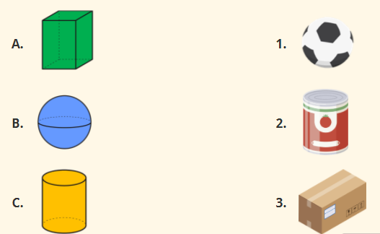
Match the 3D shape with the real-life object
Task 3: Can you draw or insert a line to match the images?
Challenge
Can you name the 3D shapes?

Slide 29
Task 4
3D Shapes
Look at this train made out of 3D shapes and fill in the blanks
The train has _____ cylinders.
The train has 2 _________.
The green shape in the train is a _________.

Slide 30
Challenge!
If you are working on a computer, insert a text box to type your answer.

Slide 31
Date: 21.01.21
L.O. To be able to describe and classify 3D shapes.
Subject: Maths

Slide 32
Pre-recorded Teaching
Access the online teaching video below that will support you to complete the work in this lesson. This video will act as a support but all of the work can still be successfully understood & completed using paper-based versions of this pack. If you need further support to understand / complete work then please contact school via e-mail or telephone.
Play Video

Slide 33
Recap: Match the 3D shape with the name
Task 1: Can you draw a line or drag the shapes to the correct name?
Cube
Sphere
Cylinder
Cuboid
Pyramid
Cone

Slide 34
Sorting 3D Shapes
Remember, shapes can be sorted into smaller groups in many ways, such as by type, size and colour.
Task 2: Sort shapes by type
Cube
Cylinder
Cone
If you are working on a computer, drag the shapes. If not, draw the shapes or draw a line to the group.

Slide 35
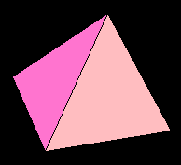
Sorting 3D Shapes
Remember, shapes can be sorted into smaller groups in many ways, such as by type, size and colour.
Task 3: Sort shapes by colour
Yellow
Red
Pink
If you are working on a computer, drag the shapes. If not, draw the shapes or draw a line to the group.

Slide 36
Sorting 3D Shapes
Remember, shapes can be sorted into smaller groups in many ways, such as by type, size and colour.
Task 4: Sort shapes by size
Small
Big
If you are working on a computer, drag the shapes. If not, draw the shapes or draw a line to the group.

Slide 37
Sorting 3D Shapes
Task 5
Try and find objects in your house which are the same shape as each of the 3D shapes we are learning about. For each shape, can you experiment if you can stack the shape up or if the shape rolls?
Cylinders are round so they would roll away if you tried to stack them up!
For example…
Cubes are flat so they stack on top of each other. Cuboids could do this too!
But it will work if you stack them this way.

Slide 38
Sorting 3D Shapes
Task 6
If you managed to carry out the experiment with 3D shapes in your house, can you sort the shapes into the right group?
Roll
Stack
Roll and stack

Slide 39
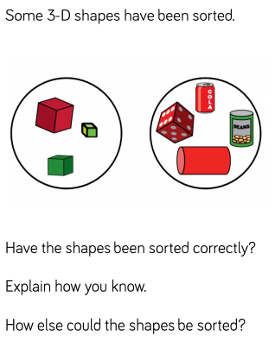
If you are working on a computer, insert a text box to type your answer.
Challenge!

Slide 40
Date: 22.01.21
L.O. To be able to recognise and create repeating patterns.
Subject: Maths

Slide 41
Repeating Patterns
2D shapes
Shapes must stay in the same order to be a repeating pattern
Square
Circle
Square
Circle
Square
Circle
Square
Say the shapes out loud to help you understand the repeating pattern!
Which 2D shape would be next in the pattern?

Slide 42
Repeating Patterns
2D shapes
Triangle
Rectangle
Triangle
Rectangle
Triangle
Rectangle
Say the shapes out loud to help you understand the repeating pattern!
Which 2D shape would be next in the pattern?

Slide 43
Repeating Patterns
2D shapes
Circle
Triangle
Square
Circle
Triangle
Square
Circle
Triangle
Say the shapes out loud to help you understand the repeating pattern!
Which 2D shape would be next in the pattern?

Slide 44
Repeating Patterns
3D shapes
Cylinder
Cube
Cylinder
Cube
Cylinder
Cube
Cylinder
Cube
Say the shapes out loud to help you understand the repeating pattern!
Which 3D shape would be next in the pattern?

Slide 45
Repeating Patterns
3D shapes
Cone
Cube
Cylinder
Cone
Cube
Cylinder
Cone
Cube
Cylinder
Say the shapes out loud to help you understand the repeating pattern!
Which 2 3D shapes would be next in the pattern?

Slide 46
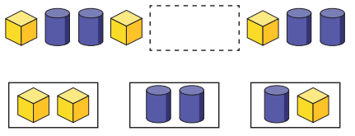
Repeating Patterns
3D shapes
Can you circle the correct 3D shapes which are missing from the pattern?

Slide 47
Repeating Patterns
Can you create your own repeating pattern? You can choose 2D or 3D shapes!
You could even challenge someone at home by asking them which shape they think will come next in the pattern.
Here is my repeating pattern!

Slide 48
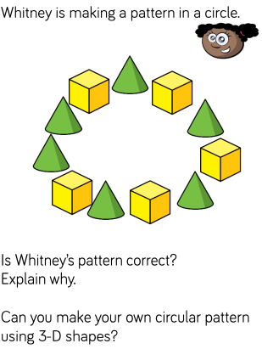
If you are working on a computer, insert a text box to type your answer.
Challenge!

Slide 49
Further Learning - Pre-recorded
Access the online teaching video below that will support you to access some further learning around the Lesson Objective. If you need further support to understand / complete work then please contact school via e-mail or telephone.
Play Video

Slide 50
Well done for your hard work this week!
Could any completed work / photographic evidence of completed work please be sent to Pioneerspupils@gmail.com
Thank you

