Slide 1
Subject: Maths
Pack: B

Slide 2
Date: 01.03.21
L.O: To be able to round decimal numbers.
Subject: Maths

Slide 3
Mental Starter: Identify the value of the digit underlined (Recap from last week’s learning)
E.G 134.25= 5 hundredths
1. 292.17 =
2. 565.123 =
3. 1820.021 =
4. 7225.622 =
5. 892.345 =
Extension: Order the numbers used in each question from smallest to largest
292.17 565.123 1820.021 7225.622 892.345
Smallest Largest
_______ ________ ________ ________ ________

Slide 4
Mental Starter: Let’s check your answers:
E.G 134.25= 5 hundredths
1. 292.17 = 1 tenth
2. 565.123 = 3 thousandths
3. 1820.021 = 0 tenths
4. 7225.622 = 2 thousandths
5. 892.345 = 4 hundredths
Extension: Order the numbers used in each question from smallest to largest
292.17 565.123 1820.021 7225.622 892.345
Smallest: Largest
292.17 565.123 892.345 1820.021 7225.622

Slide 5
Pre-recorded Teaching
Access the online teaching video below that will support you to complete the work in this lesson. This video will act as a support but all of the work can still be successfully understood & completed using paper-based versions of this pack. If you need further support to understand / complete work then please contact school via e-mail or telephone.
The link below will take you to White Rose Home learning, you will need to scroll down the page until you can see the different weeks and then select Summer Term – Week 6. Scroll down to ‘Lesson 3 Rounding Decimals and watch the video.
Play video
You can also copy and paste this link if you would prefer (but the instructions need to be followed to access the video):
https://whiterosemaths.com/homelearning/summer-archive/year-5/

Slide 6
Rounding Decimals
Rounding is important because it makes numbers easier to manage and allows us to estimate answers.
Imagine you’re in a shop and you need to quickly estimate how much your shopping will be before you get to the till. You would round up the prices, like £1.99 to £2.00, to make it easier to add up.
The rule for rounding
Always look at the digit to the right of the one you’re supposed to be rounding to:
if it is 5 or more, then round it up
if it is less than 5, then round down
If the digit ends with 5,6,7,8 or 9 we round up!
If the digit ends with 1,2,3 or 4 we round down!

Slide 7
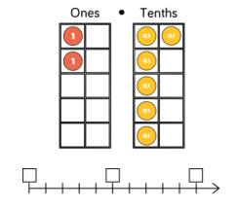
Rounding to the nearest whole number
Look at the tenths digit (the digit after the decimal point). if it is less than 5 then round the number down by removing the decimal part of the number; if it is 5 or more then round the number up by adding one on to the ones digit and removing the decimal part of the number.
E.G The number shown is 1.6.
If we use a number line, we can see 1.6 is closer to 2.
As we are rounding to the nearest whole number, we
look at the tenths.
We know 6 is more than 5, following the rules for rounding,
this is why we would round 1.6 up to 2.
1
1.5
2

Slide 8
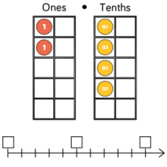
Let’s try rounding to a whole number together:
What number has been created?
2.4
Look at the tenths, how many are there?
4 tenths
If we use the number line, is 2.4 less than 2.5?
Is 2.4 closer to 2 or 3?
Do we round up to 3 or down to 2?
2
2.5
3

Slide 9
We would round down to 2.
We can see 2.4 is closer to 2.
Because 4 is less than 5, we follow the rule and round down.
2.4

Slide 10
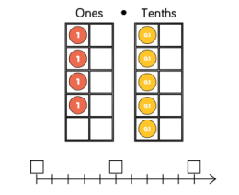
Round to the nearest whole number:

Slide 11
Let’s check: Round to the nearest whole number:
The number shown is 4.5.
It has 5 tenths.
We know if the digit we’re looking at is 5 or above, we round up.
On a number line we can see 4.5 is in the middle of 4 and 5.
We round 4.5 up to 5.
4
4.5
5

Slide 12
Try this:
As we are rounding the nearest whole number, you still need to focus on the tenths and decide if you will round the whole number up to the next or down to the whole number we already have.

Slide 13
Let’s check:
The number created is 4.56
We need to look at the tenths, we can ignore the hundredths.
There are 5 tenths.
We know this means to round up.
The next whole number after 4 is 5.
4.56 rounds up to the next whole number 5.

Slide 14
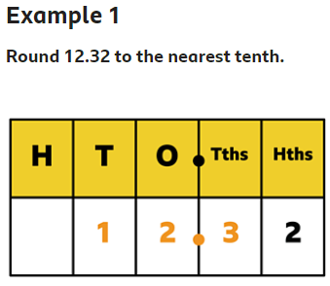
Rounding to the nearest tenth/ 1dp
We apply the same rounding rules again.
When rounding to the nearest tenth (1dp), we need to look at the hundredths.
If the hundredths is 1-4, we round the tenth down (to the tenth we have).
If the hundredth is 5-9, we round the tenth up (to the next tenth).
The whole number will rarely change and often stays the same, unless the rounding of the tenth makes it greater than 9.
The digit in the hundredths column is a 2, so we round down to 12.3

Slide 15
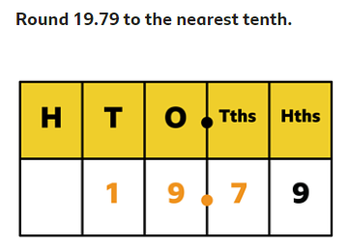
Rounding to the nearest tenth/ 1dp
How many hundredths does the number have?
Will we round the tenths digit up or down?
Will the tenths digit change or stay the same?

Slide 16
Lets check:
9 is in the hundredths, so we round up to 19.8.
There are 9 hundredths.
9 is greater than 5, therefore we round up.
This means then we change to the next tenth, after 7 is 8 therefore the tenths changes to 8.

Slide 17
Round the number below to 1dp. (Nearest tenth)
There are 4 hundredths, apply the rules to decide if we round 3.24 down to 3.2 or up to 3.3.

Slide 18
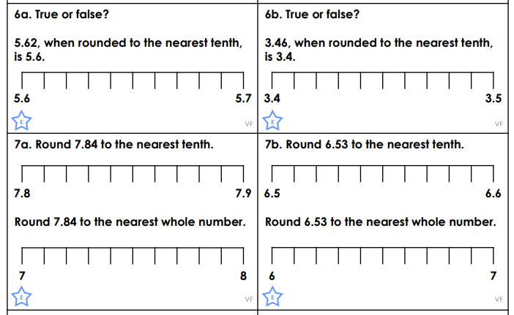
L.O: To be able to round decimal numbers
Complete the questions on to the sheet or write down the answer onto another piece of paper.
E.G: True 5.34 rounds down to 5.3
1.
2.
3.
4.
5.
6

Slide 19
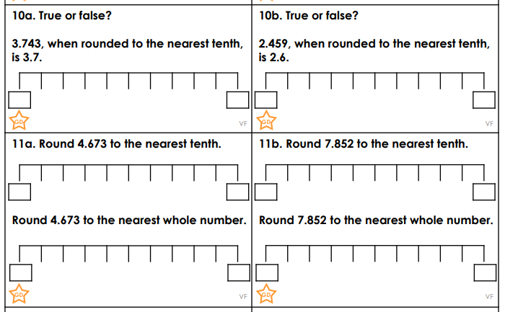
7.
8.
9.
10.
11.
12

Slide 20
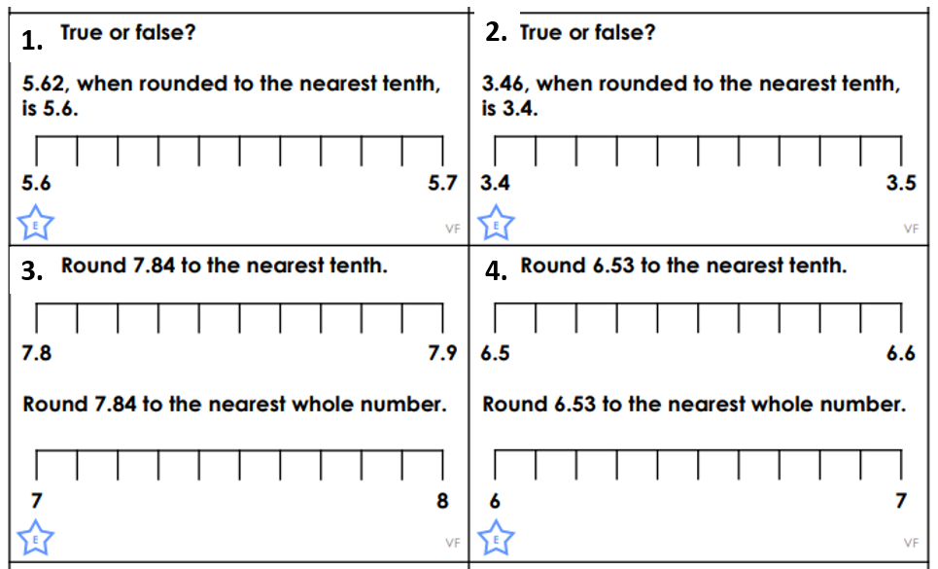
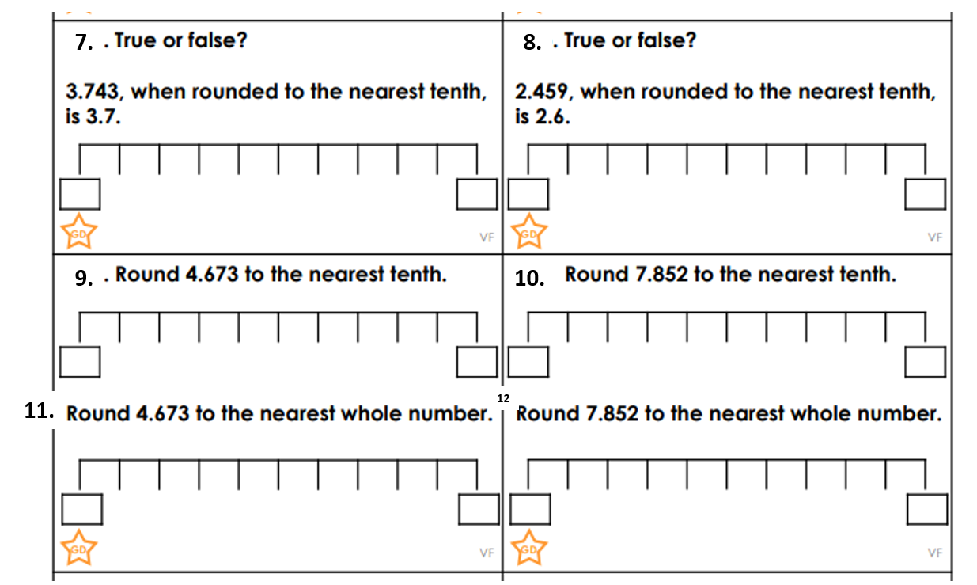
Answers:
5
6
True
False it rounds up to 3.5
7.84 rounds down to 7.8
6.53 rounds down to 6.5
7.84 rounds up to 8
6.53 rounds up to 7
7. True it rounds down to 3.7
8. False it rounds up to 2.5
9. 4.673 rounds up to 4.7
10. 7.852 rounds up to 7.9
11. 4.673 rounds up to 5
12. 7.852 rounds up to 8

Slide 21
Times-table practise
Spend at least 15mins practising your times-tables.
This can be done on TTRS, hit the button or any other times-table website.
Use the Times-Tables Rock Stars app or website.
Alternatively, copy and paste the following link into a web browser:
https://play.ttrockstars.com/auth/school/student/73173
https://www.topmarks.co.uk/maths-games/7-11-years/times-tables

Slide 22
End of Lesson

Slide 23
Date: 02.03.21
L.O: To be able to round decimal numbers.
Subject: Maths

Slide 24
Mental Starter: Rounding to 1 dp

Slide 25
Let’s check your answers: Rounding to 1 dp

Slide 26
Rounding to 2dp (hundredths)
When rounding to 2dp, we need to look at the thousandths.
Identify if it is smaller or bigger than 5.
If it is smaller, we round the hundredth down to the digit we have.
If it is larger, we round the hundredth up to the next digit.
E.g: 123.678
8 thousandths…
8 is larger than 5…
Round the hundredths up…
7 rounds up to the next digit which is 8
123.68

Slide 27
Rounding to 2 dp
1612.821
How many thousandths are there?___
Is it more or less than 5? ______
Does the hundredth round up or down? _____
Will the hundredth change?_____
What digit does the hundredth become?_____
Answer: ________

Slide 28
Let’s check:
1612.821
How many thousandths are there?_1_
Is it more or less than 5? __less__
Does the hundredth round up or down? __down_
Will the hundredth change?__no__
What digit does the hundredth become?__2__
Answer: 1612.82

Slide 29
Rounding to 2dp
Now try this:
302.018
Rounds up or down?______
Answer:______

Slide 30
Rounding to 2dp
Let’s check:
302.018
Rounds up or down? 8 thousandths round hundredths up
Answer: 302.02

Slide 31
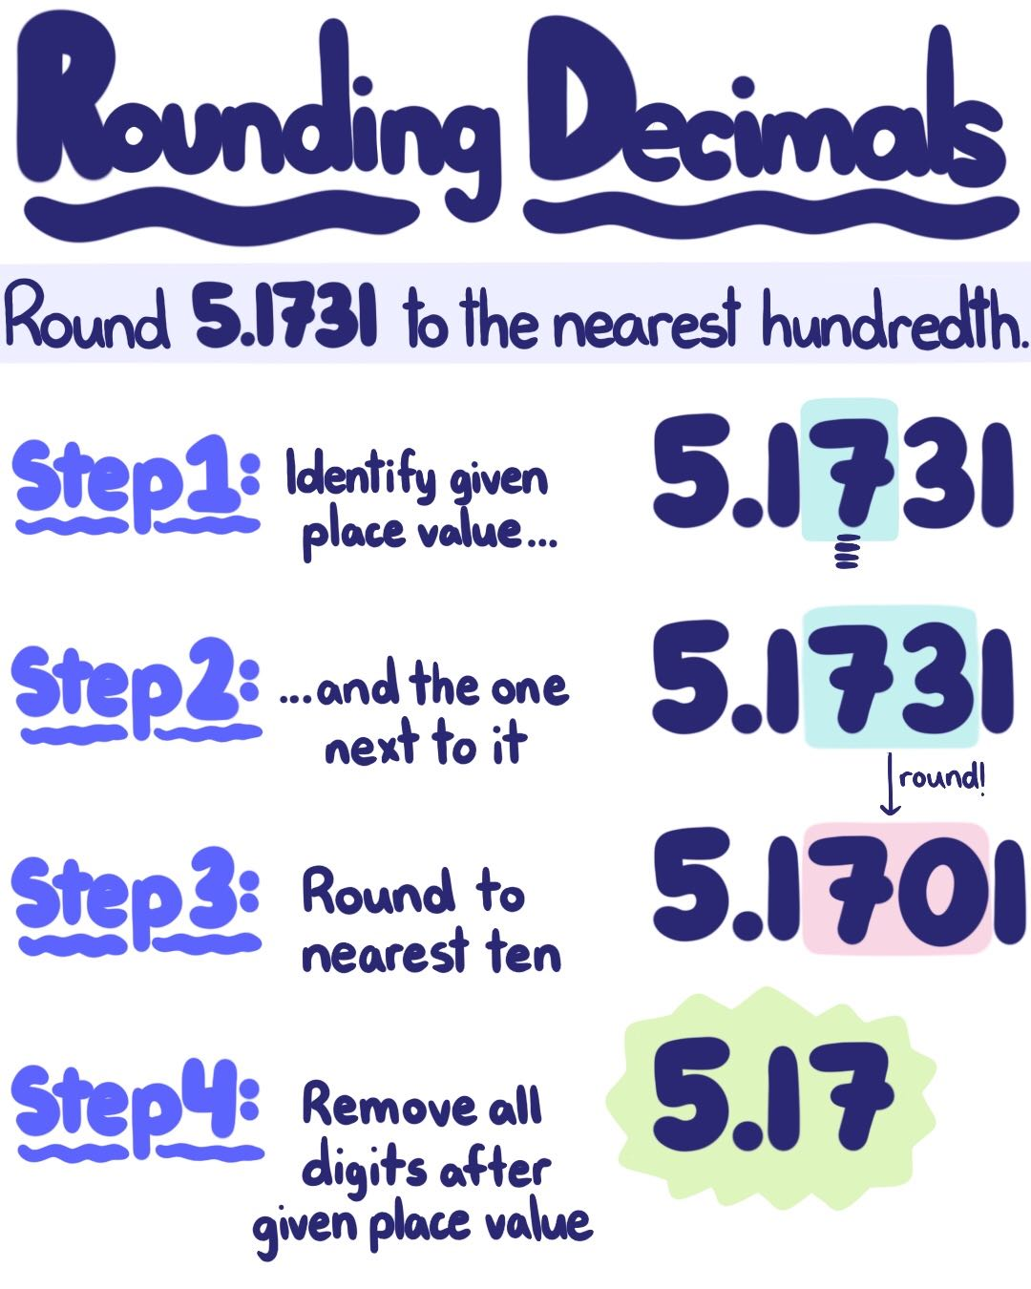
L.O: To be able to round decimal numbers
Copy the numbers for each question down as shown:
Eg. 543.561 543.56
Round each number to 2 dp.
2391.017
3402.459
5617.244
806.109
72.597
Round each number to 1 dp
6. 238.023
7. 922.996
8. 223.172

Slide 32
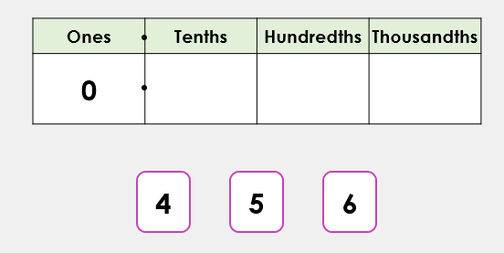
Extension:
Use the digit cards to create a number which will round to have 5 tenths. Is there more than one example?

Slide 33
Answers:
Round each number to 2 dp.
2391.017 2391.02
3402.459 3402.46
5617.244 5617.24
806.109 806.11
72.597 72.60
Round each number to 1 dp
6. 238.023 238.0
7. 922.996 923.0
8. 223.172 223.3

Slide 34
Extension answers:
Use the digit cards to create a number which will round to have 5 tenths. Is there more than one example?
Answers:
0.456
0.546
Did you find any others?

Slide 35
Times-table practise
Spend at least 15mins practising your times-tables.
This can be done on TTRS, hit the button or any other times-table website.
Use the Times-Tables Rock Stars app or website.
Alternatively, copy and paste the following link into a web browser:
https://play.ttrockstars.com/auth/school/student/73173
https://www.topmarks.co.uk/maths-games/7-11-years/times-tables

Slide 36
End of Lesson

Slide 37
Date: 03.03.21
L.O: To be able to multiply decimal numbers.
Subject: Maths

Slide 38
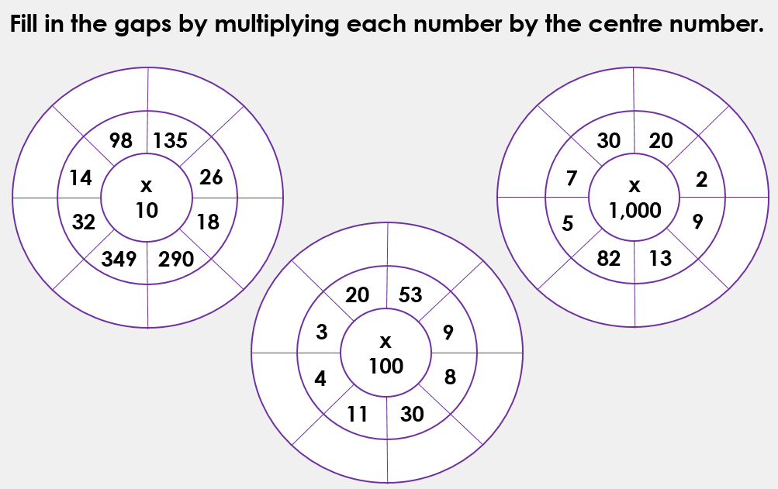
Mental Starter: x10, x100 and x 1000
If you do not have this page, you can write down the answers on a piece of paper.

Slide 39
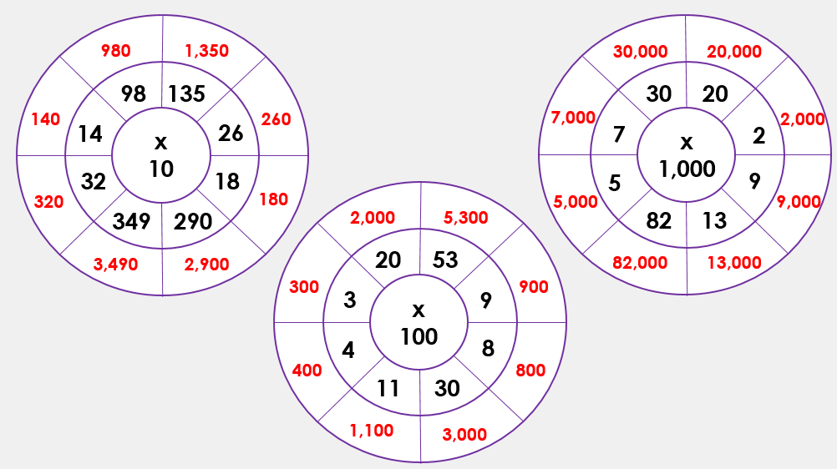
Let’s check your answers:

Slide 40
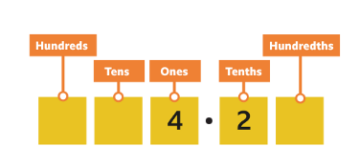
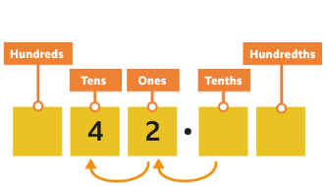
Multiplying decimals by 10
To multiply by 10, you move the digits one place value to the left.
Let's look at an example:
4.2 x 10 = 42
To multiply by 10, you move the digits one place value to the left.
So 4.2 x 10 = 42.
We don’t have any numbers after the decimal point now so we don’t have to include it!

Slide 41
Multiplying decimals by 10
The number represented is 3.24.
When we x10, each digit moves one place to the left.
The answer is 32.4

Slide 42
Multiplying decimals by 10
What number is shown?_____
Draw the counters in the place value chart after moving them one place to the left.
Write down the answer: ______

Slide 43
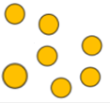
Multiplying decimals by 10 Let’s check…
What number is shown? 23.75
Draw the counters in the place value chart after moving them one place to the left.
Write down the answer: 237.5

Slide 44
Multiplying decimals by 10
What number is shown?_____
Draw the counters in the place value chart after moving them one place to the left.
Write down the answer: ______

Slide 45
Multiplying decimals by 10 Answer:
What number is shown? 423.3
Draw the counters in the place value chart after moving them one place to the left.
Write down the answer: 4233

Slide 46
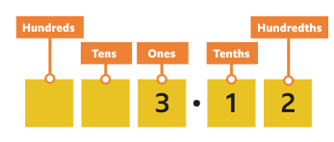
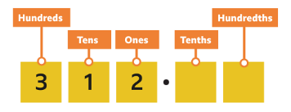
Multiply decimals by 100
To multiply by 100, you move the digits two places to the left.
Let’s look at an example:
3.12 x 100 = 312
To multiply by 100, you move the digits two places to the left. So 3.12 × 100 = 312.

Slide 47
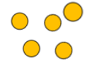
Multiplying decimals by 100
The number represented is 5.41.
When we x100, each digit moves two places to the left.
The answer is 541

Slide 48
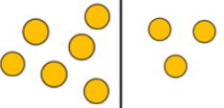
Multiplying decimals by 100
The number represented is ____.
When we x100, each digit moves two places to the left.
The answer is ___

Slide 49
Multiplying decimals by 100 Let’s check:
The number represented is 63.02.
When we x100, each digit moves two places to the left.
The answer is 6302

Slide 50
Multiplying decimals by 100
The number represented is ____.
When we x100, each digit moves two places to the left.
The answer is ___

Slide 51
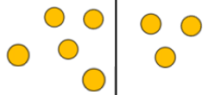
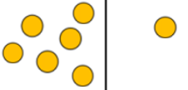
Multiplying decimals by 100 Let’s check:
The number represented is 53.61.
When we x100, each digit moves two places to the left.
The answer is 5361.

Slide 52
L.O: To be able to multiply decimal numbers
Copy down the calculations and write the answers. You can use place value charts and counter (or draw in the counters) to help you.
23.42 x 10 =
39.01 x 10 =
52.12 x 100 =
75.39 x 100 =
467. 219 x 10 =
321.012 x 100 =

Slide 53
Extension:

Slide 54
L.O: To be able to multiply decimal numbers
Check your answers and make any corrections needed.
23.42 x 10 = 234.2
39.01 x 10 = 390.1
52.12 x 100 = 5212
75.39 x 100 = 7539
467. 219 x 10 = 4672.19
321.012 x 100 = 32,101.2

Slide 55
Extension:

Slide 56
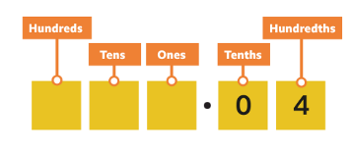
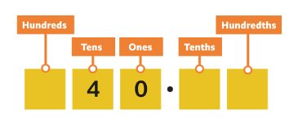
Multiplying decimals by 1000
To multiply by 1000, you move the digits three place value places to the left.
0.04 × 1000 = 40
To multiply by 1000, you move the digits three place value places to the left. So 0.04 × 1000 = 40.

Slide 57
Multiplying decimals by 1000 Practical Practice:
Create different decimal numbers on the place value chart and have a try at x by 1000.
You can use counters or small objects to represent the numbers.

Slide 58
Times-table practise
Spend at least 15mins practising your times-tables.
This can be done on TTRS, hit the button or any other times-table website.
Use the Times-Tables Rock Stars app or website.
Alternatively, copy and paste the following link into a web browser:
https://play.ttrockstars.com/auth/school/student/73173
https://www.topmarks.co.uk/maths-games/7-11-years/times-tables

Slide 59
End of Lesson

Slide 60
Date: 04.03.21
L.O: To be able to divide numbers.
Subject: Maths

Slide 61
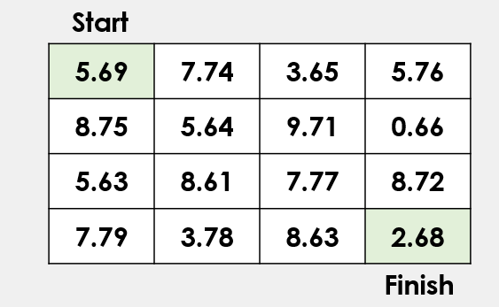
Mental Starter: Rounding Decimals
Move through the maze by circling or writing down the numbers where the tenth is rounded to 7 tenths.

Slide 62
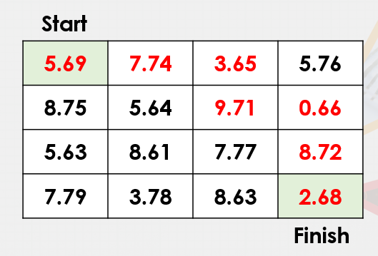
Answer:

Slide 63
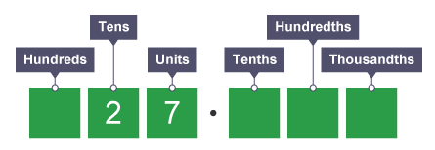
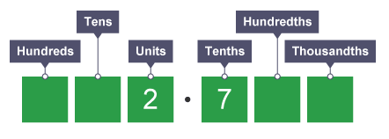
Dividing by 10
When you divide by 10, each digit moves one place to the right. Hundreds become tens, tens become units, units become tenths and tenths become hundredths.
For example:
27 ÷ 10 = 2.7
Each digit has moved 1 place to the right.

Slide 64
Dividing by 10
When dividing decimal numbers, we follow the same approach.
Each digit moves 1 place to the right.
E.G 14.4 ÷ 10 = 1.44

Slide 65
Dividing by 10
What number is shown?
______
Divide the number by 10
Move each digit 1 place to the right.
Answer:_________

Slide 66
Let’s check:
What number is shown?
423.3
Divide the number by 10
Move each digit 1 place to the right.
Answer: 42.33

Slide 67
Dividing by 10
Create the number in one place value chart.
Move the digits one place to the right and draw in the new position on the next chart.
Try these:
134 ÷ 10 =
28.9 ÷ 10 =
You can use the place value charts to help you.

Slide 68
Dividing by 10
Answers:
134 ÷ 10 = 13.4
28.9 ÷ 10 = 2.89
Each digit has moved one place to the right.

Slide 69
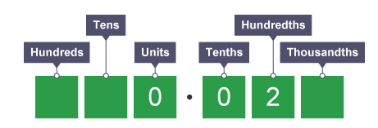
Dividing by 100
When you divide by 100, each digit moves two places to the right.
Each digit moves 2 places to the
right. We don't have any units and
tenths, so we place a '0' in the
columns.
Therefore 2 ÷ 100 = 0.02

Slide 70
Dividing by 100
When dividing decimal numbers, we follow the same approach.
Each digit moves 2 places to the right.
E.G 541.2 ÷ 100 =
5.412
Thousandths

Slide 71
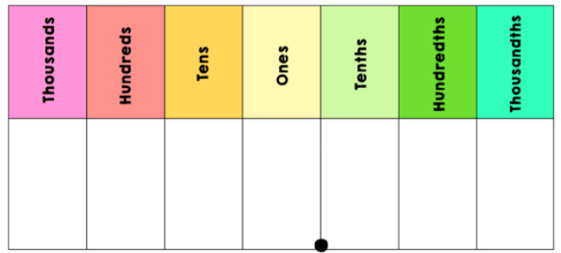
Dividing by 100
Create the number 245.6
Move each digit 2 places to the right and place the counters into the new columns.
Answer: _____

Slide 72
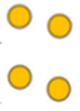
Dividing by 100
Create the number 244.5
Move each digit 2 places to the right and place the counters into the new columns.
Answer: 2.445

Slide 73
Dividing by 100
Create the number
162.8
Move each digit 2 places to the right
Answer: _________

Slide 74
Dividing by 100
Answers:
162.8 ÷ 100 = 1.628
Each digit has moved two places to the right.

Slide 75
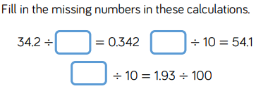
L.O: To be able to divide numbers
Copy down the calculations and write the answers. You can use place value charts, which are on the following slides, and counters (or draw in the counters) to help you.
24 ÷ 10 =
312 ÷ 100 =
885.2 ÷ 10 = Extension:
240.9 ÷ 100 =
673.07 ÷ 10 =
491.55 ÷ 100 =

Slide 78
L.O: To be able to divide numbers
Answers:
24 ÷ 10 = 2.4
312 ÷ 100 = 3.12
885.2 ÷ 10 = 88.52 Extension:
240.9 ÷ 100 = 2.409
673.07 ÷ 10 = 67.307
491.55 ÷ 100 = 4.9155
100
541
19.3

Slide 79
Dividing by 1000
When you divide by 1,000, each digit moves three places to the right.
Each digit moves 3 places to the right. We don't have any units and tenths, so we use '0' in each column.
A zero in the thousandths column is not needed so we ignore it.
Therefore 30 ÷ 1,000 = 0.03

Slide 80
Dividing by 1000
Create the number 4293.1
Move each digit 3 to the right
Answer: _________

Slide 81
Dividing by 1000
Create the number 4293
Move each digit 3 to the right
Answer: 4.293
4 2 9 3
4 2 9 3

Slide 82
Dividing by 1000
6382 ÷ 1000 =
8451.2 ÷ 1000 =
Remember, each digit moves three places to the right.

Slide 83
Dividing by 1000
6382 ÷ 1000 = 6.382
8451.2 ÷ 1000 = 8.4512

Slide 84
Times-table practise
Spend at least 15mins practising your times-tables.
This can be done on TTRS, hit the button or any other times-table website.
Use the Times-Tables Rock Stars app or website.
Alternatively, copy and paste the following link into a web browser:
https://play.ttrockstars.com/auth/school/student/73173
https://www.topmarks.co.uk/maths-games/7-11-years/times-tables

Slide 85
End of Lesson

Slide 86
Date: Friday 5th March 2021
L.O To be able to identify your own feelings
Subject: PSHE

Slide 87
We are looking forward to seeing you all back at school on Monday.
It is normal to have mixed emotions about returning to school after a long break.
Excited
Enthusiastic
You might be feeling….
Happy
Relieved
Sad
Nervous

Slide 88
Look at the ‘Feeling blob tree’ and colour in one blob person which you think might show how you are feeling.
It would be good to talk to someone about about how you are feeling.

Slide 89
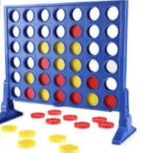
We want you to feel happy and relaxed about coming back to
school so you can concentrate on your work.
Spend some time today doing activities that you enjoy.
Play a game
Go for a walk
Read a book

Slide 90
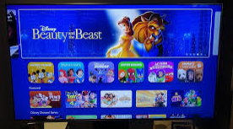
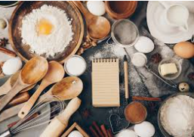
We want you to feel happy and relaxed about coming back to
school so you can concentrate on your work.
Spend some time today doing activities that you enjoy.
Ride your bike or scooter
Watch a film
Make a cake

Slide 91
Have a lovely weekend
See you Monday

