Slide 1
Base 4

Slide 2
Date:
Monday 1st March 2021
L.O.
To be able identify the first set of speed sounds.
Subject: English

Slide 3
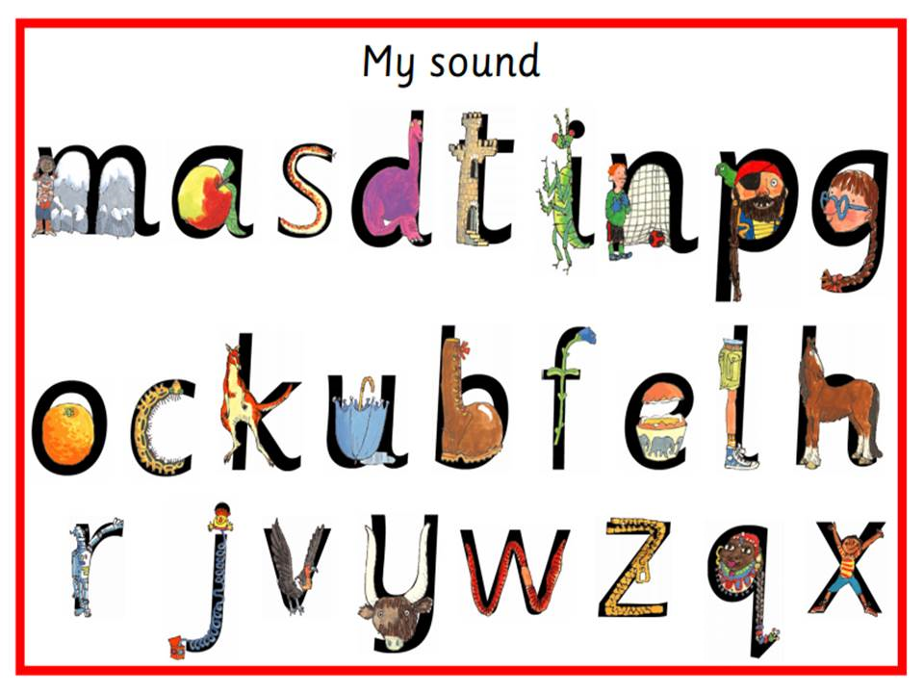
This week in our phonics lesson we are going to continue to look at set 1 sounds, including all the sounds we have explored already.
Can you remember all of the sounds below?

Slide 4
Recap: Using the letter sounds we already know, can you try blending the following words:
f-u-n fun
b-i-n bin
r-a-n ran
s-a-t sat
p-i-t pit
p-a-t pat
b-o-g bog
b-i-d bid
m-a-p map
f-a-n fan
r-a-p rap
c-a-p cap
Point to each letter as you say its sound and say it faster to blend it together to make each word!

Slide 5
Now we are going to look at some new letters and sounds. They are the sounds f, r, c and u.

Slide 7
I am going to use the sounds we have just learnt to spell out some words.
wet
w
e
t

Slide 8
van
v
a
n

Slide 9
v – a - n | van
j – a - m | jam
b – o – x | box
w- i – n | win
m- i - x | mix
j – e - t | jet
s – i - x | six
Let’s try to make some more words using our new sounds. Point to each letter as you say its sound and say it faster to blend it together to make each word!

Slide 10
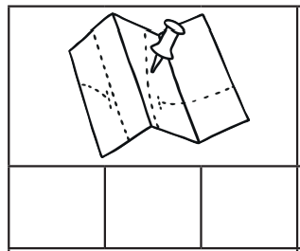
I am going to use the sounds I know to complete the secret words below. Each letter of the secret word is the initial letter sound from the word in each picture.
m
a
p

Slide 11
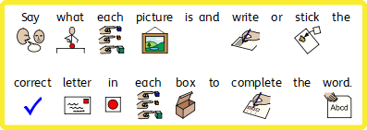
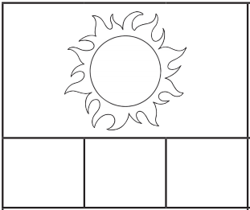
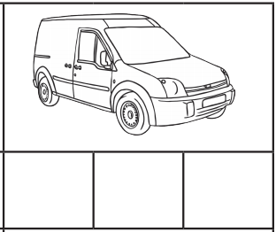
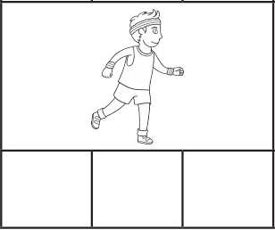

Slide 12
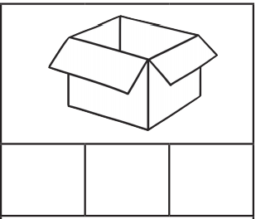
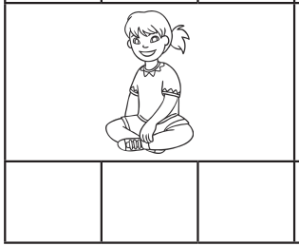
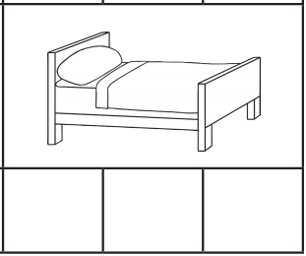

Slide 13
Challenge time!
Now we have learnt our new letters and sounds can you sign them?

Slide 14
Date: Tuesday 2nd March 2021
L.O. To be able to understand what an adjective is.
Subject: English

Slide 15
Adjectives
Last week we began to explore the characters in our class story Hansel and Gretel. The characters were described using words called adjectives, and you were given some adjectives to help you to write sentences to describe the dad in the story. Today, we are going to further explore adjectives so that you can begin to use some of your own in preparation for making your own story characters!
Can you think of any adjectives (describing words) used to describe how the dad in the story looked?

Slide 16
Amazing Adjectives
Adjectives are words that describe nouns (people, places, things, feelings). They help us to imagine what the person, place, thing or feeling is like:
delicious cake best friend sharp pin
Sometimes adjectives can be used in different ways:
The dark blue plane flew through the sky.
The plane that flew through the sky was dark blue.

Slide 17
For each picture on the following pages, see how many adjectives you can write down in a list to describe it. Or, if you need more help, find the correct symbols to describe it. Try to think of your own too without using the examples if you can!

Slide 18
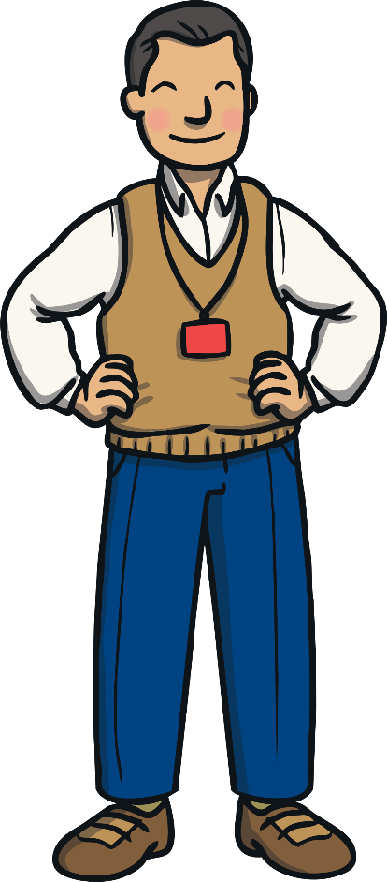
The teacher is: Helpful Kind Caring Professional Fun __________ __________ __________ __________

Slide 19
Rainbows are: ______________ ______________ ______________ ______________ ______________ ______________

Slide 20
Rainbows are: ______________ ______________ ______________ ______________ ______________ ______________
Word Bank
pink | black | purple | orange | bright | dark | Beautiful
brown | colourful | ugly | yellow | red | green | blue

Slide 21
Rainbows are: ______________ ______________ ______________ ______________ ______________ ______________

Slide 22
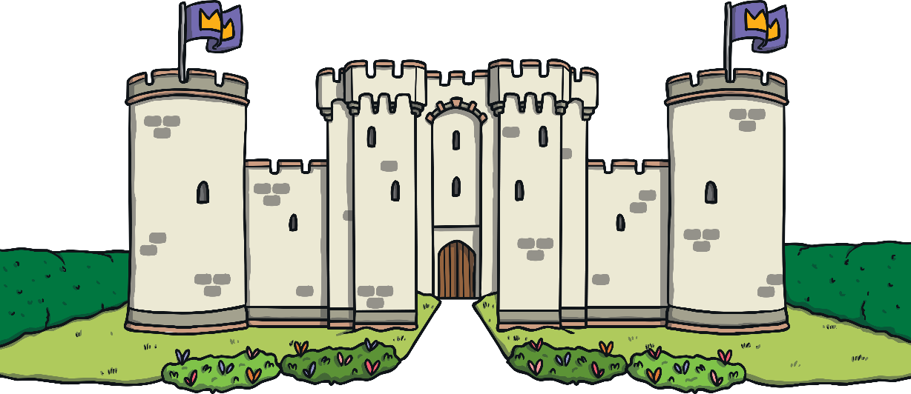
The castle is: ______________ ______________ ______________ ______________ ______________ ______________

Slide 23
The castle is: ______________ ______________ ______________ ______________ ______________ ______________
Word Bank
huge | old | new | haunted | royal | dark | beautiful
colourful | Strong | grey | big | tall | magic | dusty

Slide 24
The castle is: ______________ ______________ ______________ ______________ ______________ ______________

Slide 25
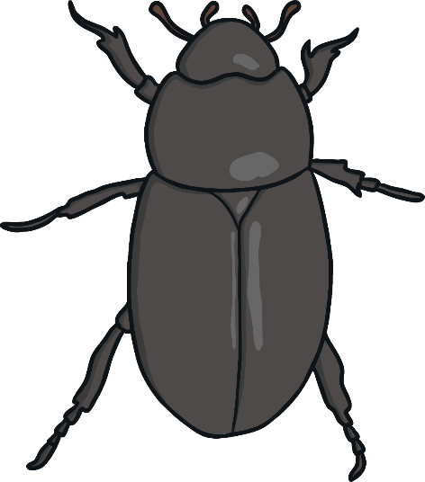
The beetle is: ______________ ______________ ______________ ______________ ______________ ______________

Slide 26
The beetle is: ______________ ______________ ______________ ______________ ______________ ______________
Word Bank
huge | shiny | massive | cute | furry | small | tiny
colourful | black | grey | scary | creepy | loud | quiet

Slide 27
The beetle is: ______________ ______________ ______________ ______________ ______________ ______________

Slide 28
Date: Wednesday 3rd March 2021
L.O. To be able to use adjectives to describe and design character.
Subject: English

Slide 29
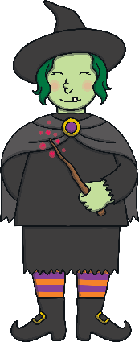
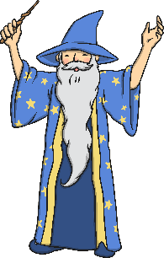
Yesterday, we explored adjectives and used them to describe pictures that we could see. Today, we are going to further explore adjectives and then use then to create our own character for our story Hansel and Gretel. The character is going to be a witch or a wizard, and it is up to you whether you make them a good character or a bad character!

Slide 30
Here is an example of a description of my new Hansel and Gretel character.
kind
The wizard is kind .

Slide 31
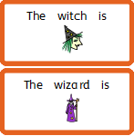

Slide 32
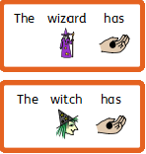

Slide 33
Write 5 sentences to describe what your witch/wizard looks like.
There is a word bank below to help you but try to think of some adjectives of your own too!
The witch/wizard is
The witch/wizard has
Adjective Word Bank
beautiful ugly pretty handsome cool skinny fat
old young long short tall hat cloak dress trousers colourful sparkly glowing tatty beard glasses hair
eyes big small nose warts teeth nails dark bright long ears jewellery shoes wrinkly smooth skin

Slide 34
The witch or wizard is wearing
The witch or wizard is wearing
The witch or wizard is wearing

Slide 35
Write 2 sentences to describe what your witch/wizard’s personality is like.
There is a word bank below to help you but try to think of some adjectives of your own too!
The witch or wizard is
The witch or wizard is also
Adjective Word Bank
grumpy caring rude happy friendly angry sly evil clever kind honest nasty gentle horrible brave helpful
Polite wise scary smart mean horrible shy furious cruel charming cross excitable silly

Slide 36
Write 5 sentences to describe what your witch/wizard looks like.
There is a word bank below to help you but try to think of some adjectives of your own too!
Adjective Word Bank
beautiful ugly pretty handsome cool skinny fat
old young long short tall hat cloak dress trousers colourful sparkly glowing tatty beard glasses hair
eyes big small nose warts teeth nails dark bright long ears jewellery shoes wrinkly smooth skin

Slide 38
Write 2 sentences to describe what your witch/wizard’s personality is like.
There is a word bank below to help you but try to think of some adjectives of your own too!
Adjective Word Bank
grumpy caring rude happy friendly angry sly evil clever kind honest nasty gentle horrible brave helpful
Polite wise scary smart mean horrible shy furious cruel charming cross excitable silly

Slide 39
Date: Thursday 4th March 2021
L.O. To be able to use adjectives to design a character.
Subject: English

Slide 40
Yesterday, you worked hard to use adjectives to describe what your new witch/wizard is going to look like. Today, you are going to draw your witch/wizard using the description you wrote yesterday. On the next page is an example of my wizard- we can’t wait to see yours! Make sure you stick to your description when drawing your witch/wizard, we would like to be able to guess whose witch/wizard belongs to witch description so take your time with your drawing.

Slide 41
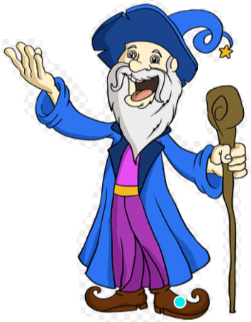
Albert
My wizard is old.
He wizard has a blue hat and cloak.
He also has purple trousers and a purple top.
He is wearing no jewellery, but he does have a gold belt.
He has short, grey hair and a long grey beard.
My wizard is a kind, caring and helpful wizard and so I have drawn him with a happy and smiling face.

Slide 43
Date:
Friday 5th March 2021
L.O.
To be able write our new phonics sounds and CVC words.
Subject: English

Slide 44
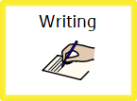
Can you remember our new speed sounds we looked at the beginning of the week?
Today, we are going to try writing them.
Down a wing and up a wing.
Down the arm and leg, repeat the other side.
Down his body, curl and dot.
Down up, down up.

Slide 45
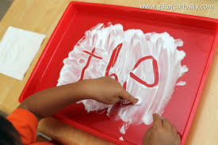
Use flour or shaving foam to write the following letters:
You can also recap on these letters too:
m a s d t i n p g
o e h l b r u f

Slide 46
Try writing the following CVC words using the sounds we have learnt this week in the foam or flour.
h – u - t | hut
f – u - r | fur
r – a - t | rat
c- a - n | can
t - i - n | tin
c – u - b | cub
f – u - n | fun

Slide 47
Challenge: Can you write and spell five of them into your book?
mix
van
jam
win
jet

