Slide 1
Date: Friday 5th March 2021
LO: To be able to understand my emotions and return to school positively.
Subject: PSHE

Slide 2
Getting ready for returning to school
The following slides are to support your child as they prepare to go back to school on 8th March.
Each slide acts as a prompt for discussions you can have with your child(ren) about their return to school.
Encourage your child to talk about their worries and reassure them about going back to school.

Slide 3
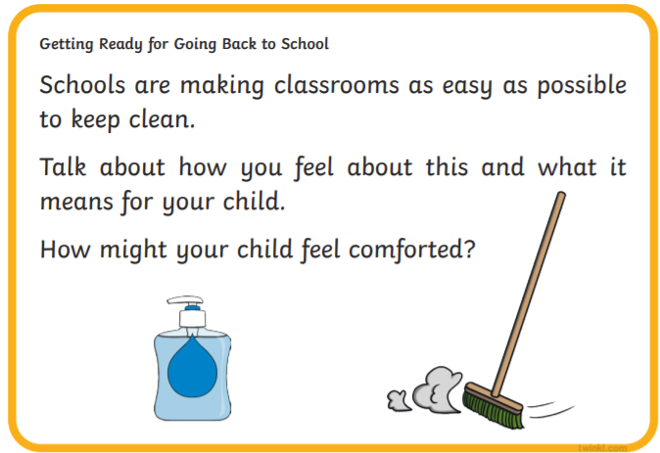

Slide 4
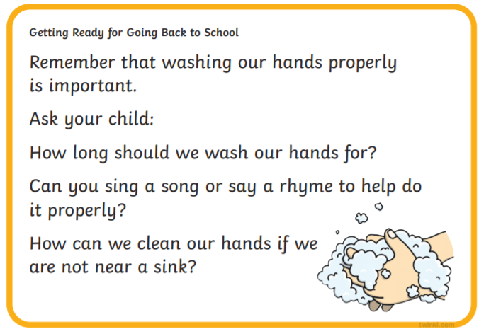

Slide 7
To help you prepare for your return to school, complete the following activities.
These will help you reflect on your experience over the last 7 weeks and get you ready to enjoy the next term and a half of school.

Slide 8
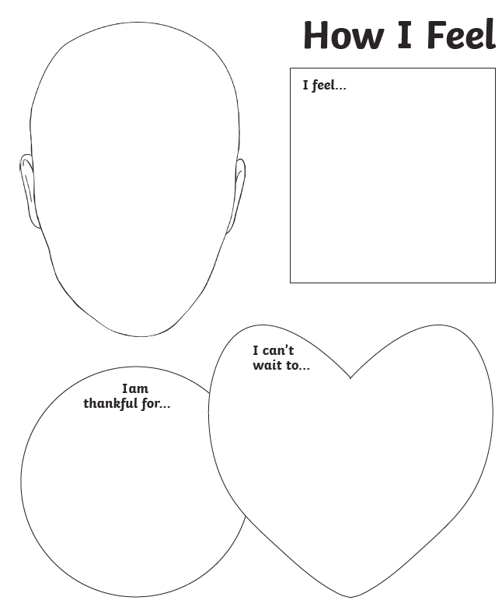

Slide 9
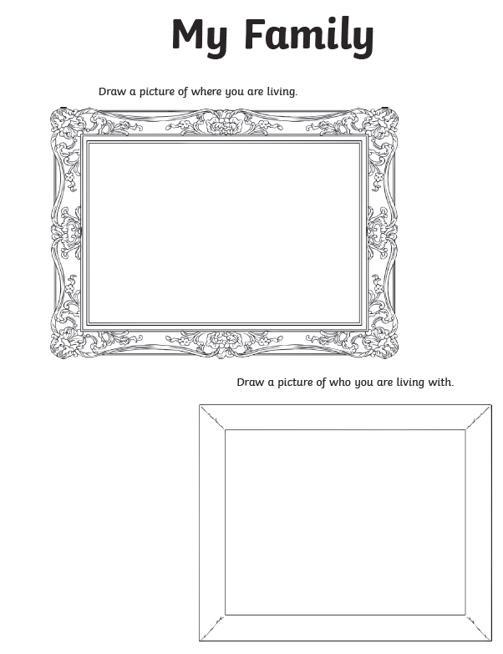

Slide 10
Once you have completed this activity, click on the slide (on the left) and click delete. Or, if you are working on paper, scrumple this up and throw it in the bin.
Imagine your worries disappearing. Focus on all the positive things about coming back to school ☺

Slide 11
__________________________________________________________________________________________________________________________________
________________________________________________________________________________________________________________________________________________________________________
________________________________________________________________________________________________________________________________________________________________________
________________________________________________________________________________________________________________________________________________________________________
________________________________________________________________________________________________________________________________________________________________________
______________________________________________________________________________________________

Slide 12
To ensure you are fully ready to return, next week, we will be setting you some extra homework to complete today and over the weekend…
Spend time with family
Go on a bike/ scooter
Read a book
Watch your favourite TV program
Smile
Eat sweets or ice-cream
Laugh until your tummy hurts
Go outside and enjoy nice weather
Go for or a walk
Spend time on your favourite hobby
Rest
Chill
Run around until you just can’t run anymore
Cook or make something
Draw a picture – and give it to somebody!
Have more sweets or ice cream
Play in your garden
Do something good that you’ve never done before
Have a super weekend!

