Slide 1


Subject: Maths
Pack: A

Slide 2



Date: 1.3.2021
LO. To be able to count back from 10.
Subject: Maths

Slide 3

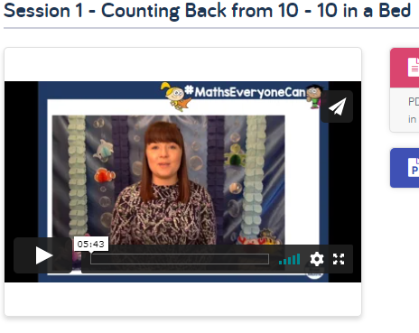
Pre-recorded Teaching
Access the online teaching video below that will support you to complete the work in this lesson. This video will act as a support but all of the work can still be successfully understood & completed using paper-based versions of this pack. If you need further support to understand / complete work then please contact school via e-mail or telephone.
Play Video
The link will take your to a page full of videos. Please make sure you watch Session 1 – Counting back from 10.
You can also copy and paste this link if you would prefer:
https://whiterosemaths.com/homelearning/early-years/building-9-10-week-2/

Slide 4



Today we are going to look further at the numbers 9 and 10.
To get us started we will look at this number line together.
Look carefully. What do you notice? There is something not quite right.
Yes that’s correct. The number 2 and 3 are in the wrong places. 2 comes before 3.
We need to swap them around.
Now it’s correct. Let’s read the numerals along the number line together.

Slide 5

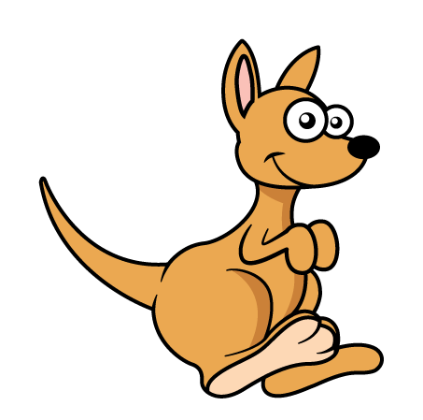
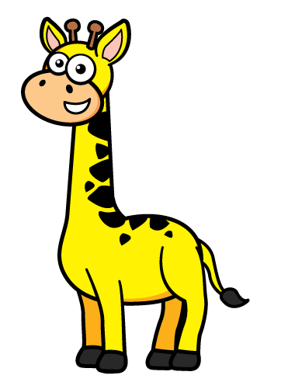
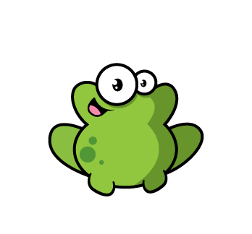

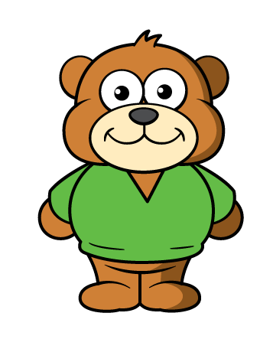
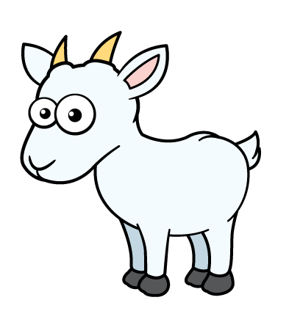
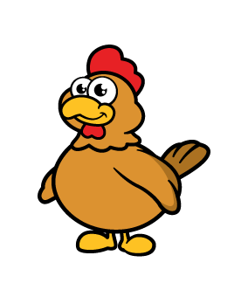


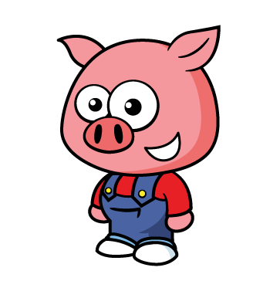

Today we are going to be looking at the ten in a bed song.
Do you know that song?
Here is our bed and in the bed are 10 animals
“There were 10 in the bed and the little one said, roll over, roll over. “

Slide 6
“So they all rolled over and one fell out.”
How may are left in the bed now?
That’s right. There are 9 left in the bed. 1 less than 10 is 9.
“There were 9 in the bed and the little one said, roll over, roll over. “

Slide 7
“So they all rolled over and one fell out.”
We don’t have 9 in the bed now. How may are left in the bed now?
That’s right. There are 8 left in the bed. 1 less than 9 is 8.
“There were 8 in the bed and the little one said, roll over, roll over. “

Slide 8
“So they all rolled over and one fell out.”
We don’t have 8 in the bed now. How may are left in the bed now?
That’s right. There are 7 left in the bed. 1 less than 8 is 7.
We are going to leave the song there now but you can keep singing it at home if you like until you have no animals left in the bed.

Slide 9

Now I need your help to sort our number line again but his time we will do it a bit different.
In our song we started with the number 10 and each time there was one animal less so we counted backwards.
Look at our number line here. It starts with 10 like the song and goes backwards to 1.
Count with me…

Slide 10
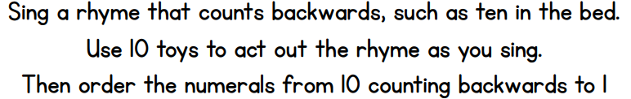
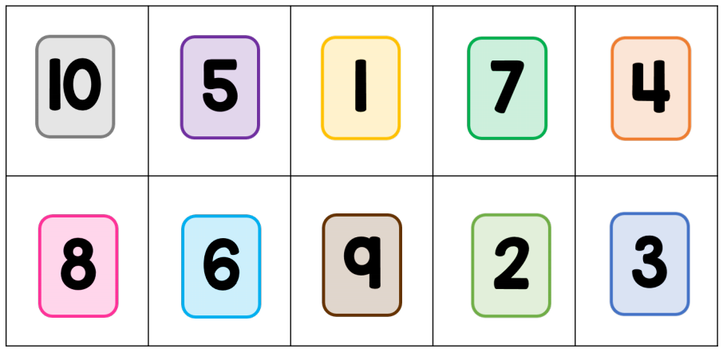

Now it’s your turn.
You can print and copy these number cards or make your own.

Slide 11
Date: 2.3.2021
LO. To be able to make pairs.
Subject: Maths

Slide 12
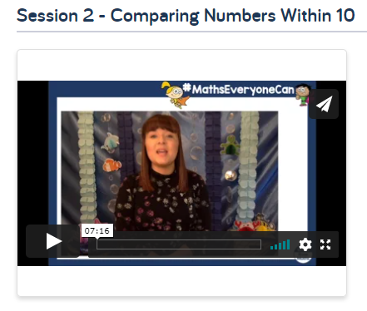
Pre-recorded Teaching
Access the online teaching video below that will support you to complete the work in this lesson. This video will act as a support but all of the work can still be successfully understood & completed using paper-based versions of this pack. If you need further support to understand / complete work then please contact school via e-mail or telephone.
Play Video
The link will take your to a page full of videos. Please make sure you watch Session 2 – Comparing numbers within 10.
You can also copy and paste this link if you would prefer:
https://whiterosemaths.com/homelearning/early-years/building-9-10-week-2/

Slide 13
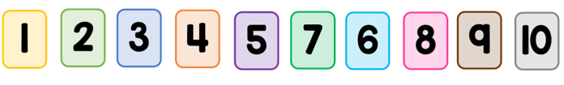
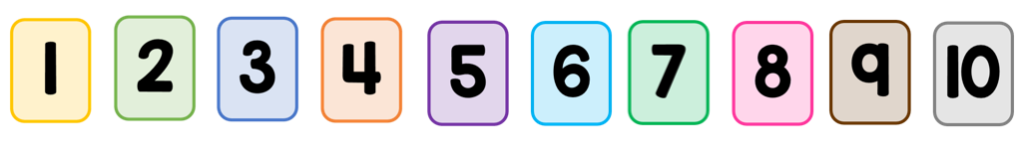
Today we are going continue our work with the numbers 9 and 10.
Let’s get started by spotting the mistake in our number line again.
Look carefully. What can you see?
That’s right. The numbers 6 and 7 are in the wrong places. Let’s put it right by swapping them around.
Now read the numerals again. This time in the right order.

Slide 14
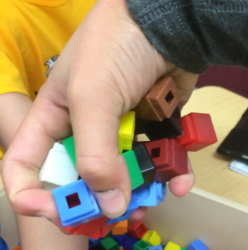
Now I have a handful of cubes. How many cubes do you think I have in my hand?
Do you think I have more than 10 in my hand?
No. My hands are only small. I wouldn’t be able to fit 10 cubes in my hand.
How many do you think I have?
Let’s count them out on the next page…

Slide 15

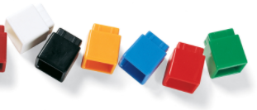
Count with me.
I had 6 cubes in my hand.
I wonder how many cubes you could fit in your hand.
Do you think you could fit more cubes than me or fewer cubes than me?

Slide 16
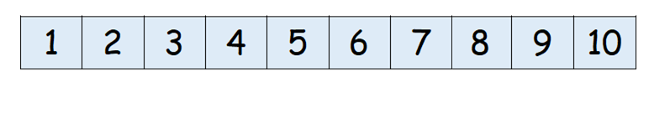
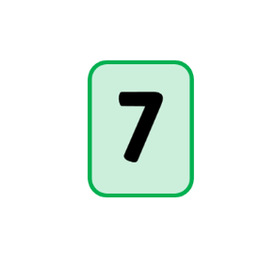
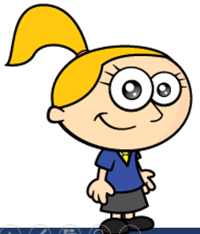
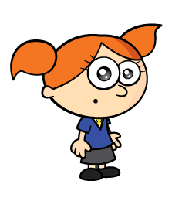


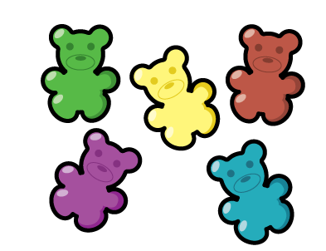
Here are my friends Eva and Alex and they both have a handful of sweets.
Eva thinks she has 7 sweets in her hand.
Let’s check by counting.
Now point to numeral 7 on the number line.

Slide 17
Alex thinks she has more than 7 sweets in her hand.
If Alex has more than 7, how many sweets could she have in her hand?
Use the number line to help you.
Yes. If Alex has more than 7 sweets then her number will be greater than 7.
It could be 8, 9 or 10.
Shall we check?

Slide 18
Count how many sweets Alex has.
Was she right? Did she have more than Eva?

Slide 19

Count how many sweets Alex has.
Was she right? Did she have more than Eva?
Yes. 10 is more than 7 and we can see on the number line that the numeral 10 is greater than 7.

Slide 20
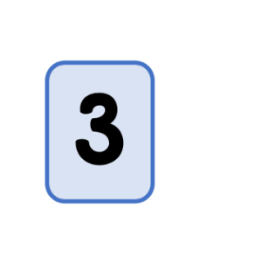
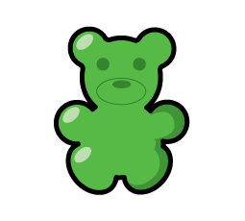
Eva and Alex have a different handful of sweets now.
This time, Alex thinks she has 3 sweets in her hand.
Let’s check by counting.
Now point to numeral 3 on the number line.

Slide 21
This time Eva thinks she has fewer than 3 sweets in her hand.
If Eva has fewer than 3, how many sweets could she have in her hand?
Use the number line to help you.
Yes. If Eva has fewer than 3 sweets then her number must be smaller than 3.
It could be 1 or 2
Shall we check?

Slide 22
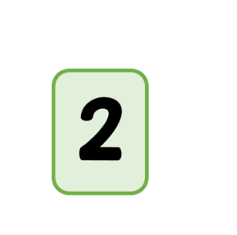
Count how many sweets Eva has.
Was she right? Did she have fewer than Alex?
Yes. 2 is fewer than 3 and we can see on the number line that the numeral 2 is smaller than 3.

Slide 23
Now it’s your turn. Have a go at playing the same game with your adult .
Grab a handful of objects. How many do you have?
Ask your adult to grab a handful too.
If your adult has more than you, how many could they have?
If your adult has fewer than you, how many could they have?
Use the number line to talk about which numbers are smaller and which are greater.
Great work today!

Slide 24
Date: 3.3.2021
LO. To be able to compare numbers within 10.
Subject: Maths

Slide 25
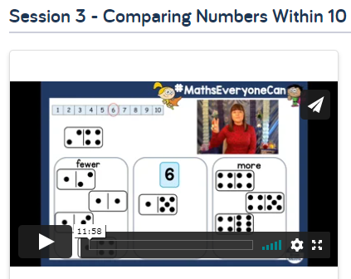
Pre-recorded Teaching
Access the online teaching video below that will support you to complete the work in this lesson. This video will act as a support but all of the work can still be successfully understood & completed using paper-based versions of this pack. If you need further support to understand / complete work then please contact school via e-mail or telephone.
Play Video
The link will take your to a page full of videos. Please make sure you watch Session 3 – Comparing numbers within 10
You can also copy and paste this link if you would prefer:
https://whiterosemaths.com/homelearning/early-years/building-9-10-week-2/

Slide 26
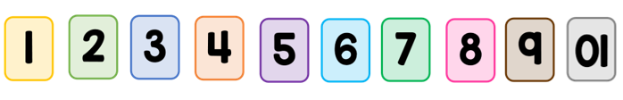
Today we are going to be comparing numbers up to 10.
Before we start, let’s warm up with a game of spot the mistake.
Miss Bentley has made a mistake in the number line.
Can you spot the problem?

Slide 27


That’s right.
The numeral 10 is upside down.
When we write 10 we write 1 and then 0.
Let’s fix it.

Slide 28
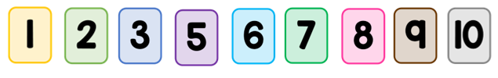
Let’s look at this number line.
Can you spot the problem?
Let’s read along the number line together.
Oh no! Miss Bentley has missed out the number 4!
Number 4 comes after 3.
Let’s fix it.
Great! Now let’s read along the number line together.

Slide 29
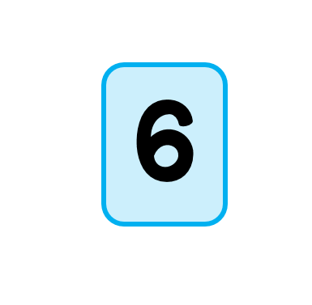
Now we are going to be sorting dominoes.
We will be sorting them into three groups.
We have a group for the number 6
A group for fewer than 6 and a group for more than 6.
more

Slide 30
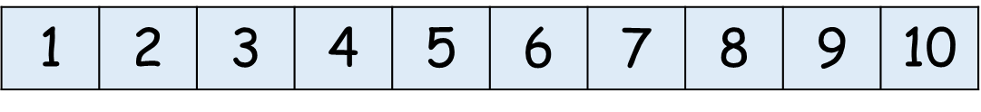
To help, we have a number line with the numeral 6 circled.
I will show you a domino and you have to count up all the spots.
Then decide which group it goes in.
Does it have 6 spots? More than 6 spots or fewer than 6 spots?
Let’s start…
more

Slide 31

Here is the first domino. Count how many spots it has altogether.
Yes there are 8 spots. 4 spots on one side and 4 spots on the other side so altogether there are 8 spots.
Is 8 more or fewer than 6?
more

Slide 32

Yes the numeral 8 is greater than 6 so 8 is more than 6.
We can put it in the more group.
more

Slide 33

Here is the next domino. Count how many spots it has altogether.
Yes there are 4 spots. 3 spots on one side and 1 spot on the other side so altogether there are 4 spots.
Is 4 more or fewer than 6?
more

Slide 34
Yes the numeral 4 is smaller than 6 so 4 is fewer than 6.
So which group should it go in?
Yes we can put it in the fewer group.
more

Slide 35

Here is the next domino. Count how many spots it has altogether.
Yes there are 9 spots. 4 spots on one side and 5 spots on the other side so altogether there are 9 spots.
Is 9 more or fewer than 6?
more

Slide 36
Yes the numeral 9 is greater than 6 so 9 is more than 6.
So which group should it go in?
Yes we can put it in the more group.
more

Slide 37

Here is the next domino. Count how many spots it has altogether.
Yes there are 6 spots. 1 spot on one side and 5 spots on the other side so altogether there are 6 spots.
more

Slide 38
So this domino goes in the numeral 6 group.
We can see 6 spots altogether.
more

Slide 39

Here is the next domino. Count how many spots it has altogether.
Yes there are only 2 spots. 1 spot on one side and 1 spot on the other side so altogether there are 2 spots.
Is 2 more or fewer than 6?
more

Slide 40
Yes the numeral 2 is smaller than 6 so 2 is fewer than 6.
So which group should it go in?
Yes we can put it in the fewer group.
more

Slide 41
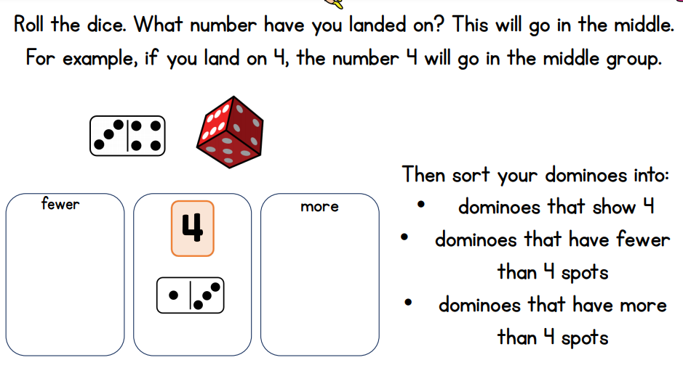
Now it’s your turn to have a go at repeating this activity. But this time, the number in the middle is going to be decided by the roll of a dice.

Slide 42
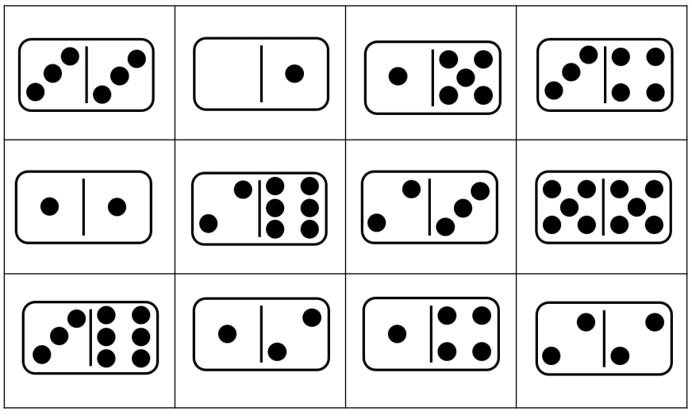
Print and cut out these dominoes for your game. If you don’t have
a dice then choose a number between 1 and 10 to go in the middle group.

Slide 43
Date: 25.2.2021
LO. To be able to combine two numbers to make 10.
Subject: Maths

Slide 44
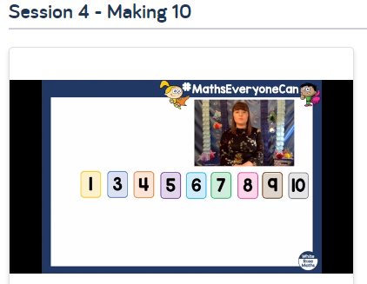
Pre-recorded Teaching
Access the online teaching video below that will support you to complete the work in this lesson. This video will act as a support but all of the work can still be successfully understood & completed using paper-based versions of this pack. If you need further support to understand / complete work then please contact school via e-mail or telephone.
Play Video
The link will take your to a page full of videos. Please make sure you watch Session 4 – Making 10
You can also copy and paste this link if you would prefer:
https://whiterosemaths.com/homelearning/early-years/building-9-10-week-2/

Slide 45
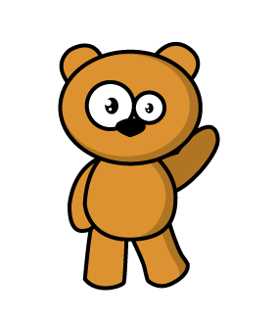
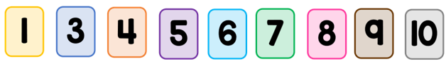
Today we are going to look be looking further at 10.
Let’s get started by having a look at this number line.
Mrs Levington has made a mistake.
Look carefully. Can you spot the mistake? Tell your adult.

Slide 46
That’s right.
The number 2 is missing!
Let’s fix it by adding in the number 2.

Slide 47

Mrs Levington has fixed it now by adding the number 2.
2 comes after the number 1 and before the number 3.

Slide 48
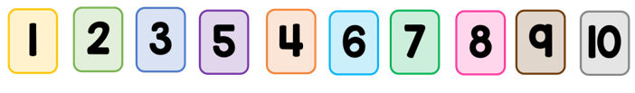
Now have a look at this number line.
Mrs Levington has made an other mistake.
Look carefully. Can you spot it? Tell your adult.

Slide 49
That’s right!
The numbers 4 and 5 are in the wrong place.
Let’s fix it by swapping them around.

Slide 50

Now we have fixed it.
Let’s check by reading the numbers along the number line together.

Slide 51



Today we are going to play a game all about making 10.
Here are three cards showing different amounts on dice.
This card shows 3 This card shows 5 This card shows 4

Slide 52

Here is another card. It has 6 spots.
Let’s look and think about which other card, from below, can go with this card to make a total of 10 spots altogether.

Slide 53
I think these two cards go together to make 10.
I can check by counting all of the spots from both dice altogether.
I was right because 6 and 4 make 10.
I can also write this like this
4 + 6 = 10

Slide 54
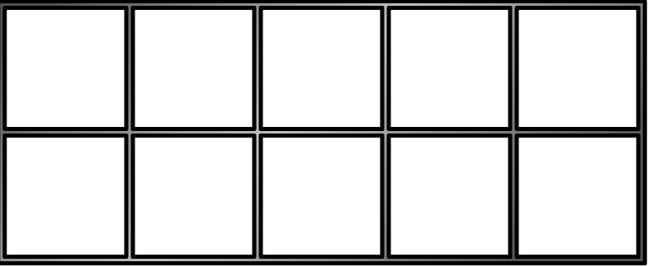
Let’s have another turn together.
Here are some more cards showing different amounts.
This time they are in ten frames.
Let’s check how many are in each ten frame by counting.
This card shows 3 This card shows 5 This card shows 6
Good counting!

Slide 55
Now here is another ten frame. Count to check how many it shows.
Yes it shows 5.
Let’s look and think about which other card, from below, can go with this card to make a total of 10 spots altogether.

Slide 56
Yes that’s right. These two cards go together to make 10.
Let’s check by counting all of the spots from both ten frames altogether.
We were right because 5 and 5 make 10.
We can also write this like this
5 + 5 = 10

Slide 57
This time it is a little bit trickier.
Here are some more cards showing the numerals instead of dots.
Can you read the numerals to your adult?
That’s right. We have two, five and one.

Slide 58
Now here is another ten frame. Let’s count to check how many it shows.
Yes it shows 8.
Let’s look and think about which other card, from below, can go with this card to make a full 10. Tell your adult.

Slide 59
Yes we need 2 because we have 8 spots in the ten frame and 2 empty spaces.
We would need 2 more spots to make a full 10.
Eight and two make ten.
We can also write it like this 8 + 2 = 10

Slide 60
Let’s have one more go together.
Here are some more cards showing the numerals instead of dots.
Can you read the numerals to your adult?
That’s right. We have six, eight and seven.

Slide 61
Now here is another ten frame. Let’s count to check how many it shows.
Yes it shows 3.
Let’s look and think about which other card, from below, can go with this card to make a full 10. Tell your adult.

Slide 62
Yes we need 7 because we have 3 spots in the ten frame and 7 empty spaces.
We would need 7 more spots to make a full 10.
Three and seven make ten.
We can also write it like this 3 + 7 = 10

Slide 63
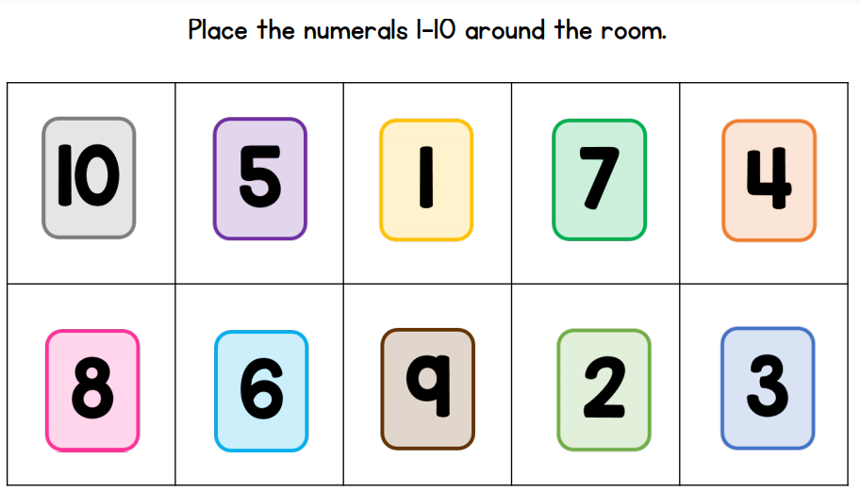
Now it’s your turn to have a go at playing this game.

Slide 64
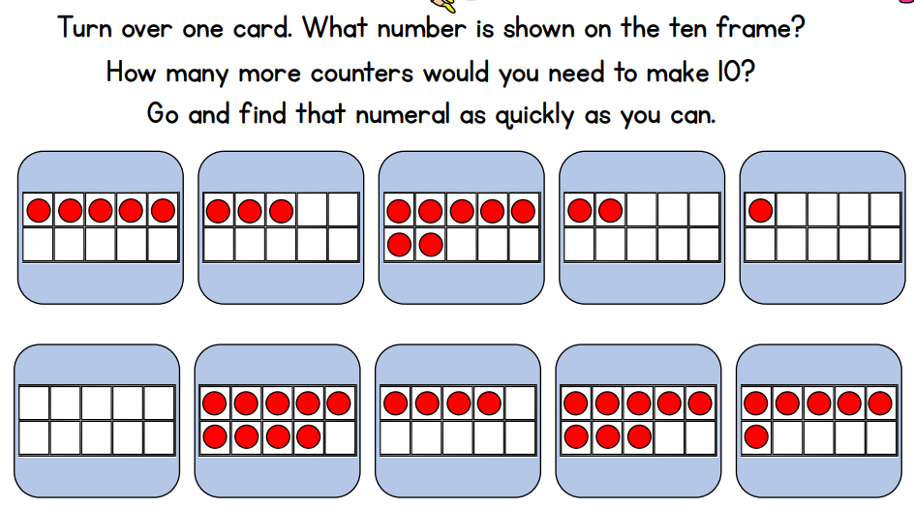
Then you are going to choose one card from below.

Slide 65
Date: 5.3.2021
LO. To be able to combine different amounts to make 10.
Subject: Maths

Slide 66
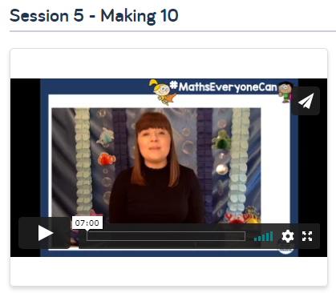
Pre-recorded Teaching
Access the online teaching video below that will support you to complete the work in this lesson. This video will act as a support but all of the work can still be successfully understood & completed using paper-based versions of this pack. If you need further support to understand / complete work then please contact school via e-mail or telephone.
Play Video
The link will take your to a page full of videos. Please make sure you watch Session 5 – Making 10
You can also copy and paste this link if you would prefer:
https://whiterosemaths.com/homelearning/early-years/building-9-10-week-2/

Slide 67

Hello everyone. Today we are going to continue our work on making 10.
Let’s get started by counting along the number line.
Count with me…
Eight, ten! That’s not right.
Oh no! Has Mrs Levington been getting it wrong again?
Tell your adult which number is missing and then we can fix it.

Slide 68

That’s right. We need to add the missing number 9.
Let’s count along the number line again.
That’s better. Nine goes after eight and before ten.

Slide 69
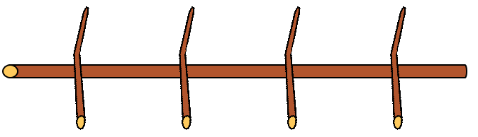
Today we have some friends to help us make 10.
We have Panda, Pig and Monkey.
Look. They have made a ten frame out of sticks.
It looks a bit different to our usual ten frame but can you see how it still has ten spaces?

Slide 70
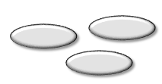
The animals want to fill up the ten frame with some natural objects.
Miss Bentley found some magic beans and gave them to the animals.
Here Panda has some beans.
I can see Panda has 3 beans. 1, 2, 3.
I want him to put them into the ten frame.
Let’s see where he puts them.

Slide 71
Panda has put his beans in the ten frame but it’s not full.
I want a full ten frame. How many more beans do we need to fill up the ten frame? Tell your adult.
That’s right. We need 7 more beans. We can see that there are 7 spaces empty on the ten frame so we need 7 more beans.
3 + 7 = 10

Slide 72
Look. Here is Pig with some beans. Let’s count how many beans Pig found.
1, 2, 3. Pig found 3 beans as well.
Let’s add these beans to the ten frame with the others.

Slide 73
Pig has put his beans in the ten frame but it’s still not full.
Count how many beans there are now.
1, 2, 3, 4, 5, 6.
I want a full ten frame. How many more beans do we need to fill up the ten frame now? Tell your adult.
That’s right. We need 4 more beans. We can see that there are 4 spaces empty on the ten frame so we need 4 more beans.
6 + 4 = 10

Slide 74
Look. Here is Bear with some beans. Let’s count how many beans Bear found.
1, 2, 3, 4. Pig found 4 beans.
Let’s add these beans to the ten frame with the others.

Slide 75
Bear has put his beans in the ten frame.
What do you notice?
Yes! We have ten beans now.
We can easily see this because the ten frame is full. There are no empty spaces.
Panda had 3 beans.
Pig had 3 beans.
Bear had 4 beans
3 and 3 and 4 make 10 altogether.

Slide 76
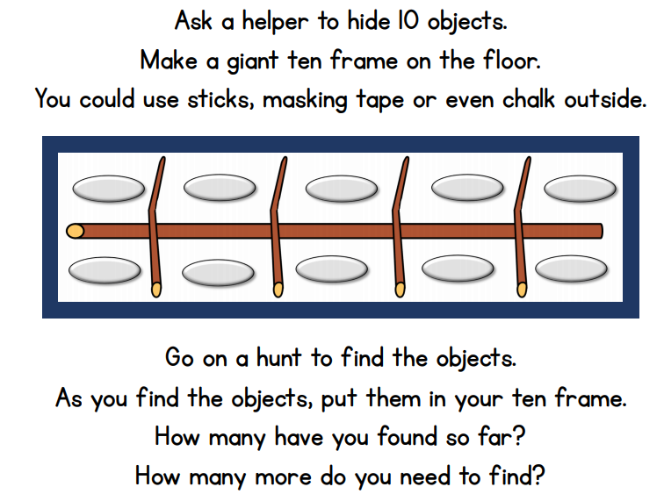
Now it’s your turn to make ten using a ten frame. You can do it in the house or even outside.

