Slide 1
Date: 18.01.21
LO To be able to identify different 2D shapes.
Subject: Maths

Slide 2
Pre-recorded Teaching
Access the online teaching video below that will support you to complete the work in this lesson. This video will act as a support but all of the work can still be successfully understood & completed using paper-based versions of this pack. If you need further support to understand / complete work then please contact school via e-mail or telephone.
Play Video

Slide 3
2D Shapes
2D shapes are flat shapes that don’t have depth.
2D means that the shape can be measured by two dimensions (ways) – length and width.

Slide 4
2D Shapes
Draw a shape from the shape to the name.
square rectangle semi-circle circle triangle
Draw a line using a ruler or the line tool on the computer.

Slide 5
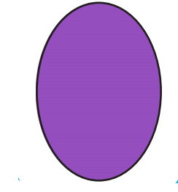
2D Shapes
Draw a shape from the shape to the name.
oval pentagon hexagon heptagon octagon
Draw a line using a ruler or the line tool on the computer.

Slide 6
Sides and Corners
How many sides and corners do these shapes have?
How many sides does a square have?
How many corners does a square have?
Square
How many sides does a heptagon have?
How many corners does a heptagon have?
Heptagon

Slide 7
Sides and Corners
How many sides and corners do these shapes have?
How many sides does a pentagon have?
How many corners does a pentagon have?
Pentagon
How many sides does a triangle have?
How many corners does a triangle have?
Triangle

Slide 8
Sides and Corners
How many sides and corners do these shapes have?
How many sides does a semi-circle have?
How many corners does a semi-circle have?
Semi-Circle
How many sides does a octagon have?
How many corners does a octagon have?
Octagon

Slide 9
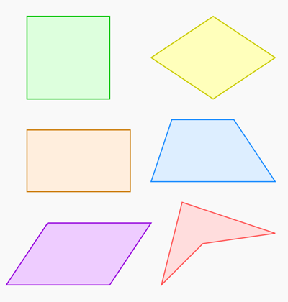
Quadrilaterals
A quadrilateral is any shape that has 4 sides and 4 corners.
FACT
The national flag of Nepal is the only flag that isn’t a quadrilateral!

Slide 10
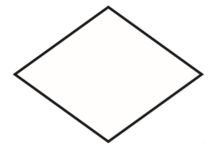
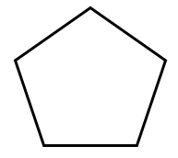
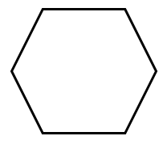
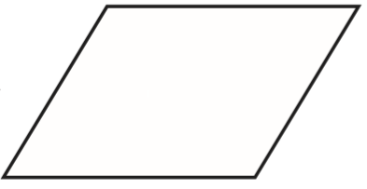
Sort the Shapes
Either drag the shapes or cut them out and stick them under the headings.
Sort the shapes into a group that are quadrilaterals and a group that aren’t quadrilaterals.
Quadrilaterals Not Quadrilaterals

Slide 11
Drawing
Quadrilaterals
Use a ruler to draw a range of different quadrilaterals on the paper.
Draw at least 5 quadrilaterals on your paper.

Slide 12
Challenge!
Have a go at these problems…

Slide 13
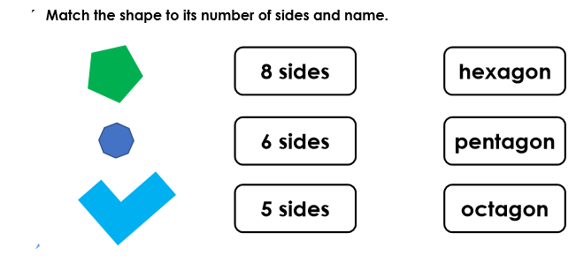
Challenge

Slide 14
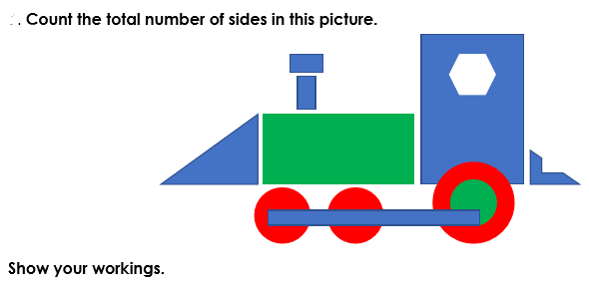
Tricky Challenge
This could be lines on each side or counting up the sides on each shape and adding them together.

Slide 15
Well done for all of your hard work this lesson!
Please send any completed work/photographed evidence of completed work (practical activities) to pioneerspupils@gmail.com or deliver it to the dropbox outside of school on a Friday.

Slide 16
Date: 19.01.21
LO To be able to find right angles in shapes.
Subject: Maths

Slide 17
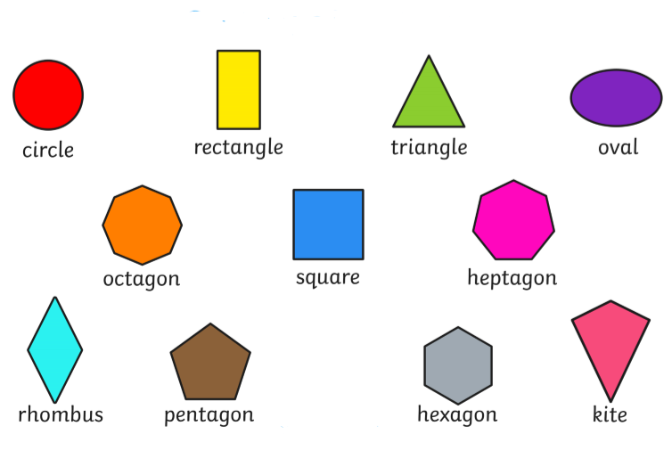
Recap
Remind yourself the 2D shapes and their names.

Slide 18
Pre-recorded Teaching
Access the online teaching video below that will support you to complete the work in this lesson. This video will act as a support but all of the work can still be successfully understood & completed using paper-based versions of this pack. If you need further support to understand / complete work then please contact school via e-mail or telephone.
Play Video

Slide 19
What is a Right Angle?
A right angle is a turn of 90⁰.

Slide 20
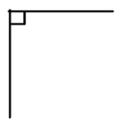
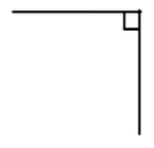
What is a Right Angle?
Right angles can be found where 2 lines meet – making an L shape.
A right angle can usually be found in the corner of a square or rectangle.

Slide 21
Right Angle Finder…
1. Get a piece of paper.
2. Use the two edges to draw a square.
3. Use your angle finder to hunt for
right angles around your house.

Slide 22
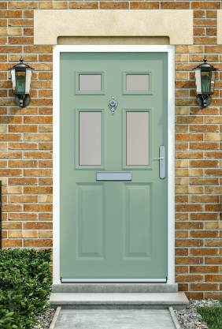
Right Angle Hunt
Things you might find…
What else did you find? Write
them down here…
A book has right angles.
A door has right angles.

Slide 23
Right Angles in Shapes
Does a square have right angles? __________
Use your right angle finder to check whether any of the angles are 90⁰.
How many right angles does a square have?
__________________
Square

Slide 24
Right Angles in Shapes
Does a circle have right angles? __________
Use your right angle finder to check whether any of the angles are 90⁰.
How many right angles does a circle have?
__________________
Circle

Slide 25
Right Angles in Shapes
Does a pentagon have right angles? __________
Use your right angle finder to check whether any of the angles are 90⁰.
How many right angles does a pentagon have?
__________________
Pentagon

Slide 26
Right Angles in Shapes
Does a rectangle have right angles? __________
Use your right angle finder to check whether any of the angles are 90⁰.
Rectangle
How many right angles does a rectangle have?
__________________

Slide 27
Right Angles in Shapes
Does an octagon have right angles? __________
Use your right angle finder to check whether any of the angles are 90⁰.
How many right angles does an octagon have?
__________________
Octagon

Slide 28
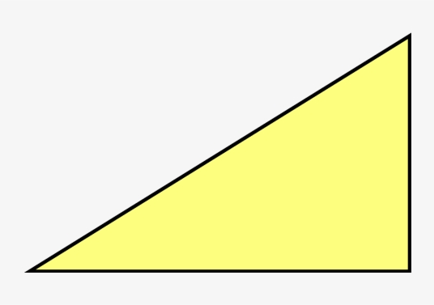
Right Angles in Shapes
Does a right-angled triangle have right angles? __________
Use your right angle finder to check whether any of the angles are 90⁰.
How many right angles does a right-angled triangle have?
__________________
Right-Angled Triangle

Slide 29
Challenge!
Have a go at these problems…

Slide 30
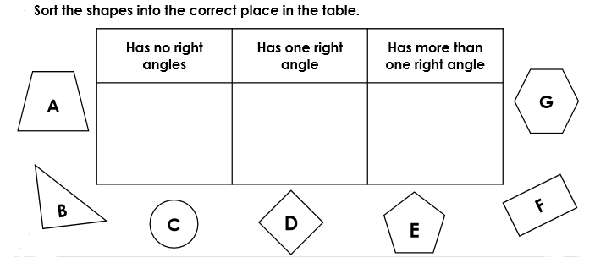
Challenge
Write the letters in the correct box in the table.

Slide 31
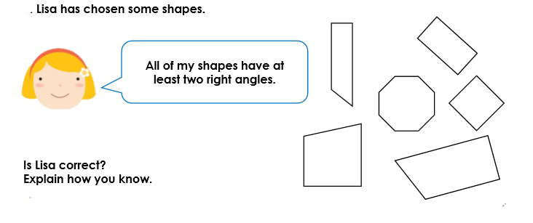
Tricky Challenge!

Slide 32
Well done for all of your hard work this lesson!
Please send any completed work/photographed evidence of completed work (practical activities) to pioneerspupils@gmail.com or deliver it to the dropbox outside of school on a Friday.

Slide 33
Date: 20.01.21
LO To be able to recognise lines of symmetry in 2D shapes.
Subject: Maths

Slide 34
Recap
Remind yourself the 2D shapes and their names.

Slide 35
Pre-recorded Teaching
Access the online teaching video below that will support you to complete the work in this lesson. This video will act as a support but all of the work can still be successfully understood & completed using paper-based versions of this pack. If you need further support to understand / complete work then please contact school via e-mail or telephone.
Play Video

Slide 36
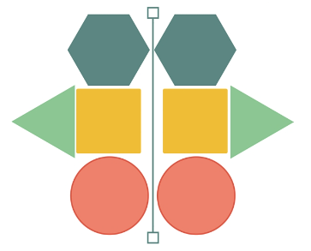
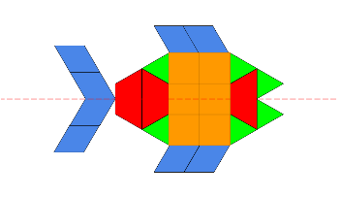
Symmetry
What is symmetry?
Something is symmetrical when it is identical on both sides.
A shape or pattern has symmetry if a mirror line can be drawn on it to show that both sides are exactly the same.

Slide 37
Vertical / Horizontal
There are different types of lines of symmetry – vertical and horizontal.
A vertical line of symmetry means the line goes up and down.
A horizontal line of symmetry means the line goes across (from side to side).

Slide 38
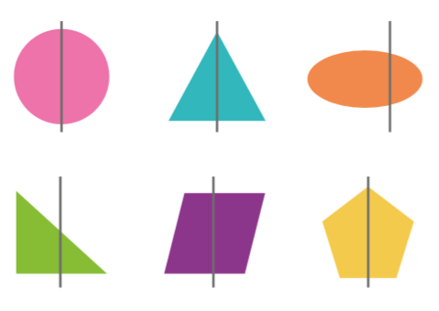
Lines of Symmetry
Tick the shapes with a correct line of symmetry.
Remember the shape as to be the same on both sides of the line of symmetry.
.

Slide 39
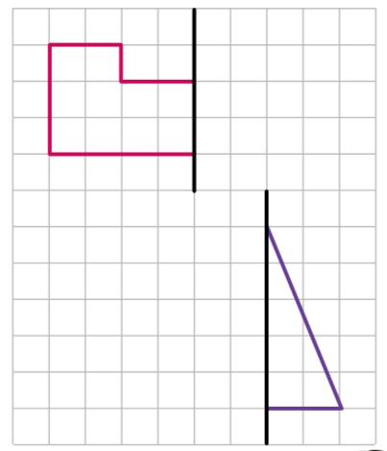
Draw the Symmetrical Shape
Draw the other side of each symmetrical shape on the grid.

Slide 40
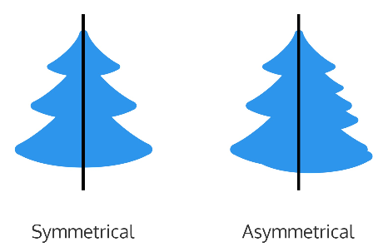
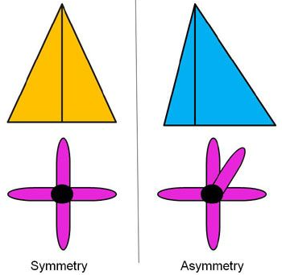
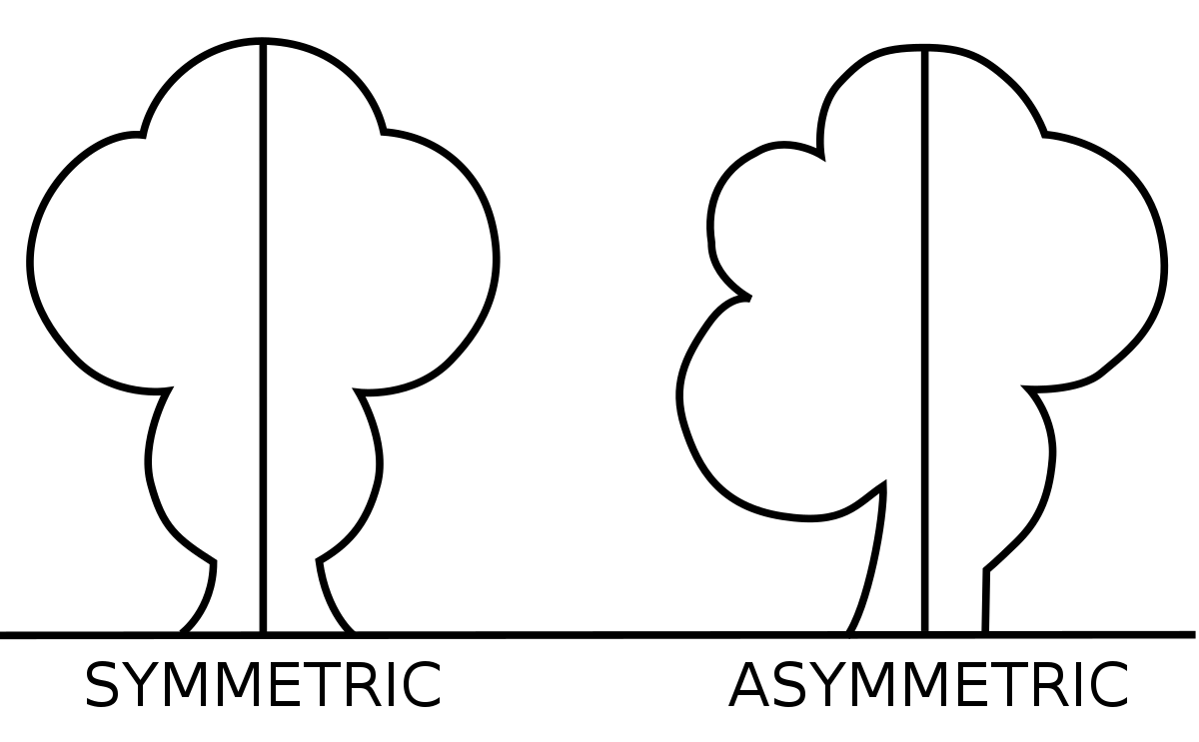
Asymmetry
What is asymmetry?
Asymmetry is when there isn’t any lines of symmetry in a pattern or shape.
It’s not the same on each side.
It is the opposite symmetrical.

Slide 41
Sort the Images
Cut + stick or drag the images.
Sort the images based on whether they are symmetric or asymmetric.
Symmetric
Asymmetric

Slide 42
Challenge!
Have a go at these problems…

Slide 43
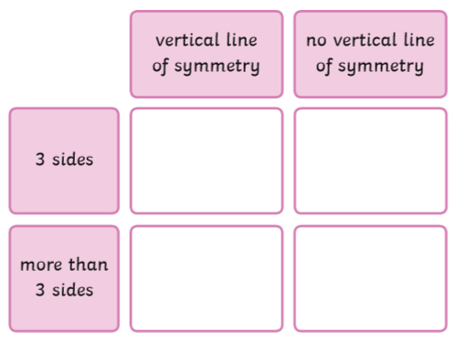
Challenge
Draw/drag the 4 shapes in the correct boxes.

Slide 44
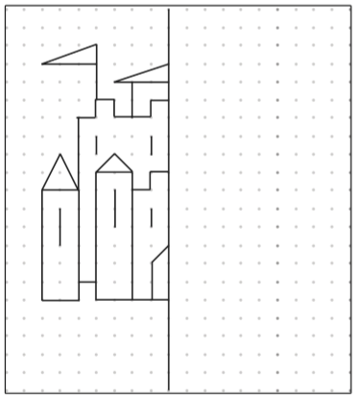
Tricky Challenge
Draw the other half of the castle, making sure it is symmetrical (the same on both sides).

Slide 45
Well done for all of your hard work this lesson!
Please send any completed work/photographed evidence of completed work (practical activities) to pioneerspupils@gmail.com or deliver it to the dropbox outside of school on a Friday.

Slide 46
Date: 21.01.21
LO To be able to describe and sort 2D shapes.
Subject: Maths

Slide 47
Recap
Remind yourself the 2D shapes and their names.

Slide 48
Pre-recorded Teaching
Access the online teaching video below that will support you to complete the work in this lesson. This video will act as a support but all of the work can still be successfully understood & completed using paper-based versions of this pack. If you need further support to understand / complete work then please contact school via e-mail or telephone.
Play Video

Slide 49
What Am I?
Use the clues to work out the shape…
1. This shape is symmetrical.
2. This shape has no right angles.
3. This shape has no corners.
Draw the shape in the box.
What shape is it?
Answer

Slide 50
What Am I?
Use the clues to work out the shape…
1. This shape has more than 1 right angle.
2. This shape is a quadrilateral.
3. This shape is has 4 lines of symmetry.
Draw the shape in the box.
What shape is it?
Answer

Slide 51
What Am I?
Use the clues to work out the shape…
1. This shape is a symmetrical shape.
2. This shape doesn’t have any right angles.
3. This shape has 5 sides.
Draw the shape in the box.
What shape is it?
Answer

Slide 52
What Am I?
Use the clues to work out the shape…
1. This shape has more than 1 right angle.
2. This shape has more than 1 line of symmetry.
3. This shape has 2 long sides and 2 short sides.
Draw the shape in the box.
What shape is it?
Answer

Slide 53
What Am I?
Use the clues to work out the shape…
1. This shape has lots of lines of symmetry.
2. This shape has 6 corners but none are right
angles.
3. This shape has 6 sides.
Draw the shape in the box.
What shape is it?
Answer

Slide 54
Either drag or cut + stick the shapes in the Venn diagram.
Sorting 2D Shapes
More than 3 sides
Less than 5 sides
Anything that fits with both criteria is grouped in the middle.

Slide 55
Either drag or cut + stick the shapes in the Venn diagram.
Sorting 2D Shapes
Straight sides
Curved sides
Anything that fits with both criteria is grouped in the middle.

Slide 56
Either drag or cut + stick the shapes in the Venn diagram.
Sorting 2D Shapes
More than 4 corners
Less than 6 corners
Anything that fits with both criteria is grouped in the middle.

Slide 57
Either drag or cut + stick the shapes in the Venn diagram.
Sorting 2D Shapes
More than 1 right angle
More than 3 sides
Anything that fits with both criteria is grouped in the middle.

Slide 58
Challenge!
Have a go at these problems…

Slide 59
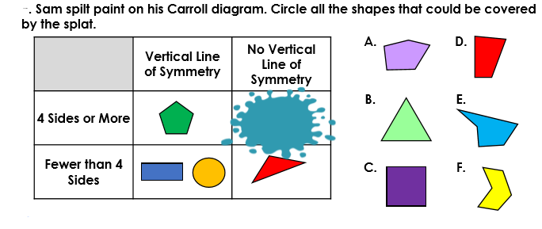
Challenge

Slide 60
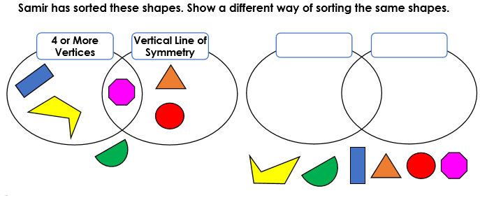
Tricky Challenge
Draw the shapes and write the new categories.

Slide 61
Well done for all of your hard work this lesson!
Please send any completed work/photographed evidence of completed work (practical activities) to pioneerspupils@gmail.com or deliver it to the dropbox outside of school on a Friday.

Slide 62
Date: 22.01.21
LO To be able to name and describe 3D shapes.
Subject: Maths

Slide 63
Pre-recorded Teaching
Access the online teaching video below that will support you to complete the work in this lesson. This video will act as a support but all of the work can still be successfully understood & completed using paper-based versions of this pack. If you need further support to understand / complete work then please contact school via e-mail or telephone.
Play Video

Slide 64
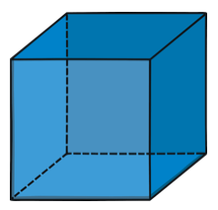
3D Shapes
For a shape to be 3D (three dimensional), it must have depth.
3D means that the shape can be measured by three dimensions (ways) – length, width and depth.
Depth is what is different between a 3D shape and a 2D shape.

Slide 65
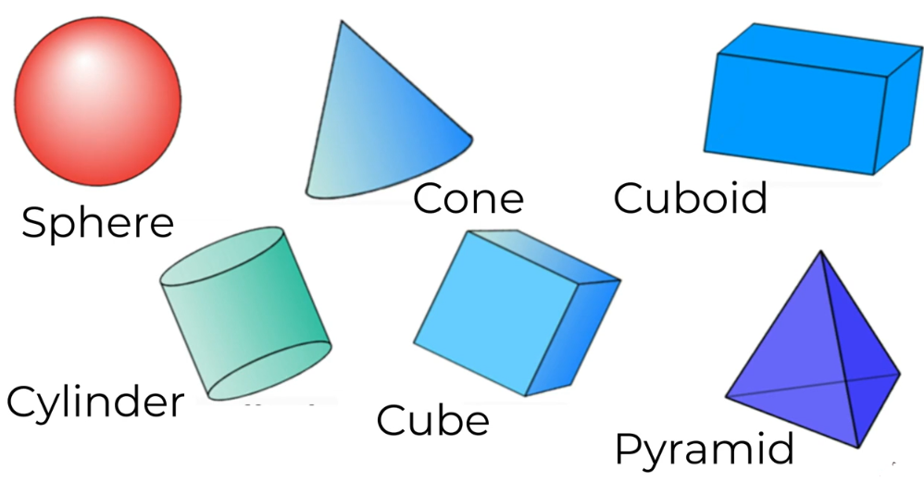
3D Shapes
We need to be able to recognise and name these 3D shapes:

Slide 66
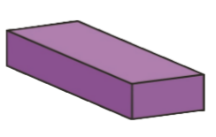
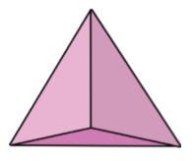
3D Shapes
Match the name to the shape…
Cylinder Cone Pyramid Cuboid Sphere Cube

Slide 67
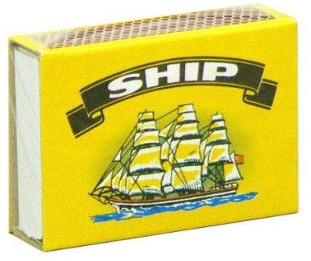
3D Shape Hunt
Find things around your house that match these 3D shapes
For example:
A tin of beans is a cylinder.
A box of matches is a cuboid.
A tennis ball is a sphere.

Slide 68
3D Shape Hunt
Use these next three slides to record what you found…

Slide 69
3D Shape Hunt
Use the slides to record what you found…

Slide 70
3D Shape Hunt
Use the slides to record what you found…

Slide 71
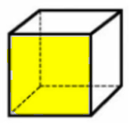
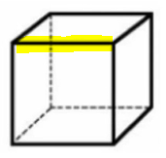
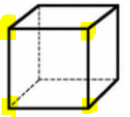
Properties of 3D Shapes
Face
Edge
Vertices
Faces are the flat areas of the 3D shape.
Edges are where two faces meet on a 3D shape.
Vertices are the corners of the 3D shape.

Slide 72
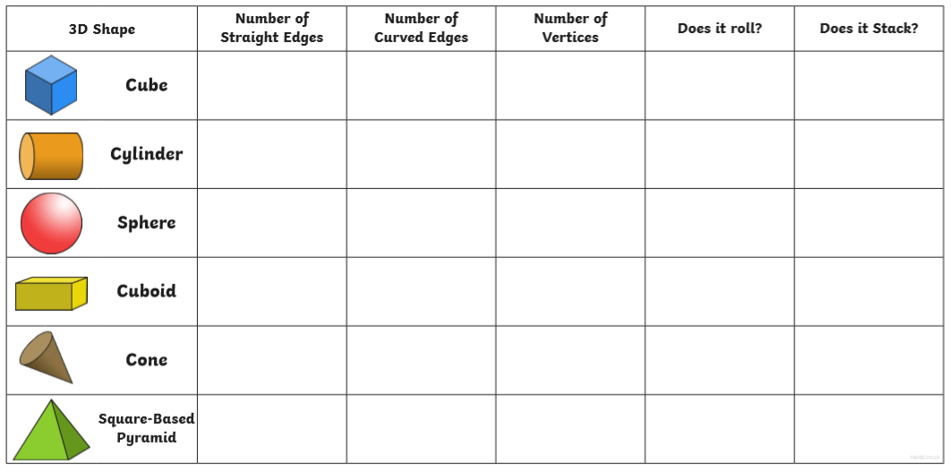
Properties of 3D Shapes
Complete the table to show how many edges and vertices each 3D shape has.

Slide 73
Challenge!
Have a go at these problems…

Slide 74
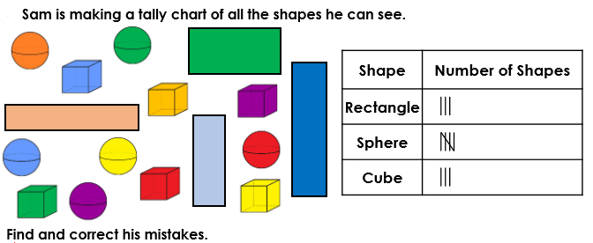
Challenge
Add to the tally chart to correct the mistakes.

Slide 75
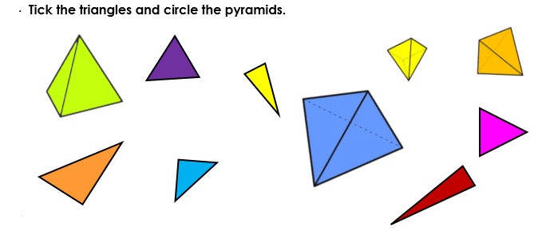
Tricky Challenge

Slide 76
Well done for all of your hard work this lesson!
Please send any completed work/photographed evidence of completed work (practical activities) to pioneerspupils@gmail.com or deliver it to the dropbox outside of school on a Friday.

