Slide 1
Date: 25.01.2021
LO: To estimate and compare right angles, obtuse, acute and reflex angles.
Subject: Maths

Slide 2
Times table practise
Spend at least 15mins practising your times tables.
This can be done on TTRS, hit the button or any other times table website.
Use the Times Tables Rock Stars app or website.
Alternatively, copy and paste the following link into a web browser:
https://www.topmarks.co.uk/maths-games/7-11-years/times-tables

Slide 3
I draw a horizontal and a vertical line, that meet at a point.
We use this symbol to show a right angle.
This is a right angle.
A right angle always will have a degree of 90°.

Slide 4
I draw two straight lines that meet at a point.
This is an acute angle.
An acute angle is less than a right angle.
An acute angle will have a degree less than 90°.

Slide 5
I draw two straight lines that meet at a point.
This is an obtuse angle.
An obtuse angle is more than one right angle but less than two right angles.
An obtuse angle will have a degree more than 90° and less than 180°.

Slide 6
I draw two straight lines that meet at a point.
This is a reflex angle.
A reflex angle is more than two right angles.
A reflex angle will have a degree more than 180° and less than 360°.

Slide 7
I draw two straight lines that meet at a point.
This is also another
reflex angle.

Slide 8
What type of angle is this?
Less than 90°

Slide 9
What type of angle is this?
This is an acute angle
Less than 90°

Slide 10
What type of angle is this?
More than 90°, but less than 180°

Slide 11
What type of angle is this?
This is an obtuse angle
More than 90°, but less than 180°

Slide 12
What type of angle is this?
Less than 90°

Slide 13
What type of angle is this?
This is an acute angle
Less than 90°

Slide 14
What type of angle is this?
More than 180°

Slide 15
What type of angle is this?
This is a reflex angle
More than 180°

Slide 16
What type of angle is this?
More than 90°, but less than 180°

Slide 17
What type of angle is this?
This is an obtuse angle
More than 90°, but less than 180°

Slide 18
A reminder:
Right angles are 90º.
Acute angles are less than 90º.
Obtuse angles are more than 90º but less than 180º.
Reflex angles are more than 180º.

Slide 19
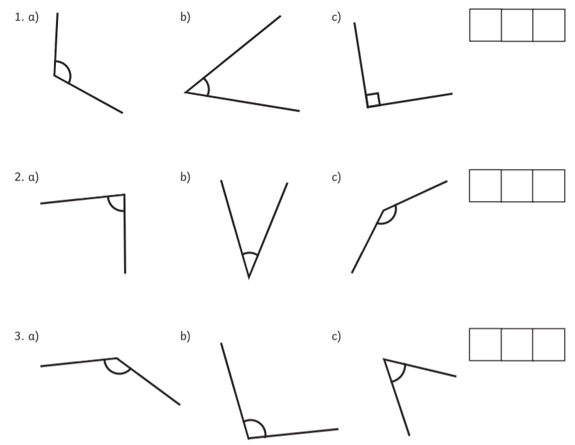
Have a go at ordering these angles from smallest to largest.

Slide 20
Have a go at ordering these angles from smallest to largest.
b, c, a
b, a, c
c, b, c
b, a, c

Slide 21
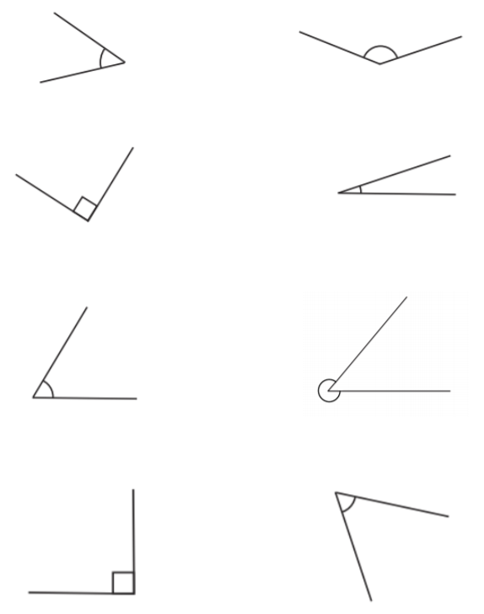
Name each of these angles.
a)
b)
Right angles are 90º.
Acute angles are less than 90º.
Obtuse angles are more than 90º but less than 180º.
Reflex angles are more than 180º.
i)
c)
d)
e)
f)
j)
g)
h)

Slide 22
Name each of these angles.
a)
b)
Acute angle
Obtuse angle
Right angle
Acute angle
Acute angle
Reflex angle
Right angle
Acute angle
Reflex angle
Obtuse angle
i)
c)
d)
e)
f)
j)
g)
h)

Slide 23
End of Lesson

Slide 24
Date: 26.01.2021
LO: To be able to calculate angles on a straight line.
Subject: Maths

Slide 25
Times table practise
Spend at least 15mins practising your times tables.
This can be done on TTRS, hit the button or any other times table website.
Use the Times Tables Rock Stars app or website.
Alternatively, copy and paste the following link into a web browser:
https://www.topmarks.co.uk/maths-games/7-11-years/times-tables

Slide 26
Recap
Can you identify the different types of angles?
2)
3)
4)
1)

Slide 27
Recap
Can you identify the different types of angles?
2)
3)
4)
1)
Right angle
Acute angle
Obtuse angle
Reflex angle
Acute angles measure less than 90°.
Right angles measure exactly 90°.
Obtuse angles measure from 90°-180°.
Reflex angles measure from 180°-360°.

Slide 28
Recap
Can you work out the missing numbers below?
100 + ____ = 180
90 + ____ = 180
75 + ____ = 180
180 – 30 = ____
180 – 45 = ____
180 – 20 = ____

Slide 29
Recap
Can you work out the missing numbers below?
100 + 80 = 180
90 + 90 = 180
75 + 105 = 180
180 – 30 = 150
180 – 45 = 135
180 – 20 = 160

Slide 30
Angles on a straight line ALWAYS add up to 180°.
180°

Slide 31
Here we have two angles on a straight line.
100°
x
Because we don’t know the size of this angle, we will call it x.

Slide 32
Here we have two angles on a straight line.
Can we work out the size of angle x?
100°
x

Slide 33
If I asked you to work out…
180-100= ___
2) 100+ __ = 180
Could you do it?
Yes! We did this at the start of the lesson.
100°
x

Slide 34
We do the same thing when we want to find the value of x.
We know that angles on a straight line add up to 180°.
So, 100° plus something must equal 180°.
Or, we can say that 180° minus 100° equals the size of angle x.
Either way, our answer is 80°.
x= 80°
100+80=180
100°
x
180- 100 = 80

Slide 35
Our working out should look like this.
 | 1 | 0 | 0 | + | x |  | = | 1 | 8 | 0
 | 1 | 0 | 0 | + | 8 | 0 | = | 1 | 8 | 0
 |  |  | x | = | 8 | 0 | °
 |  |  |  |  | or
 | 1 | 8 | 0 | - | 1 | 0 | 0 | = | x
 | 1 | 8 | 0 | - | 1 | 0 | 0 | = | 8 | 0
 |  |  | x | = | 8 | 0 | °
Work out the size of angle x.
Always remember your degrees symbol.

Slide 36
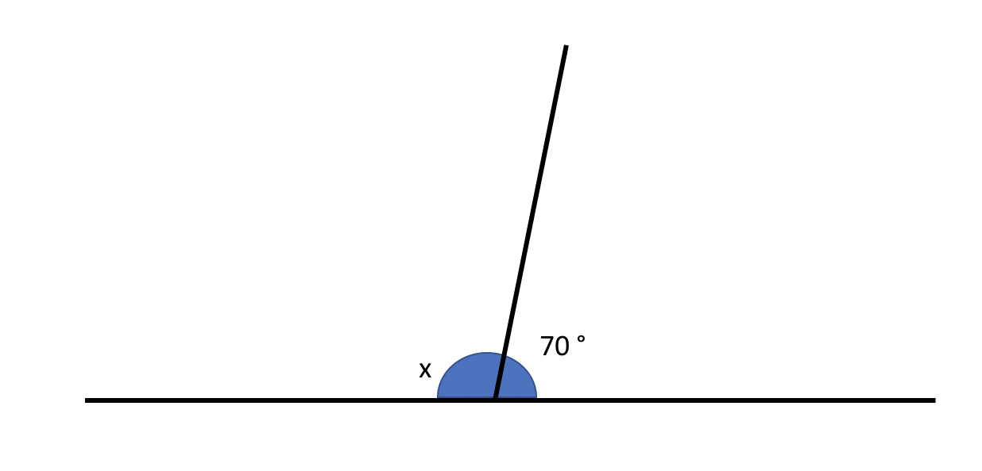
Here we have two angles on a straight line.
Can we work out the size of angle x?
Angles on a straight line always add up to 180°.

Slide 37
We know that angles on a straight line add up to 180°.
So, 70° plus something must equal 180°.
Or, we can say that 180° minus 70° equals the size of angle x.
Either way, our answer is 110°. x= 110°

Slide 38
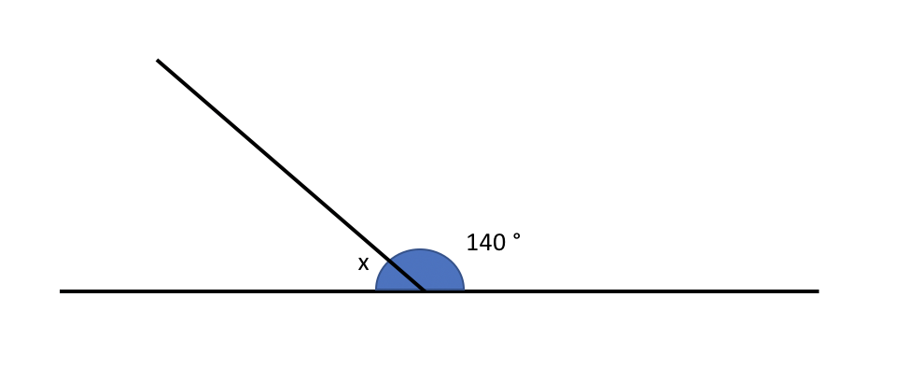
Try this on your own.
Can we workout the size of angle x?
Angles on a straight line always add up to 180°.

Slide 39
We know that angles on a straight line add up to 180°.
So, 140° plus something must equal 180°.
Or, we can say that 180° minus 140° equals the size of angle x.
Either way, our answer is 40°. x= 40°

Slide 40
Here we have three angles on a straight line.
Can we workout the size of angle x?
100°
70°
x
Angles on a straight line always add up to 180°.

Slide 41
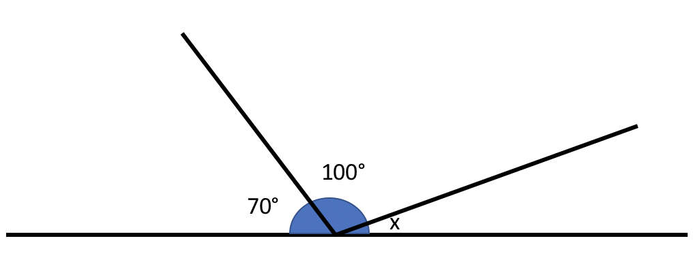
Here we have three angles on a straight line.
Can we workout the size of angle x?
We know that angles on a straight line add up to 180°.
So, 100° + 70° + something must equal 180°.
Or, we can say that 180° - 100° - 70° equals the size of angle x.
Either way, our answer is 10°.
x= 10°
100+70+ 10=180
180- 100 - 70 = 10

Slide 42
Try this on your own.
Can we workout the size of angle x?
110°
40°
x
Remember, we are doing the exact same method as before, but we have one more number to put into the working out.
Angles on a straight line always add up to 180°.

Slide 43
We know that angles on a straight line add up to 180°.
So, 110° + 40° + something must equal 180°.
Or, we can say that 180° - 110° - 40° equals the size of angle x.
Either way, our answer is 30°. x= 30°

Slide 44
Emily is measuring two angles on a straight line.
My angles measure 90° and 100°.
Why must one of Emily’s angles be wrong?

Slide 45
Emily is measuring two angles on a straight line.
My angles measure 90° and 100°.
Angles on a straight line ALWAYS add up to 180°. Emily’s angles add up to 190°.
Why must one of Emily’s angles be wrong?

Slide 46
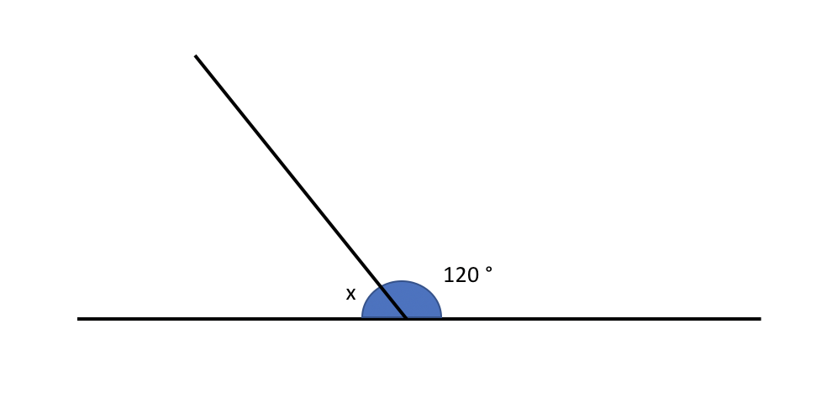
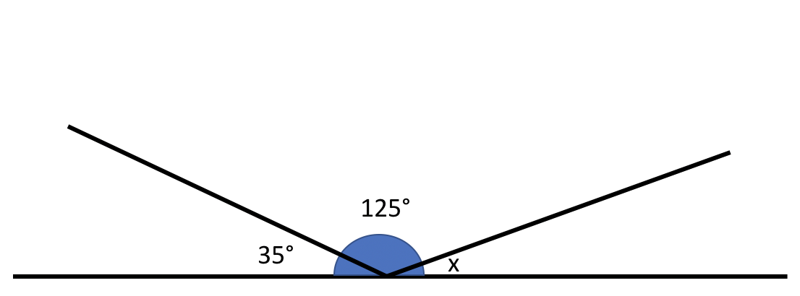
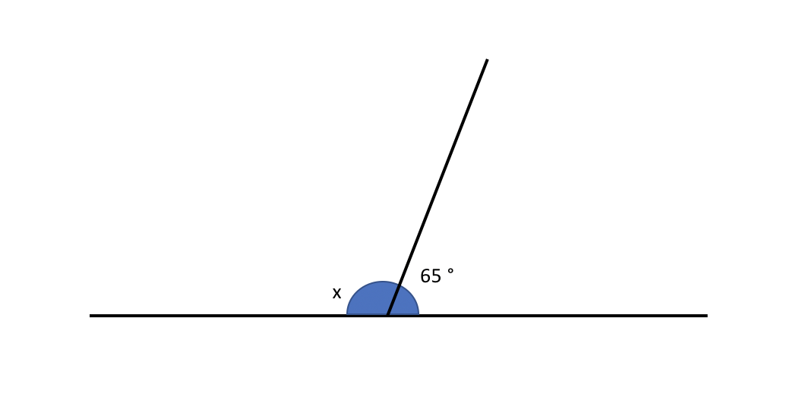
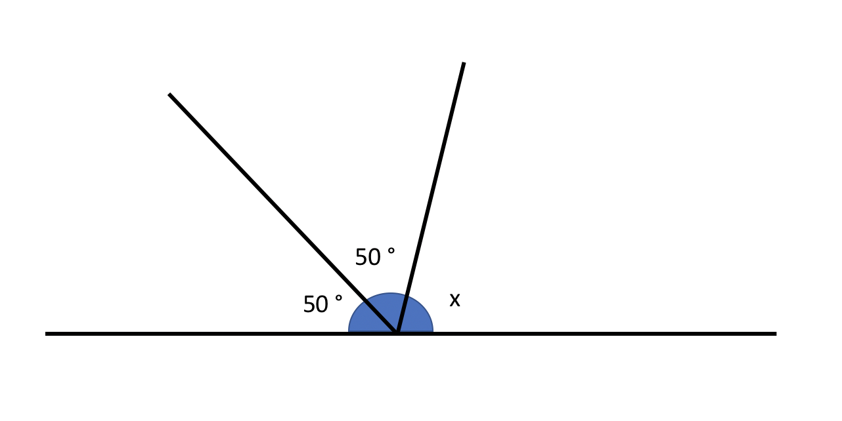
Work out the size of angle x for each question.
1.
3.
2.
4.

Slide 47
Did you remember your degrees symbol?
Work out the size of angle x for each question.
1.
3.
x = 60°
x = 20°
2.
4.
x = 115°
x = 80°

Slide 48
How would we work this out?
100°
y
x
Angles x and y are equal.
Work out the size of angles x and y.

Slide 49
How would we work this out?
Angles x and y are equal.
Work out the size of angles x and y.
We know that angles on a straight line add up to 180°.
We already know the size of one angle. If we minus 100 from 180 we are left with 80.
In the question it states that x and y are equal. So, if we divide 80 by 2, we will find the size of angles x and y.
x = 40° y = 40°
180-100=80
80 ÷ 2 = 40

Slide 50
How would we work this out?
80°
y
x
z
Angles x and z are equal.
The total of angles x and z are the same as angle y.
Angle y is 30° less than 80°.
Work out the size of angles x, y and z.

Slide 51
How would we work this out?
Angles x and z are equal.
The total of angles x and z are the same as angle y.
Angle y is 30° less than 80°.
Work out the size of angles x, y and z.
We know that angles on a straight line add up to 180°.
We know that angle y is 30° less than 80°. So, angle y= 50 °.
We know that angles x and y are equal and, x + y = 50°. So, we can divide 50 by two to work out the size of angles x and y.
x= 25° y=25° z=50°
80-30=50
50 ÷ 2 = 25

Slide 52
Try this on your own
y
x
z
Angles x and y are equal.
Work out the size of angles x, y and z.

Slide 53
Try this on your own
We know that angles on a straight line add up to 180°.
Did you spot that angle z is a right angle? So, angle z is 90°.
To work out angles x and y we divide 90° by 2 because the angles are equal.
x= 45° y=45° z=90°
z | = | 9 | 0 | °
9 | 0 | ÷ | 2 | = | 4 | 5
x | = | 4 | 5 | ° |  | y | = | 4 | 5 | °

Slide 54
Recap of Lesson
LO: To be able to calculate angles on a straight line.
We have identified the different types of angles.
We know the angle rule for a straight line.
We can calculate missing angles on a straight line.

Slide 55
End of Lesson

Slide 56
Date: 27.01.2021
LO: To be able to calculate angles around a point.
Subject: Maths

Slide 57
Times table practise
Spend at least 15mins practising your times tables.
This can be done on TTRS, hit the button or any other times table website.
Use the Times Tables Rock Stars app or website.
Alternatively, copy and paste the following link into a web browser:
https://www.topmarks.co.uk/maths-games/7-11-years/times-tables

Slide 58
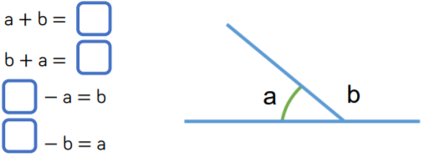
Recap
Can you complete the number sentences below?
Remember, angles on a straight line add up to 180°

Slide 59
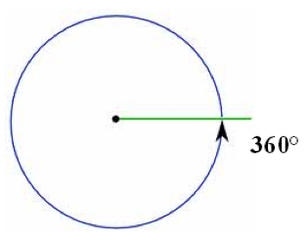
There are 360°in a full turn

Slide 60
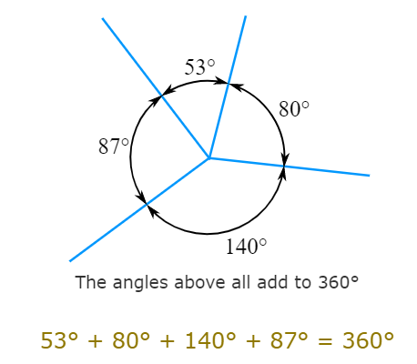
Angles that meet at a point

Slide 61
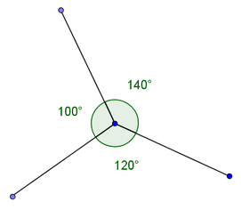
Angles that meet at a point
These will always have a total of 360°
To find a missing angle we can find the total of
the angles we have and subtract this from 360°
E.g.
100 + 120 = 220°
360 – 220 = 140°
Therefore, the missing angle is 140°

Slide 62
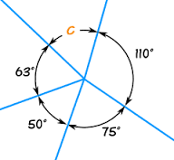
Angles that meet at a point
Another example:
To find the missing angle (c), we need to firstly add all of the known angles together.
110° + 75° + 50° + 63° = 298°
Next, we subtract this from 360°
360° - 298° = 62°
C = 62°

Slide 63
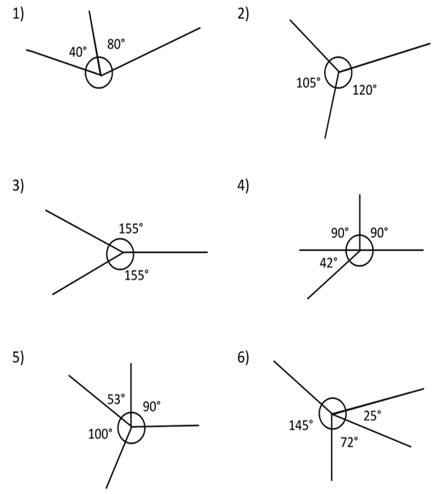
Task 1: Have a go at finding the missing angles.
Add the known angles
Subtract the known angles from 360.
Remember to add your °symbol in your answer.

Slide 64
Task 1: Answers
135°
240°
50°
138°
118°
117°

Slide 65
Task 1 Extension:
Four angles make up a full turn.
Angle A is a third of a right angle.
Angle B is 4 times more than angle A.
Angle C is a right angle.
Angle D is the remaining turn left.
What are the 4 angles?
A=
B=
C=
D=

Slide 66
Task 1 Answers:
Four angles make up a full turn.
Angle A is a third of a right angle.
Angle B is 4 times more than angle A.
Angle C is a right angle.
Angle D is the remaining turn left.
What are the 4 angles?
A= (90° ÷ 3)= 30°
B= (30° x 4) = 120°
C= 90°
D= (360° - 30° – 120° – 90°) = 120°

Slide 67
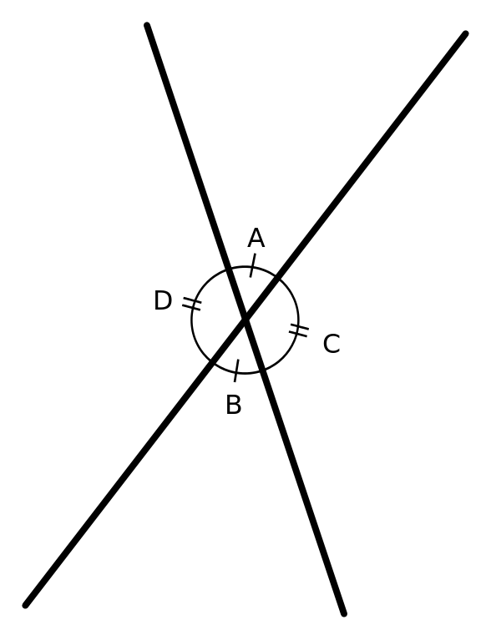
Vertically opposite angles
Angles vertically opposite each other are equal.
In this example angle A = angle B and angle C = angle D
We only need to know 1 angle to work out all of the other angles.
If angle A is 80°, angle B will also be 80° because they are
vertically opposite.
We can then use angle A to find out angle
C (or D), as together they make a straight line.
We know angles on a straight line total 180°.
180 – 80 = 100.
If angle C is 100°, angle D will also be 100°, as
they are also vertically opposite.

Slide 68
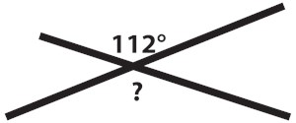
Vertically opposite angles
We can work out what angle both x and y are worth, by using the known angle.
We know that the angle vertically opposite 112° is also worth 112°.
X and y are vertically opposite, so they will both be equal.
112° and y are on a straight line together. So 180° - 112° will reveal the value of y and therefore x.
180° - 112° = 68°
X and y = 68°
x
y

Slide 69
Vertically opposite angles
An alternative way of answering this question would be:
112° + 112° (two vertically opposite angles) = 224°
Then subtract this from 360°.
360° - 224° = 136°
There for x + y = 136°
136° ÷ 2 = 68°
X and y both equal 68°
x
y

Slide 70
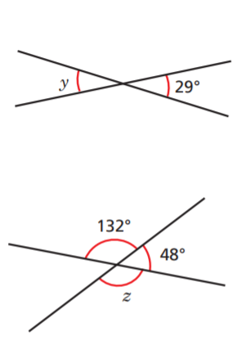
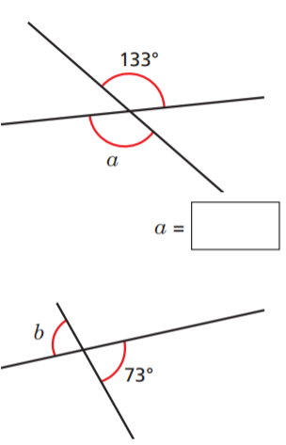
Vertically opposite angles
Task 2: Have a go at calculating the missing angles, using your knowledge of vertically opposite angles.
a
e
b
f
d
c
g
h
i

Slide 71
Vertically opposite angles
Task 2 Answers.
a
151°
47°
29°
e
47°
b
f
151°
133°
d
73°
107°
48°
c
g
h
132°
i
107°

Slide 72
End of Lesson

Slide 73
Date: 28.01.2021
LO: To be able to calculate angles in triangles and quadrilaterals.
Subject: Maths

Slide 74
Times table practise
Spend at least 15mins practising your times tables.
This can be done on TTRS, hit the button or any other times table website.
Use the Times Tables Rock Stars app or website.
Alternatively, copy and paste the following link into a web browser:
https://www.topmarks.co.uk/maths-games/7-11-years/times-tables

Slide 75
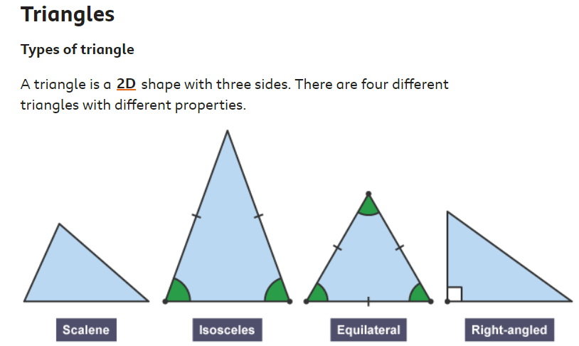
Angles in a triangle

Slide 76
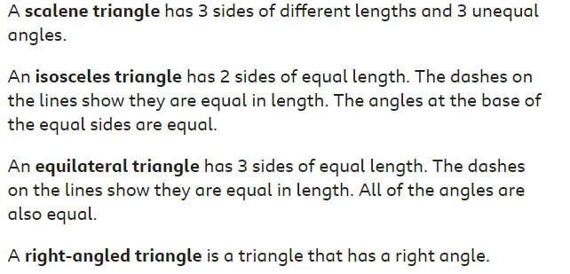
Angles in a triangle

Slide 77
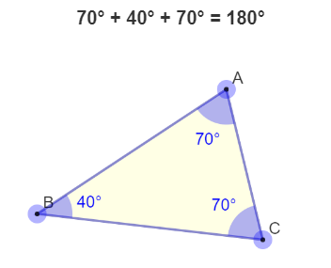
Angles in a triangle
E.g.

Slide 78
Angles in a triangle
Interior angles in an triangle always add to 180°
We can use this to find missing angles.
E.g.
38° + 85° + c = 180°
38° + 85° = 123°
180° - 123° = 57°
C = 57°

Slide 79
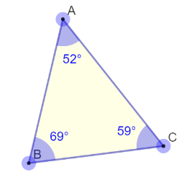
Angles in a triangle
Another example:
E.g.
52° + 69° + c = 180°
52° + 69° = 121°
180° - 121° = 59°
C = 59°
c

Slide 80
Task 1: Have a go at finding the missing angles.

Slide 81
Task 1 Answers:
41°
55°
97°
121°

Slide 82
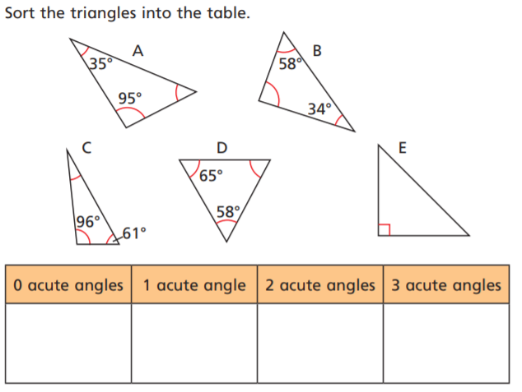
Task 2:

Slide 83
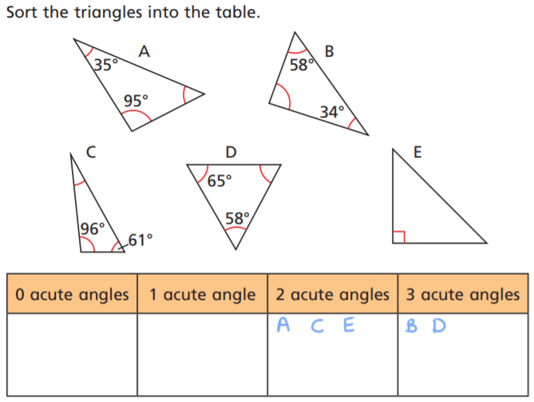
Task 2 answers:

Slide 84
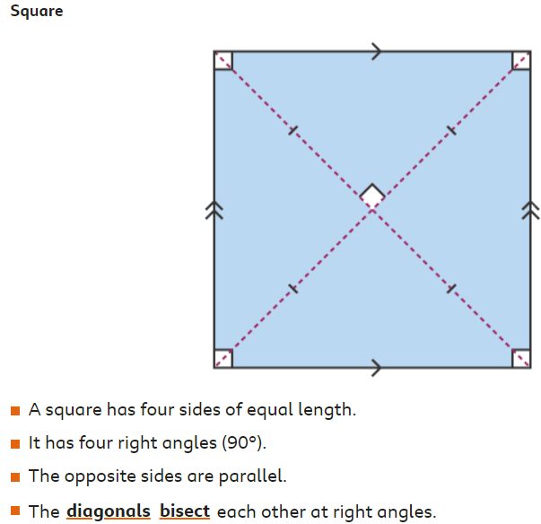
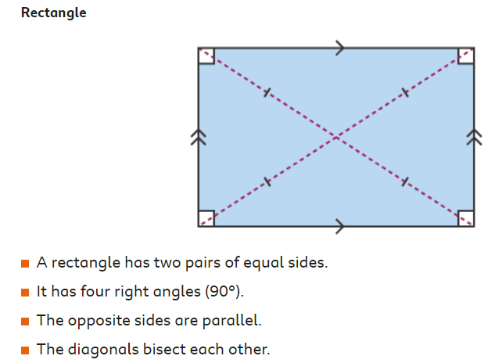
Quadrilaterals

Slide 85
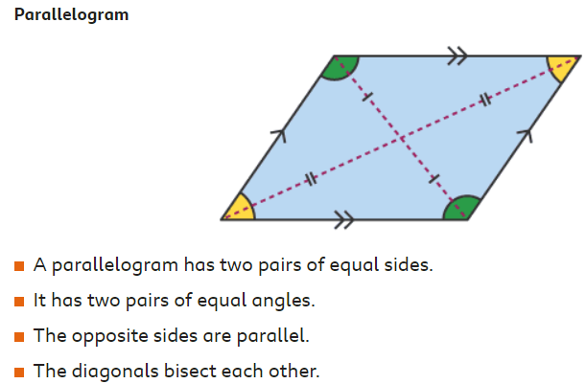
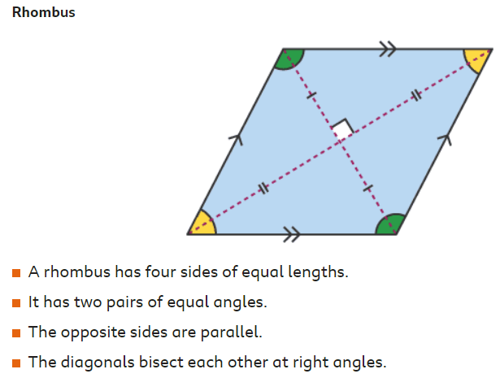
Quadrilaterals

Slide 86
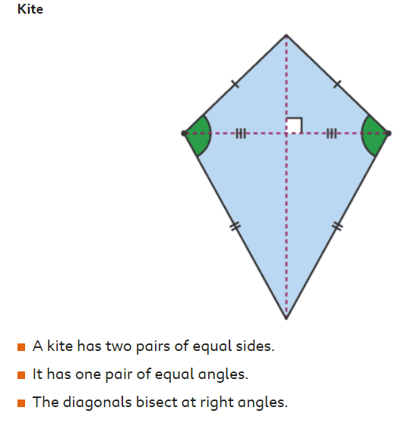
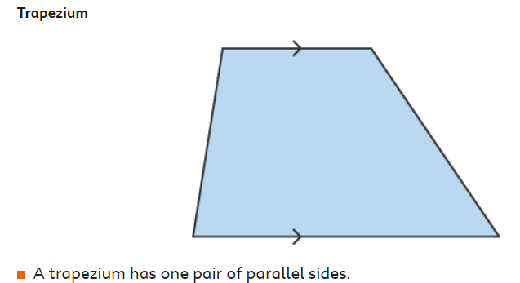
Quadrilaterals

Slide 87
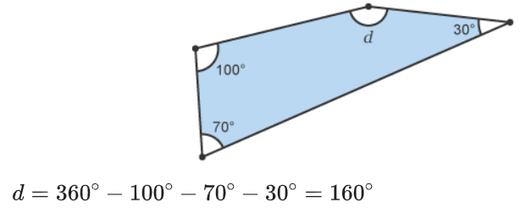
Quadrilaterals The sum of interior angles in a quadrilateral is 360° As we did with triangles, we can use this information to find missing angles.

Slide 88
Quadrilaterals
Interior angles in a quadrilateral always add to 360°
We can use this to find missing angles.
E.g.
100° + 70° + 30° + d = 360°
100° + 70° + 30° = 200°
360° - 200° = 160°
d = 160°

Slide 89
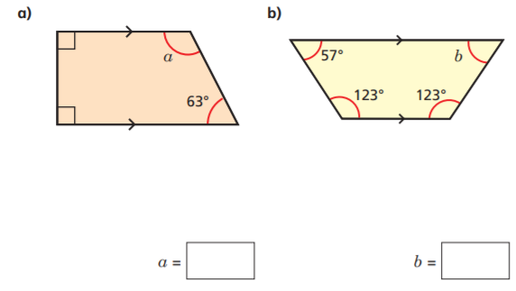
Task 3: Find the missing angles

Slide 90
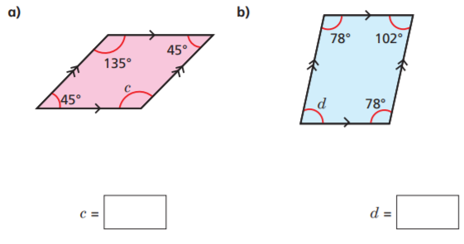
Task 3 (cont): Find the missing angles
c)
d)

Slide 91
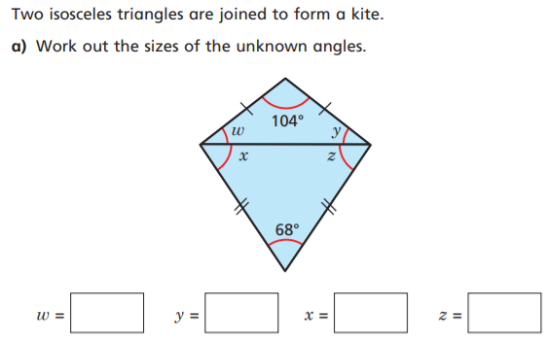
Extension:
Flick back through the slides to check the properties if an isosceles triangle.

Slide 92
End of Lesson

Slide 93
Date: 29.01.2021
LO: To be able to solve reasoning problems involving angles.
Subject: Maths

Slide 94
Times table practise
Spend at least 15mins practising your times tables.
This can be done on TTRS, hit the button or any other times table website.
Use the Times Tables Rock Stars app or website.
Alternatively, copy and paste the following link into a web browser:
https://www.topmarks.co.uk/maths-games/7-11-years/times-tables

Slide 95
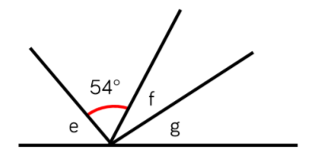
Let’s reason about angles on a straight line Task 1:
Remember, angles on a straight line always add up to 180°.
180°
The total of angle f and g are the same as angle e
Angle e is 10° more than the size of the given angle
Angle g is 10° larger than angle f

Slide 96
Let’s reason about angles on a straight line Task 1 answers :
Remember, angles on a straight line always add up to 180°.
27°
64°
37°
180°
The total of angle f and g are the same as angle e
Angle e is 10° more than the size of the given angle
Angle g is 10° larger than angle f

Slide 97
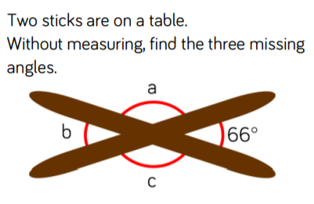
Let’s reason about angles around a point Task 2 :
Remember, angles around a point add up to 360°
Angle b is the same as the opposite angle.
Angles a and c are equal.

Slide 98
Let’s reason about angles around a point Task 2 answers :
114°
Remember, angles around a point add up to 360°
66°
114°
Angle b is the same as the opposite angle.
Angles a and c are equal.

Slide 99
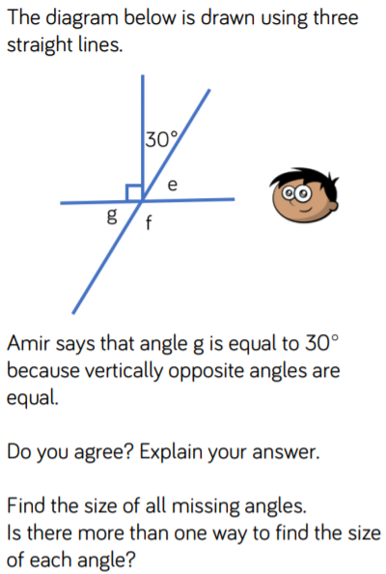
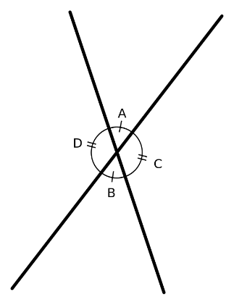
Let’s reason about angles at a point Task 3 :
Remember what we learnt about vertically opposite angles.
Where two angles directly opposite each other are equal.

Slide 100
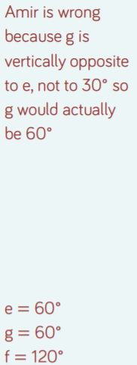
Let’s reason about angles at a point Task 3 answers:
Remember what we learnt about vertically opposite angles.
Where two angles directly opposite each other are equal.

Slide 101
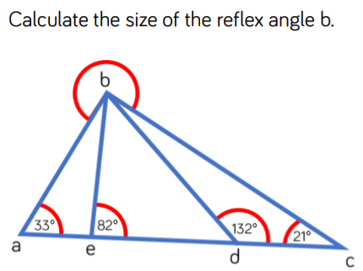
Let’s reason about angles Task 4:
To solve this problem, you will need to know:
Angles on a straight line add up to 180°
- all angles inside a triangle add together to make 180°.

Slide 102
Let’s reason about angles at a point Task 4 answers :
To solve this problem, you will need to know:
Angles on a straight line add up to 180°
- all angles inside a triangle add together to make 180°.
234°

Slide 103
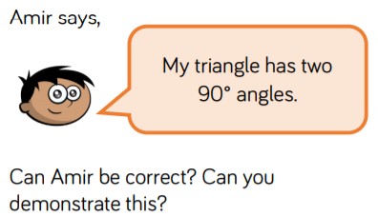
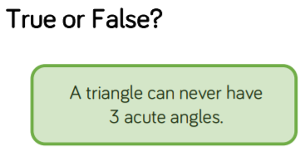
Let’s reason about angles inside of triangles Tasks 5 and 6 :
a)
b)
Prove it with a diagram!

Slide 104
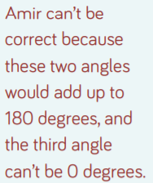
Let’s reason about angles inside of triangles Tasks 5 and 6 answers:
a)
b)
Prove it with a diagram!
False, it can. Any combination of 3 angles, which are less than 90° that add up to 180°, e.g 60° + 60° +60°

Slide 105
End of Lesson

