Slide 1
Date: Monday 22nd February 2021
L.O. To be able to identify the value of each symbol in a pictogram and use it to find the total amount.
Subject: Maths

Slide 2
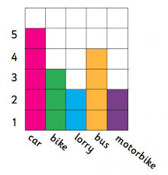
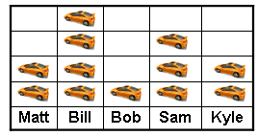
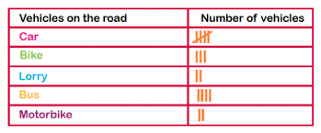
Today we are going to look at different symbols used in different types of graphs and charts and we will look at how we find their value.
As you can see, these charts and graphs all look very different. To find the value, we need to know what to count and how many each mark or picture represents.
Here on the block graph to find the value we count the coloured blocks and each block represents 1 vehicle.
Here on the pictogram, we count the cars above the boys names. There will be a ‘key’ next the pictogram telling us how much each car picture represents.
Here on the tally chart, we know that each black line is worth 1 and they are grouped together in 5s to make counting larger numbers of data quicker and easier.

Slide 3
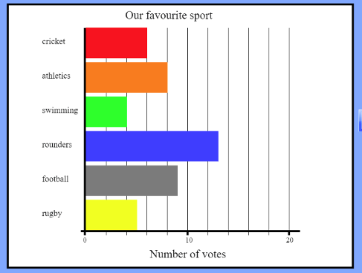
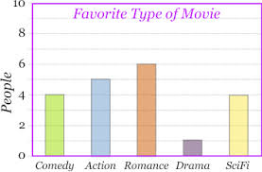
We have just looked at some simple graphs and charts, but not all are so simple. Let’s take a look at some more complicated ones:
y-axis
Here are two bar graphs but they are set out very differently.
y-axis
x-axis
x-axis
2 4 6 8 12 14 16 18
On this bar graph, the types of movies are on the x-axis. The amount of movies are on the y-axis. The amount of people is counted in 2s.
As you can see, on this bar graph the name of sports on the side, which is the y-axis. The amount of votes are on the bottom, which is the x-axis. The amounts of votes are also counted in 2s, not 1s.

Slide 4
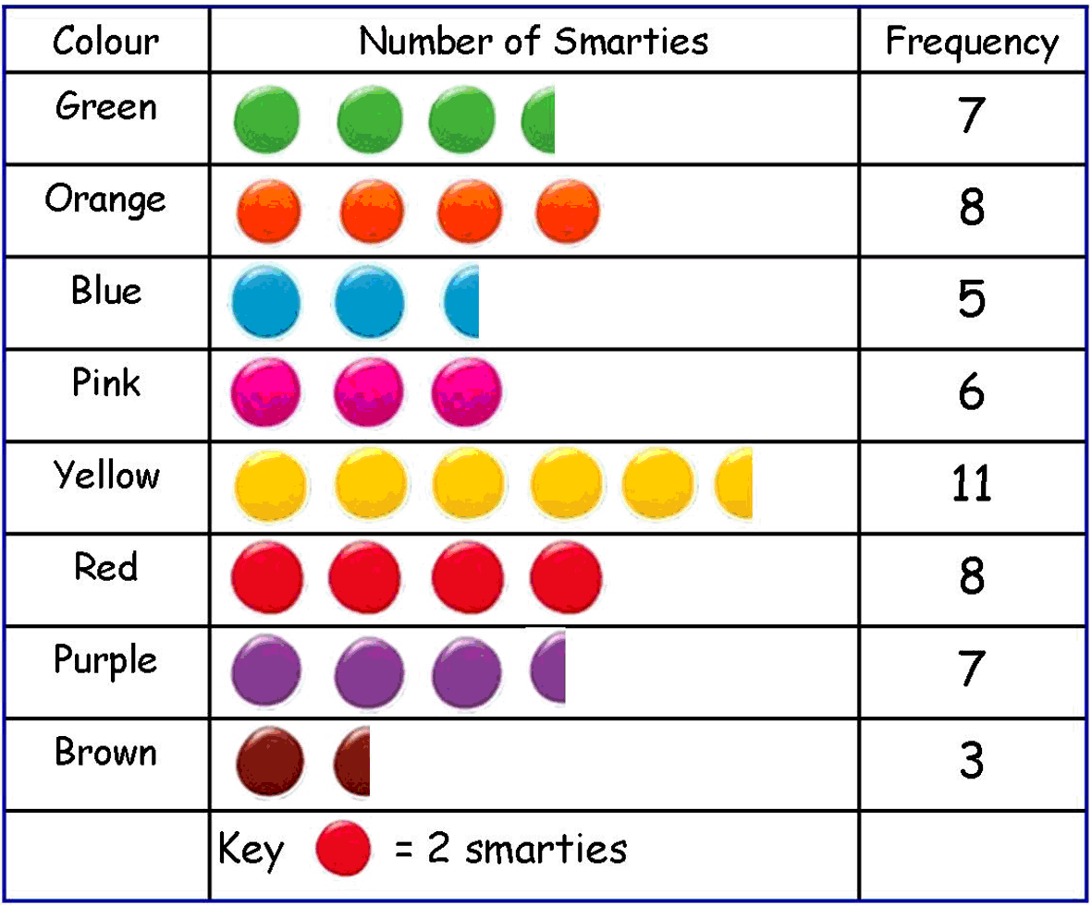
This pictogram shows us people’s favourites colours. As you can see, the pictogram tells us that each coloured circle is on a scale of 2. So when working out the frequency we would count in twos.
The key tells us that each circle is worth 2.
This means the circle that is cut in half is worth 1, because half of 2 is 1.

Slide 5
Let’s try to work out how much each picture represents on the pictogram below together – don’t forget to look at the key!
We can see the key shows us that each circle is worth 10 cars.
Now using the key and data shown, can we answer the following question?
How many cars travelled on Tuesday?
10+10+10+5= 35
10 10 10 5
 | 1 | 0
 | 1 | 0
 | 1 | 0
+ |  | 5
 | 3 | 5

Slide 6
Use the key to find our how many cars each circle represents before adding them together to answer the questions below:
How many cars travelled on Wednesday?
+
Show you working out.
How many cars travelled on Thursday?
+
Remember to check the key or scale
5

Slide 7
The number of cars the circles represent has changed! Use the key to find our how many cars each circle represents before adding them together to answer the questions below:
+
How many cars travelled on Tuesday?
Show you working out.
+
How many cars travelled on Friday?
Remember to check the key or scale
20 cars

Slide 8
Date: Tuesday 23rd February 2021
L.O. To be able to read and interpret information from a pictogram and use it to answer questions about the data.
Subject: Maths

Slide 9
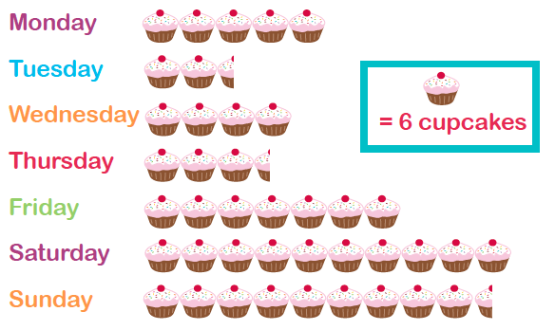
Today we are going to learn how to read and interpret information from a pictogram.
Pictograms are set out in a similar way to a bar chart. However, they use pictures instead of bars and do not have numbers on an axis.
Each picture could represent 1 or more items, and half or part-pictures represent fractions of a number. This information is usually represented in a key.
2
Pictogram

Slide 10
Key
I can see that the key represents 2s therefore I will need to count in 2s.
Question:
How many cakes are sold on Tuesday?
2
2 2 1
Pictogram
2+2+1= 5

Slide 11
Let’s try together to read information from the pictogram so that we can answer questions.
key
I can see that the key represents 6 and so I will need to count in 6s.
Question:
How many cakes are sold on Thursday?
Pictogram
6+6+6+1=

Slide 12
Can you read the information from the pictogram and answer the questions?
scale/key
Question: remember to show your working out
How many cakes were sold on Monday?
How many cakes were sold on Friday?
How many cakes were sold on Sunday?
2
Pictogram

Slide 13
Here are a couple of videos to help further support your learning. Click on the links under the videos or copy and paste the links into your web browser.
https://classroom.thenational.academy/lessons/reading-and-understanding-pictograms-6xj62c?activity=video&step=1
https://www.youtube.com/watch?v=7oyDsm-k9YQ

Slide 14
Date: Wednesday 24th January 2021
L.O. To be able to gather information and construct a pictogram.
Subject: Maths

Slide 15
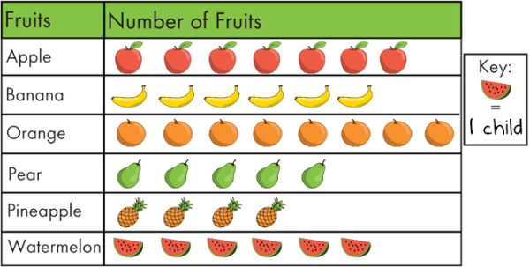
Today we are going to try and collect and construct our very own pictogram.
Pictograms are set out in a similar way to a bar chart. However, they use pictures instead of bars and do not have numbers on an axis.
Each picture could represent 1 or more items, and half or part-pictures represent fractions of a number. This information is usually represented in a key.
If you are at home you could collect your data by phoning your family, friends or you could even phone school and ask myself and Danielle, we would love to here from you!
Here are some ideas:

Slide 16
First I thought of what data I was going to collect.
I am going collect data about people’s favourite colours and the colours I am going to collect data about are:
Here are my results:
3 people like red.
2 people like yellow.
6 people like pink.
Next, I rang around school and asked my work friends what their favourite colour is:
“ What is your favourite colour? Here are your choices”.
3 people like blue.
1 people like green.
5 people like purple.

Slide 17
Colours | Number of colours | Frequency
Red |  | 3
Yellow |  | 2
Pink |  | 6
Blue |  | 3
Green |  | 1
Purple |  | 5
Now I have all of my data, I began making my pictogram.
I made sure my pictogram had:
Headings
A key
The information I am collecting in the first column.
Key: Each colour = 1

Slide 18
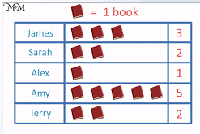
Collect data to input into your constructed a pictogram.
Now you know all about collecting and inputting data into a pictogram. It’s your turn to have a go.
Don’t forget if you are at home you could collect your data by phoning your family, friends or you could even phone school and ask myself and Danielle, we would love to here from you.
Here are a some pictures to help you with some ideas.
We cant wait to see all your amazing pictograms and what you choose to collect your data on. Adults; please can you help you child draw their pictogram or use the blank template on the next page.
Challenge time:
Once you have created your pictogram, can you write some questions for Danielle and I to answer?

Slide 19
Key:

Slide 20
Date: Thursday 25th January 2021
L.O. To be able to gather information and input the data onto bar chart.
Subject: Maths

Slide 21
Here is a reminder of the features of a bar chart
Title to tell us what the chart is showing.
y-axis
On this bar chart, the types of movies are on the x-axis. The amount of movies are on the y-axis. The amount of people is counted in 2s.
Amount
x-axis
Choices from survey

Slide 22
Favourite Fruit
Here is a bar chart showing the favourite fruit for a class of children.
The scale counts up in 1s.
10
9
8
7
6
5
4
3
2
1
0
Favourite Fruit | Tally
Banana | IIII IIII
Grapes | II
Apples | IIII III
Pears | IIII I
Banana | Grapes | Apples | Pears

Slide 23
Favourite Fruit
Here is the same bar chart with the number scale changed to only show the even numbers.
The scale counts up in 2s.
10
8
6
4
2
0
Favourite Fruit | Tally
Banana | IIII IIII
Grapes | II
Apples | IIII III
Pears | IIII I
Banana | Grapes | Apples | Pears

Slide 24
Favourite Fruit
Take your own fruit survey in your class or ring around your family and friends. Add the tally marks to make a total for each fruit.
Don’t forgot to mark your fifth tally mark across the other four; this makes it easier and quicker to count your tally marks,
Favourite Fruit | Tally
Banana
Grapes
Apples
Pears

Slide 25
Favourite Fruit
Use your tally to create your own bar chart. Change the length of the bars to show the number of children that like each fruit or draw the chart onto graph paper.
10
9
8
7
6
5
4
3
2
1
0
Banana | Grapes | Apples | Pears

Slide 26
Favourite Fruit
Use your tally to create your own bar chart. Change the length of the bars to show the number of children that like each fruit or draw the chart onto graph paper.
10
8
6
4
2
0
Banana | Grapes | Apples | Pears

Slide 27
Date: Wednesday 26th January 2021
L.O. To be able to answer questions using data from a bar chart.
Subject: Maths

Slide 28
Favourite Fruit
I am going to answer some questions about the data shown on my bar chart below.
Question | Answer
Which was the most popular fruit? | Bananas were the most popular fruit.
Which was the least popular fruit? | Grapes were the least popular fruit.
How many more children liked bananas than grapes? | 8 more children liked apples than grapes.
How many more children liked pears than grapes? | 4 more children liked pears than grapes.
How many fewer children liked pears than apples? | 2 fewer children liked pears than apples.
10
9
8
7
6
5
4
3
2
1
0
Banana | Grapes | Apples | Pears

Slide 29
Favourite Fruit
Look at the bar chart you made yesterday. Can you use the data on your bar chart to answer the questions below?
Question | Answer
Which was the most popular fruit?
Which was the least popular fruit?
How many more or fewer people liked apples than pears?
How many more or fewer people liked bananas than grapes?
How many more or fewer people liked pears than grapes?

Slide 30
Favourite Fruit
I am going to answer some more questions about the data shown on my bar chart. These questions require me to do some working out before I can answer.
Question | Answer
1) How many children liked fruit all together? | 10+ 2 + 8 + 6 = 26 2 children liked fruit all together.
2) How many children liked apples or pears? | 6 + 8 = 14 14 children liked apples or pears.
3) How many children liked the other fruits in the survey, accept grapes? | 26 – 2 = 24 24 children liked the fruits in the survey, accept grapes.
1)
 |  | 8
 |  | 2
 | 1 | 6
+ | 1 | 0
 | 2 | 6
2)
 |  | 6
+ |  | 8
 | 1 | 4
3)
 | 2 | 6
- |  | 2
 | 2 | 4

Slide 31
Favourite Fruit
Answer the questions about the data shown on the bar chart you collected data for and made yesterday. The questions require you to do some working out before you can answer them.
Question | Answer
1) How many children liked fruit all together?
2) How many children liked grapes or apples? | .
3) How many children liked the other fruits in the survey, accept grapes?
1)
+
2)
+
3)
-

