Slide 1
Subject: Maths

Slide 2
Date: Monday 8th February 2021
L.O. To round numbers to the nearest 10
Subject: Maths

Slide 3
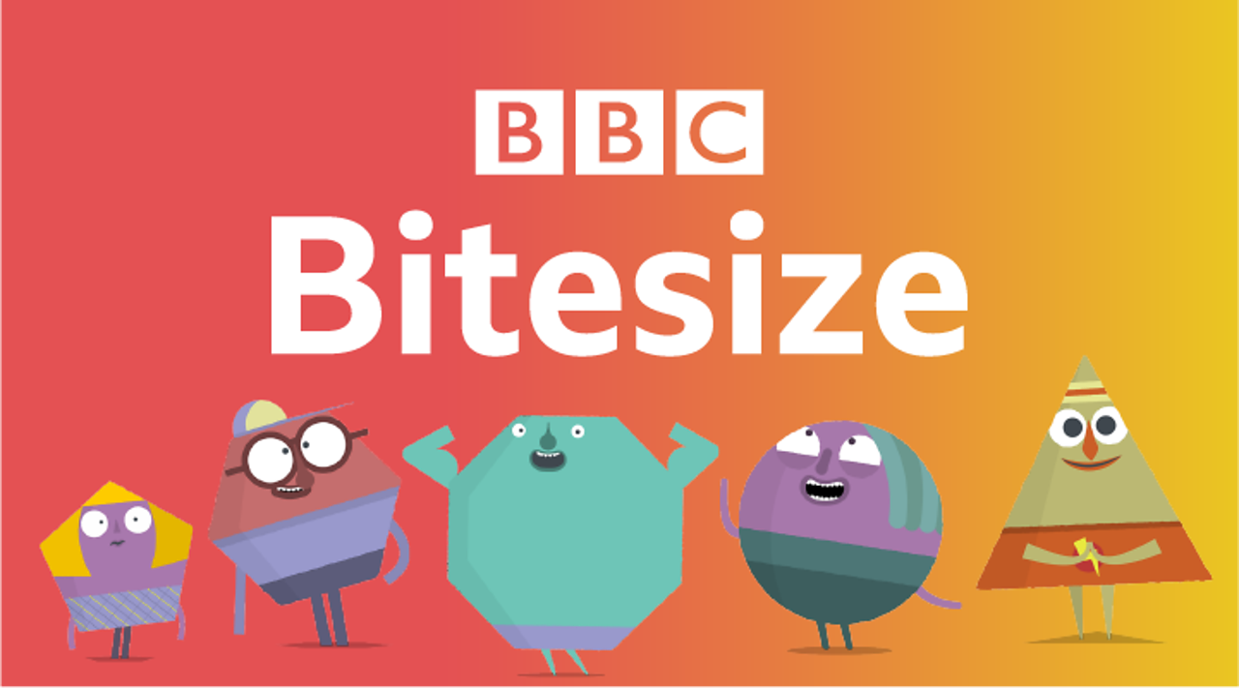
Pre-recorded Teaching
Access the online teaching video below that will support you to complete the work in this lesson. This video will act as a support but all of the work can still be successfully understood & completed using paper-based versions of this pack. If you need further support to understand / complete work then please contact school via e-mail or telephone.
https://www.bbc.co.uk/bitesize/articles/zjf492p

Slide 4
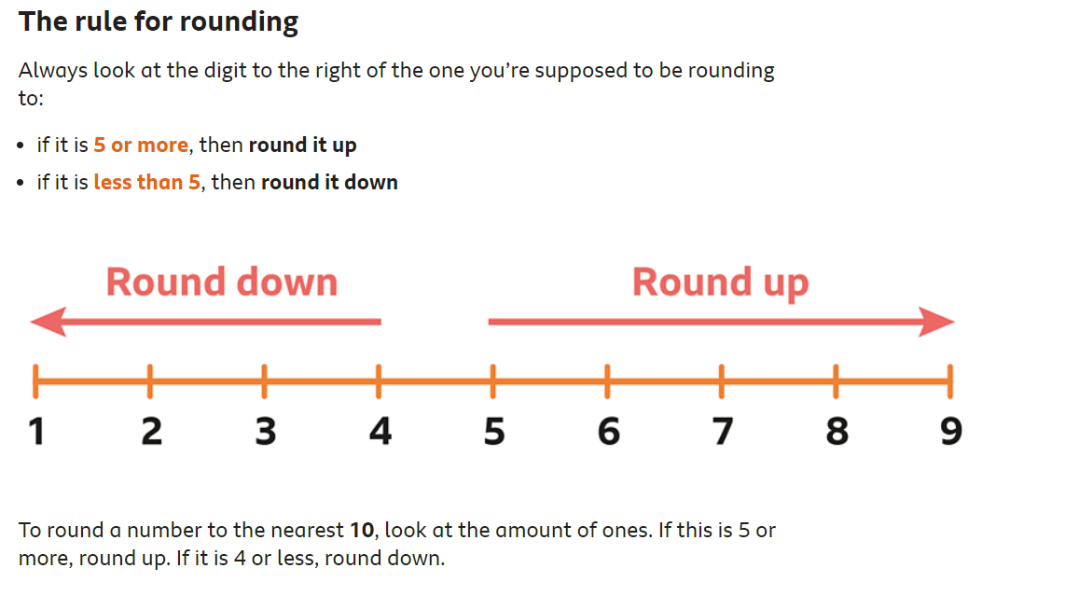

Slide 5
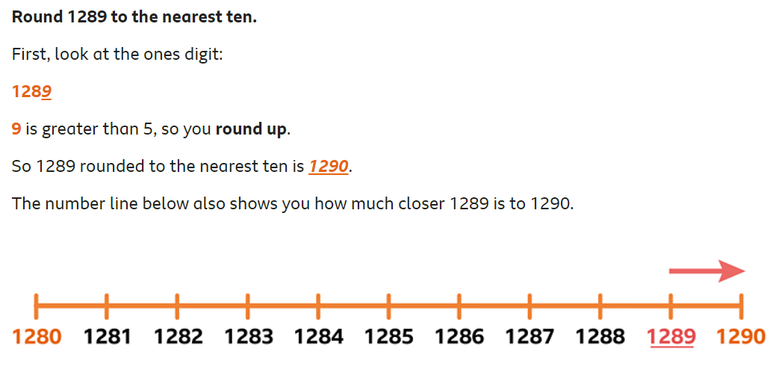
To round a number to the nearest 10, look at the amount of ones. If this is 5 or more, round up. If it is 4 or less, round down.

Slide 6
Round to the nearest 10
Remember - to round a number to the nearest 10, look at the amount of ones. If this is 5 or more, round up. If it is 4 or less, round down.
H T O
1 6 3 – 3 is less than 5, so we round down to 160
1 6 6 – 6 is more than 5, so we round up to 170
1 6 7 – 7 is more than 5, so we round up to 170

Slide 7
Round to the nearest 10
Round the following numbers to the nearest 10.
462
987
651
765
879
643
124

Slide 8
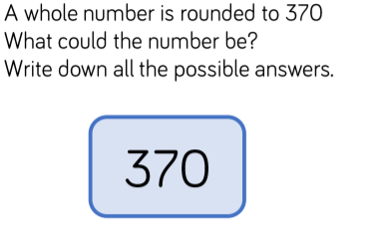
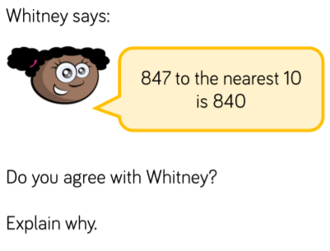
Round to the nearest 10
__ , __ , __, __ , __ , __ , __ , __ , __ , __
Yes I do agree with Whitney / no I do not agree with Whitney because…

Slide 9
Date: Tuesday 9th February 2021
L.O. To round numbers to the nearest 100
Subject: Maths

Slide 10
Pre-recorded Teaching
Access the online teaching video below that will support you to complete the work in this lesson. This video will act as a support but all of the work can still be successfully understood & completed using paper-based versions of this pack. If you need further support to understand / complete work then please contact school via e-mail or telephone.
https://www.bbc.co.uk/bitesize/articles/zjf492p

Slide 11
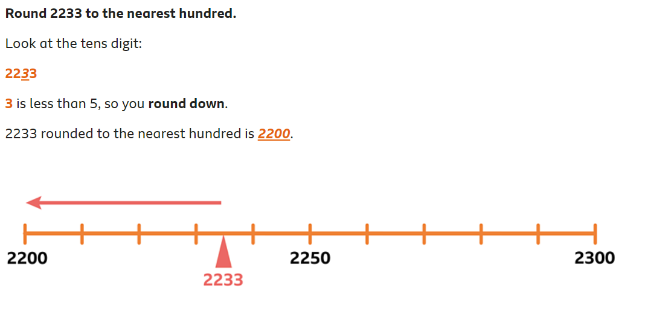
To round a number to the nearest 100, look at the tens digit. If the tens digit is 5 or more, round up. If the tens digit is 4 or less, round down.

Slide 12
Round to the nearest 100
Remember - to round a number to the nearest 100, look at the tens digit. If the tens digit is 5 or more, round up. If the tens digit is 4 or less, round down.
H T O
5 3 5 – 3 is less than 5, so we round down to 500
5 5 6 – the tens digit is 5 or more, so we round up to 600
5 6 8 – 6 is more than 5, so we round up to 600

Slide 13
Round to the nearest 10
Round the following numbers to the nearest 100.
432
927
691
765
879
621
128

Slide 14
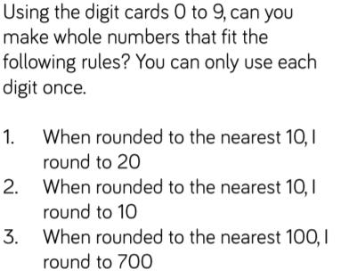
Round to the nearest 100
0
1
2
3
4
5
6
7
8
9

Slide 15
Date: Wednesday 10th January 2021
L.O. To round numbers to the nearest 1000
Subject: Maths

Slide 16
Pre-recorded Teaching
Access the online teaching video below that will support you to complete the work in this lesson. This video will act as a support but all of the work can still be successfully understood & completed using paper-based versions of this pack. If you need further support to understand / complete work then please contact school via e-mail or telephone.
https://www.bbc.co.uk/bitesize/articles/zjf492p

Slide 17
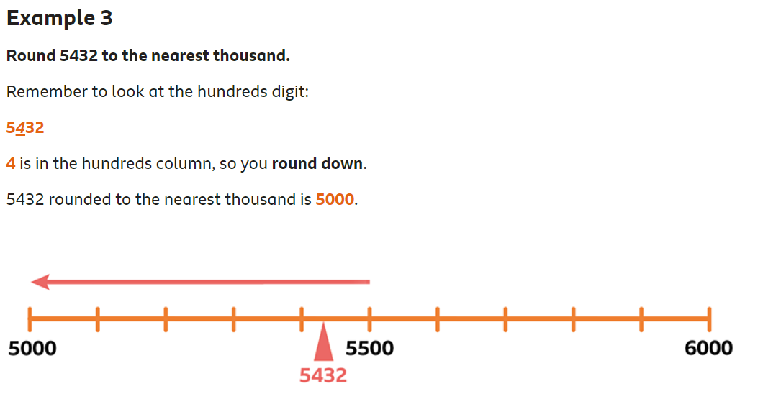
To round a number to the nearest 1000, look at the hundreds digit. If the hundreds digit is 5 or more, round up. If the hundreds digit is 4 or less, round down.

Slide 18
Round to the nearest 1000
Say whether each number on the number line is closer to 2000 or 3000.
2000
2229
2521
2986
3000
Remember - To round a number to the nearest 1000, look at the hundreds digit. If the hundreds digit is 5 or more, round up. If the hundreds digit is 4 or less, round down.
Th H T O
2 2 2 9 – 2 is less than 5, so we round down to 2000
2 5 2 1 – the number is 5 or more, so we round up to 3000
2 9 8 6 – the number is more than 5, so we round up to 3000

Slide 19
Round to the nearest 1000
Round the following numbers to the nearest 1000.
6462
9387
6151
7865
8979
6043
1124

Slide 20
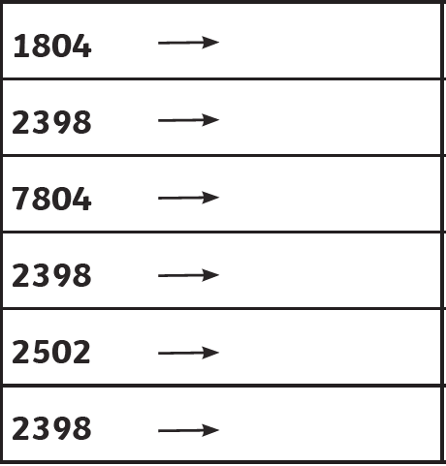
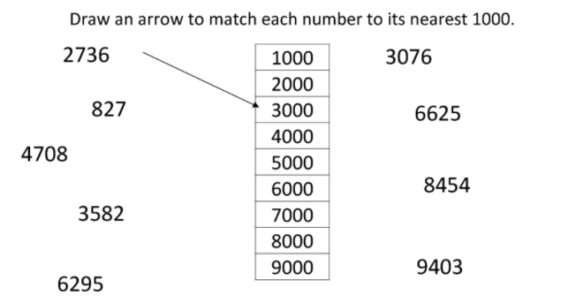
Round to the nearest 1000

Slide 22
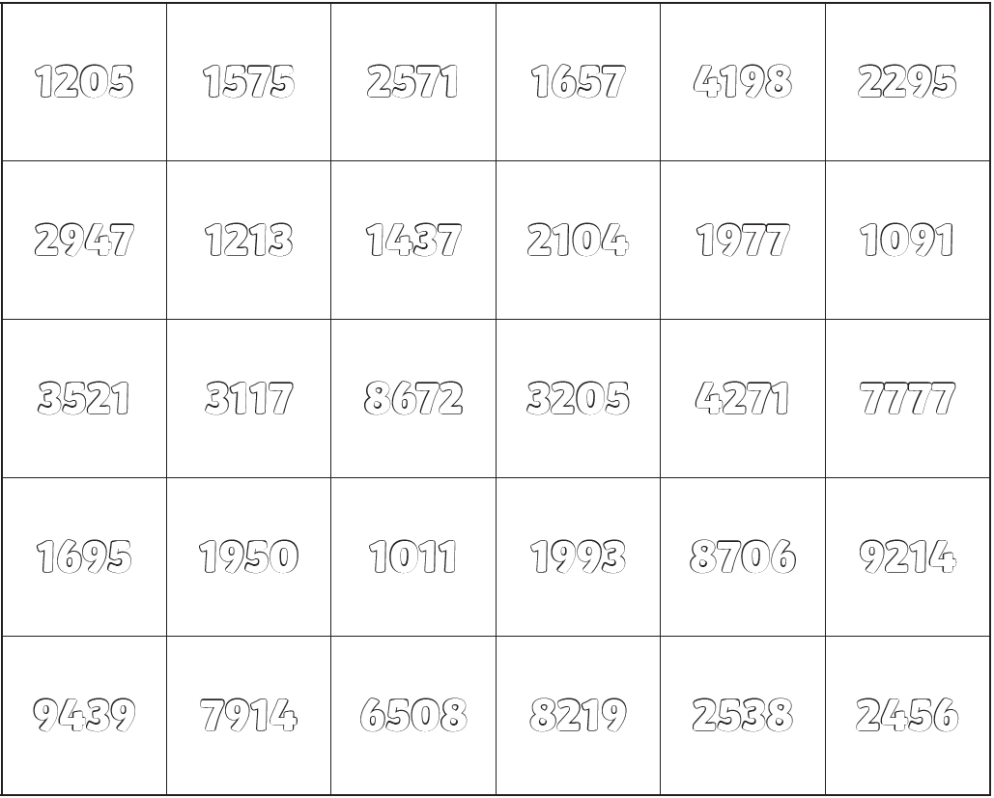

Slide 23
Date: Thursday 11th February 2021
L.O. To round numbers to 10, 100 or 1000
Subject: Maths

Slide 24
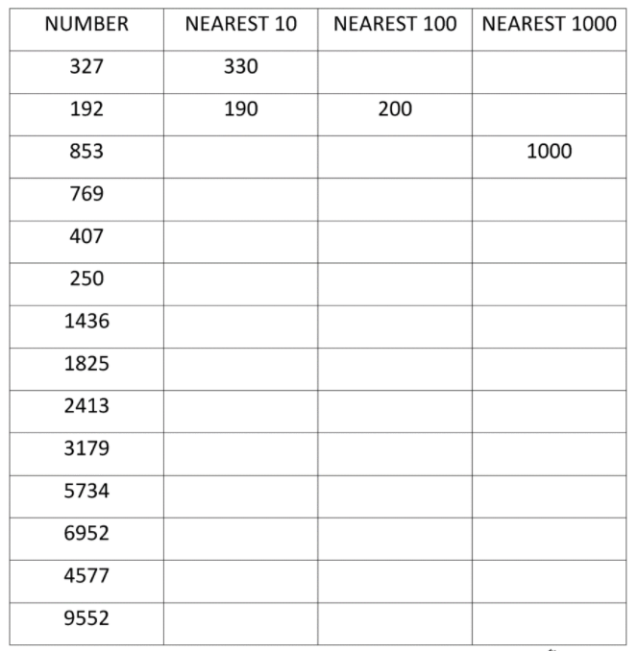
Look at the numbers on the left. Can you round them to the nearest 10, 100 and 1000?

Slide 25
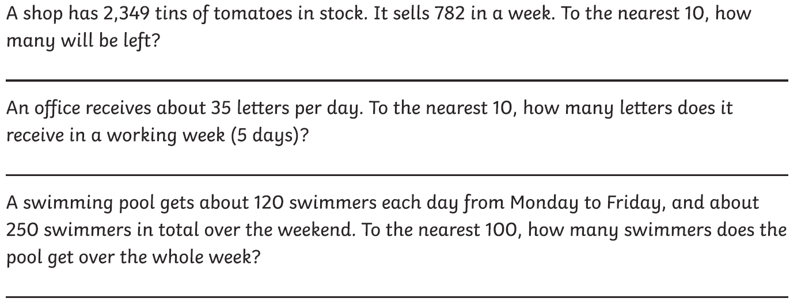
Solve the word problems with rounding.

Slide 26
c
Date: Thursday 21st January
Date: Friday 12th February 2021
L.O. To practice the 6 times tables
Subject: Maths

Slide 27
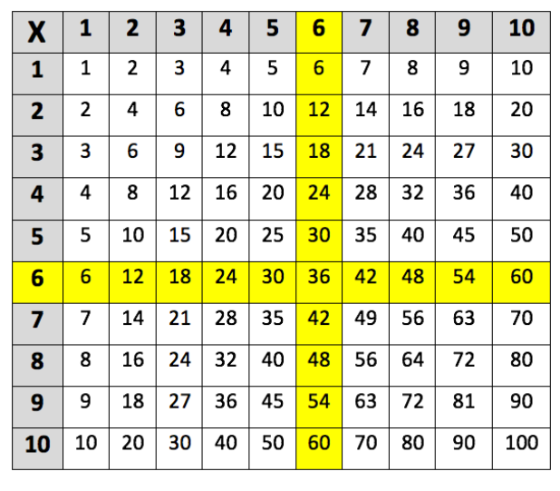
Every number in the 6 times table is an even number and that the final digits repeat themselves in a pattern. For example:
Here is the 6 times tables:

Slide 28
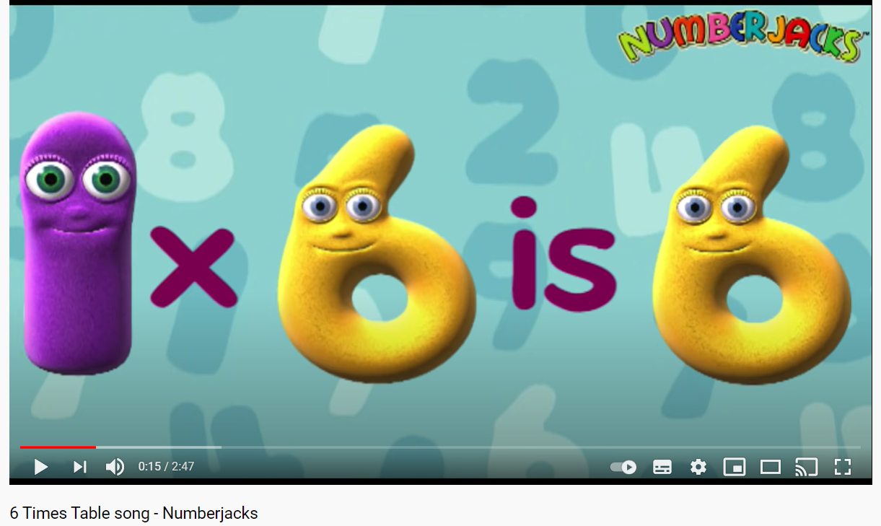
Click here to listen to the Numberjacks 6 times tables song!

Slide 29
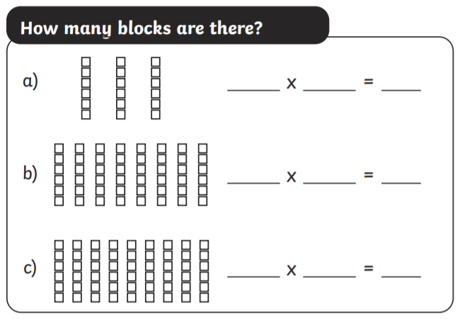
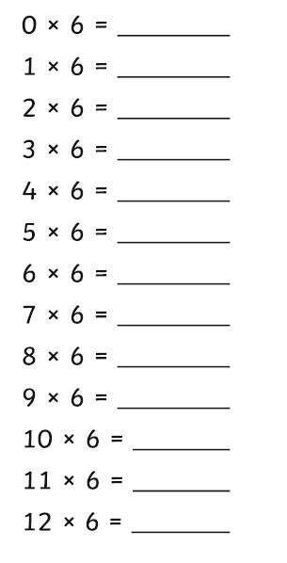
Complete the 6 times tables
3
6
18

Slide 30
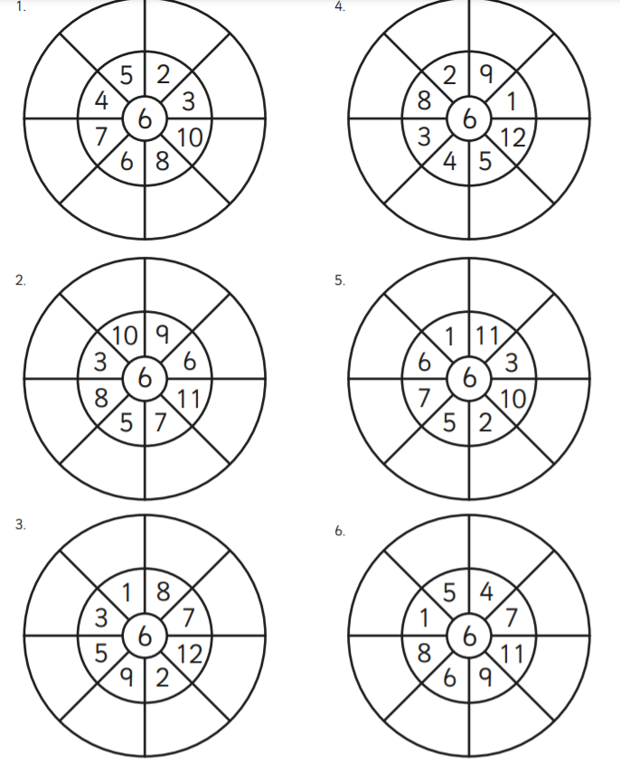
30
12
24
18
42
60
38
48
Complete the multiplication wheels. I have done the first one for you! ☺

Slide 31
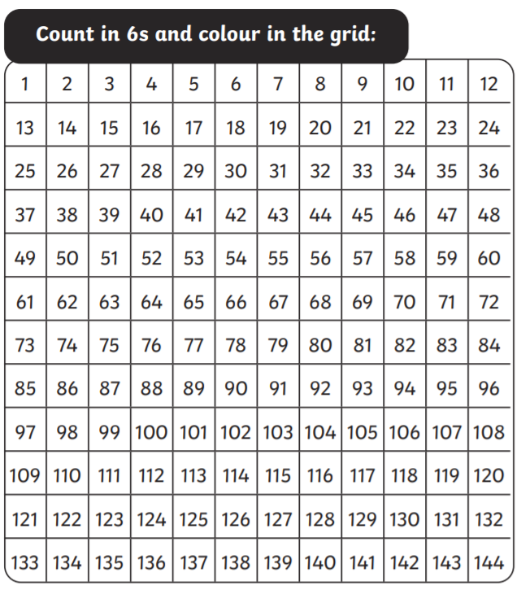

Slide 32
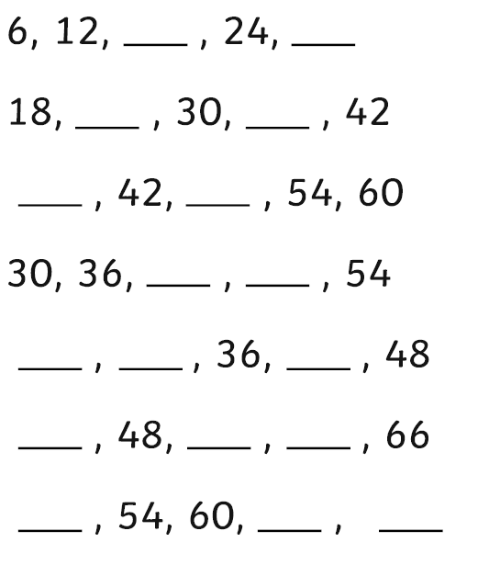
18
30
Can you count in 6’s, starting from any point?
I have done the first one for you ☺
Click here for some extra activities on your 6 times tables!

