Slide 1
g
Date: Monday 8th February
LO: To be able to identify the ‘g’ sound
Subject: English

Slide 2
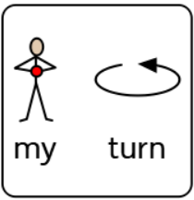
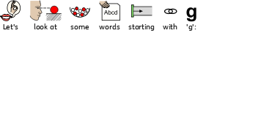
The ‘g’ sound
Gg
This is the letter ‘g’.

Slide 3
Click on the pencil to see how we draw a ‘g’.
G
Can you follow along with your finger?
Can you draw a g on some paper?

Slide 4
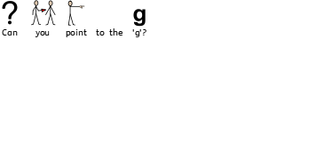
g
n

Slide 5
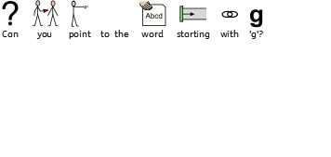

Slide 8
Date: Tuesday 2nd March
LO: To be able to retell a traditional tale using pictures.
Subject: English

Slide 9
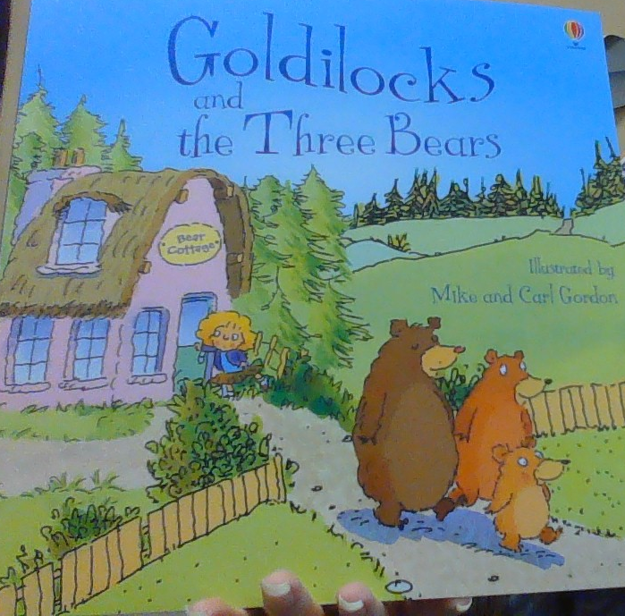
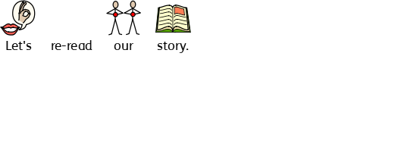

Slide 10
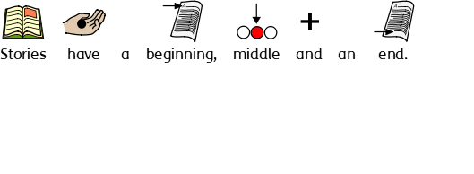

Slide 14
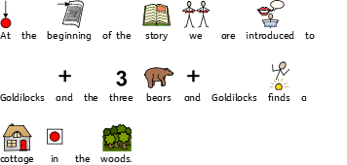

Slide 15
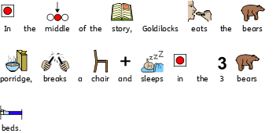

Slide 16
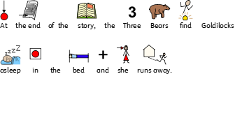

Slide 17
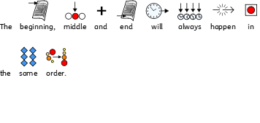

Slide 18
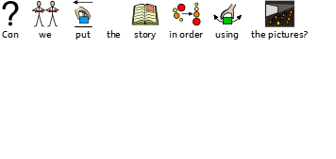
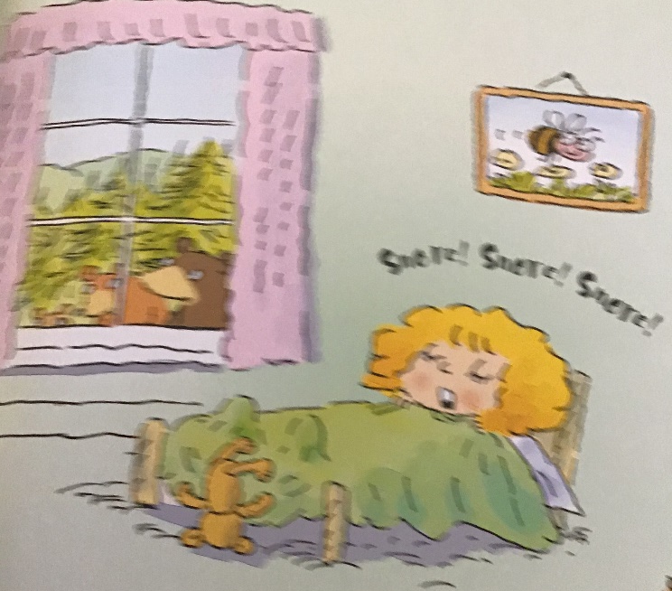
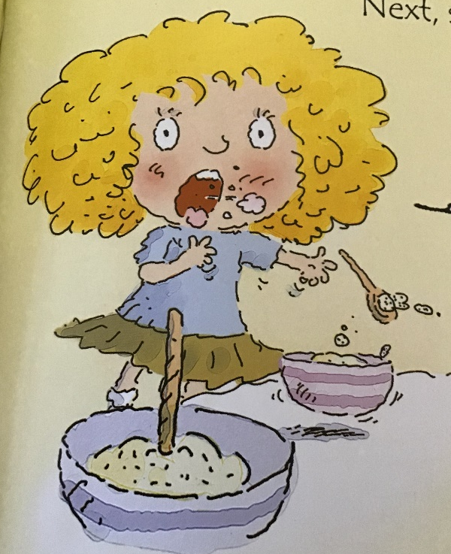
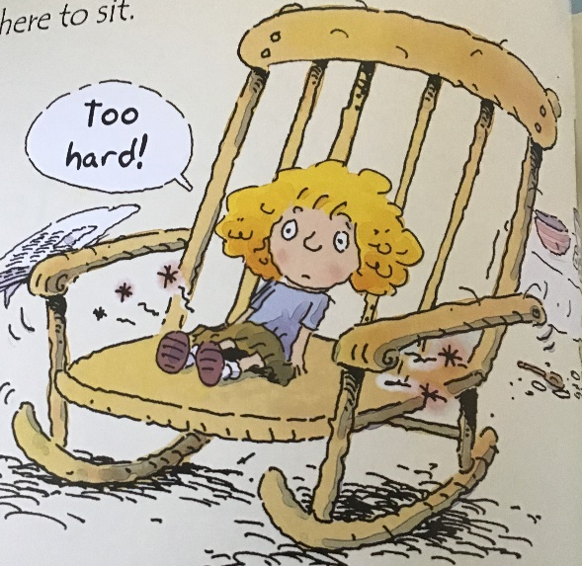
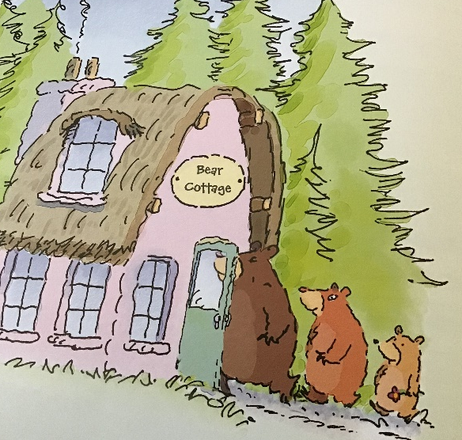

Slide 19
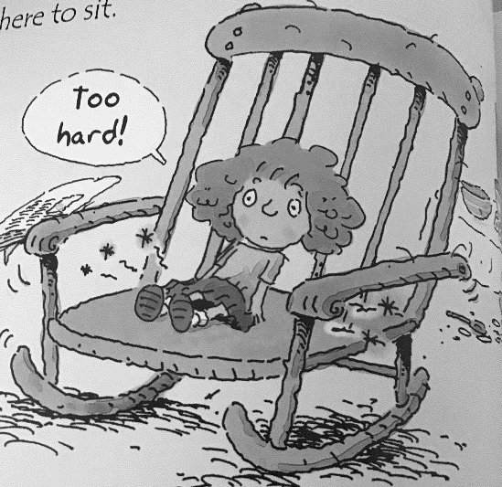
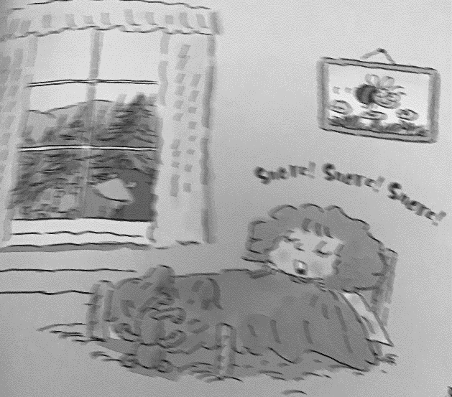
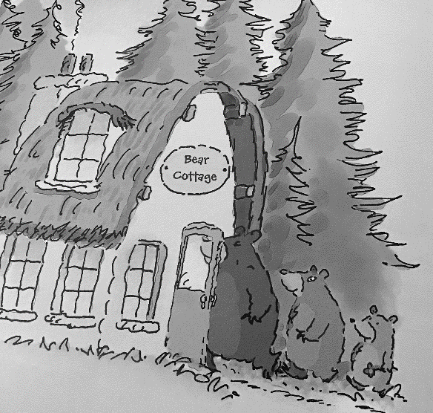
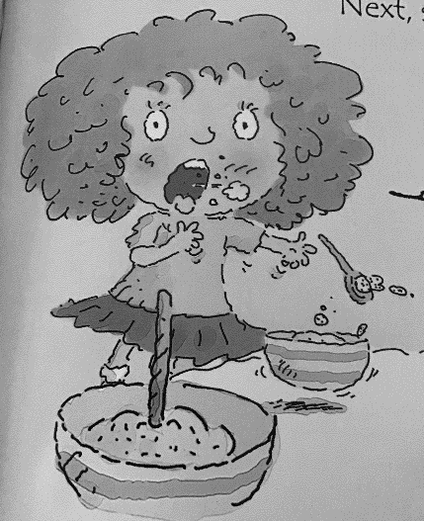

Slide 21
Date: Wednesday 10th February
LO: To be able to make a prediction about the ending of a traditional tale.
Subject: English

Slide 24
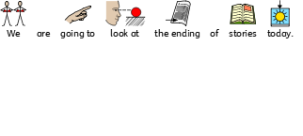

Slide 25
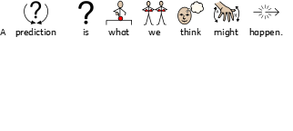

Slide 26
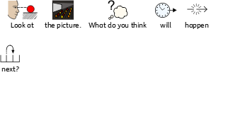
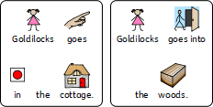

Slide 28
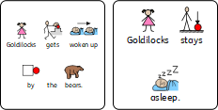

Slide 29
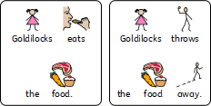

Slide 30
Date: Thursday 4th February
LO: To be able to recognise dialogue in a traditional tale.
Subject: English

Slide 32
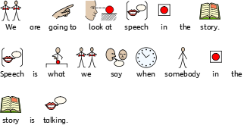

Slide 33
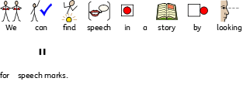
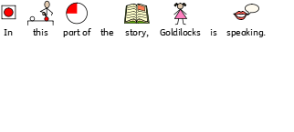

Slide 34
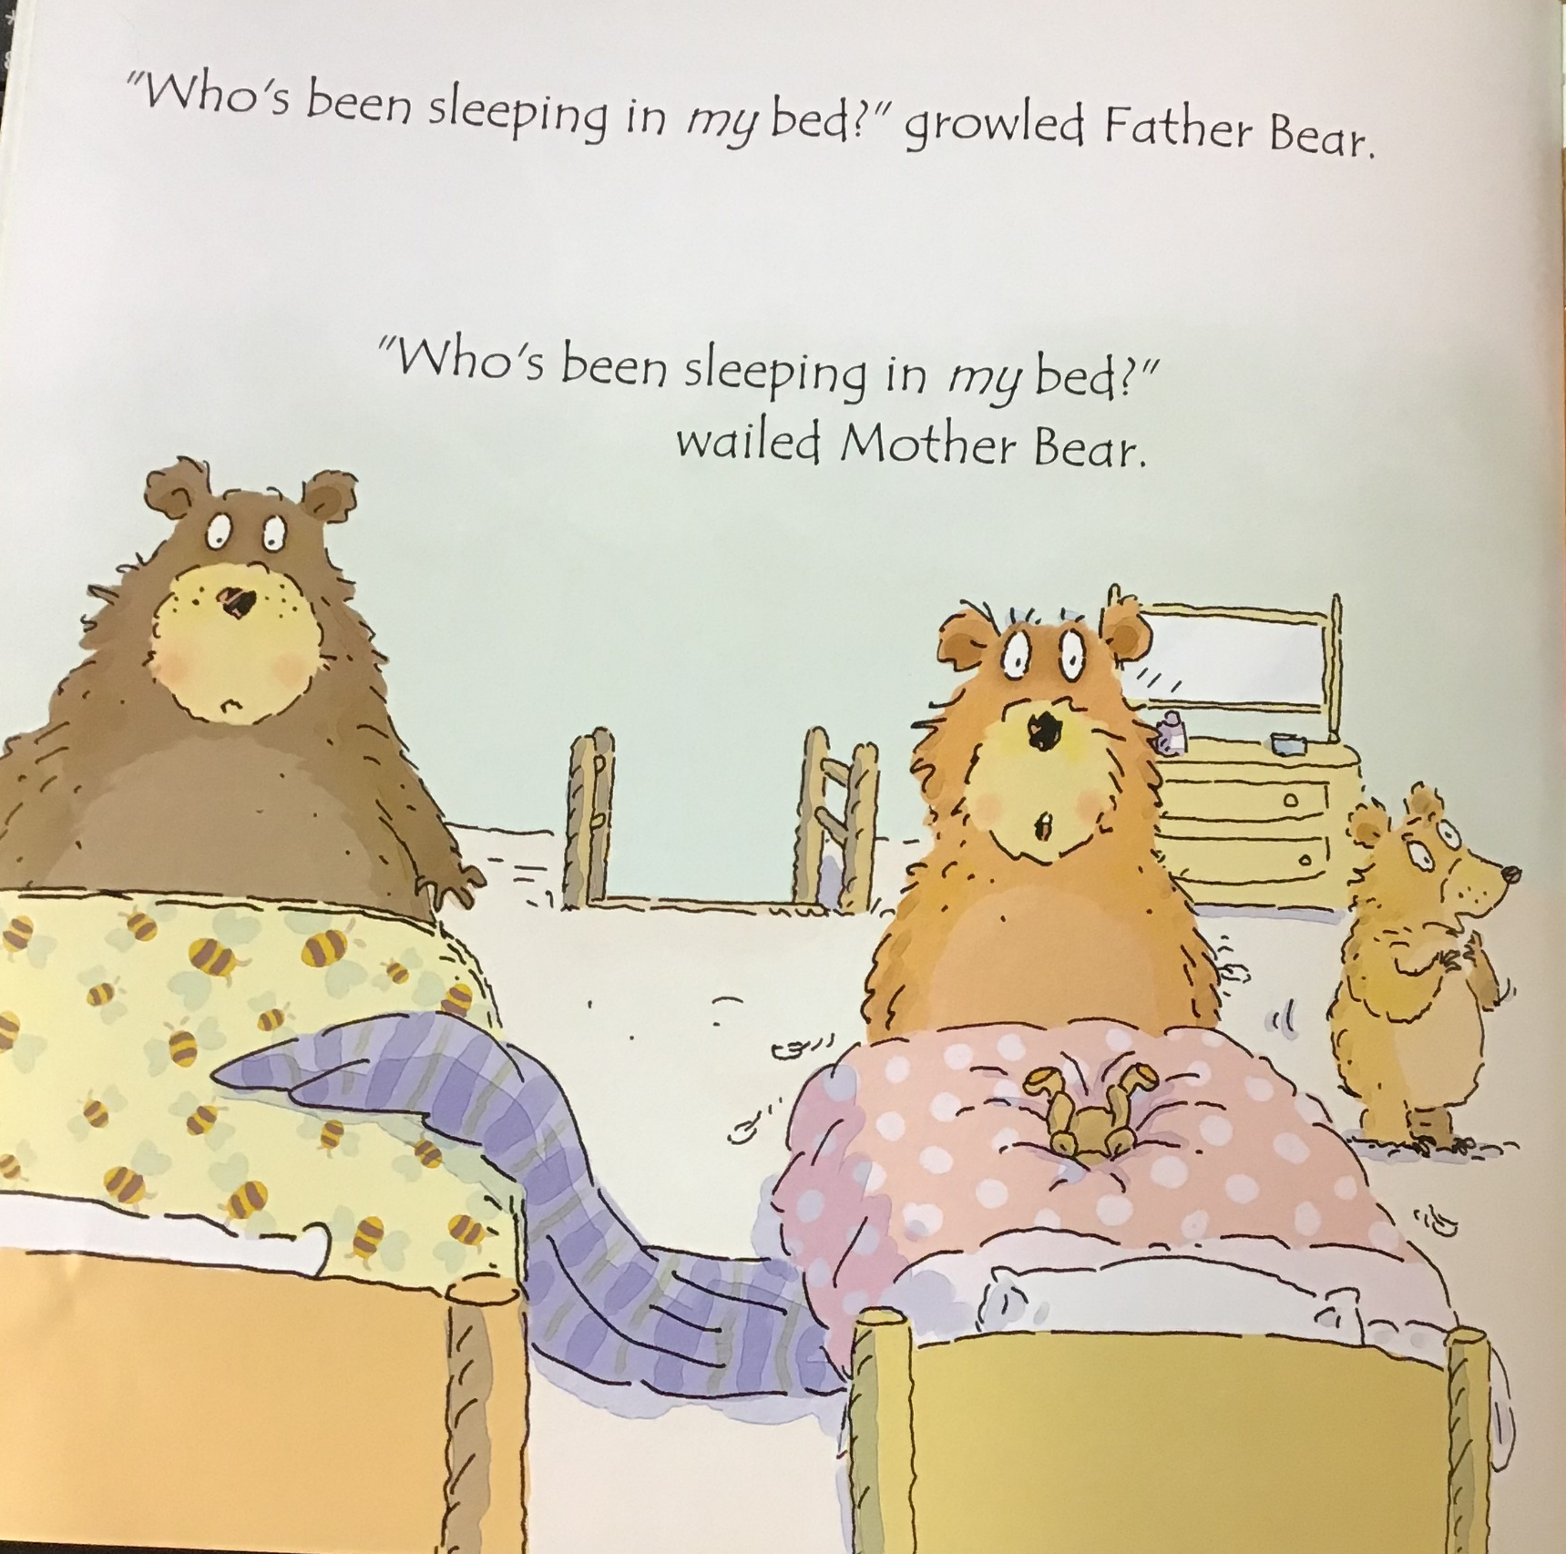

Slide 36
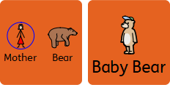

Slide 40
Date: Friday 5th February
LO: To be able to match letters to sounds.
Subject: English

Slide 41
The ‘n’ sound
Gg
This is the letter ‘g’.

Slide 42
The ‘p’ sound
Pp
This is the letter ‘p’.

Slide 43
The ‘n’ sound
Nn
This is the letter ‘n’.

Slide 44
Let’s recap our phonics sounds
Ii
This is the letter ‘i’.

Slide 45
The ‘t’ sound
Tt
This is the letter ‘t’.

Slide 46
The ‘d’ sound
Dd
This is the letter ‘d’.

Slide 47
The ‘s’ sound
Ss
This is the letter ‘s’.

Slide 48
The ‘a’ sound
Aa
This is the letter ‘a’.

Slide 49
The ‘m’ sound
Mm
This is the letter ‘m’.

Slide 50
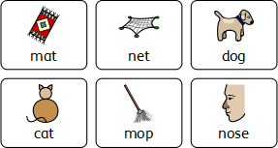

Slide 51
